Slide 1
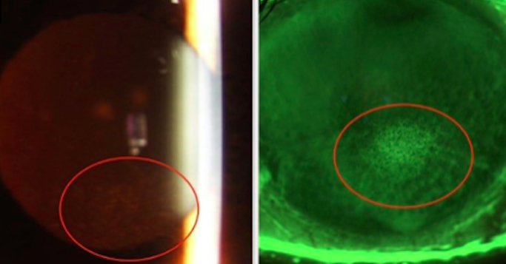
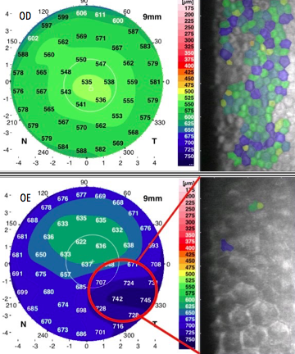
ATYPICAL PRESENTATION OF CHANDLER SYNDROME: A CASE REPORT Carolina Netto, Jade Melo, Camila Mamede, Francisco Bandeira H. Olhos São Gonçalo, São Gonçalo – Rio de Janeiro
INTRODUCTION
Iridocorneal endothelial (ICE) syndrome encompasses a group of diseases that affect the corneal endothelium, often accompanied by iris abnormalities and glaucoma in a single eye. ICE is subdivided into three subtypes (1) Chandler syndrome (CS), (2) progressive iris atrophy and (3) Cogan-Reese syndrome. The present report depicts a rare case of a middle-aged man presenting unilateral corneal edema with findings suggestive of ICE syndrome in its variant Chandler.
METHODS
Case report of a male adult with a recent complaint of low visual acuity and blurred vision accompanied by unilateral corneal edema.
RESULTS
A.P.P.A., a sixty-eight year-old man referred redness and tearing in his left eye with several relapsing episodes of blurred vision, without pain, that resolved spontaneously over the past 6 years. He was taking oral acyclovir and 1% Prednisolone drops q.d for the past 2 weeks. In his medical record, there was a presumed diagnosis of Fuchs corneal endothelial dystrophy. The routine ophthalmologic exam showed an inferior paracentral focal stromal edema in the left cornea (Fig.1). The visual acuity was 20/60 in the left eye, and 20/20 in the other eye. The fundus exam revealed an increased cup/disc ratio that did not respect the ISNT rule. Under gonioscopy of the left eye, there was an appositional contact between the iris and pigmentary trabeculum inferiorly, without synechias or other abnormalities. Biomicroscopy, gonioscopy and fundus exam of the fellow eye were otherwise normal. The pachymetry map obtained with the scheimpflug was consistent with biomicroscopy, showing an increased corneal thickness paracentral in the left eye (700-740 µm). The specular microscopy showed a homogeneous and normocytic endothelial monolayer of the right eye with cell counts above 2.000 cells/mm², while in the left eye, adjacent to the edematous area it was possible to identify enlarged polygonal cells at the level of the endothelium. Besides, the cell counts were between 800 - 1.400 cells/mm² presented with disrupted and irregular cell border patterns with a reversal of the light/dark color of the cell cytoplasm/wall. (Fig 2)
Figure 1: Focal edema, with corneal epithelial swelling
Figure 2: Pachymetry map and Specular microscopy. RE – Normal; LE – PM: Focal edema; SM: inverted light-dark pattern – ICE cells
DISCUSSION
Management should be based on the prevention of the most common complications: glaucoma and corneal edema. Intraocular pressure can be effectively managed with eye drops in 50%) of patients while others required surgical intervention. The failure rate of glaucoma control with drug therapy reached 60 to 80% of cases, in which surgery was required. Corneal edema is a common finding that leads to keratoplasty. However, none of the keratoplasty techniques available is able to completely eliminate the abnormal endothelial cells, thus they are unable to prevent the progression of glaucoma.
CONCLUSION
REFERENCES/KEYWORDS
Chandler syndrome is a rare condition which is often challenging to manage due to the multiple comorbidities associated with it. That might interfere with the therapeutical success. Proper diagnosis is warranted to establish a therapeutial plan and avoid complications.
Key Words: chandler, cornea, edema, man, keratoplasty
1. Silva, L. et al. (2018) Survey of Ophthalmology
2. Ranjan, R., et al. (2016). Journal of Basic & Clinical Medicine
2. Chandran, P., et al. (2017) PLoSOne;
3. Estacia, C., et al (2017). RBO

