Slide 1
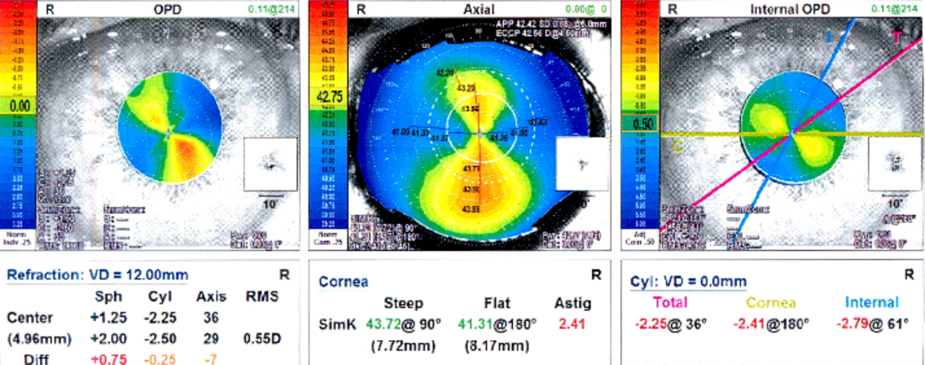
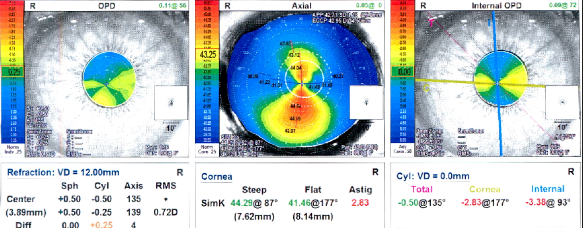
Rotation and repositioning of toric intraocular lens with intraoperative aberrometry: a serie of cases.
Laura Dayane Moreira de Jesus, Isadora Ferro Nogueira, Jady Foganholo, Jessica Thais Campos Lopes Gonçalves, Liane de Moura Santos Perreira Ferraz Baptista, Wilson Takashi Hida
Department of Cataract
INTRODUCTION
Due to the emergence of new technologies and the increasing demands on the results of cataract surgeries, the use of intraoperative aberrometry has now increased¹. One of the most studied devices is the ORA® System (Alcon Laboratories, Inc., Fort Worth, TX, USA), which uses a new form of wavefront analysis, known as Talbot-Moiré Interferometry. It is able to provide intraoperative information, such as biometric data, real-time refraction, guide intraocular lens (IOL) positioning and incision clean relaxing². The report presents three cases that evolved with toric IOL rotation after cataract surgery, emphasizing the importance of complementary propaedeutics for the management of refractive correction by adjusting the IOL position with the use of intraoperative aberrometry.
Figure 1: ORA - IOL implant
CASES REPORT
Figure 2: lens rotation - UDVA 20/40 and refraction pl -2.50 x 30 (20/20).
Case 1: Female, 47 years old, cataract in both eyes (BE). Apparent refraction: -6.00 -2.75 X 10 (20/25) right eye (RE) and -4.75 -3.00 X 180 (20/30) left eye (LE), addition +1,75 BE (J1). Optical biometry RE (IOL Master v.5.0, Carl Zeiss Meditec): SRK/T formula (AL 26.8mm) and HILL-RBF calculator (Symfony Toric +12.50 ZXT375 at 93°). Phacoemulsification and IOL implantation were performed in the RE, using femtosecond laser (capsulorhexis and nucleous fracture) and ORA for IOL positioning (figure 1). Three months after surgery, complained of low visual acuity in RE. Lens rotation was observed at 61°(figure 2). Repositioning of the IOL with ORA was performed (figure 3), promoting visual rehabilitation without correction of 20/20.
Case 2: Female, 61 years old, cataract in BE. Apparent refraction -3.00 -1.50 X 155 (20/30) in RE, and -2.50 -1.00 X 25 (20/30) in LE, addition +3,00 BE (J1). Optical biometrics LE (IOL Master v.5.0, Carl Zeiss Meditec) with IOL calculation using the formula Holladay 2 (AL 23.66mm) and HILL-RBF calculator (IQ Toric +19.00 SN6AT3 at 110°). Phacoemulsification and IOL implantation were performed in the LE, and ORA for IOL positioning. Two months after surgery, complained of low visual acuity in LE. Lens rotation was observed at 56°. The repositioning of the IOL with ORA was performed, reducing the residual refractive error to the PL -0.50 x 30 (20/20) and promoting visual rehabilitation without correction of 20/20.
Case 3: Male, 49 years old, cataract in BE. Apparent refraction -9.75 -4.25 X 10 (20/100) in RE and - 2.00 - 2.00 X 180 (20/80) in LE, addition +2,25 (J1). Optical biometrics RE (IOL Master v.5.0, Carl Zeiss Meditec) with IOL calculation using the formula SRK/T (AL 27.35mm) and HILL-RBF calculator (Symfony Toric +17.50 ZXT375 at 105°). Phacoemulsification and IOL implantation were performed in the RE, and ORA for IOL positioning. Two months after surgery, complained of low visual acuity in RE. Lens rotation was observed at 85°. The repositioning of the IOL with ORA was performed, reducing refraction -1.50 -1.00 x 105 (20/20) scale RE, J1 without correction.
Figure 3: residual refractive error -0.50 spherical (20/20).
DISCUSSION
Rotation of the IOL or misalignments causes a significant deterioration of image quality^{3,4}. According to Felipe et al. and Langenbucher et al., approximately 3% of the cylinder's corrective power is lost for every 1 degree of calculated off-axis rotation ⁴. In 2015, Hatch et al. increased the probability of achieving a remaining refractive astigmatism of 0.50 D or less by 2.4-fold with the assistance of intraoperative aberrometry compared with standard methods for the placement of the IOL².
The cases reported show the management of the residual refractive error using intraoperative aberrometry (ORA System) for repositioning to the programmed axis. The use of intraoperative aberrometry has corroborated with the planning, demonstrating greater predictability and reproducibility.
REFERENCES
Tanos FW, Lopes IS, Wagner A, Mendes JC, Barros SR, Rosenberg I, Jr. Ambrósio R. Manejo do astigmatismo residual após implante de lente intraocular. Rev Bras Oftalmol. 2018; 77 (3): 207-10
Hatch KM, Woodcock EC, Talamo JH. Intraocular lens power selection and positioning with and without intraoperative aberrometry. J Refract Surg 2015; 31:237–242
Tognetto et al. Quality of images with toric intraocular lenses: J Cataract Refract Surg 2018; 44:376–381.
Felipe A, Artigas JM, Díez-AjenjoA, García-Domene C, Alcocer P. Residual astigmatism produced by torció intraocular len rotation. JCataract Refract Surg 2011; 37; 1895-1901

