Slide 1
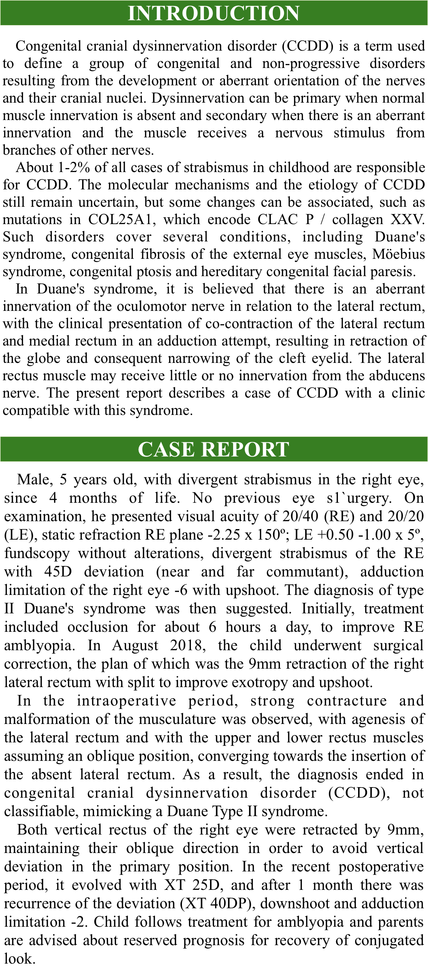
Jéssica Thaís Campos Lopes Gonçalves; Isadora Ferro Nogueira; Laura Dayane Moreira de Jesus; Jady Foganholo; Liane de Moura Santos Pereira Ferraz Baptista; Natanael de Abreu Sousa
Congenital cranial dysinnervation disorder presented as Duane’s syndrome: a case report

