Slide 1
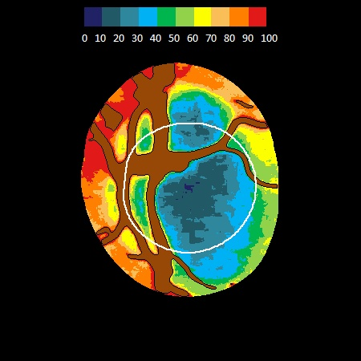
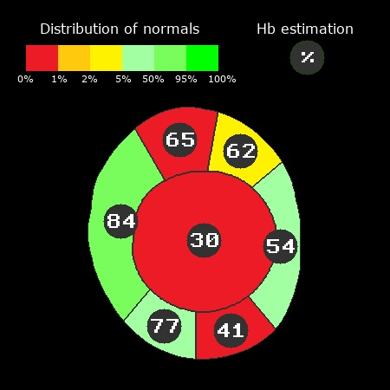
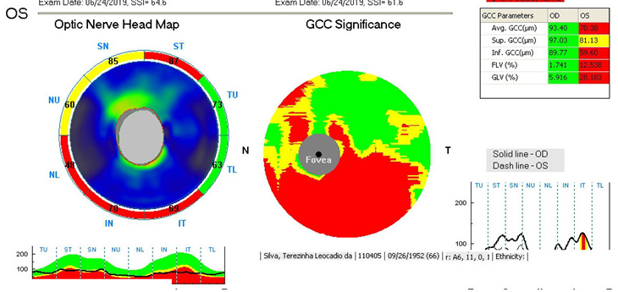
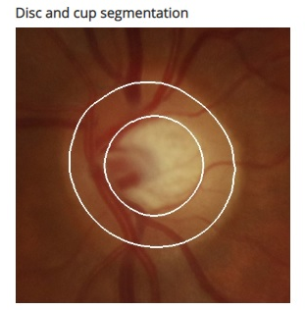
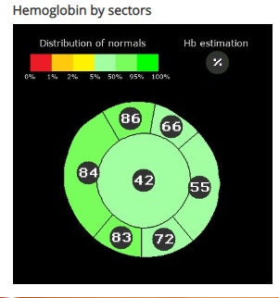
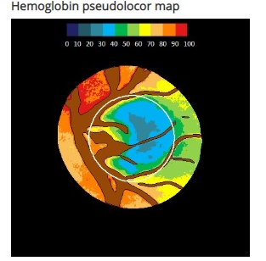
RELATIONSHIP BETWEEN OPTIC NERVE HEAD HEMOGLOBIN LEVELS AND STRUCTURAL-FUNCTIONAL DAMAGE IN GLAUCOMA: A CROSS-SECTIONAL OBSERVATIONAL STUDY
Victoria Gontijo, MD1,2; Ana Luiza B Scoralick, MD1,3; Carolina P B Gracitelli, MD3; Janaina Guimaraes, MD2,3; Fabio N Kanadani, MD, PhD2,4; Tiago S Prata, MD, PhD1,3,4
1.Department of Ophthalmology, Hospital Medicina dos Olhos, Osasco, Brazil; 2.Department of Ophthalmology, Instituto de Olhos e Ciências Médicas, Belo Horizonte, Brazil; 3.Department of Ophthalmology, Federal University of São Paulo, Brazil; 4.Department of Ophthalmology, Mayo Clinic, Jacksonville, Fl;
PURPOSE
It has been previously shown that patients with established glaucoma have lower levels of optic nerve head hemoglobin (ONH Hb). We sought to investigate structural and functional correlations in glaucoma patients using ONH Hb measurement-derived parameters as assessed by non-invasive automated colorimetric analysis (RetinaLyze®; RetinaLyze System A/S).
METHODS
A prospective, observational, cross-sectional study was carried-out, in which glaucomatous patients were consecutively enrolled. Nonmydriatic color fundus photographs and peripapillary retinal nerve fiber layer (pRNFL) thickness measurements (through spectral-domain optical coherence tomography [OCT]) were obtained. The software initially delineated the ONH border and identified the central retinal vessels. On the basis of colorimetric analysis, ONH Hb levels and the glaucoma discriminant function (GDF) index were determined. Scatter plots were constructed to investigate the correlation between GDF values and structural-functional parameters.
RESULTS
A total of 35 eyes were included. Mean age of study patients was 58.3±9.8 years. Average values for visual field mean deviation index (VFMD), retinal nerve fiber layer thickness and GDF index were -4.6±4.9dB, 89.1±11.2µm and -20.3±28.1, respectively. There was a significant non-linear correlation between GDF and VFMD values (R² = 0.461, P = 0.006). This correlation was similar to that found between OCT´s RNFL thickness and VFMD (R² = 0.534, P = 0.006). Finally, a strong linear correlation was found between GDF and OCT´s RNFL thickness values (R² = 0.618, P<0.001).
Figure 1: Patient with advanced glaucoma
Figure 2: Patient without glaucoma
CONCLUSION
Our results showed significant associations between ONH Hb values and both structural and functional damage in glaucoma. The non-linear correlation we found between GDF values and visual field loss suggest that ONH Hb levels reduction precedes visual function changes in glaucoma. Further analyses are warranted in order to confirm our initial findings and to investigate its applicability in a clinical setting.

