Slide 1
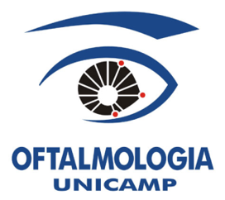
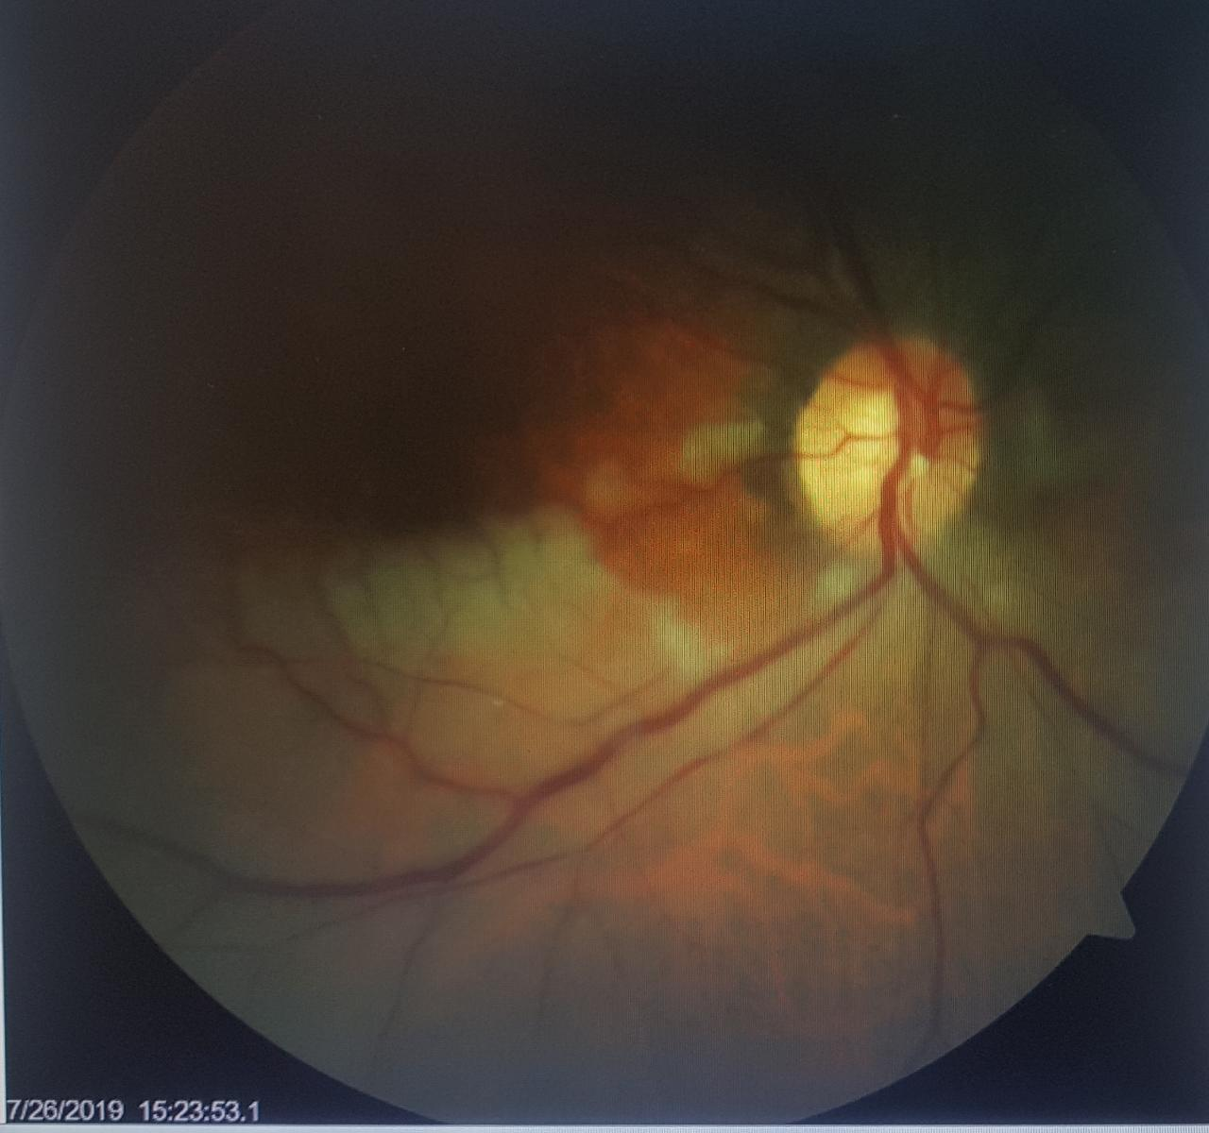
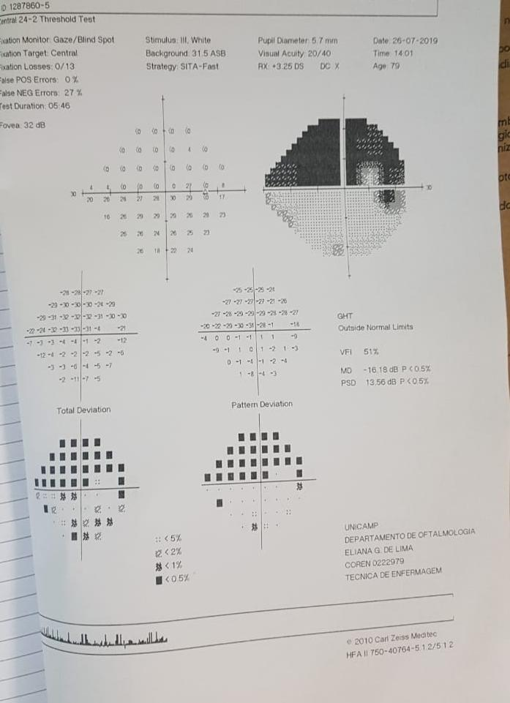
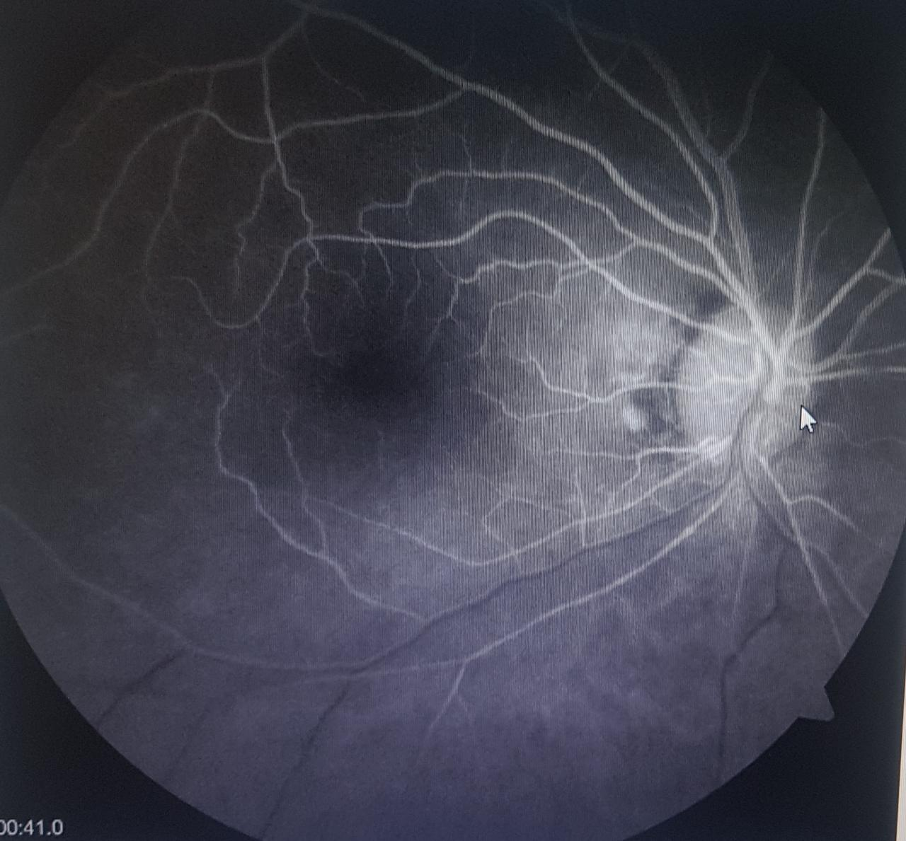
OPEN YOUR EYES FOR STROKE
HOLANDA, E.C.; GASPARINI, M.S.; NASSARALLA NETO J.J.; HUARASHI D.R.G.; SILVA, I.C.; FERNANDES, V.H.R.; NASCIMENTO, M.A.; TORIGOE, A.M.S.
erickdeholanda1991@gmail.com
DEPARTMENT OF OPHTHALMOLOGY OF THE UNIVERSIDADE ESTADUAL DE CAMPINAS (UNICAMP) – SÃO PAULO, BRAZIL
OBJECTIVE
We will present the importance of the diagnosis of arterial occlusion as a way of preventing stroke.
DISCUSSION
Arterial occlusions present an important differential diagnosis in elderly patients with sudden low vision. Today we know that these patients have a high risk of stroke in the future, due to 90% of these patients having multiple cardiovascular risk factors. Because of this, we now consider it as a subtype of the classical stroke. Therefore, the identification of these cases is essential for prevention of a deadly or highly morbid event soon..
CASE REPORT
A 79-year-old female patient was admitted to the UNICAMP Hospital de Clínicas, with scotoma in the upper right eye hemicamp, started 4 days before the admission day , suddenly. She denied pain or photopsies. On examination, BCVA 20:40 OD/OE, normal intraocular pressure in both eyes. Anterior segment biomicroscopy without changes. Right eye fundus with pallor and retinal edema of the inferior temporal arch with preserved macula. Presence of embolus in lower first branch of central retinal artery Normal left eye. Visual field showed scotoma of the entire upper hemicamp. Fluorescein angiography showing inferior temporal territory filling failure. Patient undergoing follow-up, presenting in subsequent returns, sustained visual acuity and reperfusion of the affected area, but with maintenance of the scotoma.
CONCLUSION
We wish this case to serve as an alert for ophthalmologists regarding the identification of arterial occlusions and their subsequent referral to centers with stroke units available

