Slide 1
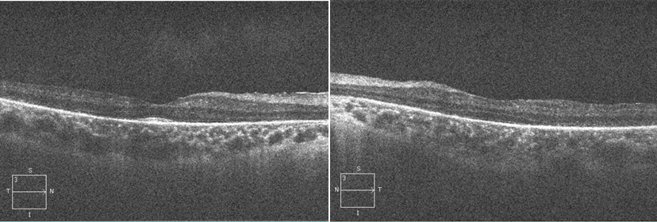
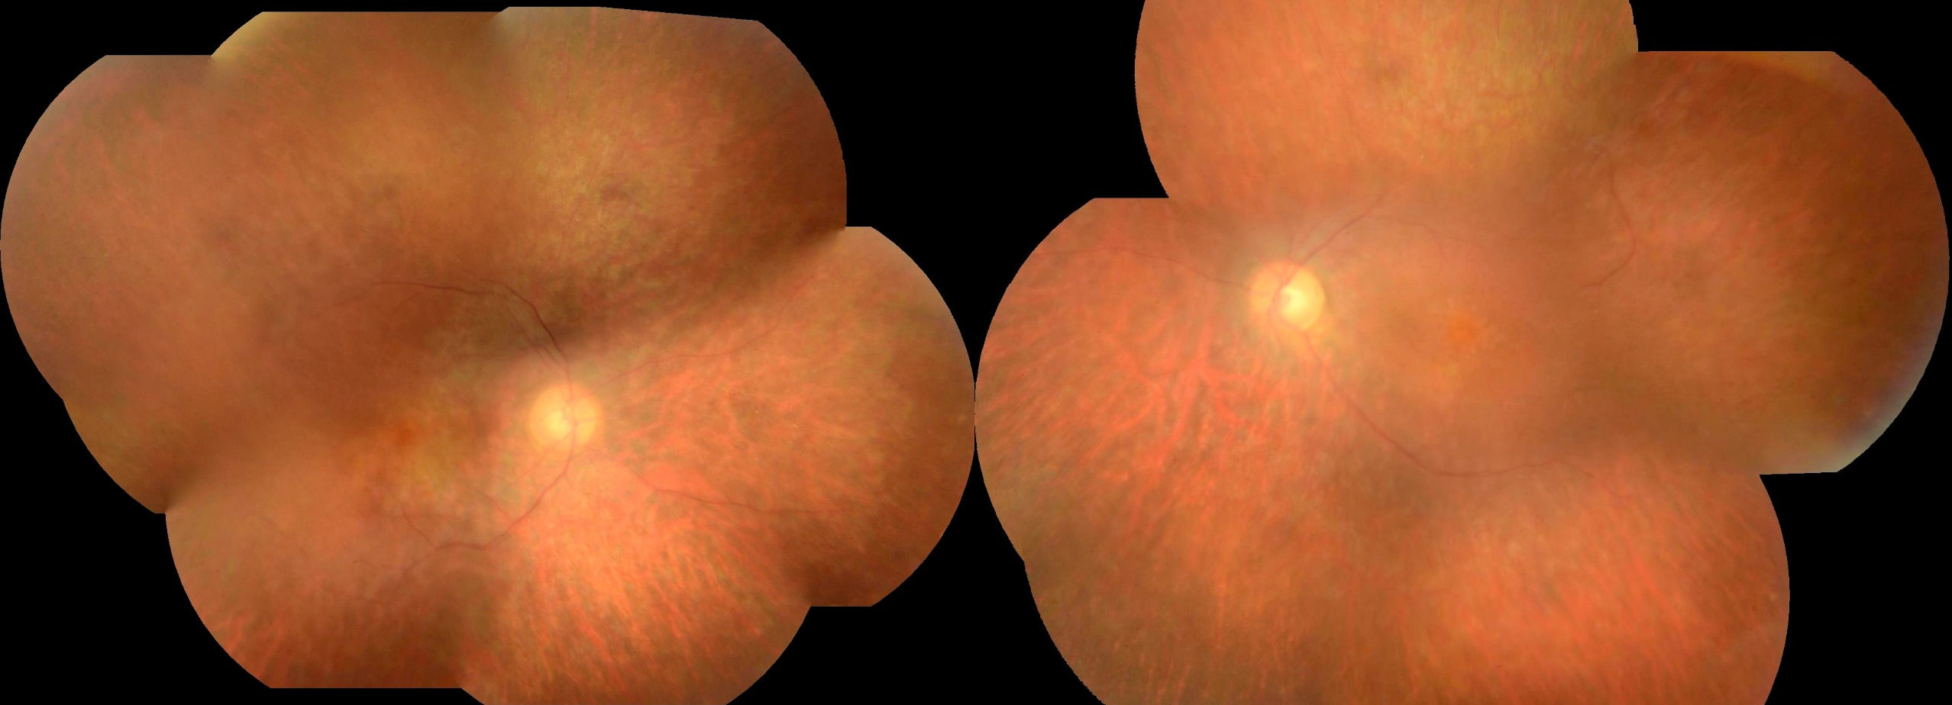
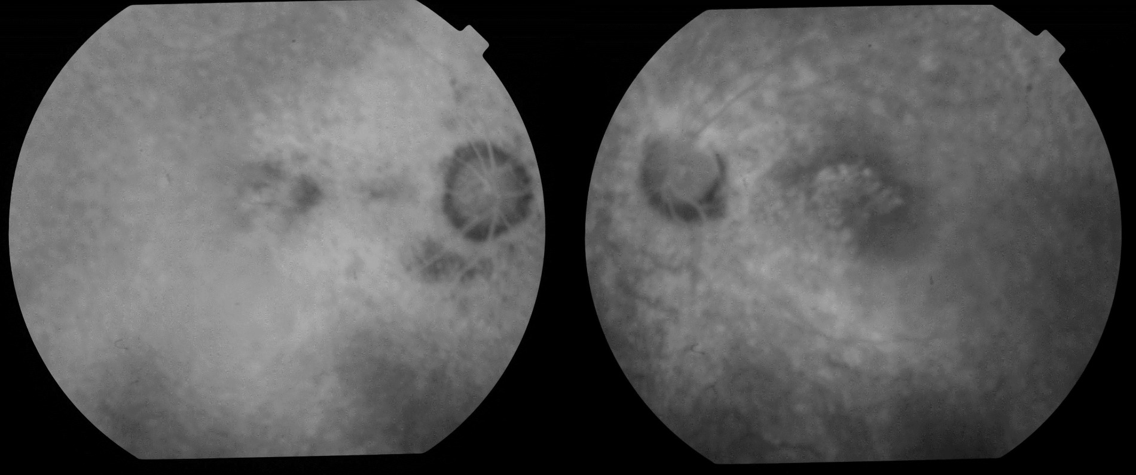
SALT AND PEPPER RETINOPATHY IN CONGENITAL RUBELLA SYNDROME: CASE REPORT
Andréia Novelli; Paulo Henrique Horizonte; Luciano Fuzatto; Lucas Holdack; Gabriella M. Mingione; Fernanda Salata Antunes; Carolina Maria B. Lemos; André Marcelo V. Gomes.
Instituto Suel Abujamra
PURPOSE
Fundus examination revealed a classic salt-and-pepper appearance of the retina with mottling of the retinal pigmented epithelium (RPE); optical disc pallor, diffuse thinning of the vessels and alteration of the macular shine (Image 1 and 2). Fluorescein angiography revealed preserved filling time; diffuse areas of hyperfluorescence due to a window defect, suggestive of atrophy / sequelae of involvement of the retinal tissue; macular hiperfluorescence due to a window defect sparing the foveal region (Image 3 and 4). Presence of discontinuity of photoreceptor layer being preserved only in the foveal region in OD. (Image 5). Syphilis was ruled out by serologic workup. The patient is being currently monitored by specialists in ophthalmology, otolaryngology and cardiology.
Image 5
To report a case of salt and pepper retinopathy in a 35-year-old patient with congenital rubella syndrome.
INTRODUCTION
Congenital rubella syndrome (CRS) is a constellation of birth defects that include eye changes, cardiac malformations and deafness, caused by a virus composed of single-stranded RNA of the Togaviridae family. The fetus is infected transplacentally during primary infection, especially in the presence of maternal exanthematic eruption. The rates of fetal infections are highest during the first 10 weeks of pregnancy and after the 36th week, the severity of the condition being inversely proportional to the gestational age at the time of exposure. Salt and pepper retinoapathy associated with systemic findings and a history of maternal exposure to rubella may suggest the diagnosis of CRS.
Diagnostic criteria include a four-fold increase in rubella-specific IgG in paired serum; serological conversion of rubella-specific IgM; or finding rubella-specific IgM or IgA antibodies in umbilical cord blood. Ocular involvement in CRS is seen in about 75% of patients and its main manifestation is salt-and-pepper pigmentary retinopathy, which can be stationary or progressive.
Image 1
IMAGES
Image 2
DISCUSSION
Image 1
Image 2
The rubella is considered an important cause of blindness in developing countries, however the epidemic pattern of the disease was interrupted after the 2000s with the introduction of the vaccine in the Brazilian vaccination calendar.
Although the mechanism of the disease is not known at the cellular level, it is believed that the rubella virus inhibits cell multiplication and establishes a chronic and persistent infection during organogenesis, with maintenance of its replication even after birth, which leads to continuous tissue damage, sometimes until adulthood.
Salt and pepper retinopathy, although exuberant, is commonly observed, and does not impair visual function, unless complications develop, including congenital cataracts and microphthalmia, which are the most frequent causes of visual impairment in these patients.
METHODS
Medical record review.
Image 3
Image 4
RESULTS
A 35-years-old female patient presented with a history of deafness since birth, cardiac disease and renal structural changes. Her mother reported a condition compatible with rubella in the first trimester of pregnancy, with viral prodromes, followed by a typical cutaneous rash.
Her best corrected visual acuity (BCVA) was 20/30 in the right eye and 20/25 in the left eye. Anterior segment examination was unremarkable.
BIBLIOGRAPHY
1. American Academy of Ophthalmology – http://www.aao.org/.
Notes:
purpose, methods, results and discussion

