Slide 1
Purtscher-like retinopathy: description of one likely case
Brunelle Francino Nunes
Luís Felipe da Silva Alves Carneiro
Renata de Sousa Carneiro
Wilton Feitosa Araújo
Rafael Mourão Agostini

Slide 2
Case Report
Female, 37 years old, comes to opthalmologic evaluation after being discharged from clinical hospitalization and treatment for meningitis, encephalitis and pneumonia. She complained of low visual acuity.
Pathological background: no comorbidities.

Slide 3
Case Report
Visual acuity: counts fingers at 20 cm in both eyes
Mydriatic, isochoric and photoreactive pupils
Preserved extrinsec eye movement

Slide 4
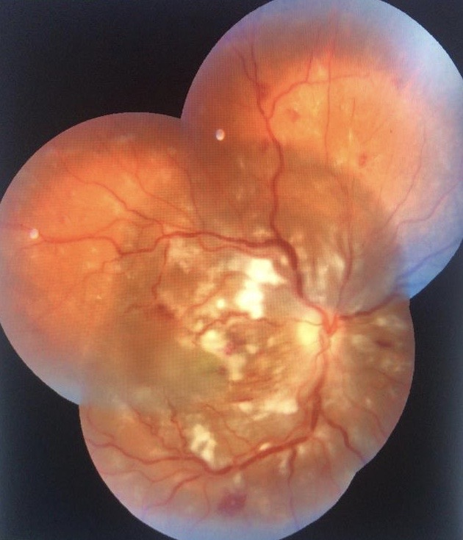
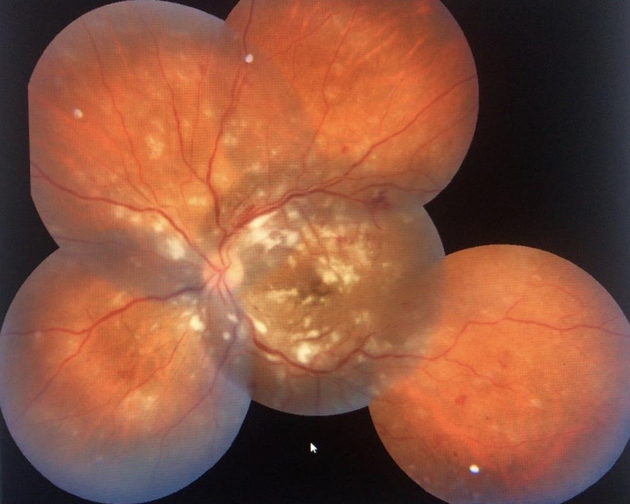
Fundus examination

Slide 5
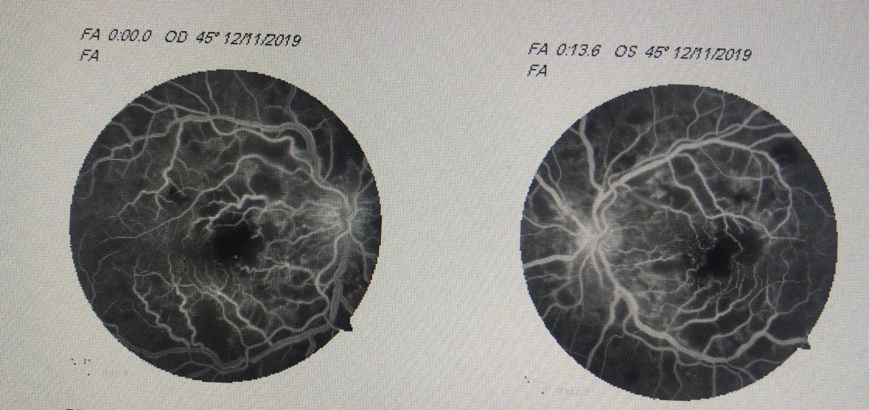
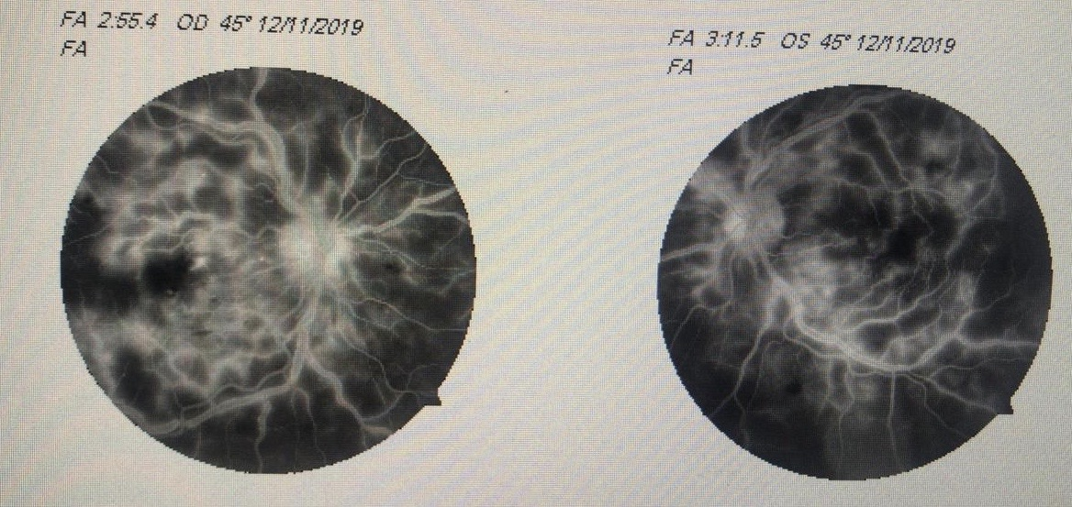
Fluorescein angiography

Slide 6
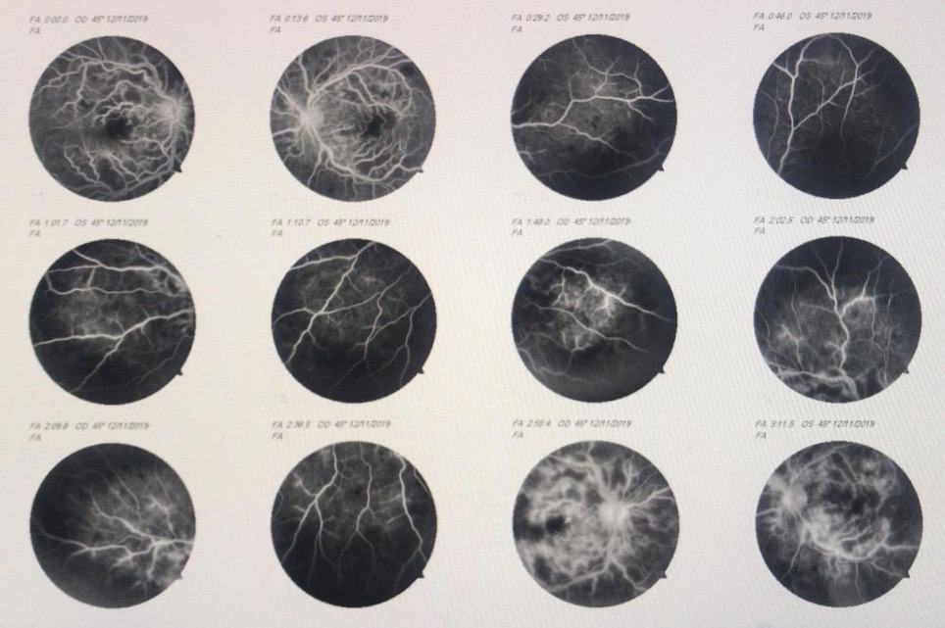
Fluorescein angiography

Slide 7
Laboratorial tests
Herpes family infectious tests (CMV, Epstein Barr, Herpes Simplex 1 and 2, Herpes Zoster), toxoplasmosis, HIV, syphilis: negative
Rheumatological tests negatives (awaits ANF)
Skull CT (october 24th and november 11th): no brain abnormalities
Chest CT angiography (october 24th): no signs of central pulmonary thromboembolism
Lumbar puncture (october 24th): opening pressure of 27cmH2O, 27 cells, proteins 212 mg/dL and glucose 86mg/dL

Slide 8
Diagnostic hypothesis
Purtscher-like retinophatie

Slide 9
Treatment
Systemic steroids?

