Slide 1
Case report bilateral retina serous detachment
Santa Casa de Belo Horizonte
Letícia Torres Elias Silva
Rafael Mourão Agostini
Wilton Feitosa de Araújo
Luis Felipe da Silva Alves Carneiro
Carlos Bernardo Moura Dalle
Amanda Lima de Oliveira
Neiffer Nunes Rabelo
Renata de Sousa Carneiro

Slide 2
OPHTALMOLOGIC ER – 11 AM
Female, 21 yo
Sudden, painless low vision OU 1 day ago
Ocular history: deny trauma or surgery
Clinical history: deny comorbidities or medications
Drug user (marijuana, cocaine, LSD, cigar...)
Deny headache and other symptoms
Denies viral prodromes
Last use of cocaine 1 day before symptoms
Denied possibility of pregnancy → reported homosexual relationship

Slide 3
Eye examination
VA: counting fingers OU
BIO: no cells in the anterior chamber
IOP 12/12 mmHg
Fundoscopy:
OD: serous detachment - almost total
OS: inferior serous detachment

Slide 4
Retinografy and FA OD impracticable
Retinografy OS:

Slide 5
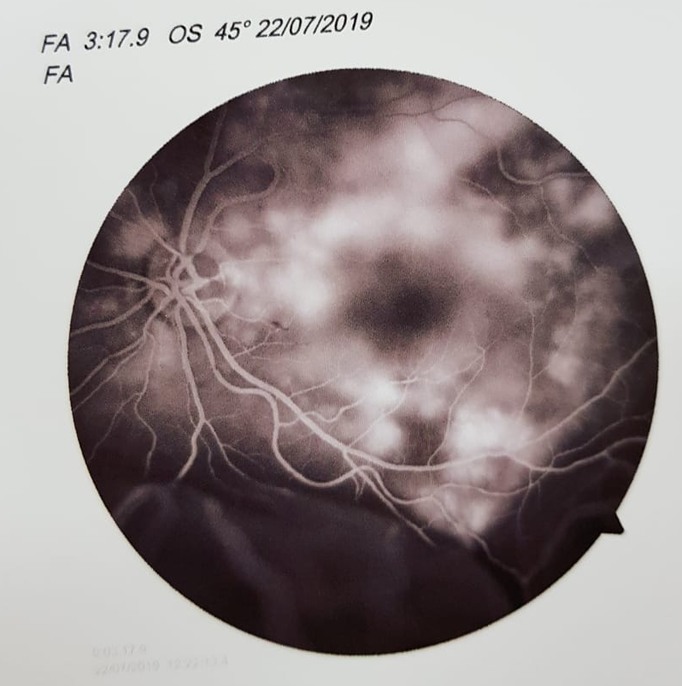
Notes:
1 - a AGF na fase inicial mostra pontos escuros na coroide que podem estar associados a esses infartos.
2 - a AGF NAO MOSTRA PINPOINTS
3 - mulher jovem com descolamento seroso agudo e infartos coroidianos
4 - nao tem celulas no vítreo
HD: Harada, púrpura trombocitopênica (caso de descolamento seroso em pcte usuário de opióide EV), trombose maciça induzida pela cocaína

Slide 6
OD
OS
Notes:
fácica, ecos membranáceos de alta refletividade e baixa mobilidade sugestivos de DR, ecos puntiformes sugestivos de processo inflamatório e/ou hemorrágico subrretiniano, aumento da espessura da coroide
o US ou medição da coroide na OCT é essencial. Se estiver espessada difusamente pensaria em VKH, alteração escleral , espessamento focal em infiltração metástica ou infecciosa. Se não tiver espessamento falência parcial ou total da retina externa (substâncias termogênicas, estimulantes, afastar infecções)

Slide 7
HYPOTHESES
VKH syndrome
Thrombotic thrombocytopenic purpura – microangiopathic hemolytic anemia
Cocaine-induced massive thrombosis
Cocaine-induced microangiopathic hemolytic anemia mimicking idiopathic thrombotic thrombocytopenic purpura: a case report and review of the literature. Odronic S¹, Quraishy N, Manroa P, Kier Y, Koo A, Figueroa P, Hamilton A. 2014
Bilateral exudative retinal detachments due to thrombotic microangiopathy associated with intravenous abuse of Opana ER. Fazila Aseem,ª Brian G. Zamora,ª Levi Kauffman,ª Peter J. Miller,^{b} and Vishak J. John. 2018
Notes:
Microangiopathic hemolytic anemia (MAHA)
The proposed pathogenesis is likely a combination of cocaine-induced vasoconstriction, vascular damage, platelet activation, and procoagulation.
The patient was found to have microangiopathic hemolytic anemia (MAHA), acute kidney injury in conjunction with hypertensive crisis and bilateral exudative retinal detachments.

Slide 8
AFTERNOON → HOSPITAL INTERNMENT
Complete blood count:
Red blood cell count: 3,99 milhões/mm³
Hemoglobin: 11,8 g/dL
Hematocrit: 35,1%
Leukocytes: 9000 /mm³
Platelet: 218000
LDH: 271 U/L (VR.: <247)
Urea: 17,5 / Creatinine: 0,77
HIV, Hep B e Hep C: nonreactive
VDRL: nonreactive
Urinalysis: protein +++
BP: 140X90 mmHg
Notes:
Laboratory investigations revealed severe anemia (Hgb 7.5 g/dL), leukocytosis (13,500 WBCs/uL), and thrombocytopenia (76,000 platelets/uL).
LDH and reticulocytes were significantly elevated at 945 IU/L and 16.4%, respectively, consistent with a hemolytic anemia.

Slide 9
04 AM
Severe abdominal pain and vaginal discharge
Evolved to normal birth of 3050g newborn, Apgar 9
Estimated gestational age: 35-36 weeks
β-HCG: 38585,14 mUI/mL
Notes:
Possivelmente foi uma soma da dheg com a coca. Has tbm. Na maternidade 16x12

Slide 10
1 WEEK LATER– VA 20/200 OU

Slide 11
DISCUSSION
Previous high blood pressure? → Arteriolar narrowing, pathological arteriovenous crossing
Hypertensive Disorders of Pregnancy: increased blood pressure + proteinuria → pre eclampsia
Increased blood pressure + vasoconstriction secondary to cocaine use?

Slide 12
Thank you! leticiatorreselias@gmail.com

