Slide 1
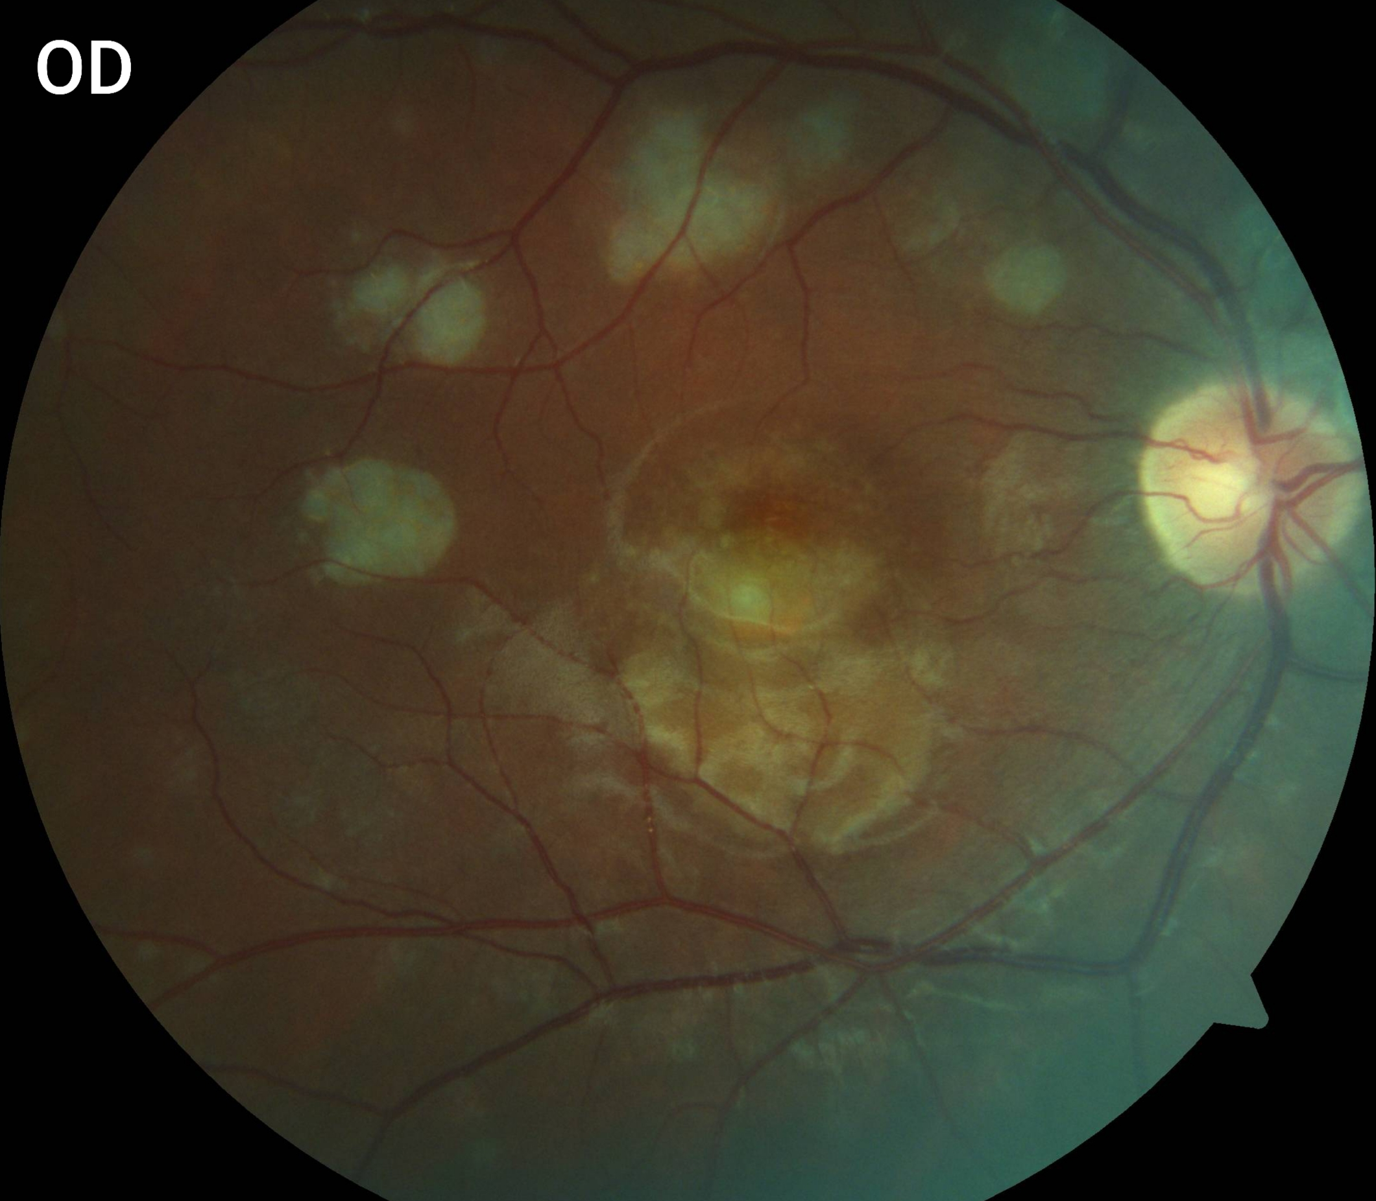
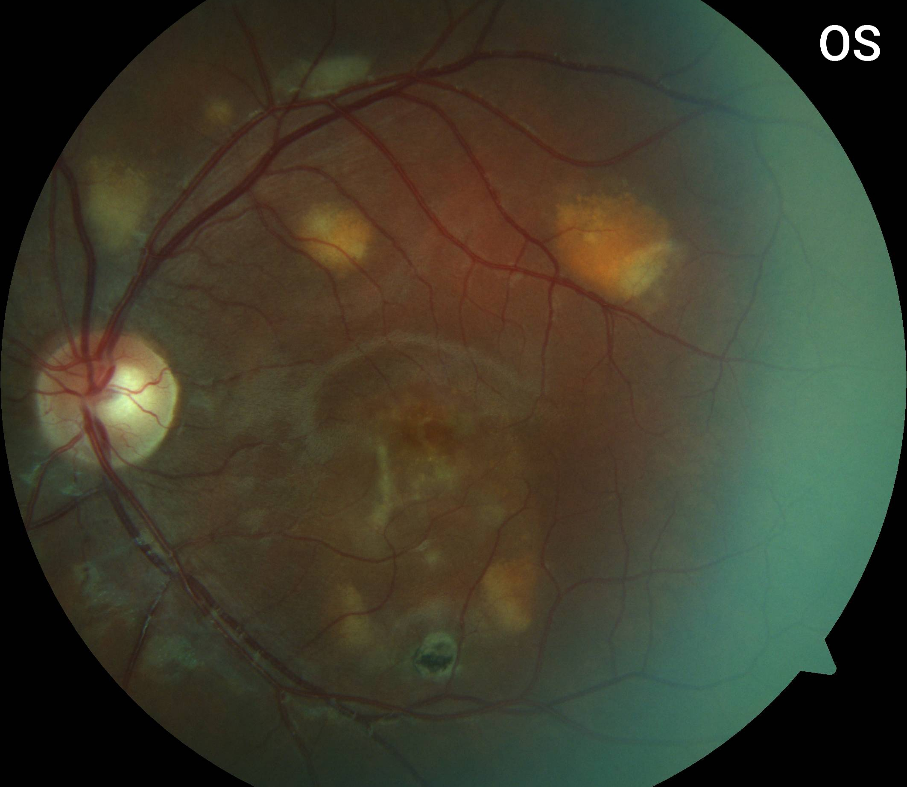
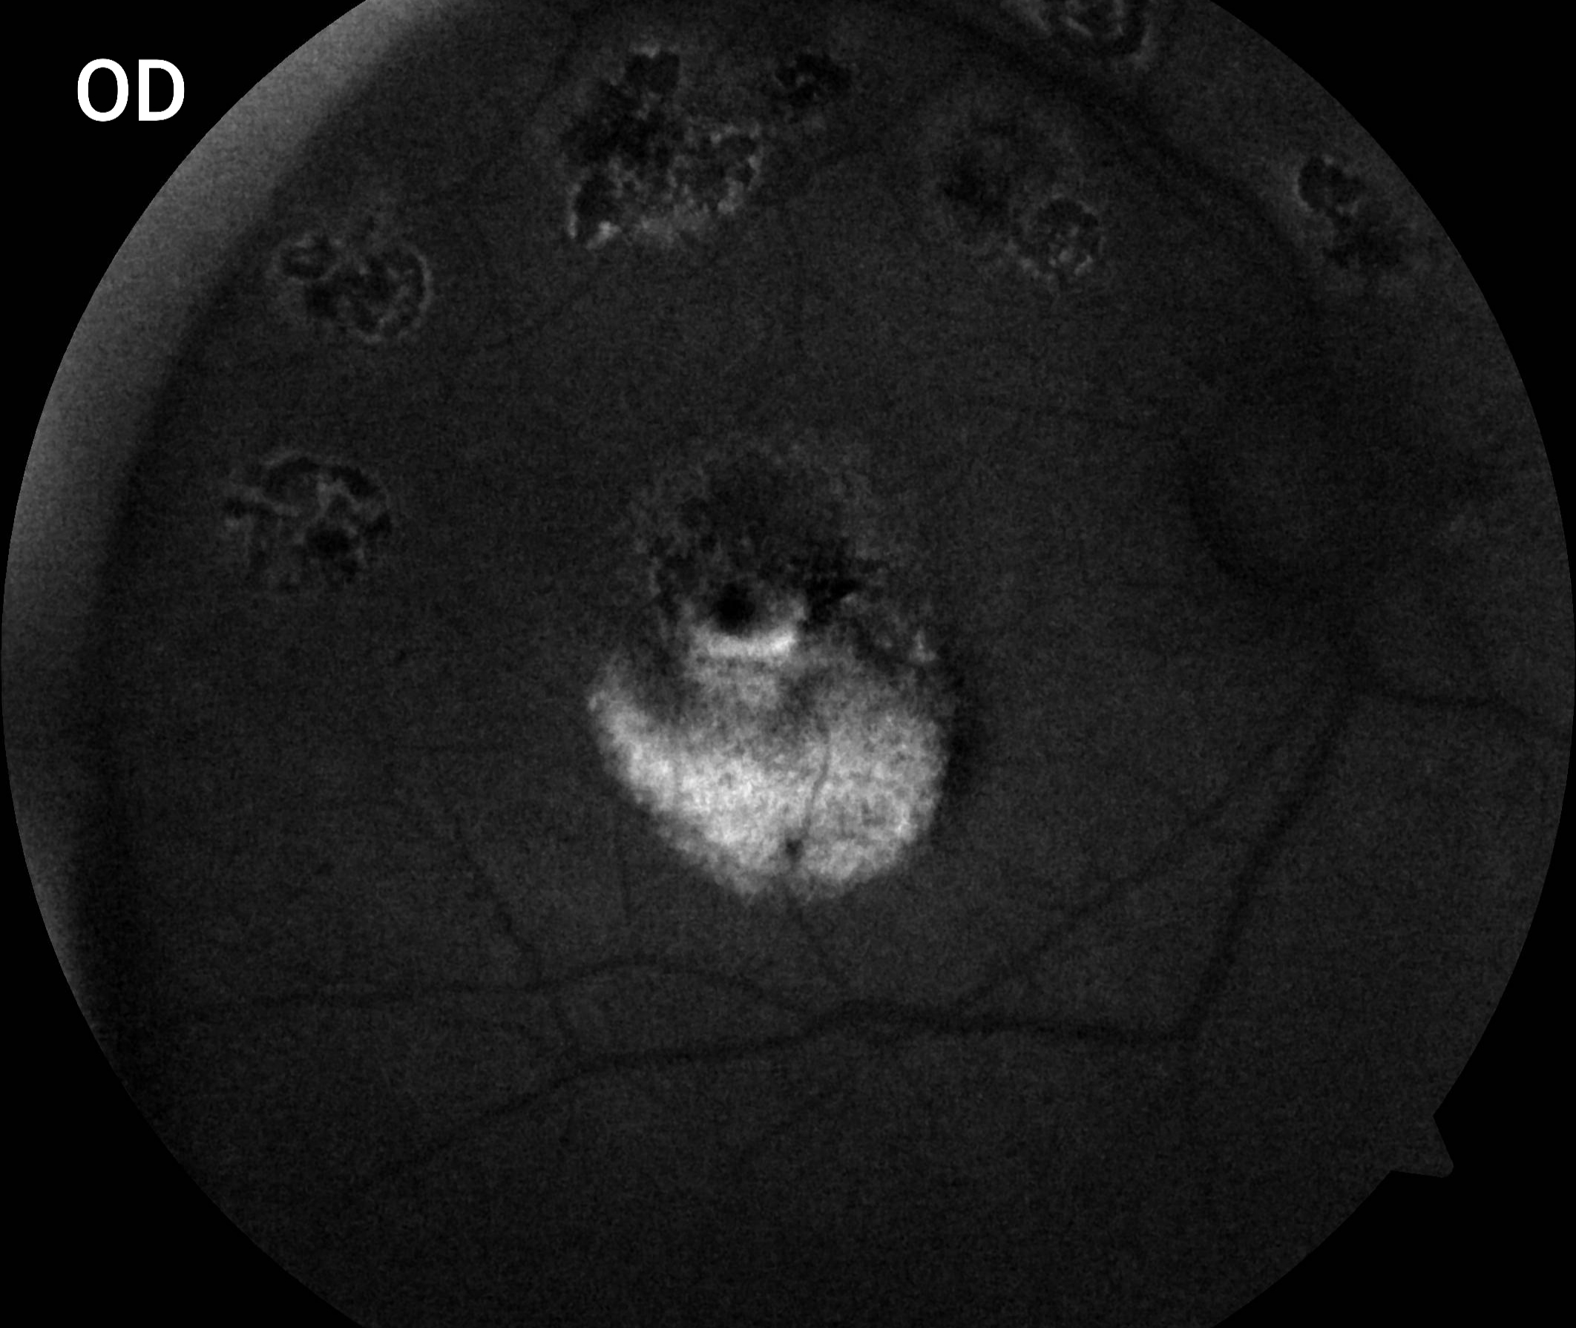
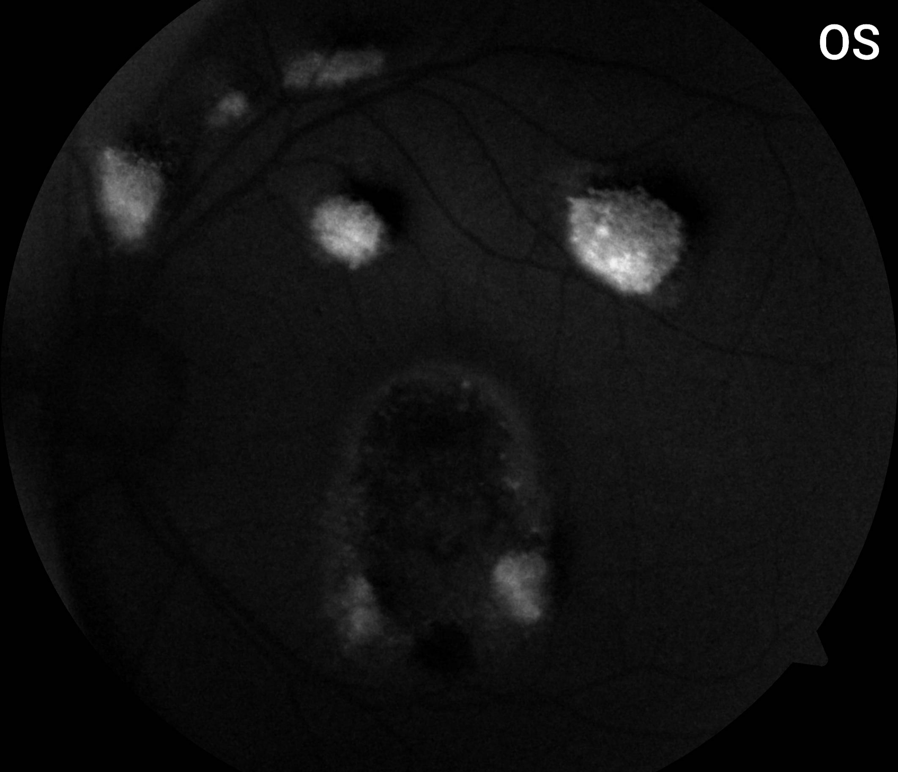
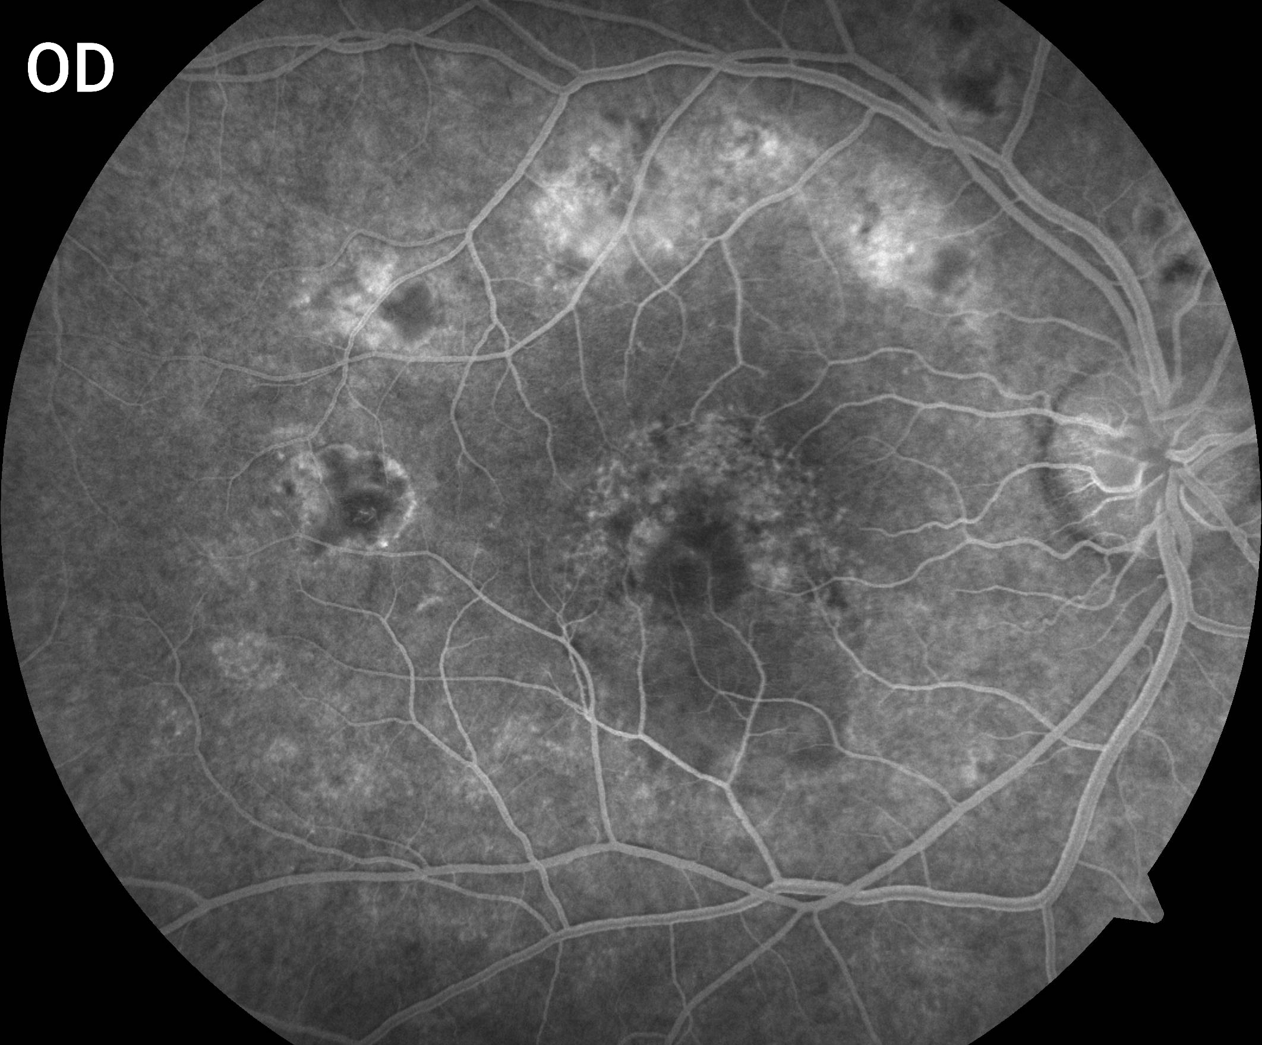
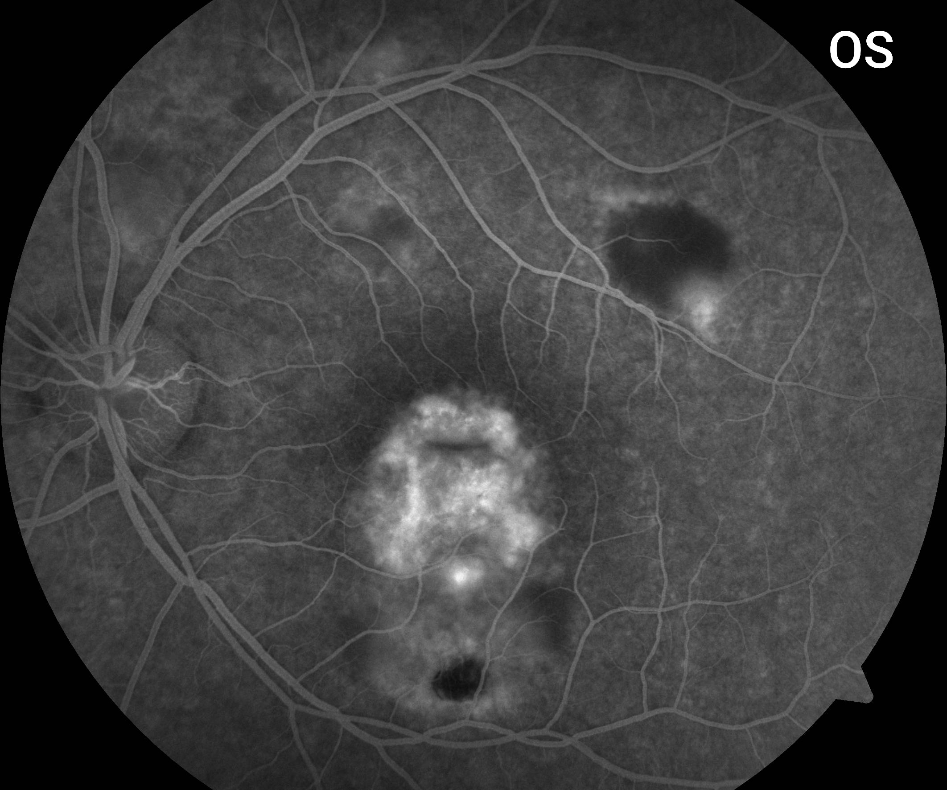
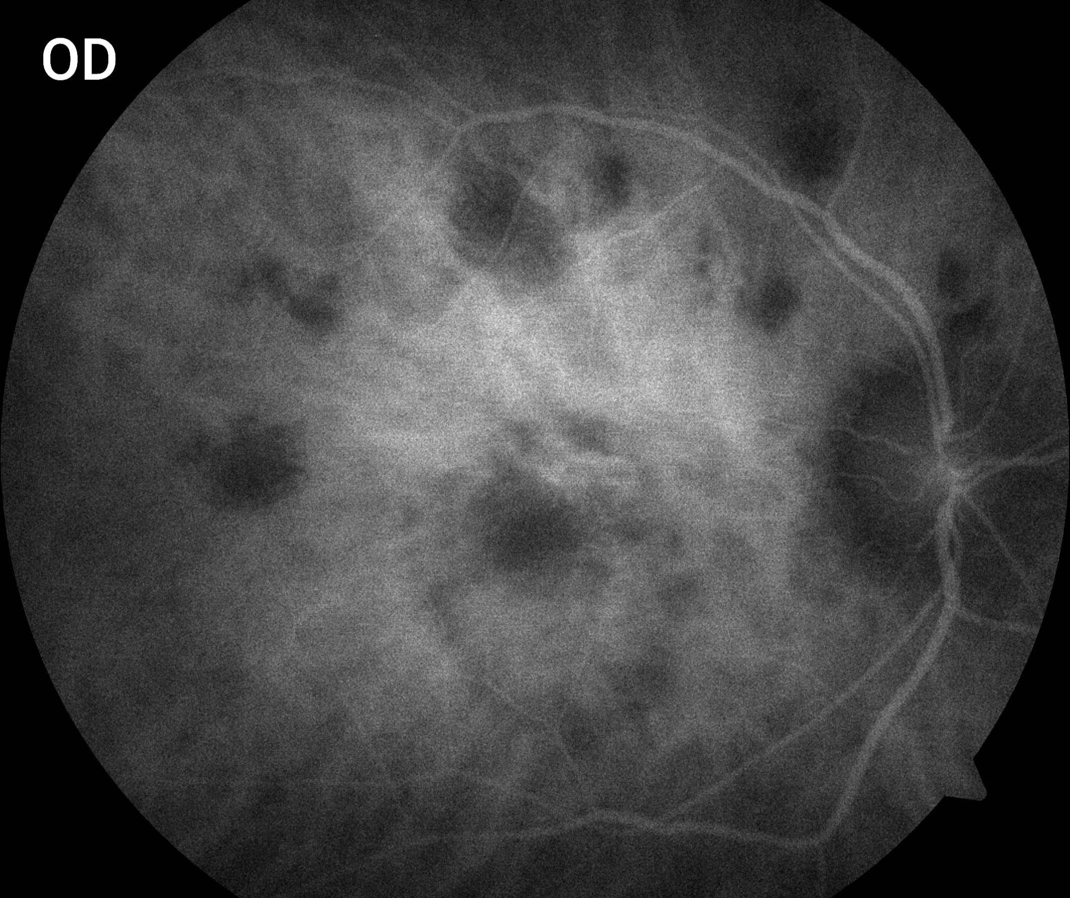
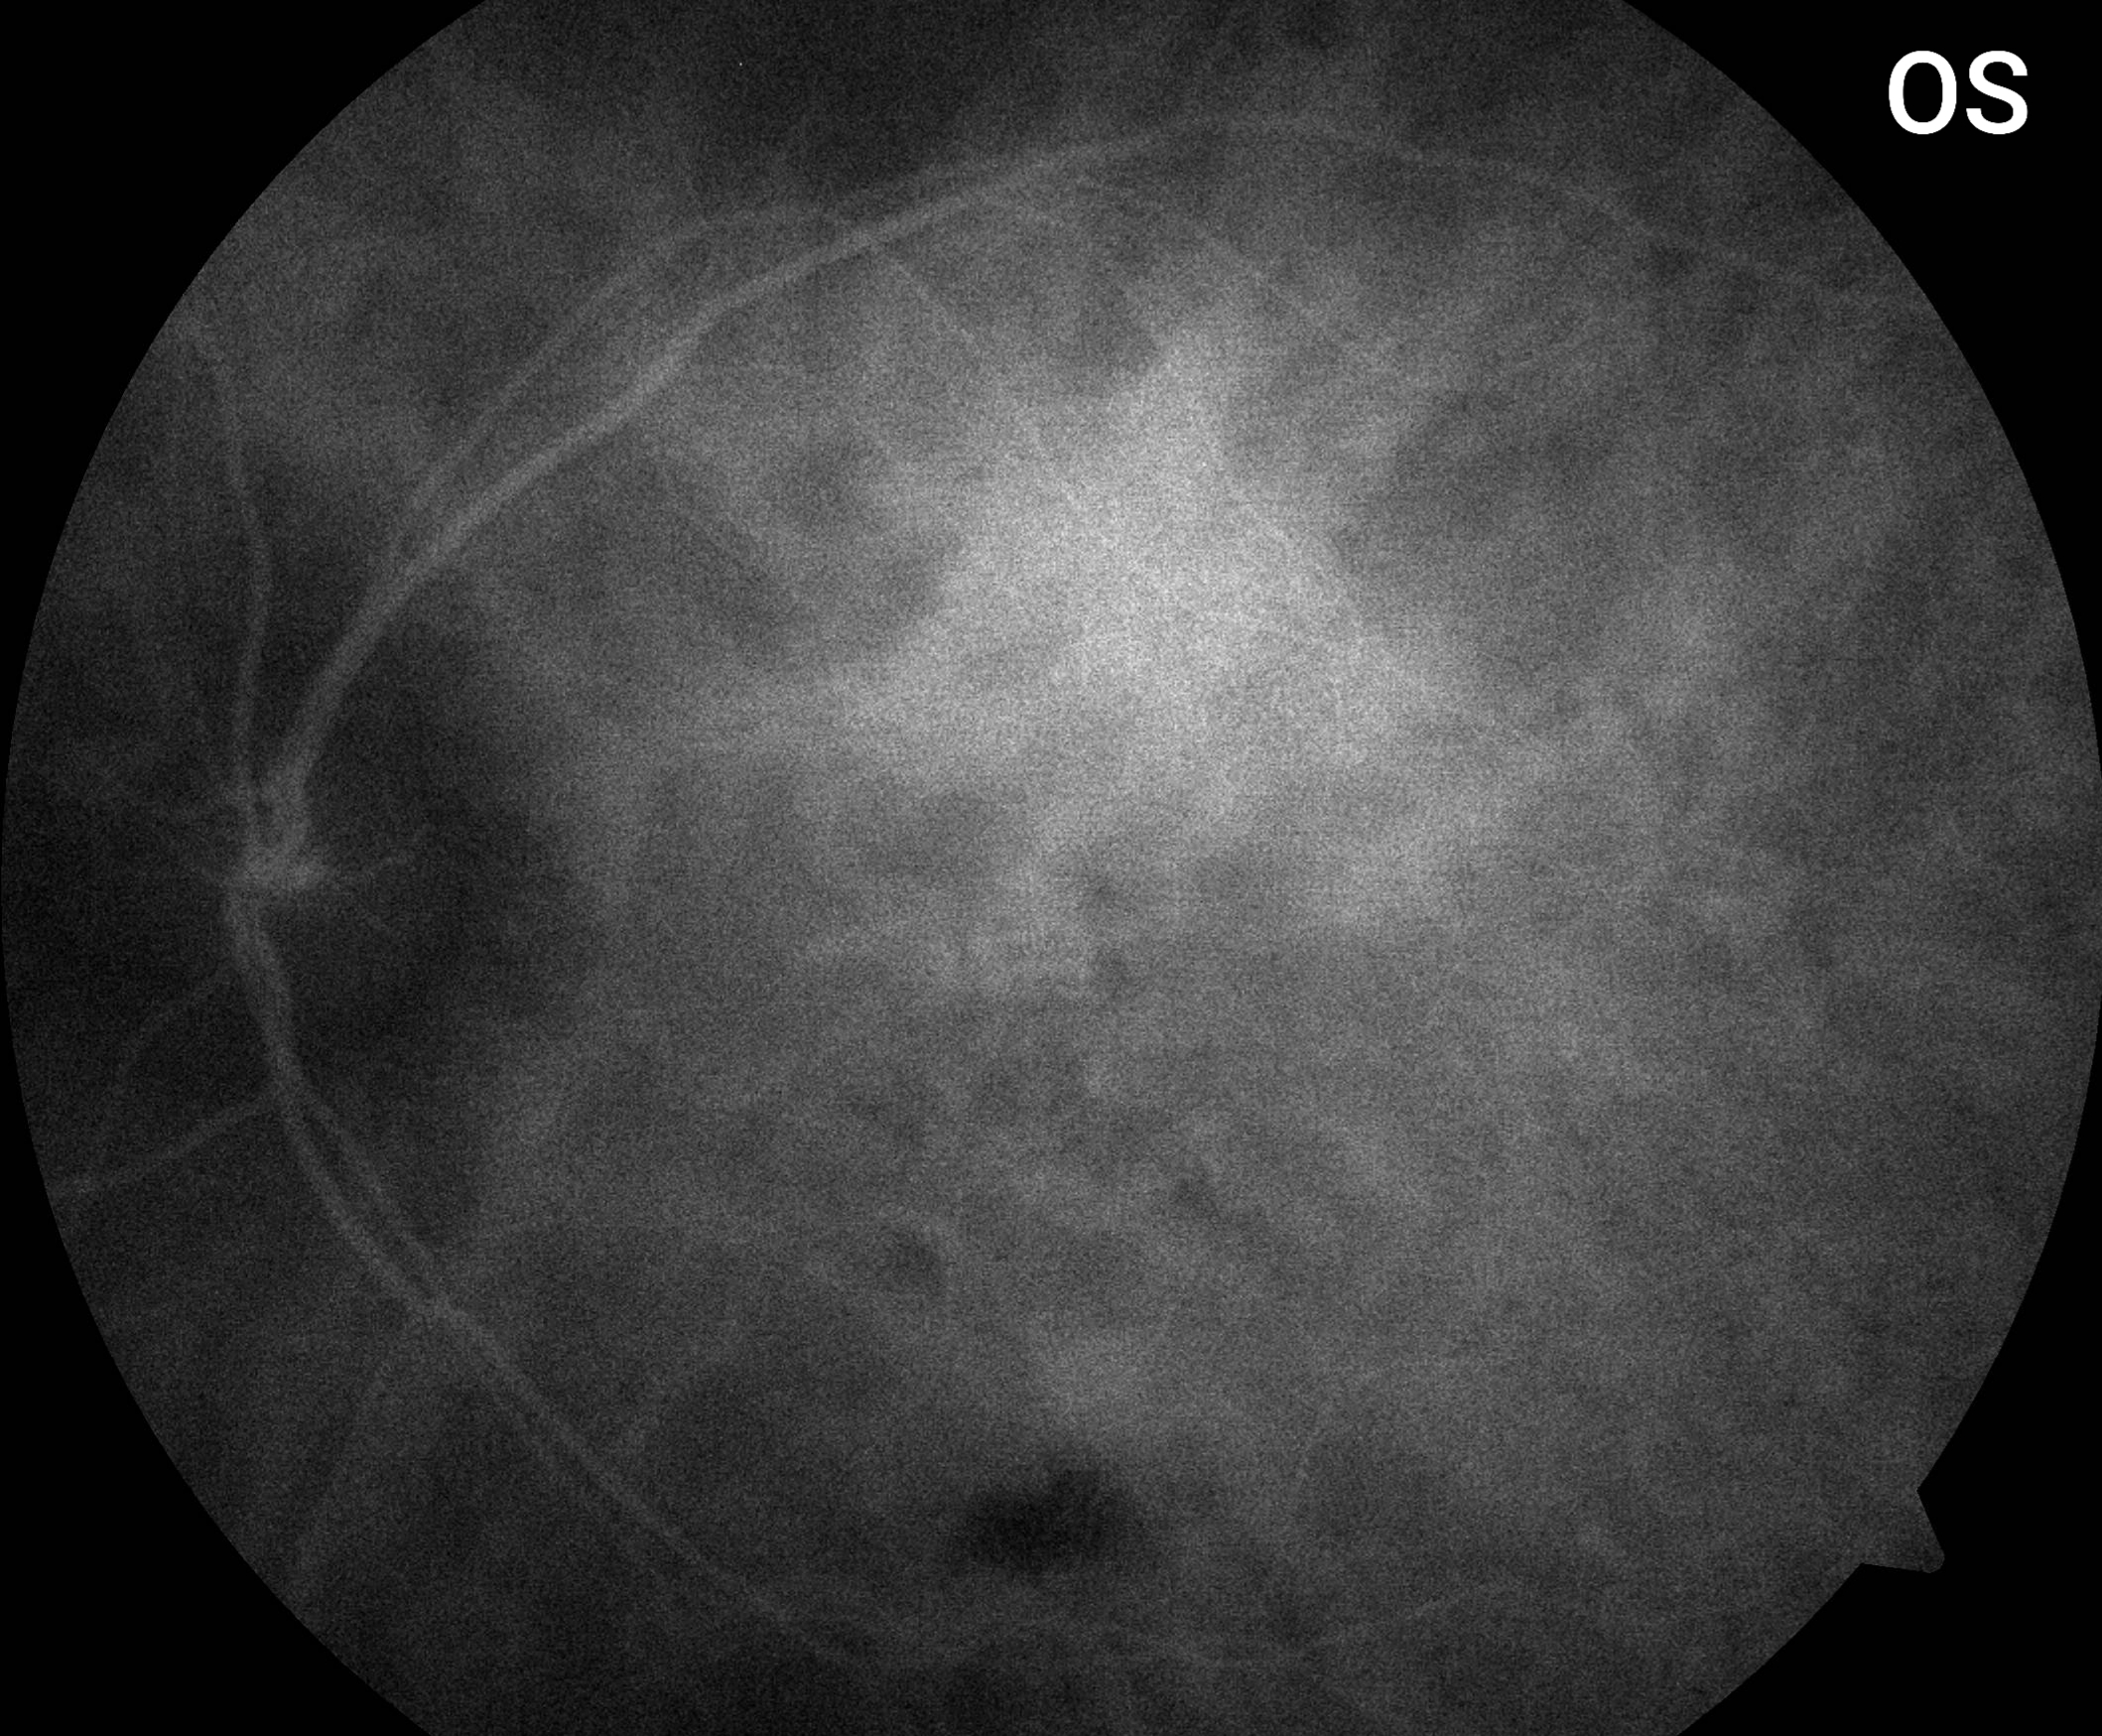
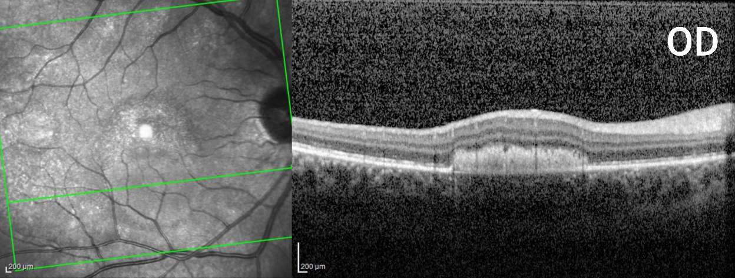
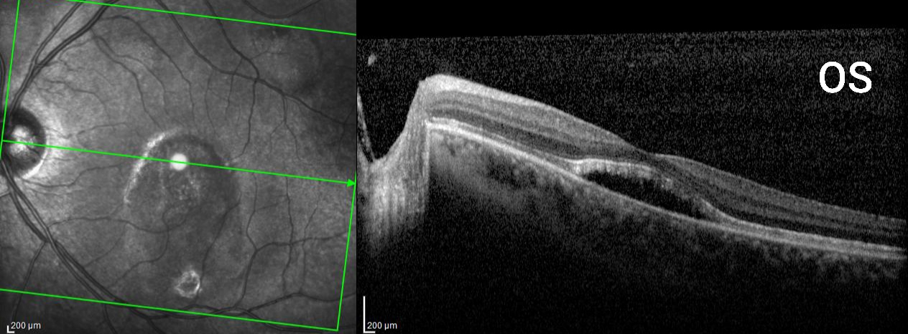
ACUTE POSTERIOR MULTIFOCAL PLACOID PIGMENT EPITELIOPATHY (APMPPE) COMPLICATING WITH CHOROIDAL NEOVASCULARIZATION: CASE REPORT
Erick C. Holanda; Arthur P. Favarato; Pedro A. Rebello; Luisa G. Gross; Vicente H. R. Fernandes; Delma R. G. Huarachi; Iuri C. Silva; Osias F. Souza;
eickdeholanda1991@hotmail.com
DEPARTMENT OF OPHTHALMOLOGY OF THE UNIVERSIDADE ESTADUAL DE CAMPINAS (UNICAMP) – SÃO PAULO, BRAZIL
OBJECTIVE
We present a case of APMPPE complicating with choroidal neovascularization
By exclusion, APMPPE was the final diagnosis. It was intiated oral prednisone 1mg/kg due to the central macular involvement. Patient continues in close monitoring and still in early stage of the treatment. In case of worsening of the subretinal fluid, anti-VEGF intravitreal injection to manage the choroidal neovascular membrane in the left eye will be scheduled.
CASE REPORT
Female, 25 year old, showed up in the HC-UNICAMP ophthalmology emergency room presenting with 10 days onset of worsening of vision in both eyes. No previous record of ocular trauma, pathologies or surgeries. Presented bulimia in the past. Patient reported stress and stomach discomfort but denied flu or diarrhea prior to the present symptoms. Entrance vision acuity was 20/30 and 20/200 in the right and left eyes, respectively. Pupillary exam and anterior segment biomicroscopy were normal. Fundus examination revealed clear vitreous and multiple yellow-white lesions varying in size in the posterior pole. Optic nerve disc and retinal vessels were physiological. Infectious and rheumatologic screenings were negative (Sifilis, HIV, Toxoplasmosis, Mantoux test, Rheumatologic factor, FAN, Chest X-ray). SD-OCT showed multiple dome-shapped lesions on the outer retina in both eyes, and presence of subretinal fluid with foveal involvement in the left eye. Fluorescein angiography (FA), demonstrated early hypofluorescence and late hyperfluorescence by staining and leakage. Indocyanine Green showed both early and late hypofluorescence.
DISCUSSION
APMPPE has a unknown etiology, associated with hypoperfusion of the choriocapillaris and lesion of the overlying retinal pigment epithelium. There is no sex predilection, occurring in youth as an acute onset of blurred vision or scotomas. Fundus examination may present with yellow-white lesions varying in size in the posterior pole that are represented in the OCT by dome-shapped lesions in the outer retina. Some conditions can present APMPPE-like lesions, such as syphilis, sarcoidosis and tuberculosis. Therefore, they should be ruled out before closing diagnosis. APMPPE can be observed, but oral corticosteroids should be considered if central macular involvement or cerebral vasculitis and Anti-VEGF intravitreal injections if presence of choroidal neovascular membrane.
CONCLUSION
In summary, APMPPE should always be remembered as a possible disease, so that the patient can benefit better from early diagnosis and avoid possible serious complications such as choroidal neovascularization.

