Slide 1
RETINA 2020
RETINA START – CLINICAL CASES
JEAN VÍTOR DE AGUIAR LÉDO COUTINHO
F2 SURGICAL AND CLINICAL RETINA
ÍCARO AUGUSTO GODINHO
F3 SURGICAL AND CLINICAL RETINA
ARNALDO FURMAN BORDON
HEAD OF THE RETINA AND VITREOUS SECTOR
SOROCABA EYE HOSPITAL
SÃO PAULO, APRIL 22TH 2020

Slide 2
FIRST APPOINTMENT– 02/01/2016
59 years-old, White, female.
CC: Floaters in OD for months, without loss of visual acuity.
PMx: Major depression, dyslipidemia, pre-DM, SAH, chronic arthralgia.
POx: None.

Slide 3
FIRST APPOINTMENT
EXAMINATION:
BCVA OU: 20/20.
BIO: OU: Phakic.
IOP: 17 /16 mmHg.
Fundus examination: OU:
Mobile vitreous opacities with Weiss ring,
Attached retina without peripheral lesions.

Slide 4
FIRST APPOINTMENT
DH:
PVD.
CD:
Annual retinal examination.

Slide 5
RETINA – 10/22/2018
CC: Sudden visual loss on OS with floaters.
BCVA:
OD:20/20
OS: 20/100
Fundus:
RE: Stable.
LE: Light vitreous hemorrhage, MHs at the end of STA, without tears, retina attached.

Slide 6
RETINA – 12/10/2018
CC: Floaters OU, photopsias and improvement of BCVA on OS.
BCVA OU: 20/20
UWF retinography and FA:

Slide 11
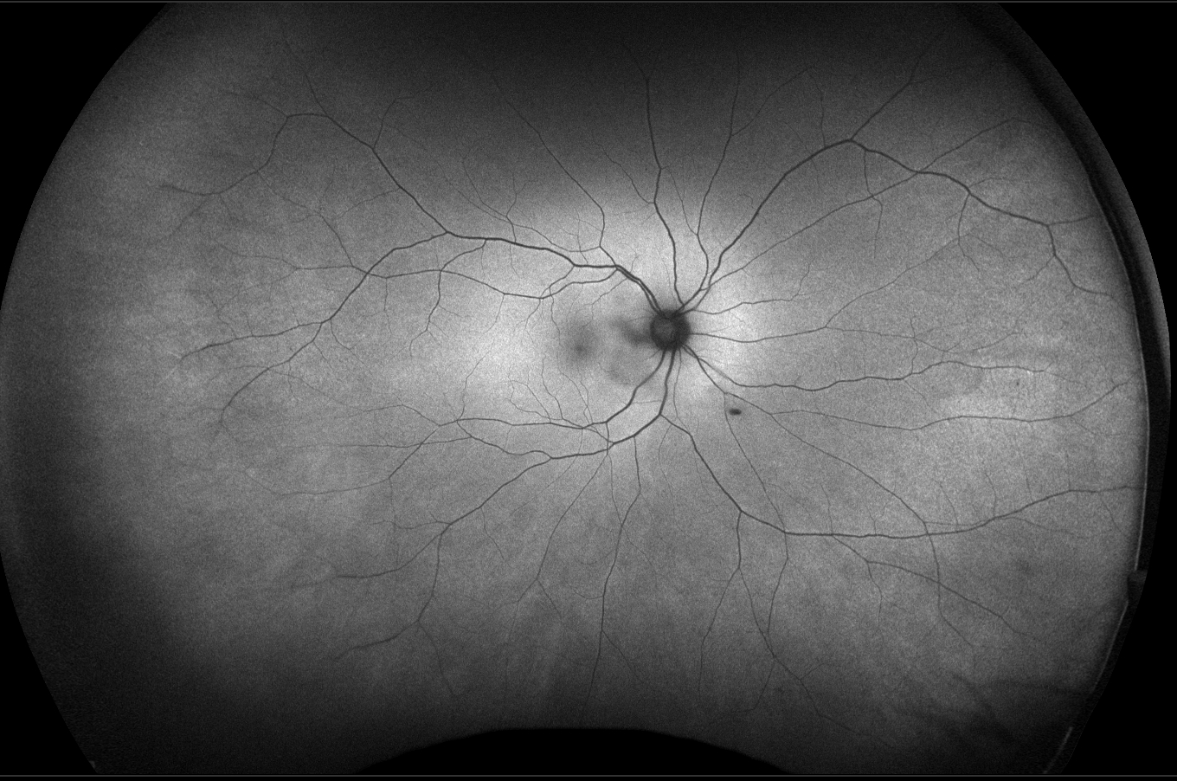

Slide 13
15 sec

Slide 14
17 sec

Slide 15
23 sec

Slide 16
38 sec

Slide 17
49 sec

Slide 18
1 min 2 sec

Slide 19
1 min 16 sec

Slide 20
5 min 8 sec

Slide 21
5 min 22 sec

Slide 22
RETINA – 12/10/2018
HD:

Slide 23
RETINA – 12/10/2018
DH:
Peripheral retinal ischemia
Eales’ disease
Idiopathic retinal vasculitis
DR
Systemic Vasculitis
Syckle Cell Retinopathy
MCL
Others

Slide 24
RETINA – 12/10/2018
Systemic work-up:
Blood cell count
Hb electrophoresis
Fasting Glucose e Hb1AC
ANF, RF, ANCA
Anti-TOXO, -HIV 1 e 2, -HCV, HbsAg, VDRL
ACE, Serum Calcium
PPD
Chest X-ray PA and profile

Slide 25
RETINA – 07/15/2019
DH:
Eales’ Disease.
CD:
Retinal evaluation every six months;
Stable disease;

