Slide 1
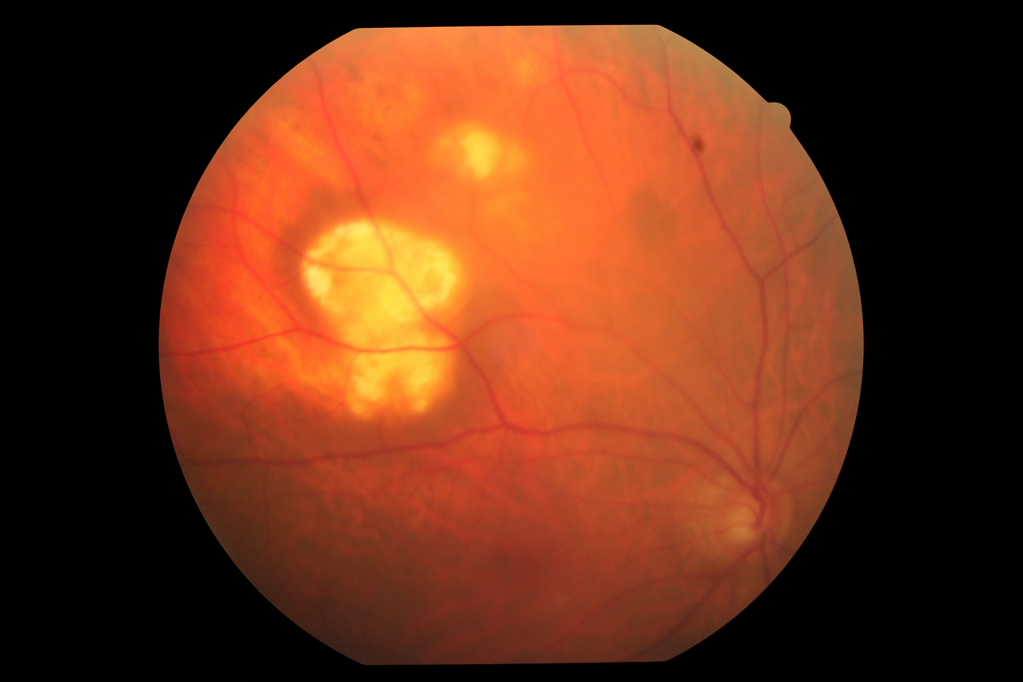
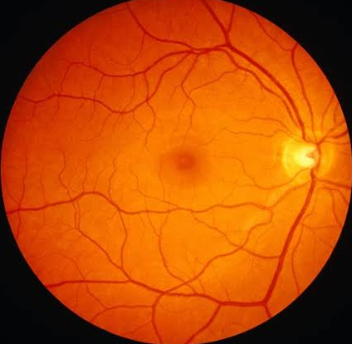
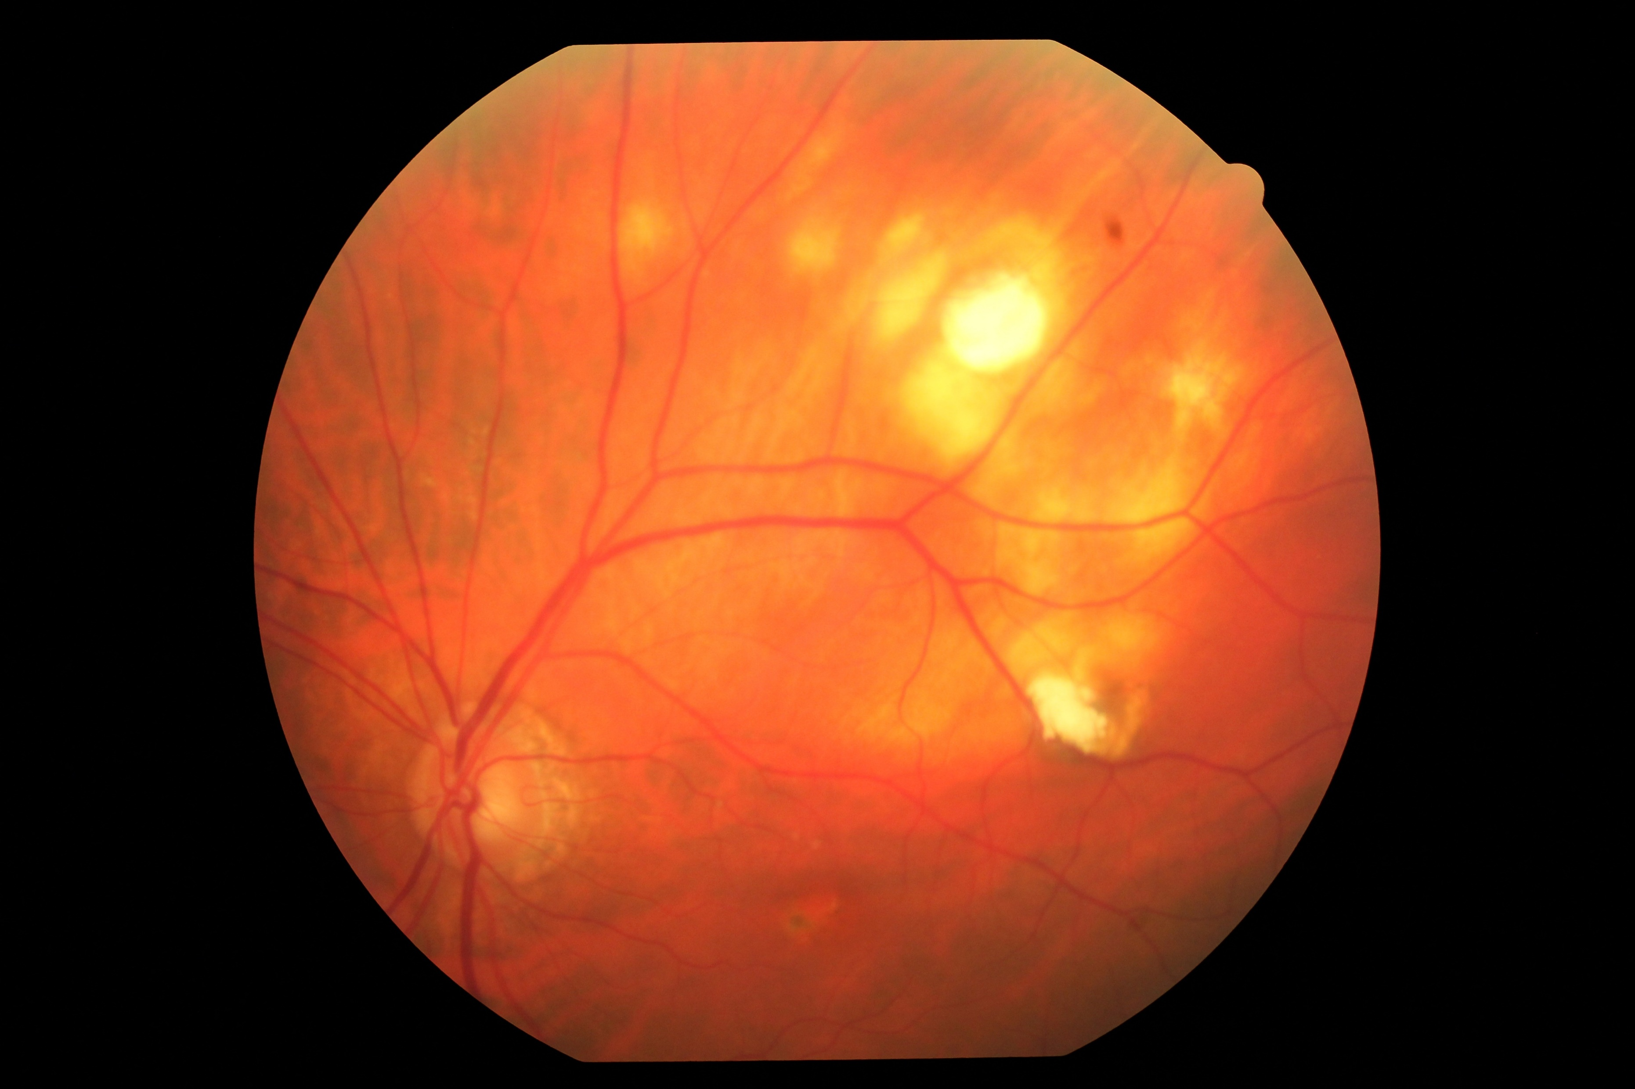
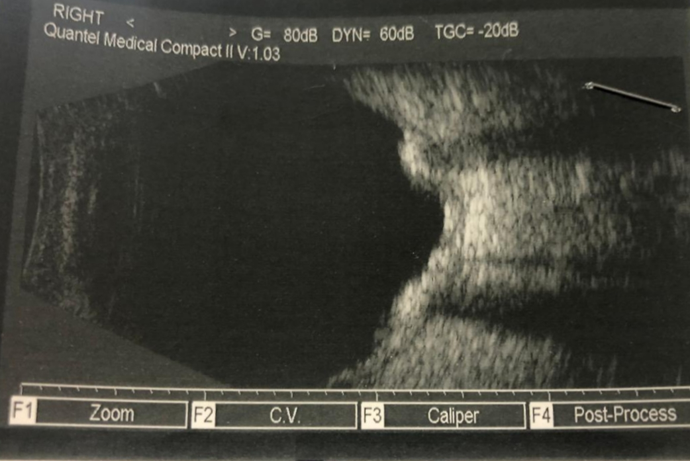
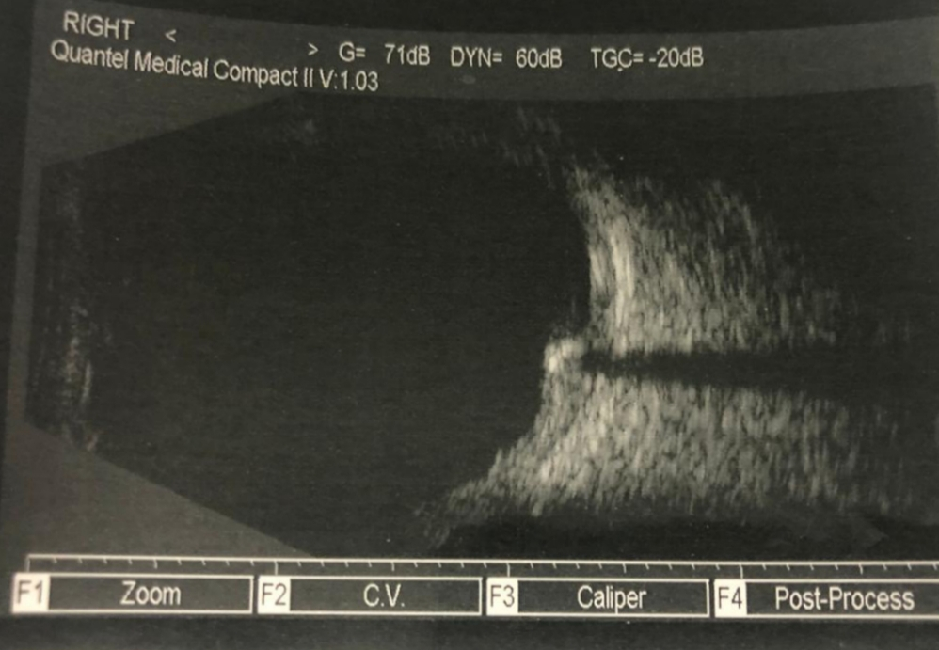
DIFFERENTIAL DIAGNOSIS FOR SUBRETINAL YELLOWISH LESIONS: METASTASIS VERSUS SCLEROCHOROIDAL CALCIFICATIONS
TOCHETO, B.B.²; LUCENA, P¹; VALLE, I.V.¹; CARVALHO, T.A²; FALCÃO, V.C.²; FIGUEIREDO, T.C.S.²; NEHEMY, A. ³; COSTA, M.A.N³
¹ Resident of Ophthalmology of the João Penido Burnier Foundation
² Retina and Vitreous Fellowships of João Penido Burnier Foundation
³ Heads of the Retina and Vitreous sector of the João Penido Burnier Foundation
PURPOSE
To report a case of sclerochoroidal calcifications in an 80-year-old man.
METHODS
Case report and correlation to literature.
RESULTS
Fundus examination of both eyes revealed yellowish lesions of approximately 10 mm from superotemporal macula to superotemporal periphery. There was no associated subretinal fluid, heme or significant retinal pigment epithelium changes.
B-scan ultrasonography revealed moderate solid elevations as well as high internal reflectivity compatible with calcified lesions.
Clinical screening was negative, including calcium metabolism and renal function. These findings excluded the first hypothesis of metastasis, confirming the diagnostic of sclerochoroidal calcifications.
CONCLUSION
Sclerochoroidal calcifications present as deposits of calcium pyrophosphate in the sclera and/or choroid, typically in elderly, white individuals.
Ultrasonography confirm the presence of intrinsic calcification.
Differential diagnosis include choroidal osteoma, choroidal metastasis, subepithelial infiltrates of large cell ocular lymphoma, amelanotic nevus/melanoma and chorioretinitis.
Cases are considered idiopathic after excluding other pathologies by investigating ocular history and blood tests.
Even in rare cases of parafoveal involvement, no treatment protocols have been established. Visual prognosis is usually good. Although sclerochoroidal calcification is a rare disease it’s important to recognize it in order to avoid unnecessary intervention.
OR
80 yo
No symptoms
Irregular, yellow chorioretinal lesions, usually superotemporal
Idiopathic – can be associated to calcium metabolism
Far from fovea
Remain stable
Prostate
cancer
Best corrected VA
20/30 both eyes
OS
Figure 2
Ultrasonography revealing calcified lesions
Figure 1 Retinography evidencing bilateral lesions

