Slide 1
LASER TREATMENT IN AN EXTENSIVE COATS DISEASE CASE IN A YOUNG FEMALE
Autores:
Carlos Gustavo Leite Vieira
Nádia Carolina Lima e Lima
Vinicius Carriero Lima

Slide 2
Purpose
To present a case of laser treatment in Coats disease in a female children with extensive exudation
Methods
This is a case report of a patient examined at the Centro Oftalmológico de Minas Gerais on May 2019
Case Report
15 year old female with worsened vision for about 30 days in the right eye (OD)
Best visual acuity:
OD 20/400 / OS 20/25
Nadia Carolina Lima e Lima

Slide 3
Case Report
Retinal exam:
Extensive macular exudation
Hemorrhage and vascular abnormalities in the macular area and temporal periphery
Wide-field fluorescein angiography:
Multiple vascular dilation
Ischemic areas and exudation
OCT:
Extensive intraretinal exudation
Laser photocoagulation was performed with visual improvement and less exudation
Nadia Carolina Lima e Lima

Slide 4
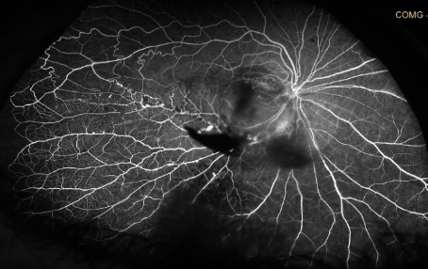
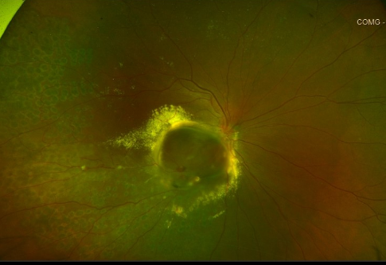
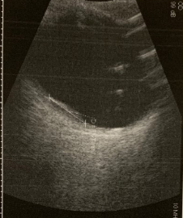
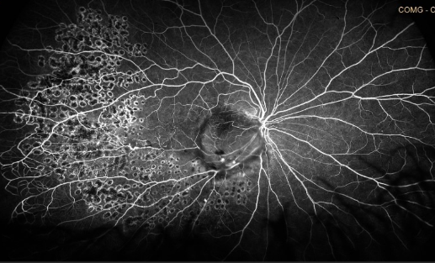
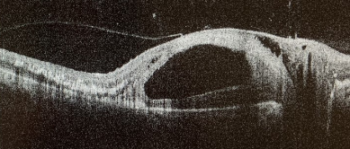
Exams

Slide 5
Discussion
Coats disease (CD) is a congenital and idiopathic condition most frequent in male children. It presents with retinal telangiectasia and exudation. Our patient was a female children, what is not usual. Sorologic exams were performed to discard other exsudation causes
The natural history of the disease is the lipoprotein leakage that can evolve with retinal detachment. Our patient had evolved to a large macular intraretinal exudation, but without retinal detachment
Treatment is necessary to eliminate telangiectasias leading to improvement of the exudation and preventing neovascular glaucoma. Therapeutic options include crioteraphy, photocoagulation and vitrectomy. In this case the retina was attached, so we decided to treat with laser photocoagulation and succeeded. Althought CS having a poor visual outcome, it’s important to reduce complications, and our patient had also visual quality improvement
Nadia Carolina Lima e Lima

