Slide 1
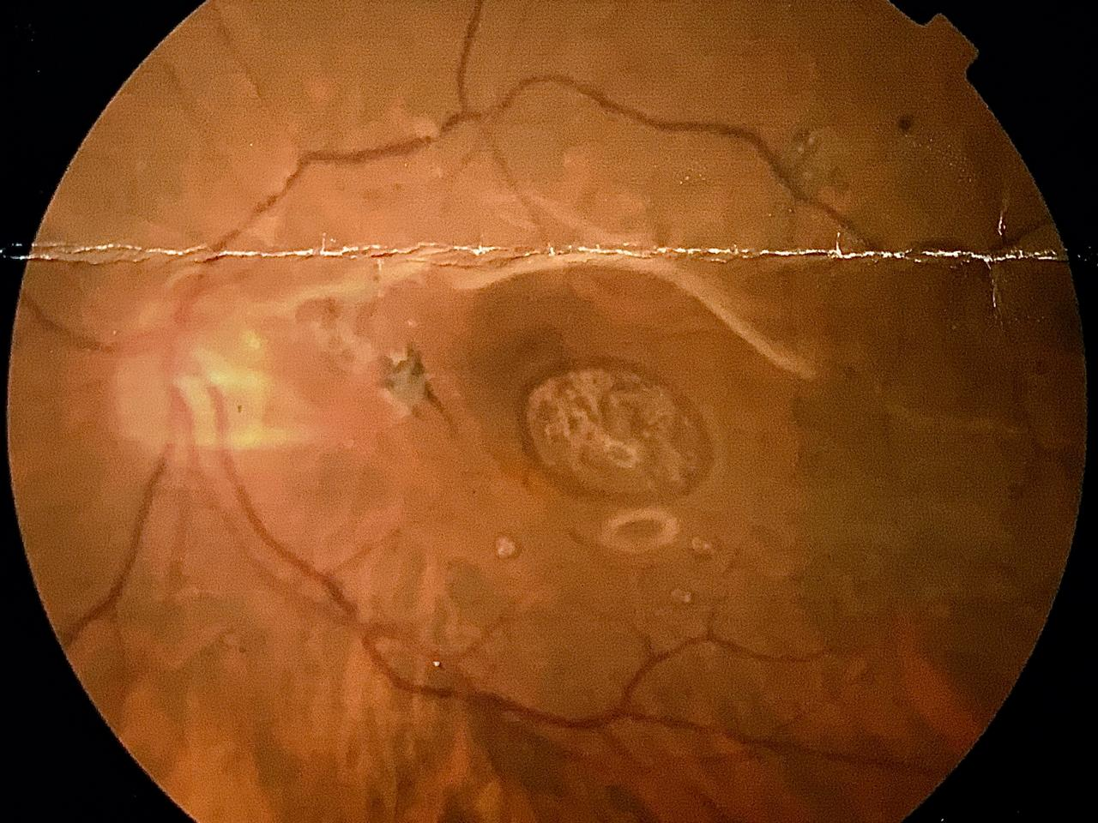
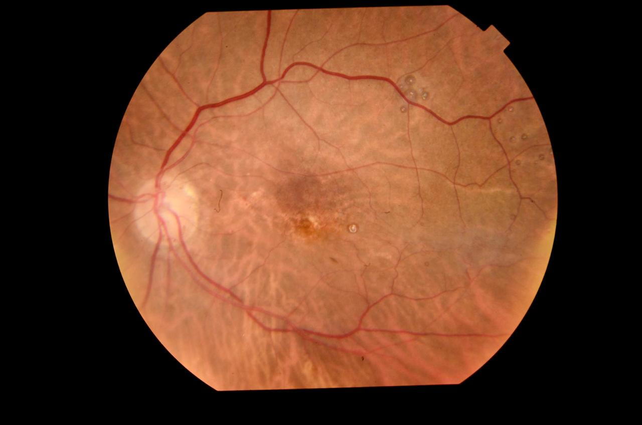
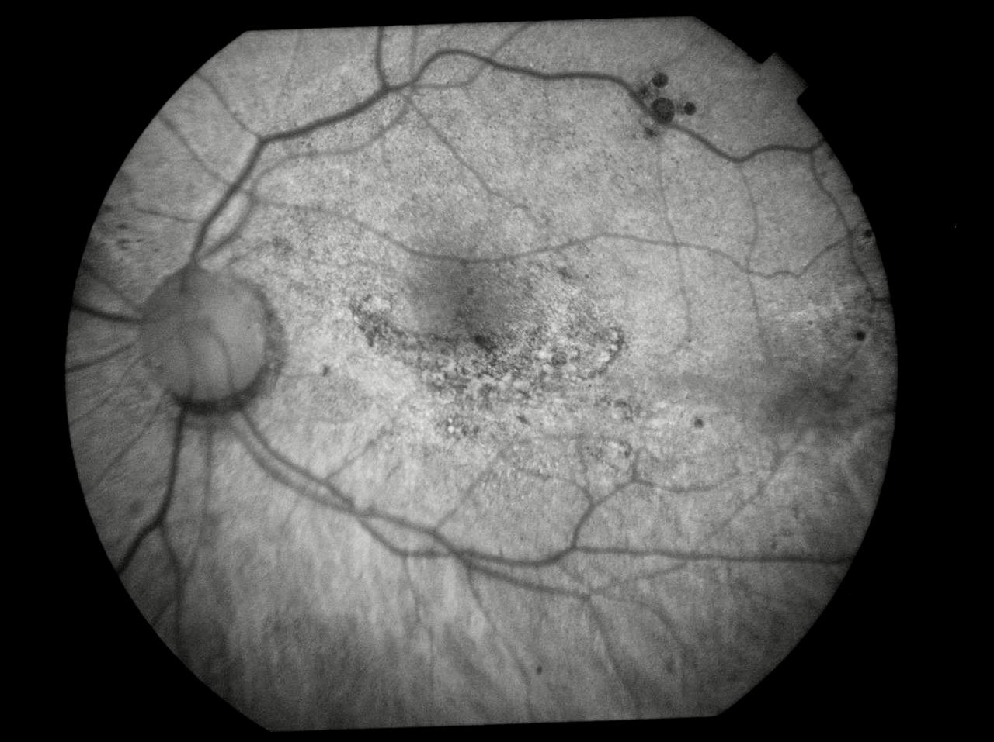
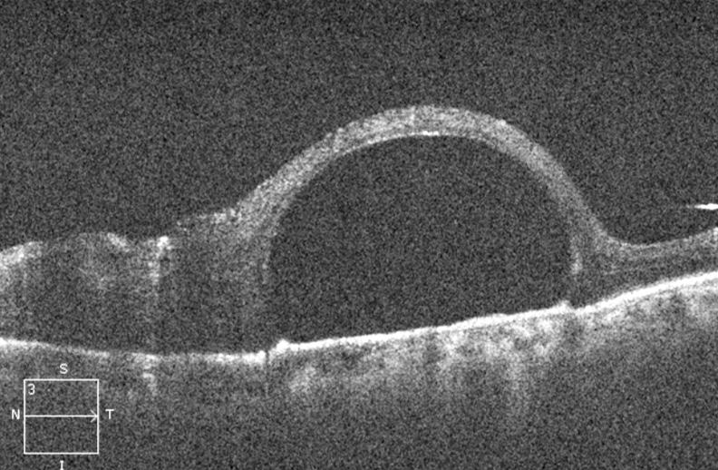
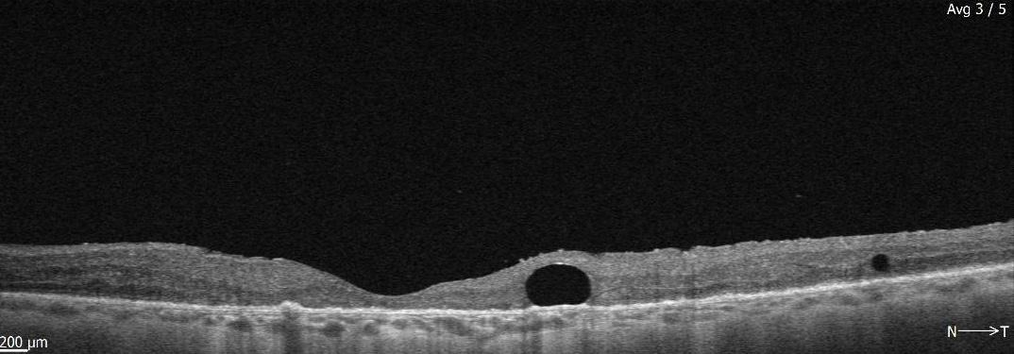
Subretinal Perfluoroctane After Vitrectomy Surgery: Case Study
Rafael Garcia, Nathália Nishiyama Tondelli, Mariângela Zanon Casoni , Amanda Venturini Arantes , Paulo Henrique Horizonte , Leandro Pocay Alves da Silva , Raimunda Cristina Mendonça Freire de Oliveira , André Marcelo V. Gomes
Instituto Suel Abujamra
PURPOSE
Fundoscopy revealed subretinal perfluorocarbon drops in the macula of the left eye.The OCT showed the typical omega sign. A posterior vitrectomy was performed with perfluorocarbon aspiration with a 39-Gauge cannula. The post-op OCT demonstrated an important anatomical improvement. Moreover, the BCVA of the left eye improved to 20/200.
To describe a case of Subretinal Perfluoroctane After Vitrectomy Surgery.
INTRODUCTION
Perfluorocarbons (PFC) are synthetic compounds of high density and low viscosity. They are commonly used intraoperatively to manage cases of rhegmatogenous retinal detachment.They aid in intraocular surgical maneuvers to drain the subretinal fluid. Perfluoroctane (C8F18) is the one used in vitreoretinal surgeries, filling the vitreous cavity and generating internal retinal pressure against the retinal pigmented epithelium, reattaching the retina. PFC are toxic to the retina, but residual drops in the vitreous cavity can remain for up to 6 months without complications. Nevertheless, when in the subretinal space, they are not tolerated.
DISCUSSION
PFC cannot be left in the vitreous cavity for a long time, due to its toxicity and dispersion. PFC toxicity occurs both because of its chemical composition and its mechanical effects. Its high specific gravity causes rupture of the photoreceptors and narrowing of the outer plexiform layer. The dispersion occurs through the formation of droplets when in contact with the residual vitreous, causing a decrease in the optical transparency of the cavity and predisposing to subretinal migration. When in large quantities it can lead to a severe inflammatory response and. consequent important vision loss.
Fig 3 and 4. Retinography of the left eye before and after second surgery.
Fig. 5: Fluorescence angiography of the left eye after the second surgery
METHODS
Medical records review
Fig. 1 and 2: OCT of the left eye before and after the second surgery.
BIBLIOGRAPHY
RESULTS
1- Tewari A1, Eliott D, Singh CN, Garcia-Valenzuela E, Ito Y, Abrams GW. Changes in retinal sensitivity from retained subretinal perfluorocarbon liquid. Retina. 2009 Feb;29(2):248-50
2. Lavezzol MM, Hokazonoll K, Zacharias LC, TtakahashiII WY- Perfluoro-n-octane in orbital cavity after posterior vitrectomy and suture of eye perforating injury: case report. Arq. Bras. Oftalmol. vol.74 no.4 São Paulo July/Aug. 2011.
3. Marcos Ávila e David Isaac– Vitrectomia 20, 23 e 25G – Rio de Janeiro: Cultura Médica; Guanabara Koogan, 2010.
4- Basic and Clinical Science Course 2016-2017 American Academy of Ophthalmology
A 78-year-old male patient presented with a history of phacoemulsification surgery with IOL implantation and posterior vitrectomy in the left eye 11 months ago. His best corrected visual acuity (BCVA) was 20/80 in the right eye and 20/600 in the left eye.
Notes:
purpose, methods, results and discussion

