Slide 1
Nd:YAG LASER POSTERIOR HYALOIDOTOMY IN VALSALVA RETINOPATHY – CASE REPORT
Estado de Santa Catarina
Secretaria de Estado da Saúde
Hospital Regional de São José Dr. Homero de Miranda Gomes
Presenter Author: Dr. Eduardo da Silva Eli
Co-Author: Dr. Marcelo Brillinger Novello

Slide 2
CASE REPORT
ID: MJL, 28 years-old, female;
History of present illness: 7-day history of sudden, painless vision loss of the left eye, after vomiting episode;
No history of:
Trauma or other symptoms;
Comorbidities;
Previous ocular surgeries;

Slide 3
CASE REPORT
Ocular examination (10/22/19):
 | RIGHT EYE | LEFT EYE
BCVA | 20/20 | Hand motion
IOP | 10 | 10
Biomicroscopy | normal | normal
Fundus | pictures | pictures

Slide 4
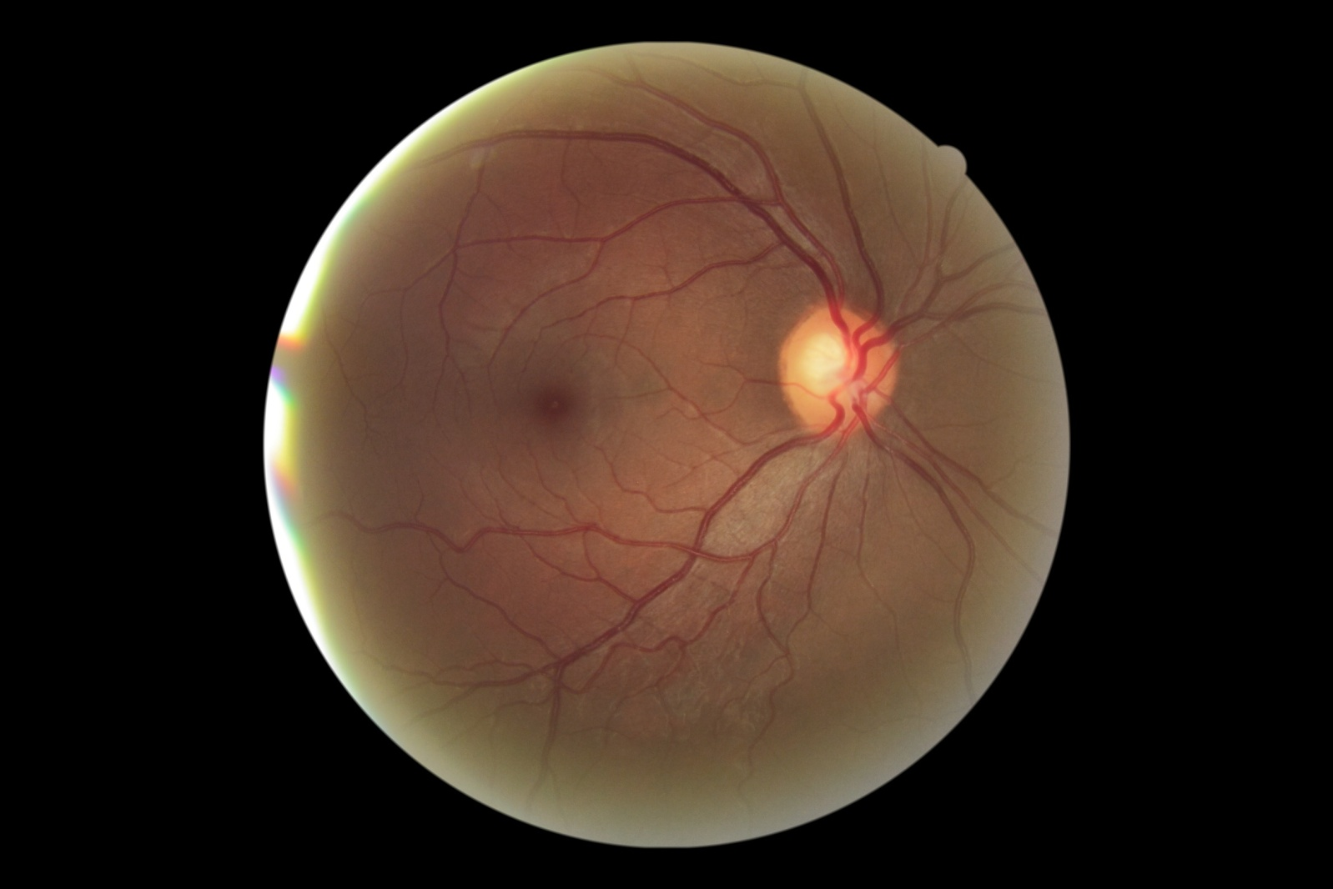
CASE REPORT

Slide 5
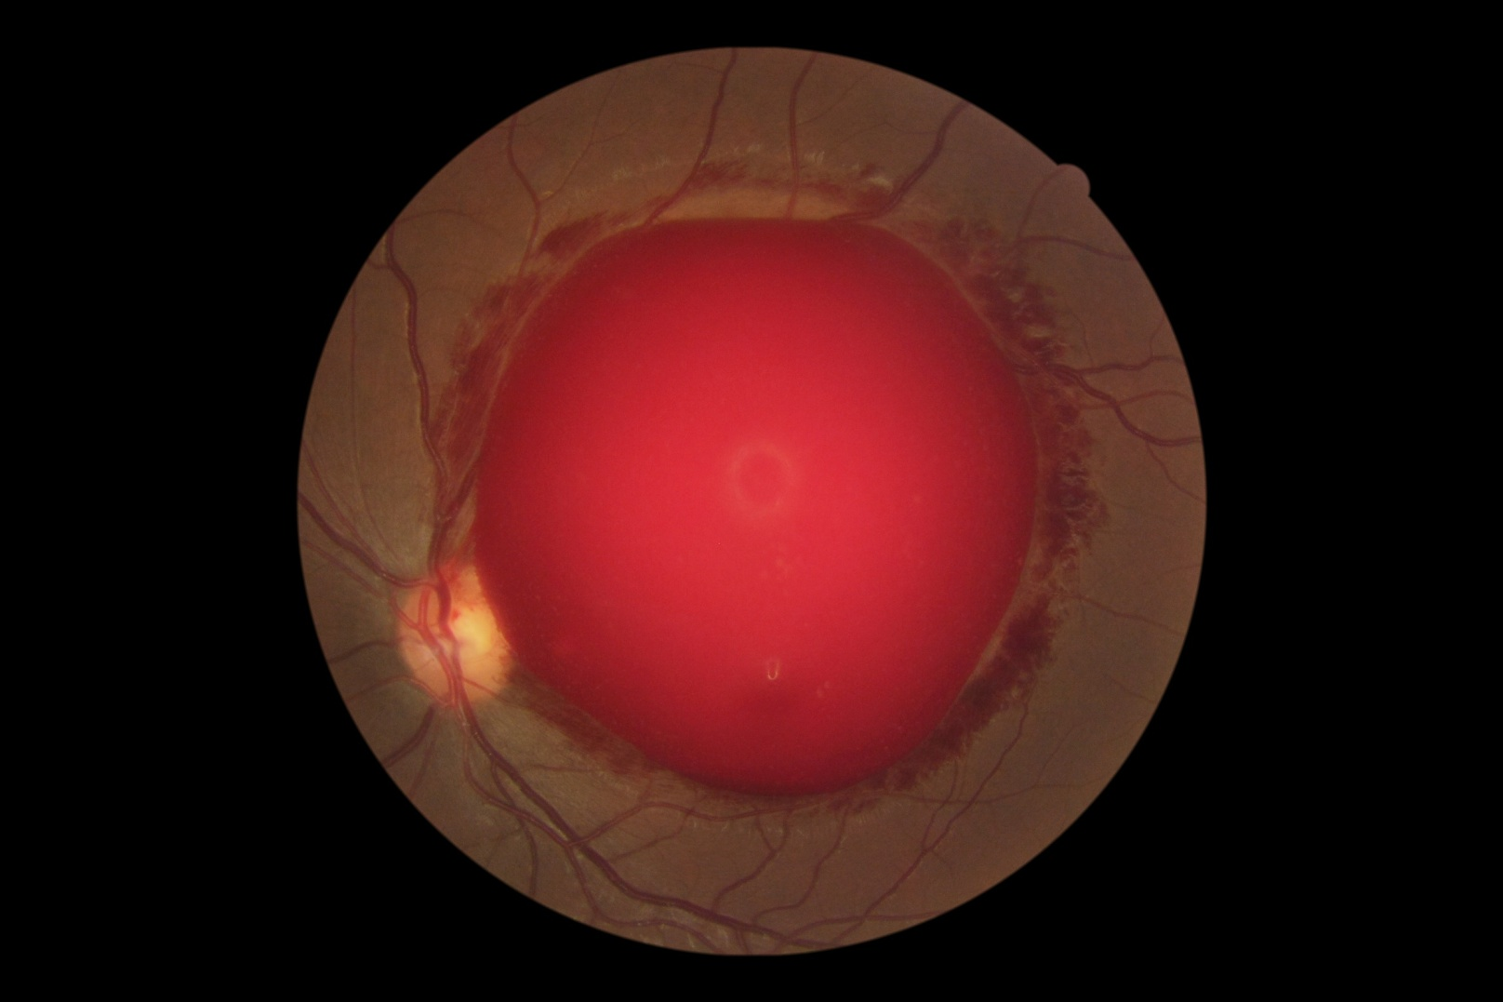
CASE REPORT

Slide 6
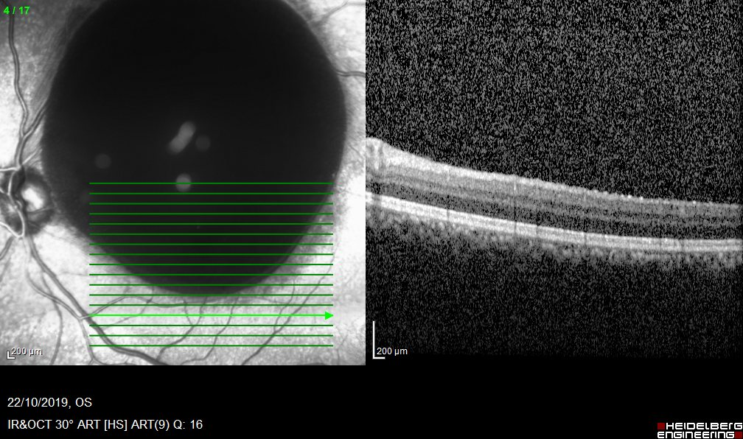
CASE REPORT

Slide 7
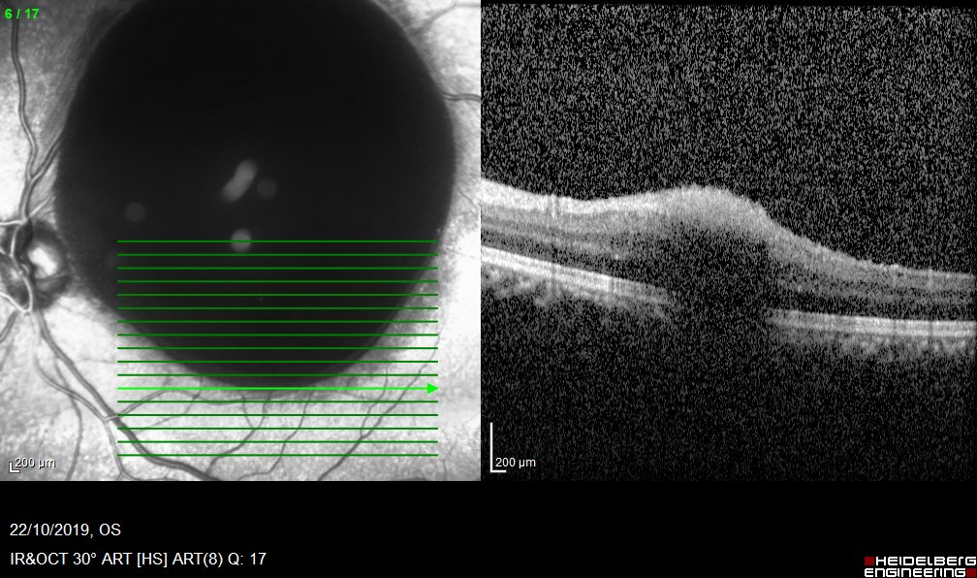
CASE REPORT

Slide 8
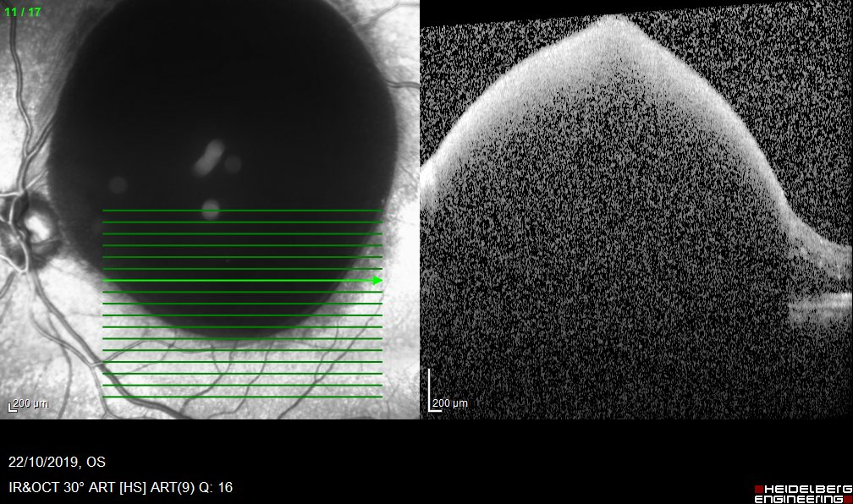
CASE REPORT

Slide 9
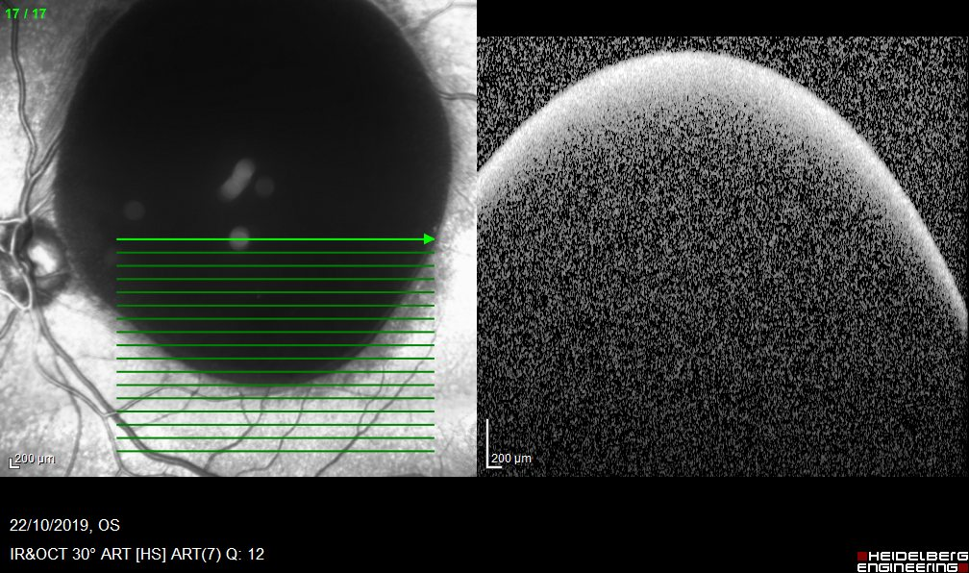
CASE REPORT

Slide 10
CASE REPORT
Provisional Diagnosis:
Valsalva Retinopathy;
Differential Diagnosis:
Arterial macroaneurysm;
Terson’s syndrome;
Posterior vitreous detachment;
Anemic retinopathy;
Sickle cell retinopathy;

Slide 11
CASE REPORT
Management options:
Conservative;
Nd:YAG laser posterior hyaloidotomy;
Pneumatic displacement – injection of gas with or without recombinant tissue plasminogen activator;
Pars plana vitrectomy;
Notes:
conservative management, laser membranectomy, pneumatic displacement of the hemorrhage by an intravitreal injection of gas with or without recombinant tissue plasminogen activator, and pars plana vitrectomy should be considered.

Slide 12
CASE REPORT
Management:
Performed Nd:YAG laser posterior hyaloidotomy on the same day (5.5 – 6.0 mJ, 15 shots);
Oriented raised headboard;
Follow-up after 2 days;

Slide 13
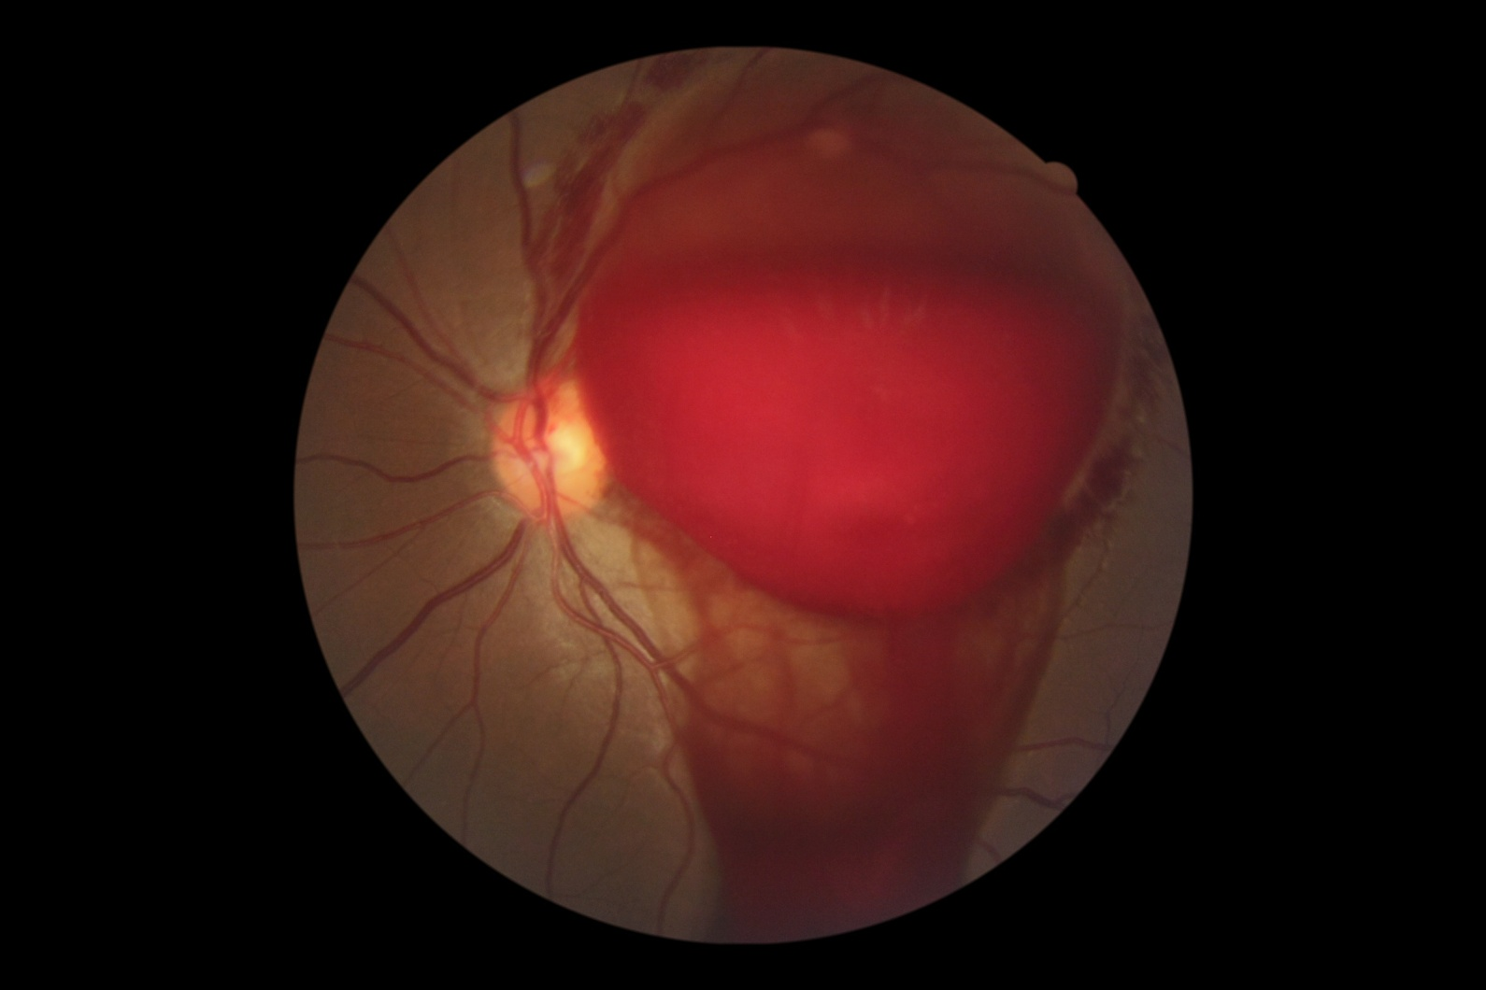
CASE REPORT
After Nd:YAG laser posterior hyaloidotomy (10/22/19):

Slide 14
CASE REPORT
Follow-up (10/24/19):
 | RIGHT EYE | LEFT EYE
BCVA | 20/20 | 20/40
IOP | 10 | 10
Biomicroscopy | normal | normal
Fundus | normal | pictures

Slide 15
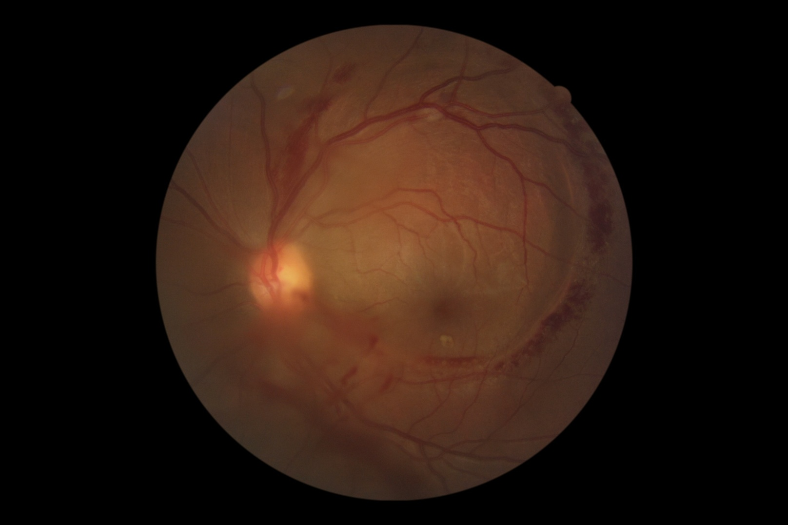
CASE REPORT
10/24/19:

Slide 16
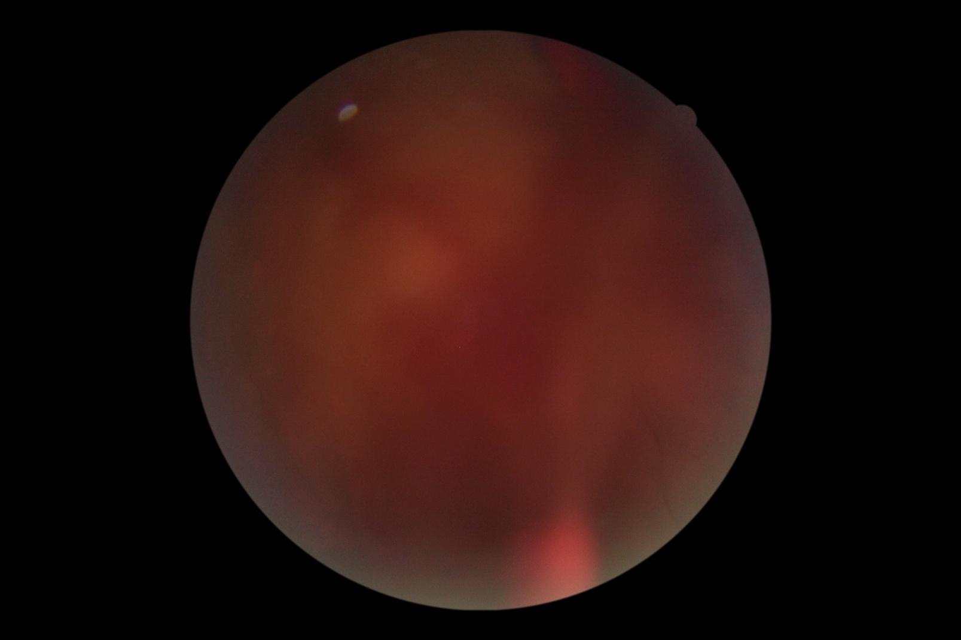
CASE REPORT
10/24/19:
Notes:
Inferior vitreous hemorrhage

Slide 17
CASE REPORT
Conclusion:
Nd:YAG laser posterior hyaloidotomy is a quick and less invasive approach to patients with large premacular hemorrhages offering fast recover of visual acuity;
Notes:
The present case shows that Nd:YAG laser posterior hyaloidotomy is a simple, quick and less invasive approach to patients with large premacular hemorrhages, offering fast recover of visual acuity in these cases.

