Slide 1
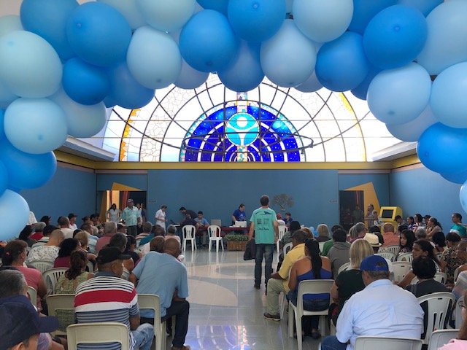
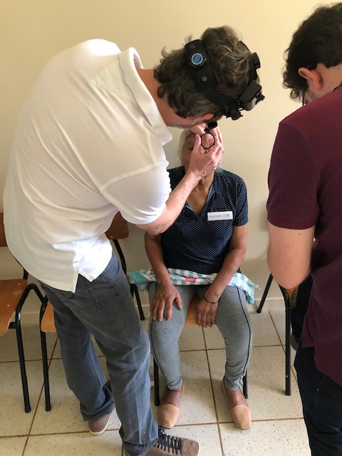
PREVALENCE AND SEVERITY OF DIABETIC RETINOPATHY IN CAMPO GRANDE, BRAZIL
Elder Ohara de Oliveira Júnior¹, Marco Bonini Filho², Alberto Luís Patriarcha³, Nádia Meneguesso Calheiros⁴, Natascha de Almeida Netto⁵, Vanessa Barbieri⁶, Bruno de Albuquerque Furlani⁷, Moisés Tabosa⁸
INTRODUCTION
OD
Diabetic Retinopathy (DR) is a microvascular complication of Diabetes Mellitus (DM), which originates from endothelial damage caused by physiological and biochemical changes in a context of prolonged hyperglycemia.
We aimed to identify the severity and prevalence of DR of patients attended in the DR prevention program of São Julião Hospital in Campo Grande, Mato Grosso do Sul State, Brazil (Picture 1).
Visita inicial
48 meses
METHODS
OE
A cross-sectional observational study including 183 diabectic patients (348 eyes) referred to detection and treatment of DR by the Medical Care Regulation System of Mato Grosso do Sul State.
Visita inicial
RESULTS
Among the participants, 111 (59.7%) were female and 75 (40.3%) were male. The mean (SD) age was 61.62 (11,96) years, and the mean (SD) duration of DM was 14.47 (9,24) years. Diabetic retinopathy was present in 80,74% of the sample.
The prevalence of DR increased from 60,57% at 5 years of diabetes onset to 88,23% after 15 years of Diabetes. Severe stages of DR were detected in 43 (65,15%) patients with insulin dependent DM and 23 (34,85%) with non-insulin dependent DM.
Sight-threatening retinopathy requiring laser therapy was present in 59 (32,24%) patients. Proliferative DR stages requiring vitreoretinal surgery was present in 26 (14,20%). Of the subjects requiring laser therapy or vitreoretinal surgery, 20 (28,16%) had been submitted to previous laser sessions.
48 meses
34,85%
65,15%
OD
OE
DISCUSSION
In Brazil, it is estimated that blindness among diabetic patients reaches a prevalence of 4.8%. In our study, DR was present in approximately 80% of the patients. This high frequency emphasis the need to screen patients with DM for the detection of DR in the diagnosis of diabetes. Early recognition through screening prevention program followed by treatment assistance allows to reduce social and financial losses in public health system.
OD
OD
Picture 1: Diabetic Retinopathy Prevention Program – São Julião Hospital, Campo Grande
Graphics
REFERENCES
Fong DS, Aiello L, Gardner TW, et al. Retinopathy in Diabetes. Diabetes Care 2004 Jan; 27 (suppl 1): s84-s87.
Bansal P, Gupta KP, Kotecha M. Frequency of diabetic retinopathy in patients with Diabetes Mellitus and its correlation with duration of diabetes mellitus. Official publication of Nigerian Surgical Research Society, volume 6, page 366-369.
Ávila M, Alves MR, Nishi M. As condições de saúde ocular no Brasil. Conselho Brasileiro de oftalmologia, 1 edição, 2015.
Basic and Clinical Science Course, Retina and Vitreous. American Academy of Ophthalmology, 2016-2017.

