Slide 1
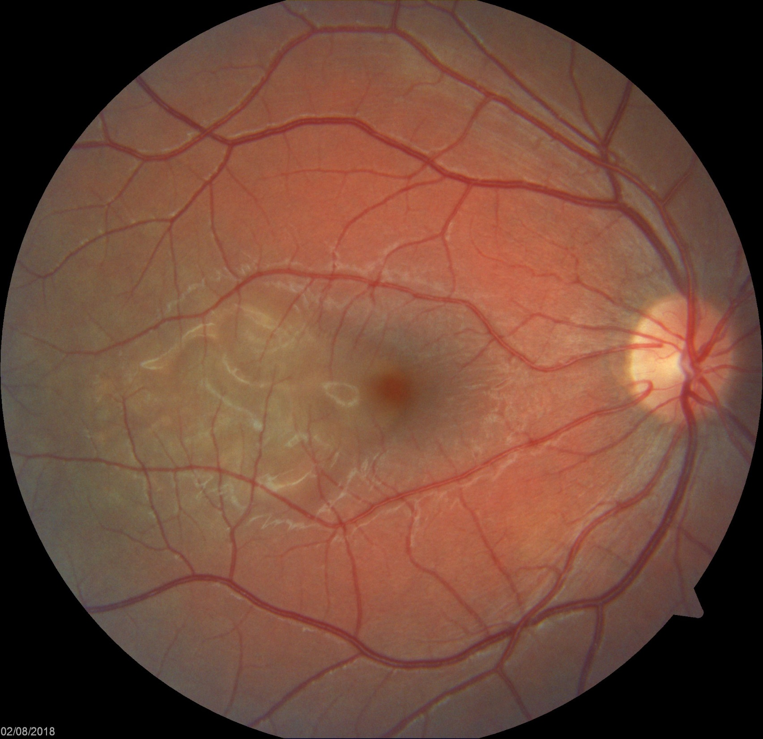
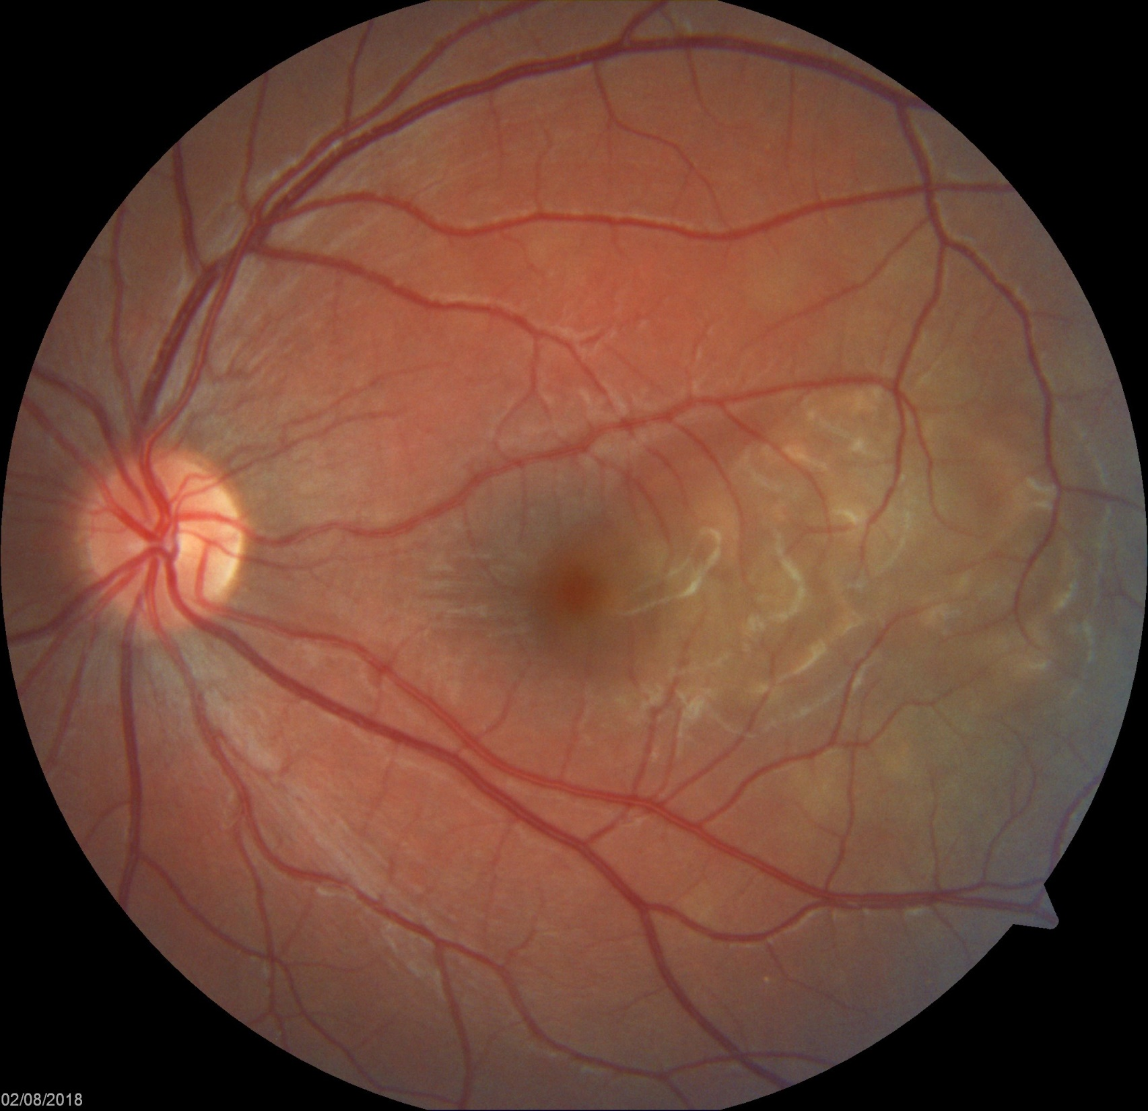
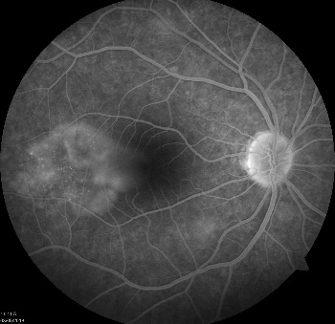
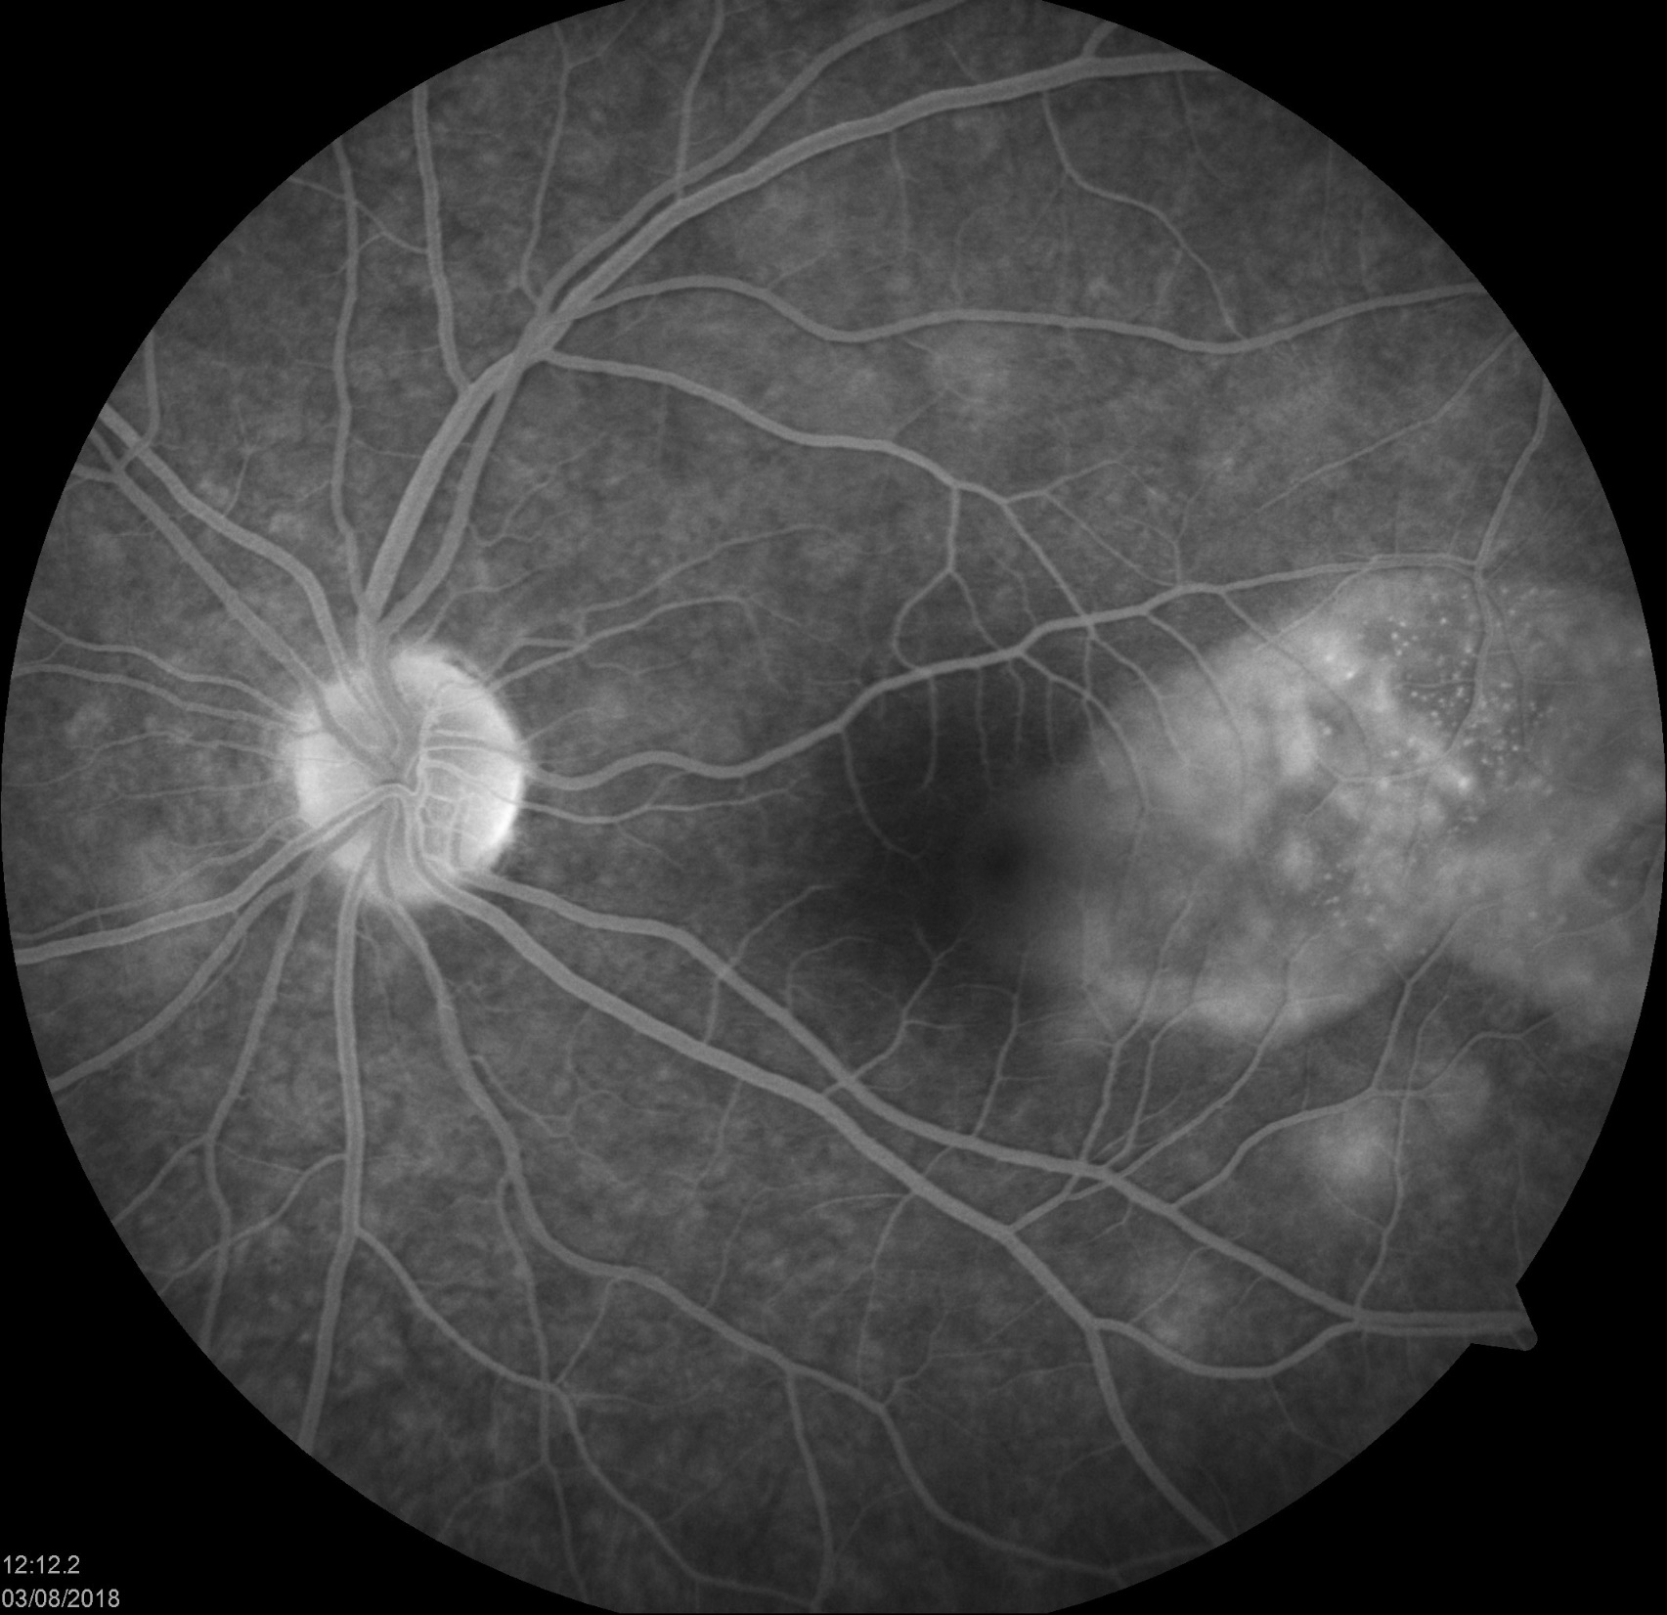
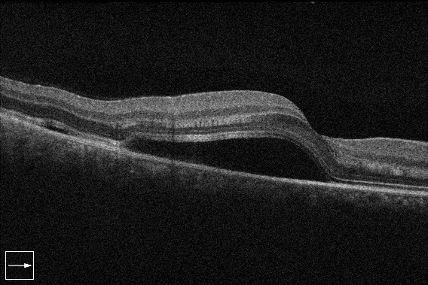
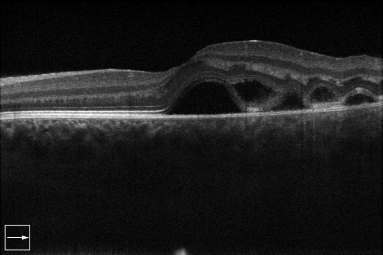
Central serous chorioretinopathy associated with isotretinoin.
Authors: Alexandre Tagliari Cestari¹ Paulo Kin Takara MD²
.
Introduction:purpose to report a case bilateral excessive subretinal fluid during the use of isotretinoin.
Methods: A 17 years old male patient presented to our clinic with blurred vision both eyes 1 week ago. He had been using oral isotretinoin for the last 2 weeks, as prescribed by his dermatologist to treat acne vulgaris.On examination visual acuity was 20/40 in both eyes. His pupils were equal round and reactive with no afferent pupillary defect. Intraocular pressure was 15mmhg. Biomicroscopic examination revealed blepharitis and meibomitis.Dilated fundus examination revealed lobulated shallow serous retinal detachment temporal of the fóvea bilateral. On fundus fluorescein angiography, multiple hyper fluorescent spots were seen in the temporal of the fovea in the early phases. Late phase phase revealed persistent and increased hyper fluorescence and serous macular detachment. OCT demonstrated neurosensory retinal detachment with subretinal fluid both eyes. results: One month later, visual acuity increased to 20/20 and oct demonstrate totally recovered with no residual sub retinal fluid after the discontinuation of isotretinoin.
Discussion
We found only 2 cases described in the literature with suspicion of Serous retinal detachment secondary to the use of oral Isotretinoin. Both dysfunction of the RPE and vascular hypermeability can generate the accumulation of subretinal fluid, however hypermerbeality is the main reason for the increase in hydrostatic pressure on the RPE and causes disintegration of the RPE {1,2}. We know that corticosteroids influence the expression of adrenergic receptors, contributing to the effect of catecholamines {3}. We believe that isotretinoin can act just like corticosteroids, increasing the permeability of EPR, Bruch's layer and choriocapillaries. In the literature, several causes for the accumulation of serous retinal fluid have been reported as diabetic retinopathy, choroidal ischemic disorders such as hypertension, lupus erythematosus, choroidal tumors, corticosteroid usage and inflammatory disorders such as Harada’s disease {3,4}. However, no systemic or ocular disorders were found in the patient in question. The relationship between stressed patients and the accumulation of subretinal fluid is well known, in the case presented here, the patient did not report that he was in stress activities and did not complain about stress that justifies the retinal injury. [3]
Conclusion
In conclusion, we present a patient with bilateral Serous detachment of retina that used oral isotretinoin. We believe that the accumulation of liquid was caused by isotretinoin, which increased choriocapillary and EPR permeability. In our literature search, the serous retinal detachment caused by isotretinoin has been described in only 2 scientific studies, this would therefore be the third report of this type of retinal lesion caused by oral isotretinoin
1. Int Ophthalmol(2017) Excessive serous retinal detachment during the use of isotretinoin 2. Can J Ophthalmol (2017) Central serous chorioretinopathy probably associated with isotretinoin in a keratotoconus patient 3. Marmor M (1997) On the cause of serous detachments and acute central serous chorioretinopathy. Br J Ophthalmol 81:812–813 4. Haddock JR, Malbon CC (1988) Regulation of adrenergic receptors by permissive hormones: glucocorticoids increase steady state levels of receptor mRNA. Proc Natl Acad Sci USA 85:8415–8419 /// 5. Hikichi T, Ohtsuka H, Higuchi M, Matsushita T, Ariga H, Kosaka S et al (2009) Causes of macular serous retinal detachments in Japanese patients 40 years and older. Retina 29:395–404

