Slide 1
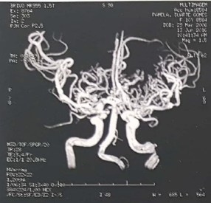
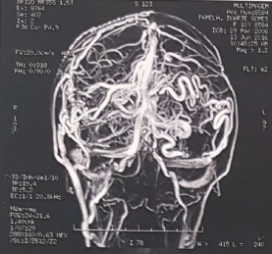
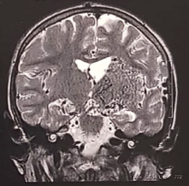
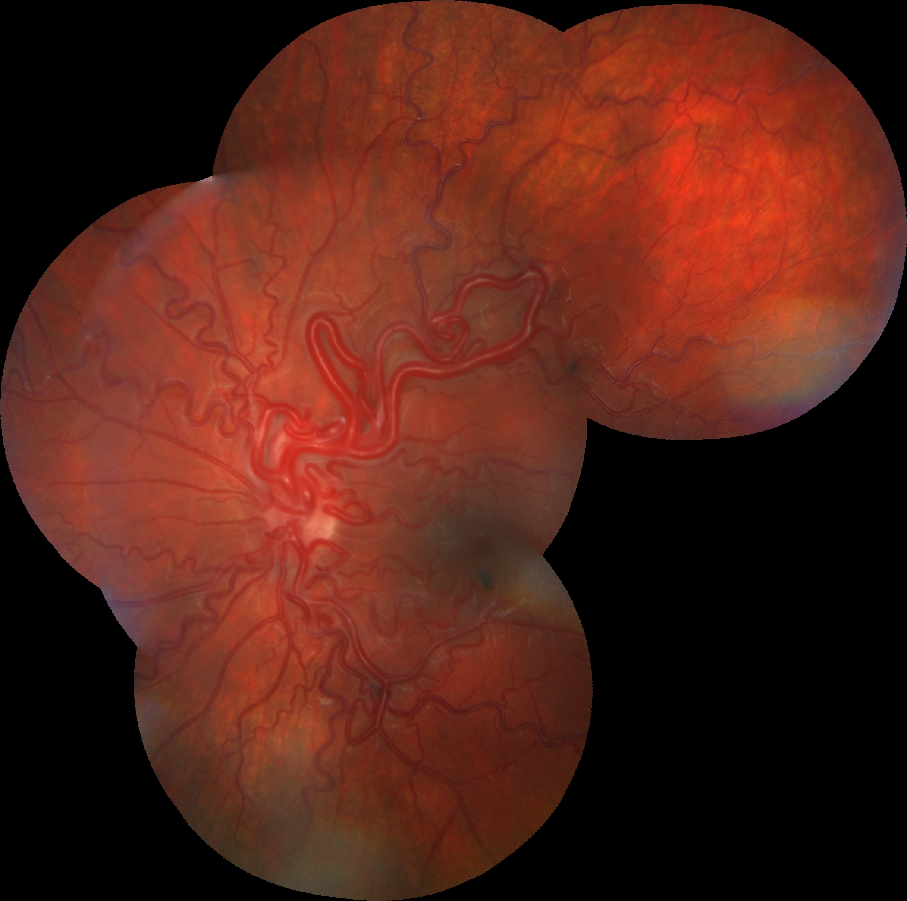
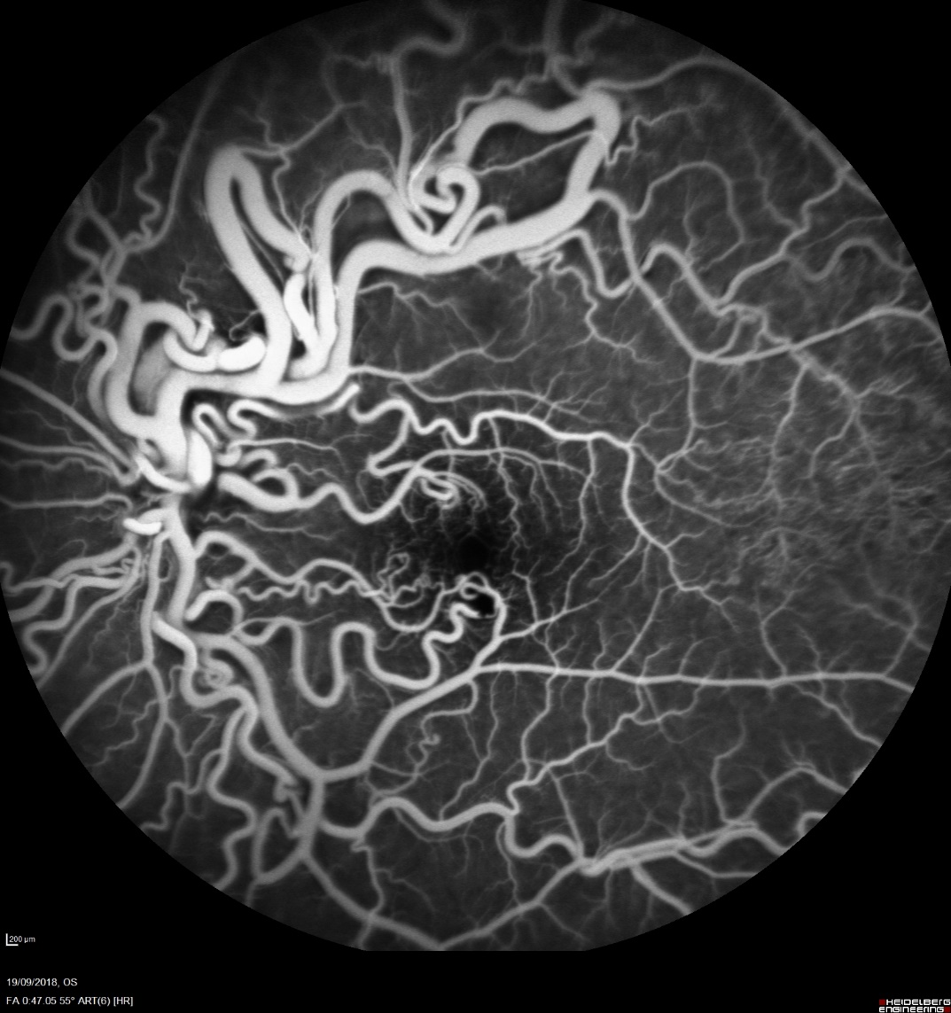
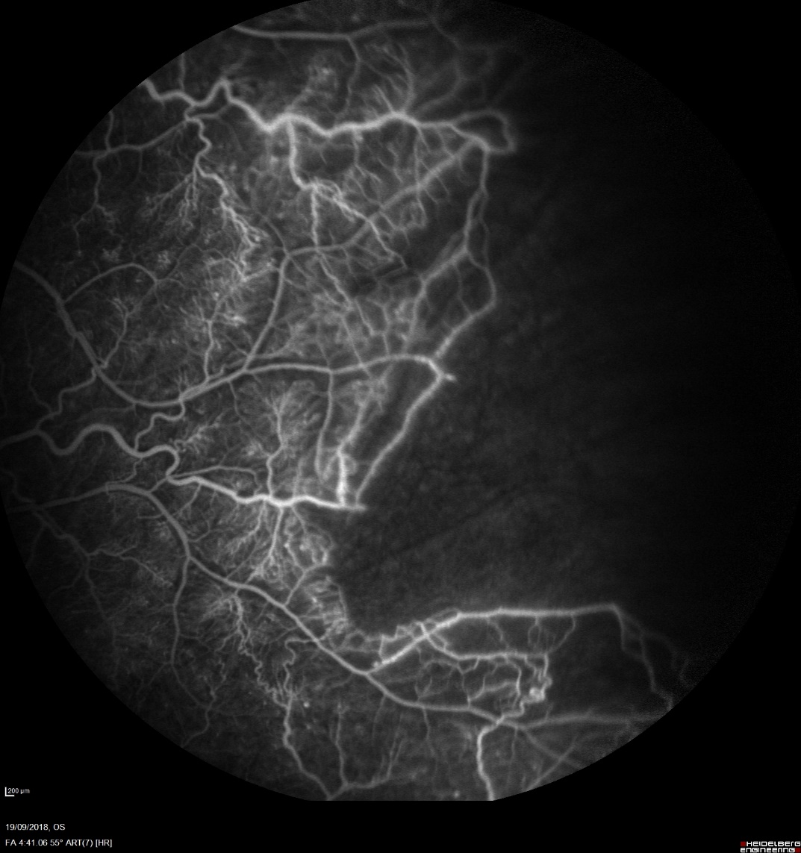
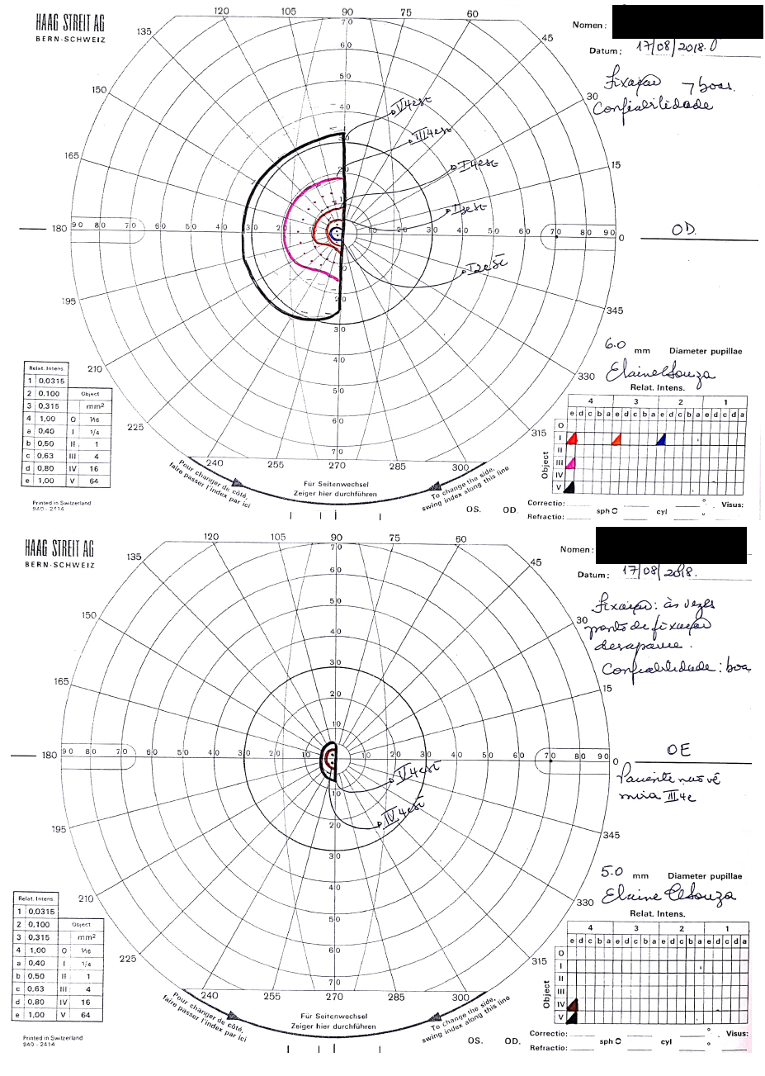
Retinal racemose hemangioma (Wyburn-Mason syndrome): a case report
José Arthur Pinto Milhomens Filho; Letícia Sant Ana Cardoso da Silva; Luciana da Cruz Noia; Luis Filipe Nakayama
INTRODUCTION
FIGURES
Retinal racemose hemangioma (Wyburn-Mason syndrome) is a rare congenital non inherited disease marked by arteriovenous malformations (AVMs) found in eyes and midbrain, therefore grouped with the phakomatoses (neurocutaneous syndromes). Its cause is not yet known and its clinical presentation is deeply variable, depending on the number, size and location of the AVMs. The diagnosis can be established through the identification of pathognomonic ocular findings in the retina, as well as neuroimaging of the AVMs. This case is about a 12-years old female patient with a chief complaint of headache and intermittent low visual acuity in her left eye for the past 2 years. She had a previously neurological investigation with a diagnosis of brain arteriovenous malformation – AVM.
Cerebral angiography and MRI of the brain evidencing AVM, specially at the left side of the brain
METHODS
Neuro-Ophthalmological work up, Goldmann campimetry, retinography (Zeiss Visucam 500), Fluorescein angiography(FA) and OCT (Heidelberg Spectralis HRA) and OCT-angiography (Topcon DRI OCTTriton).
RESULTS
At presentation she had best corrected visual acuity of 20/30 in the right eye and counting fingers at 1 meter in the left eye, right hemianopsia and retinal angiomatous proliferation (worst in OS) at fundoscopy. The FA of her OS showed dilated vessels with increased tortuosity, but no leakage neither neovascularization. A non-perfusion area was identified at the temporal retina.
Composite of the fundoscopy OS shows a “bag of worms” aspect of the racemose AVM lesions of the retina.
DISCUSSION AND CONCLUSION
There is still no specific treatment to the disease, being the therapeutic directed to occasional hemorrhages of the retina or the central nervous system (CNS).
Retina team decided that laser therapy of the avascular zone, in order to prevent neovascular stimulus, was not needed. Patient is in follow-up at the Neuro-Ophthamology and the Retina sectors, with active surveillance.
Fluorescein angiography of the OS with singular abnormal retinal arteriovenous malformations and the temporal avascular region of the retina. Goldmann campimetry demonstrate the right hemianopsia.
REFERENCES
KEYWORDS
1. Jain IS, Sharma SK, Dhir SP, Kaul RL. Wyburn-Mason syndrome (a case report). Indian J Ophthalmol. 1980;28(3):161-3; 2. Reck SD, Zacks DN, Eibschitz-Tsimhoni M. Retinal and intracranial arteriovenous malformations: Wyburn-Mason syndrome. J Neuroophthalmol. 2005;25(3):205-8; 3. Dayani PN, Sadun AA. A case report of Wyburn-Mason syndrome and review of the literature. Neuroradiology. 2007;49(5):445-56.
Retinal racemose hemangioma; Wyburn-Mason syndrome; phakomatoses; arteriovenous malformations
This case report has no financial disclosures.

