Slide 1
CLINICAL CASE
AMANDA SCHNORR
RETINA FELLOW HCFMRP-USP

Slide 2
86 year-old Caucasian woman
Previous diagnosis by ophthalmologist: wet AMD, referenced to anti-VEGF treatment
Progressive blurred vision in both eyes for 4 y
Pseudophakic
Arrhythmia and smoking
 | OD | OE
BVAC | 20/100 -0,25 -1,50 105 | CD 1m +1,00 -0,50 90
IOP | 7 | 9
BIO | unremarkable | unremarkable

Slide 3
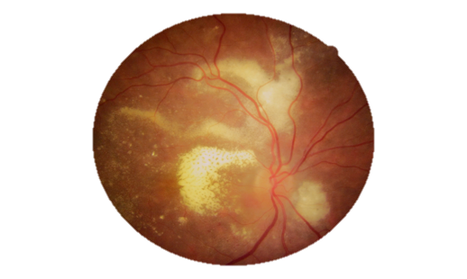
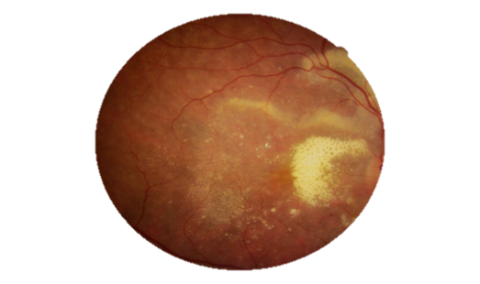
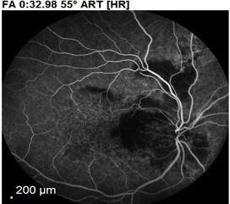
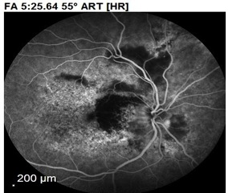

Slide 4
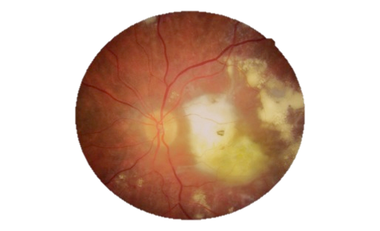
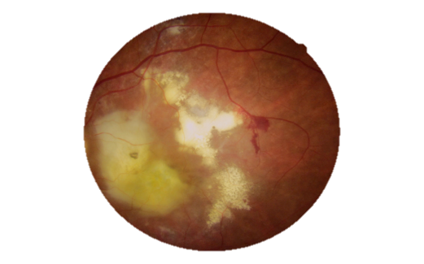
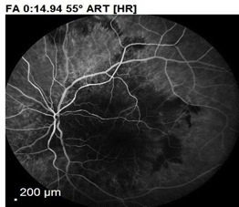
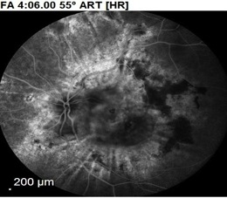

Slide 6
Complete hemogram: unremarkable
Blood glucose: 90
Creatinine: 0,98
VHS: 38
FAN: -
FR: -
HBsAg: -
Anti-HIV: -
Toxo IgG + IgM –
CMV IgG + IgM –
PPD: não reagente
VDRL: -
FTA-ABS: +

Slide 7
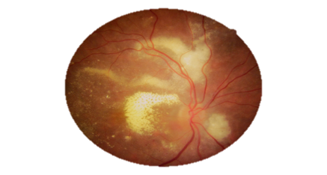
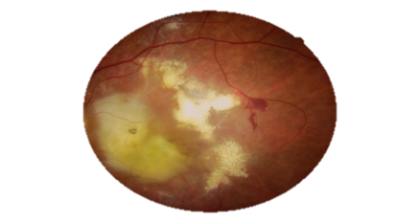
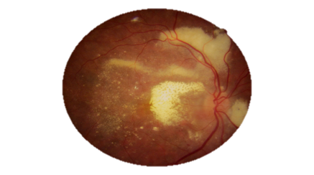
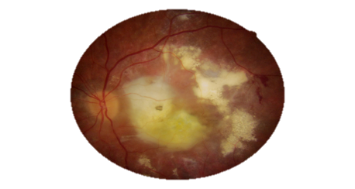
Ocular syphilis treatment -> Ceftriaxone 2g/d EV 15 d
BEFORE: 12/09/19
BEFORE: 12/09/19
BVAC: 20/100
BVAC: CD
AFTER: 24/10/19
AFTER: 24/10/19
BVAC: 20/80
BVAC: CD

Slide 8
BEFORE: 12/09/19
AFTER: 24/10/19

Slide 9
BEFORE: 12/09/19
AFTER: 24/10/19

Slide 10
Treatment to be continued with oral corticosteroid 50 mg/d, 10 mg/d reduction every 10 days and subtenon triamcinolone injection in OR…

