Slide 1
RETINA START Clinical Case CHOROIDAL NEOVASCULARIZATION DUE TO MULTIFOCAL CHOROIDITIS AND PRESUMED TUBERCULOSIS
FEDERAL UNIVERSITY OF SAO PAULO
PAULISTA SCHOOL OF MEDICINE
OPHTHALMOLOGY DEPARTMENT
RETINA AND VITREOUS CLINICS
Bruno Mauricio R de Oliveira, MD

Slide 2
ANAMNESIS
ID: Male, 60yo, caucasian, born and raised in Sao Paulo/SP.
CC: Low visual acuity in left eye of onset one year ago.
PMH: Smoker. Denied systemic and ocular diseases. Denied use of medications.
 | OD | OE | OS
BCVA | 20/50 | CD 1m | CF 1m
Slit Lamp Exam | Clear conjunctiva, clear cornea, nuclear cataract 1+, no anterior chamber reaction, no vitreous cells
IOP (mmHg) | 13 | 12
Fundus | Photos | Photos

Slide 3
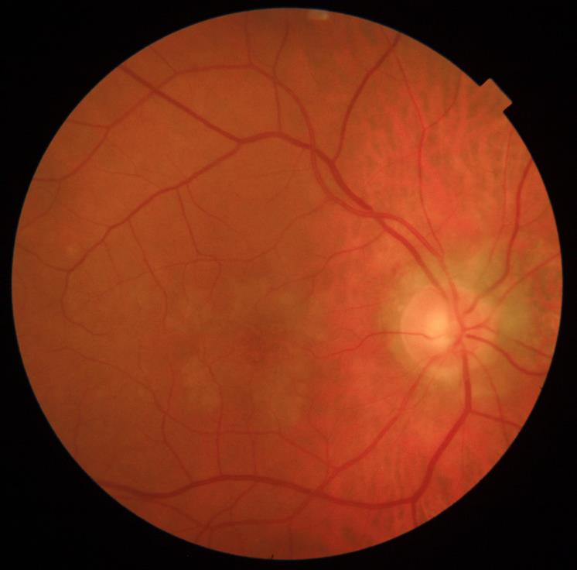
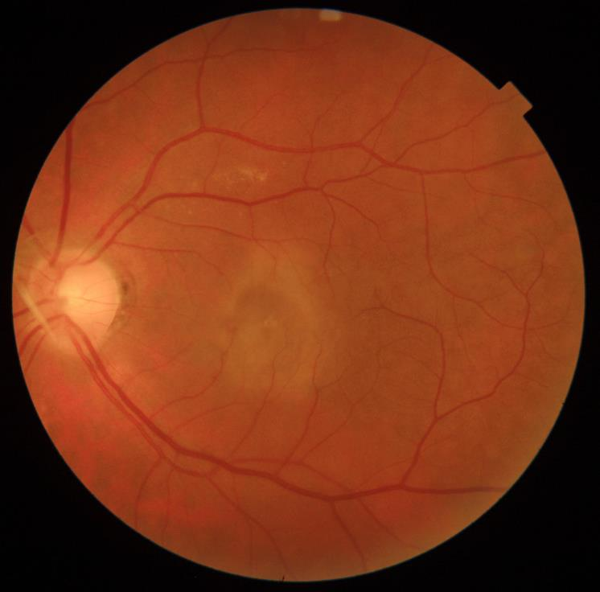

Slide 4
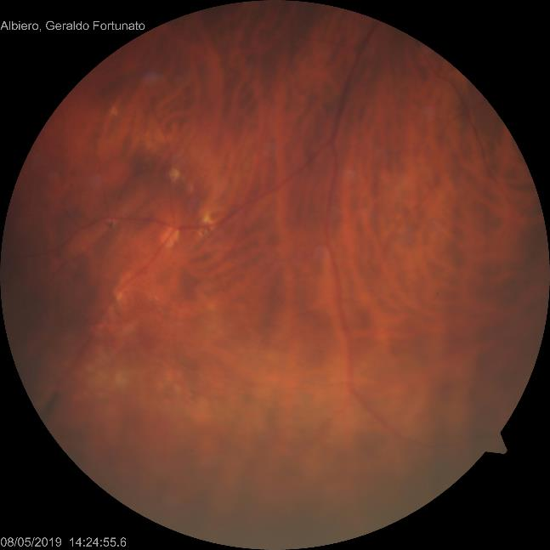
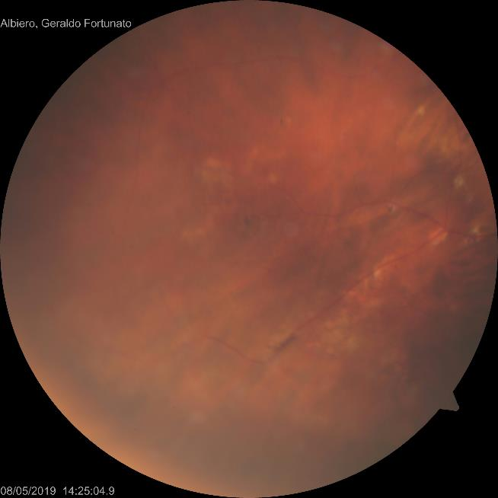
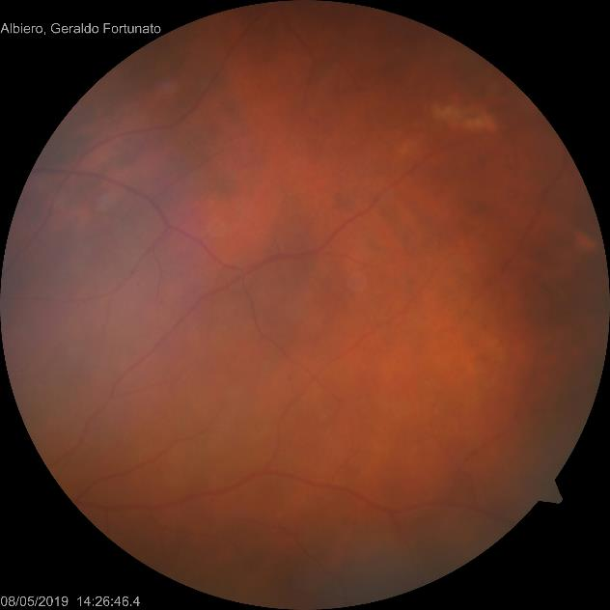

Slide 5
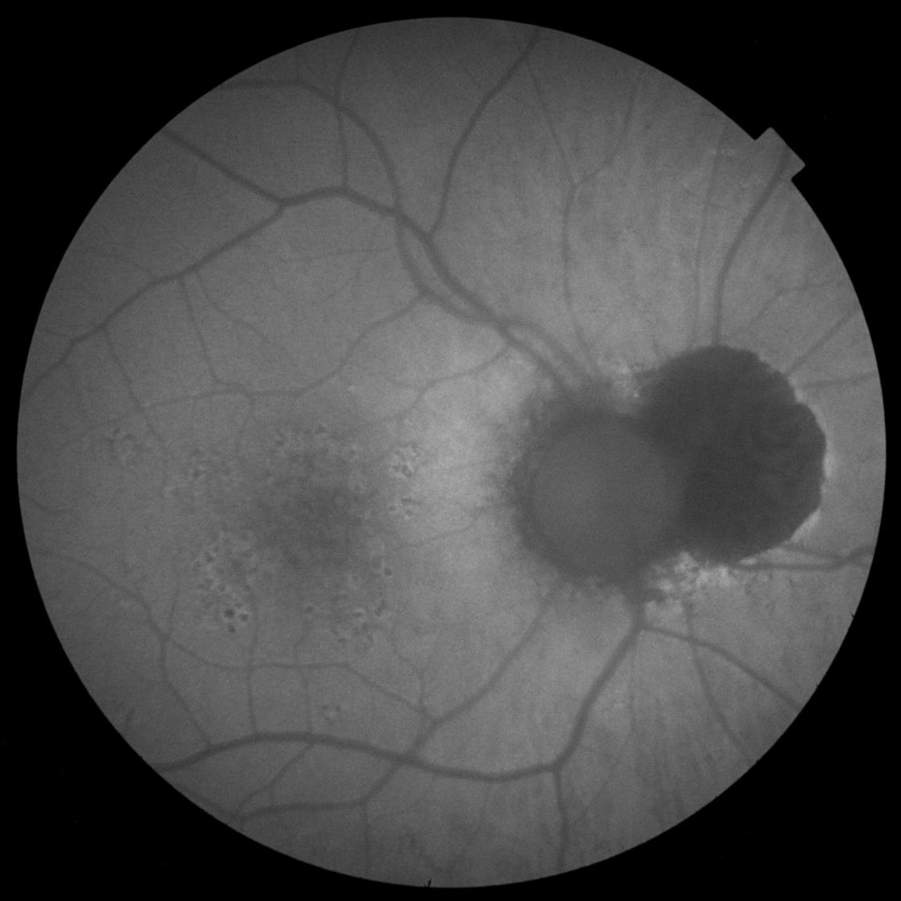

Slide 6
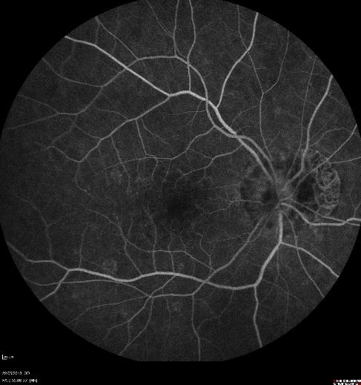
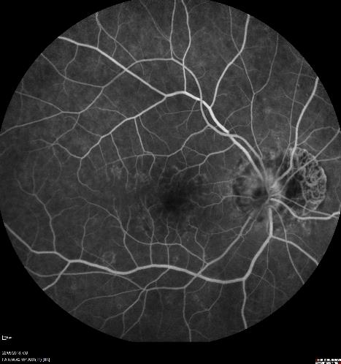
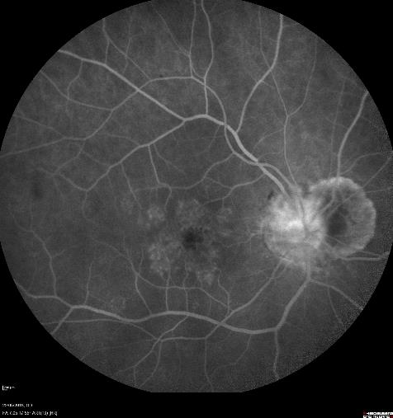
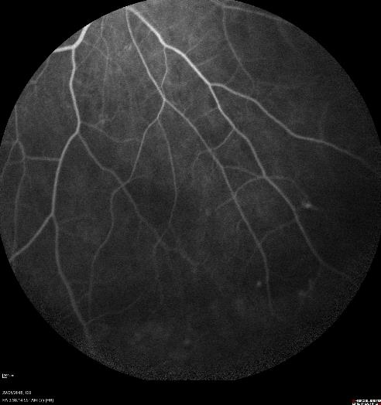
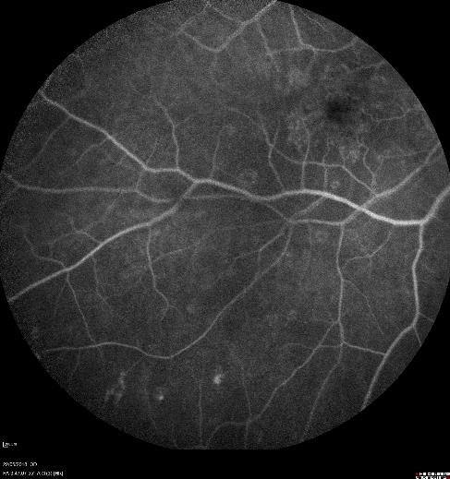

Slide 7
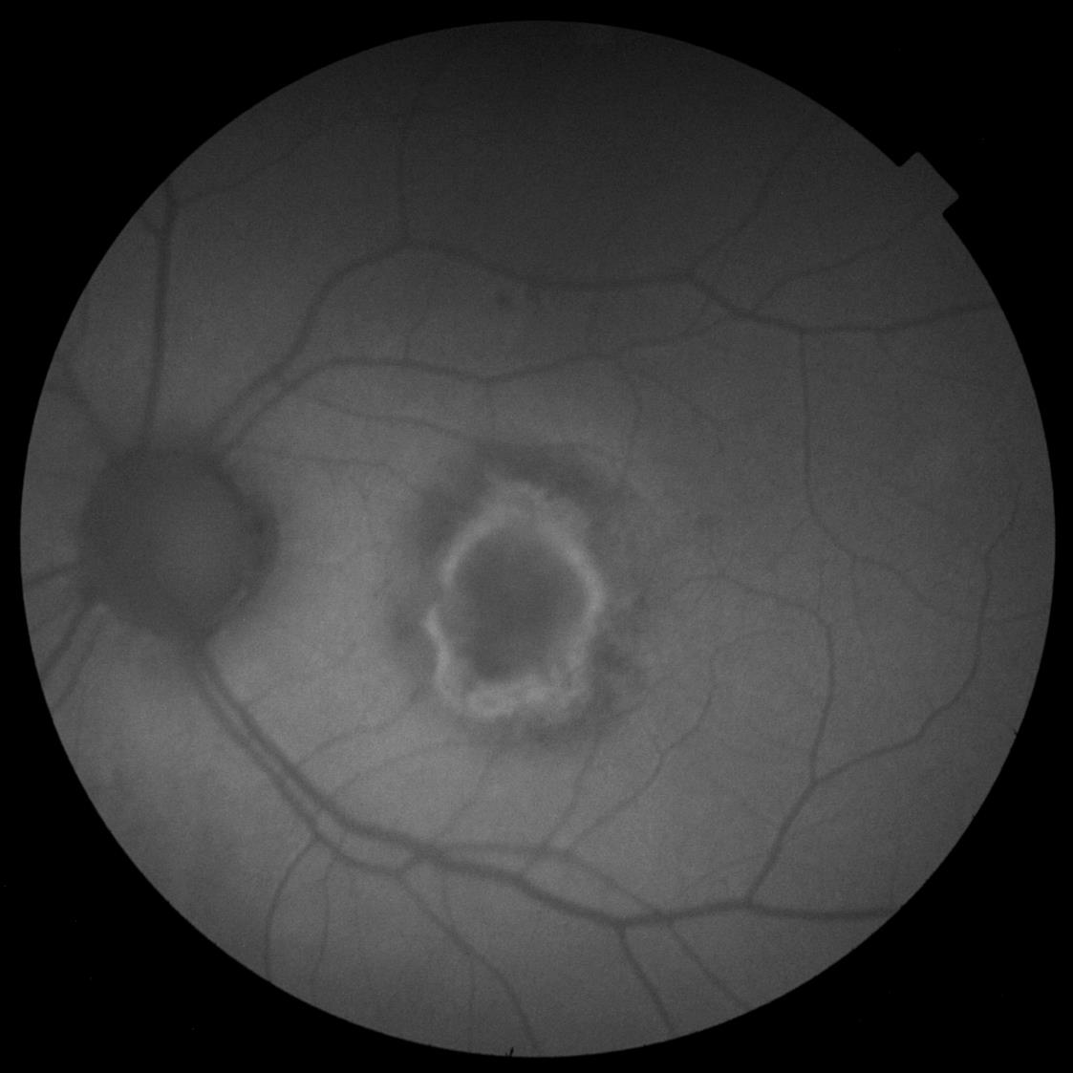

Slide 8
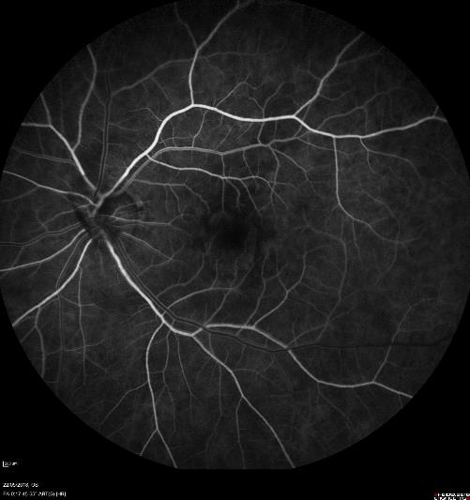
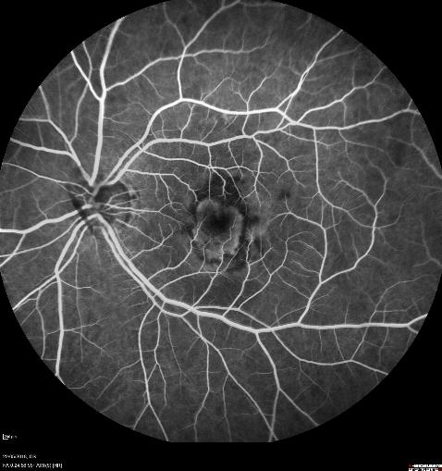
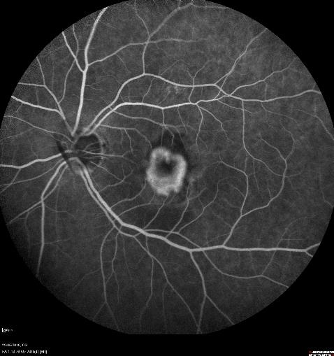
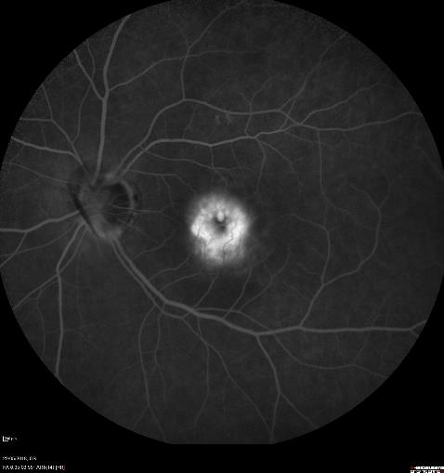
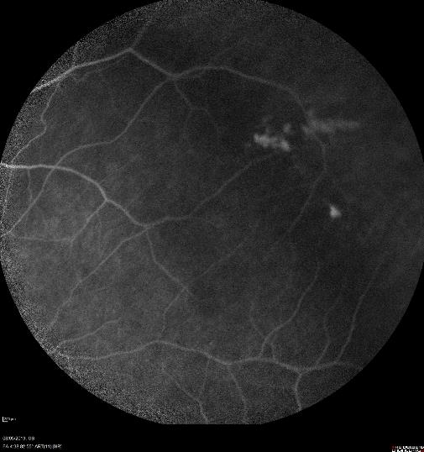

Slide 9
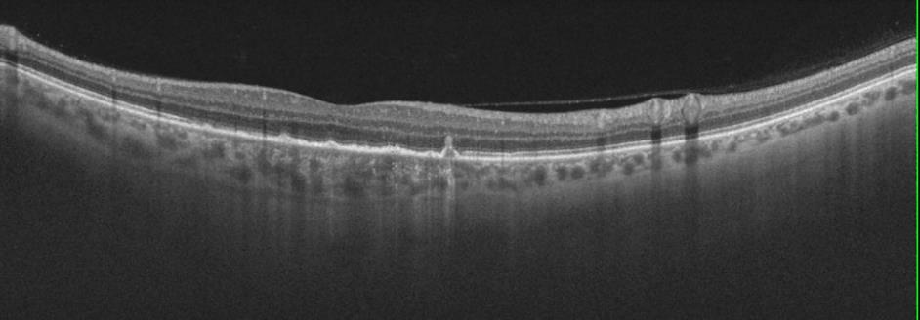
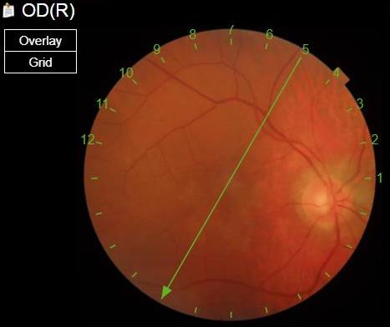
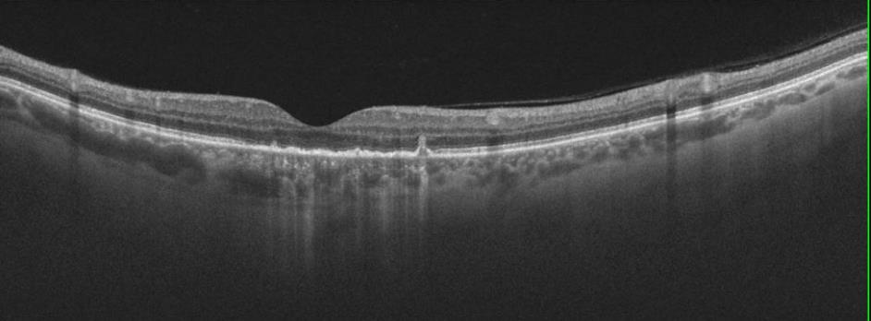
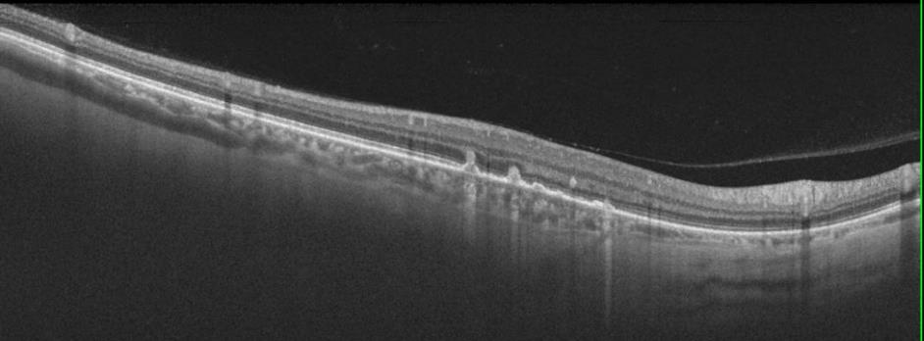

Slide 10
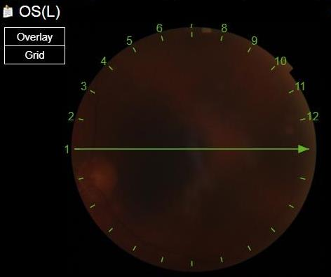

Slide 11
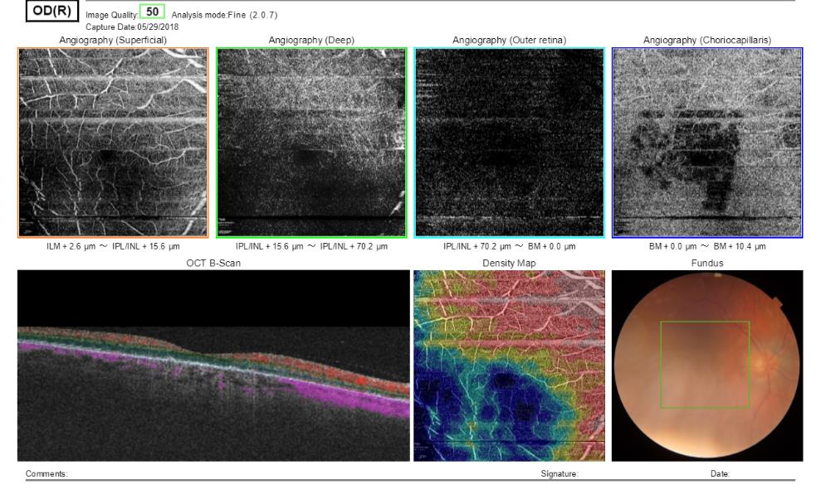
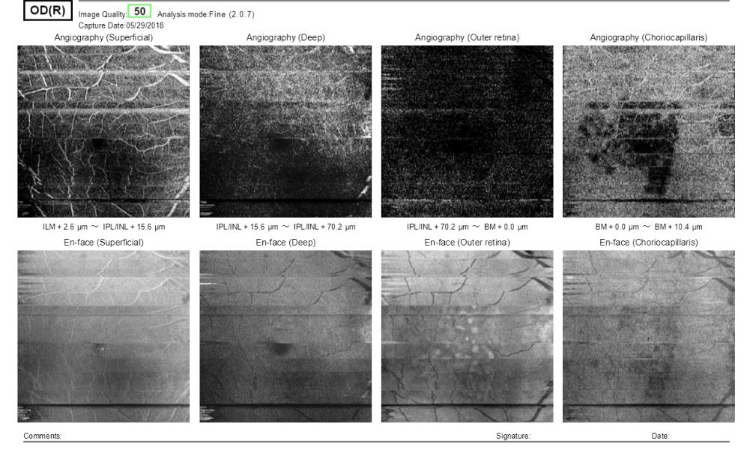

Slide 12
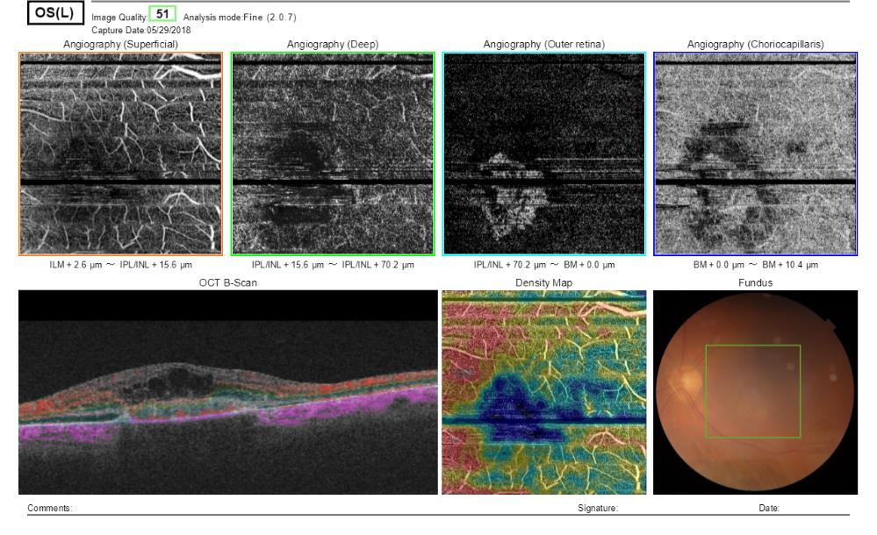
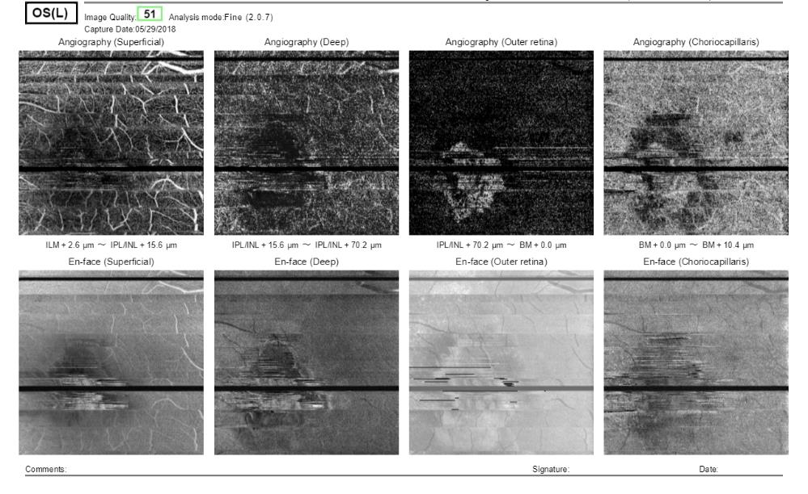

Slide 13
Diagnostic Hypothesis
Choroidal neovascularization (CNV) in left eye secondary to Multifocal Choroiditis/ Punctate Inner Choroidopathy

Slide 14
Follow-up
Bevacizumab intravitreal injection in OS
Laboratory workup
Serologies
Tuberculin test (PPD)

Slide 15
Follow-up
Patient had only one intravitreal injection in left eye and lost follow-up on our service.
After six months, patient returned reporting visual impairment in right eye.
 | OD | OS
BCVA | 20/100 | 20/400
Slit Lamp Exam | Clear conjunctiva, clear córnea, nuclear cataract 1+, no anterior chamber reaction, no vitreous cell.
IOP (mmHg) | 14 | 14
Fundus | Photos | Photos

Slide 16
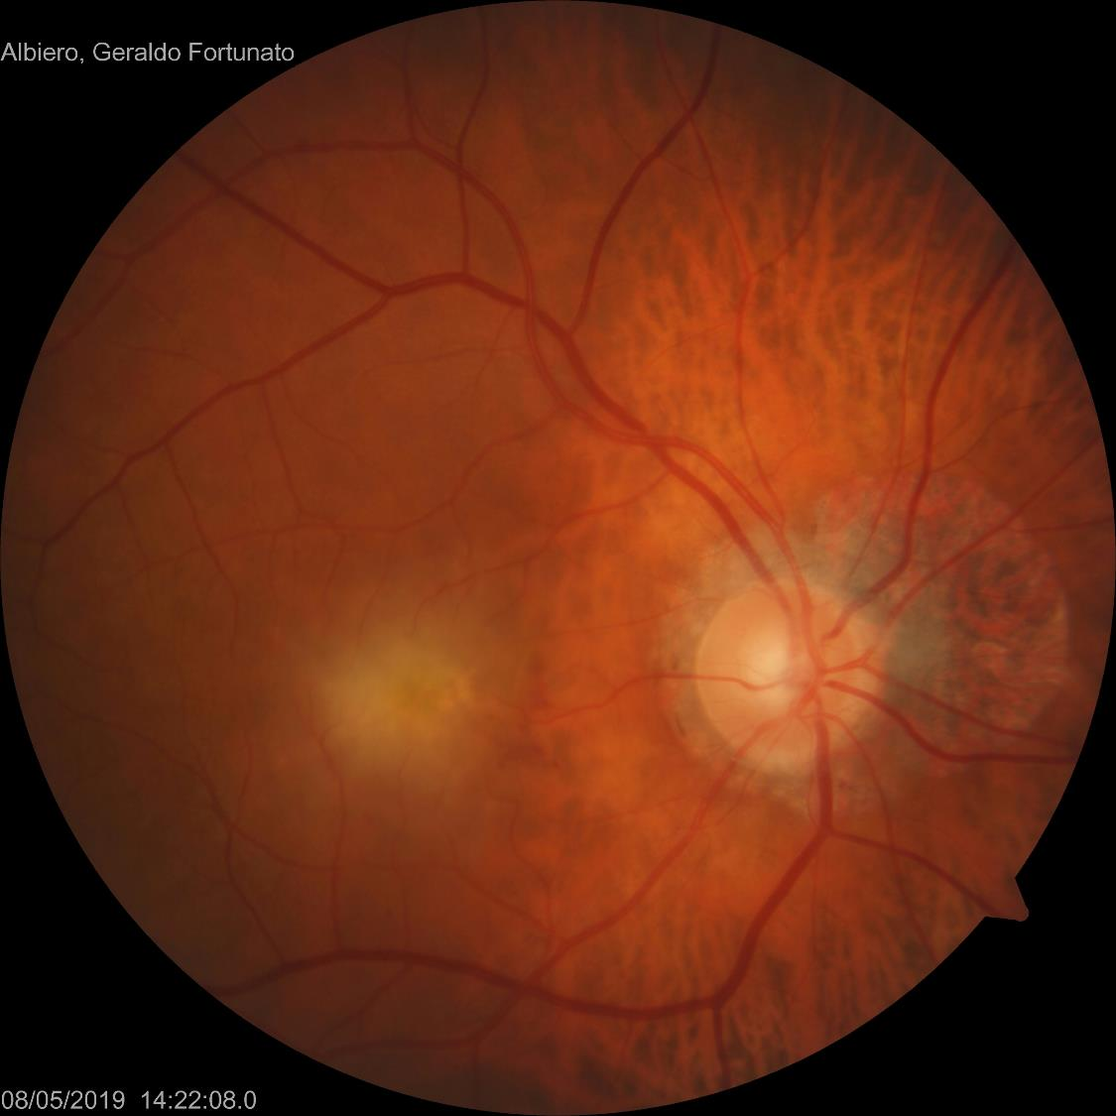

Slide 17
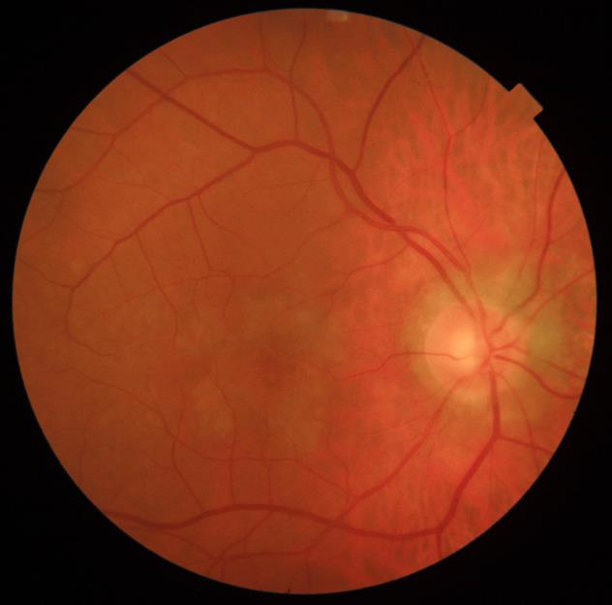
Before
After 6 months

Slide 18
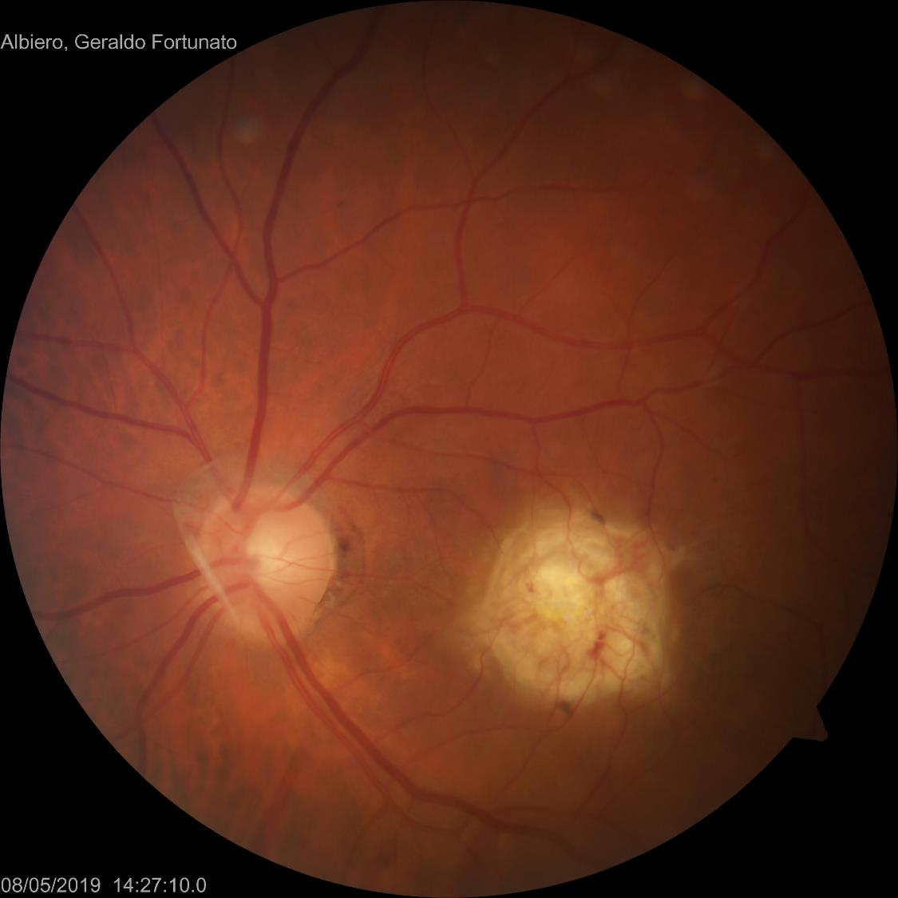

Slide 19
Before
After 6 months

Slide 20
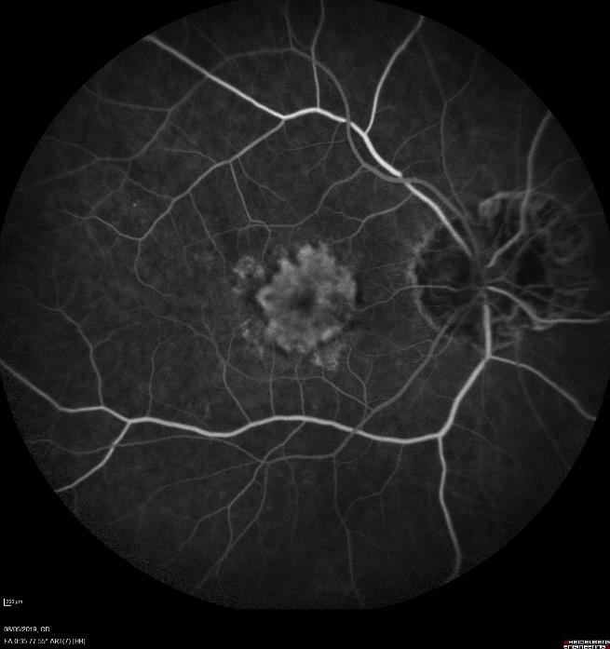
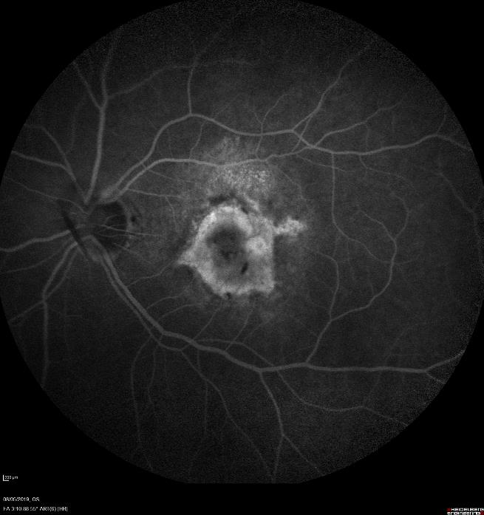

Slide 21
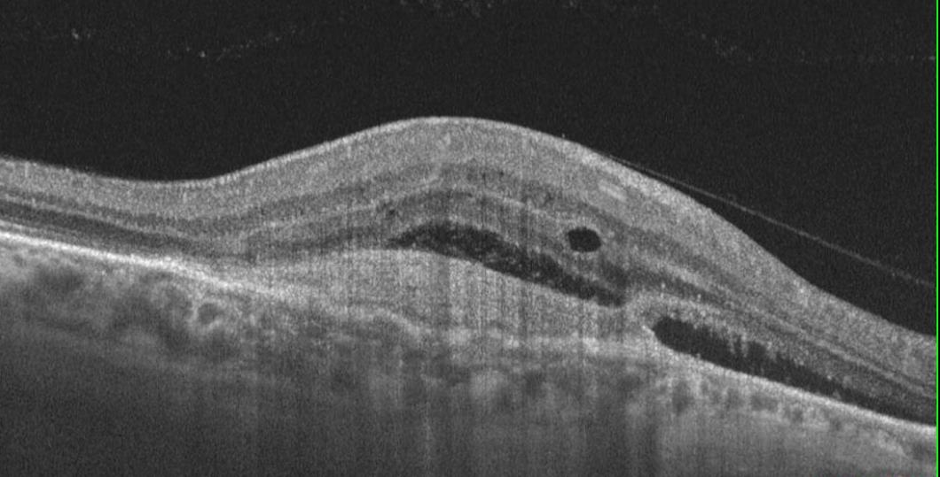
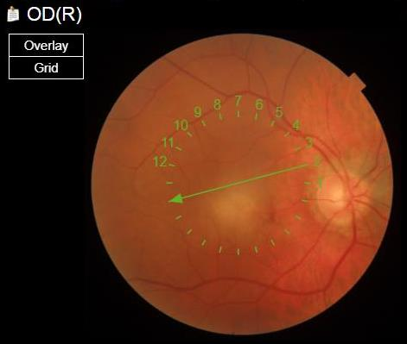
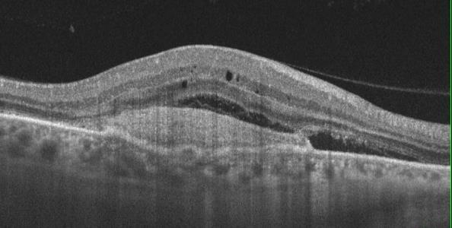
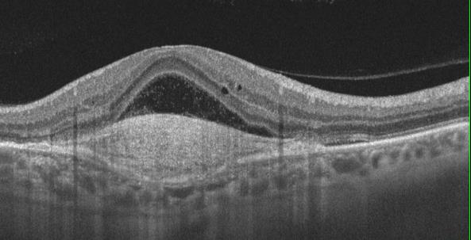
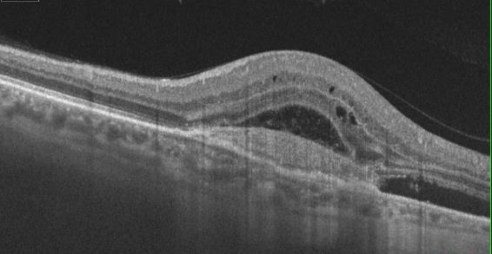

Slide 22
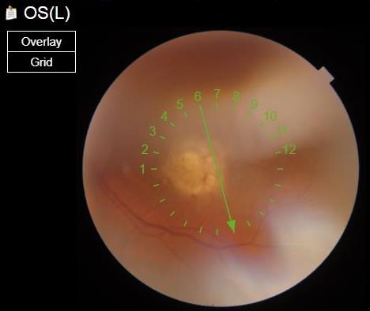
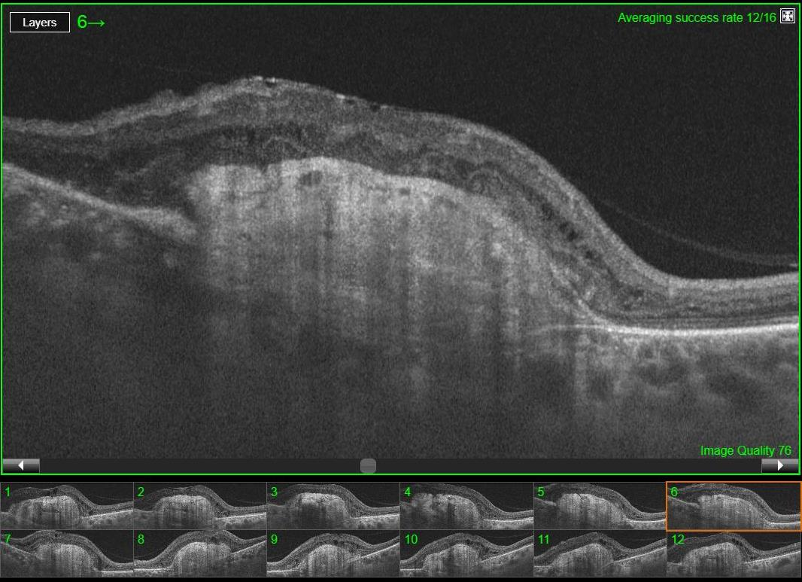

Slide 23
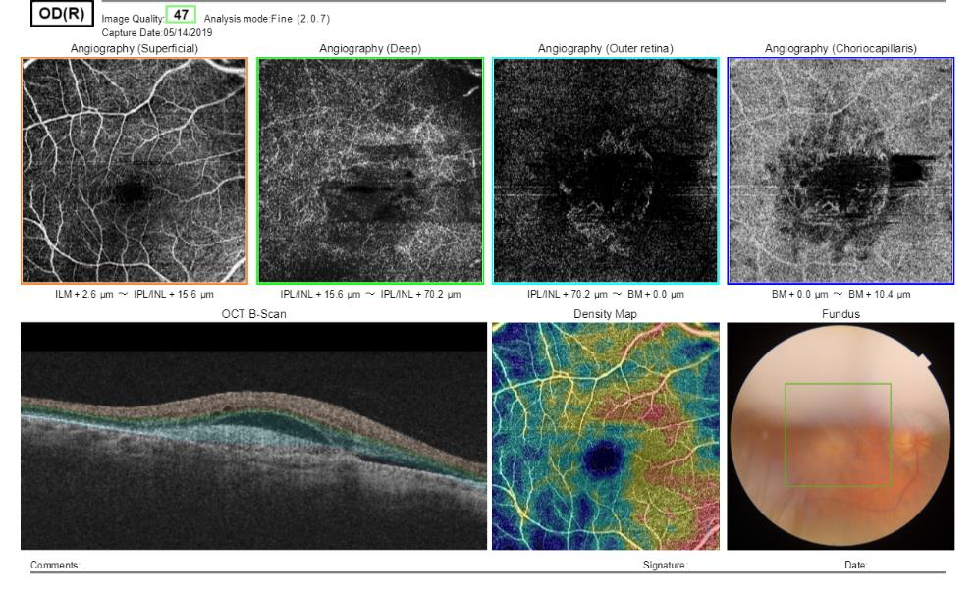
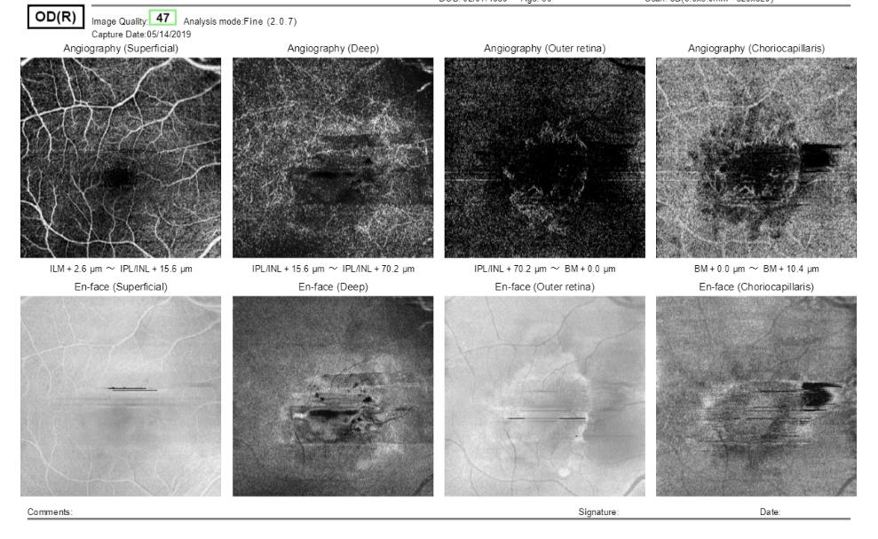

Slide 24
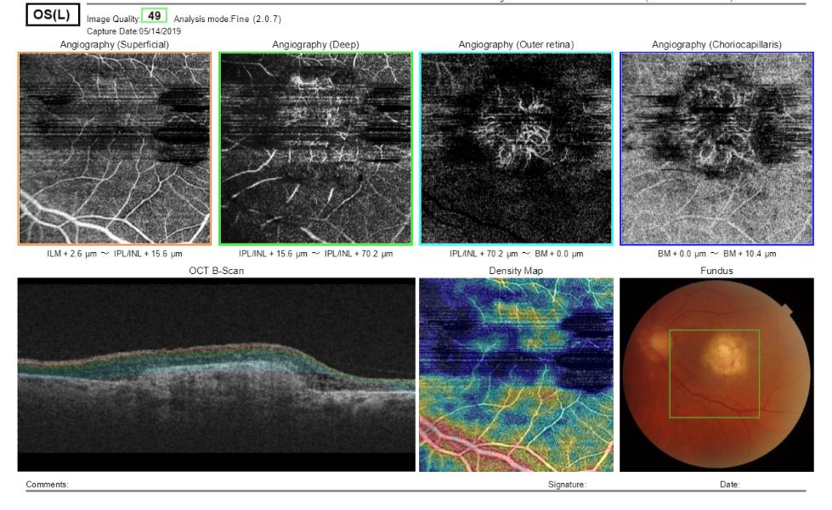
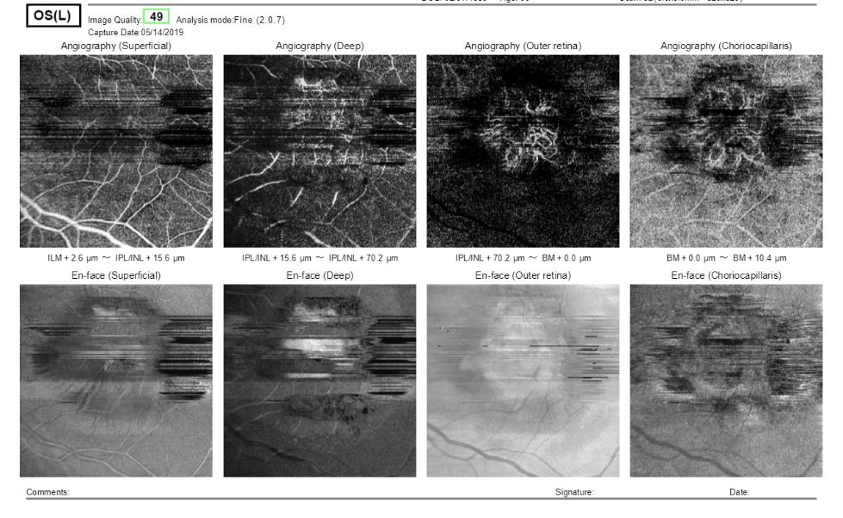

Slide 25
Follow-up
Exams:
Normal complete blood count (CBC)
Serum creatinine test and BUN: normal
VDRL negative / TPHA negative
Toxoplasmosis IgG and IgM: negative
Rheumatoid factor negative
ANA negative
ECR and CRP: normal
Tuberculin Test (PPD): 19 mm
Chest X-ray: normal

Slide 26
Follow-up
Aflibercept intravitreal injection in OD
Treatment of latent tuberculosis

Slide 27
Follow-up
After three Aflibercept intravitreal injections
AV: 20/80

