Slide 1
CLINICAL CASE
Ana Paula da Silva Maganhoto
Ophthalmologist from Sadalla Amin Ghanem Eye Hospital – Joinville/SC – Brazil
anamaganhoto@Hotmail.com

Slide 2
Case Report: Choroidal osteoma with subretinal neovascular membrane - multimodal analysis

Slide 3
Clinical Case
A 31-year-old healthy woman complaining of central scotoma in her right eye (RE) two day ago.
BCVA: right eye: 20/25 / left eye: 20/20
Biomicroscopy: normal.

Slide 4
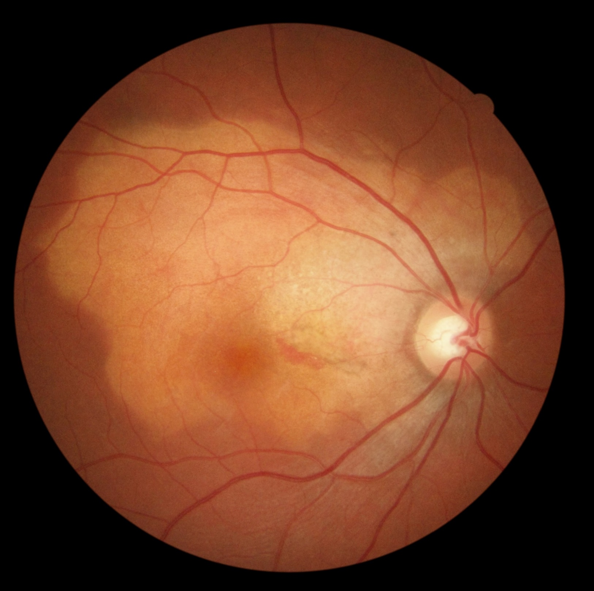
Notes:
Indirect fundus ophthalmoscopy revealed a subretinal whitish lesion in macular arear, with subretinal hemorrhage in papilomacular bundle in RE.

Slide 5
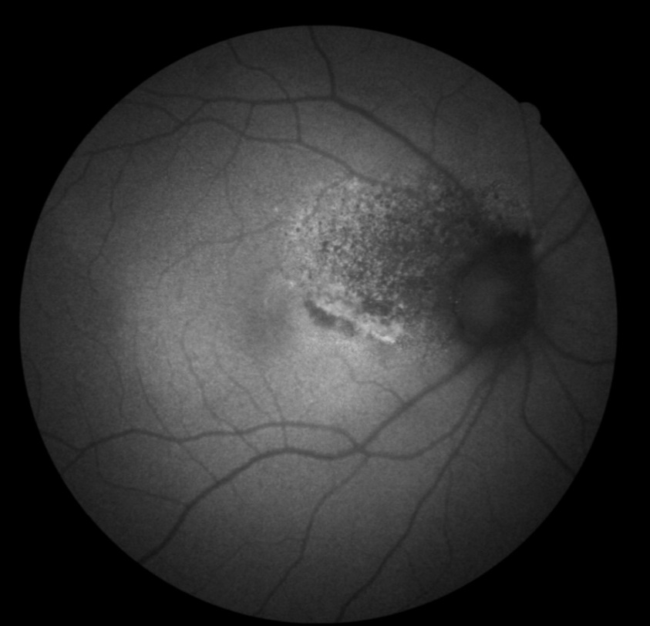
Choroidal Osteoma
Notes:
FAF with hipo and hyperautofluorescence

Slide 6
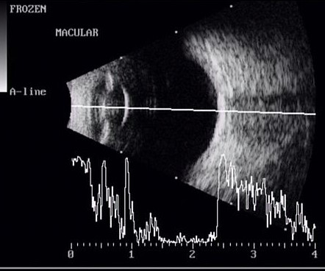
Notes:
The ultrasonography of RE showed a lesion with increased reflectivity and echogenicity, suggesting calcium deposition.

Slide 7
Notes:
The OCT revealed choroid with sponge bone like appearance, choroidal excavation, outer retina tubulation and subretinal elevation, suggesting choroidal neovascular membrane, confirmed by OCT angiography (OCT-A). The diagnosis of choroidal osteoma was made and the patient followed up. There were signs of subretinal fluid during the attendance, with indication of intravitreal treatment with anti-VEGF (bevacizumab). After one injection, the patient remained stable after three months of follow-up. The last OCT showed absent subretinal fluid.
Conclusion: choroidal osteoma is a benign tumor, with typical findings on complementary exams and that may evolve with choroidal neovascularization, causing reduced visual acuity. Attention should be paid to this complication because anti-VEGF treatment can ensure satisfactory visual acuity.

Slide 8
Notes:
The diagnosis of choroidal osteoma was made and the patient followed up. There were signs of subretinal fluid during the attendance, with indication of intravitreal treatment with anti-VEGF (bevacizumab). After one injection, the patient remained stable after three months of follow-up. The last OCT showed absent subretinal fluid.

Slide 9
Notes:
There were signs of subretinal fluid during the attendance, with indication of intravitreal treatment with anti-VEGF (bevacizumab). After one injection, the patient remained stable after three months of follow-up. The last OCT showed absent subretinal fluid.

Slide 10
Intravitreal treatment with anti-VEGF (bevacizumab)
Notes:
There were signs of subretinal fluid during the attendance, with indication of intravitreal treatment with anti-VEGF (bevacizumab). After one injection, the patient remained stable after three months of follow-up. The last OCT showed absent subretinal fluid.

Slide 11
Notes:
After one injection, the patient remained stable after three months of follow-up. The last OCT showed absent subretinal fluid.

Slide 12
Take home messages
Choroidal osteoma is a benign tumor, with typical findings on complementary exams.
Choroidal neovascularization may ensue→ reduced visual acuity.
Physicians should be aware of this complication because anti-VEGF treatment can provide maintenance of visual acuity.
Notes:
Este relato mostra um caso típico de OC, com análise multimodal bem ilustrativa das alterações encontradas neste tipo incomum de tumor. Mesmo apresentando benignidade, o OC pode evoluir com formação de NVC, cursando com redução da acuidade visual. Deve-se ter atenção para esta complicação, pois o tratamento com injeções de anti-VEGF pode garantir uma acuidade visual final satisfatória

