Slide 1
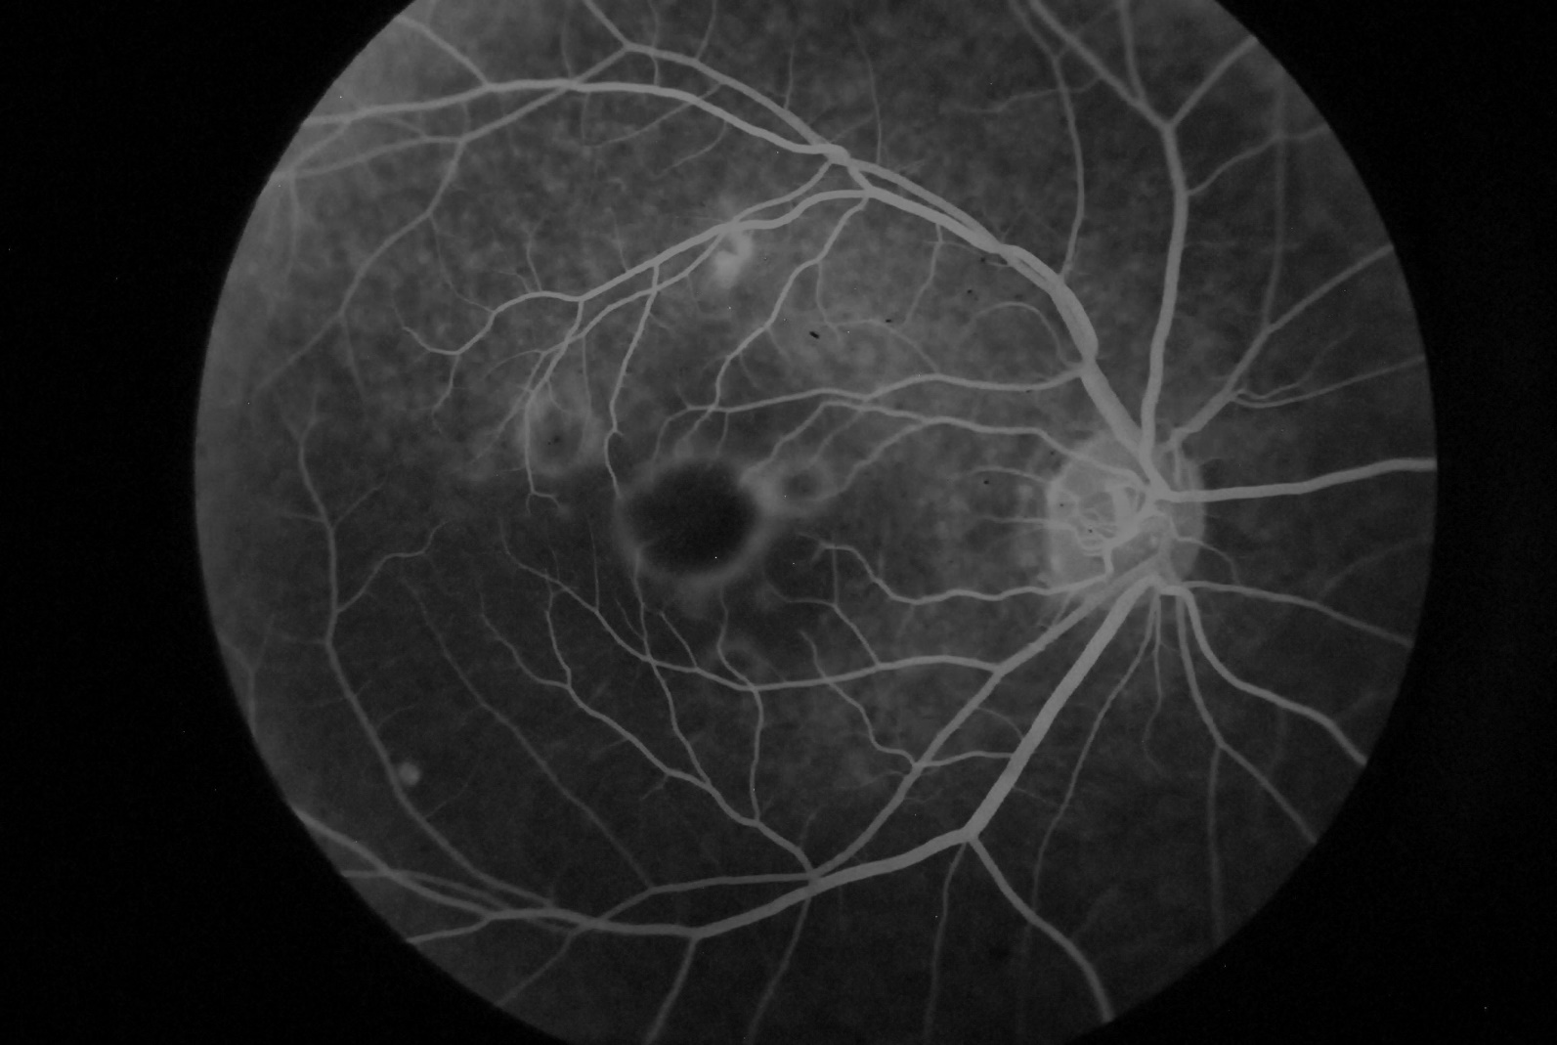
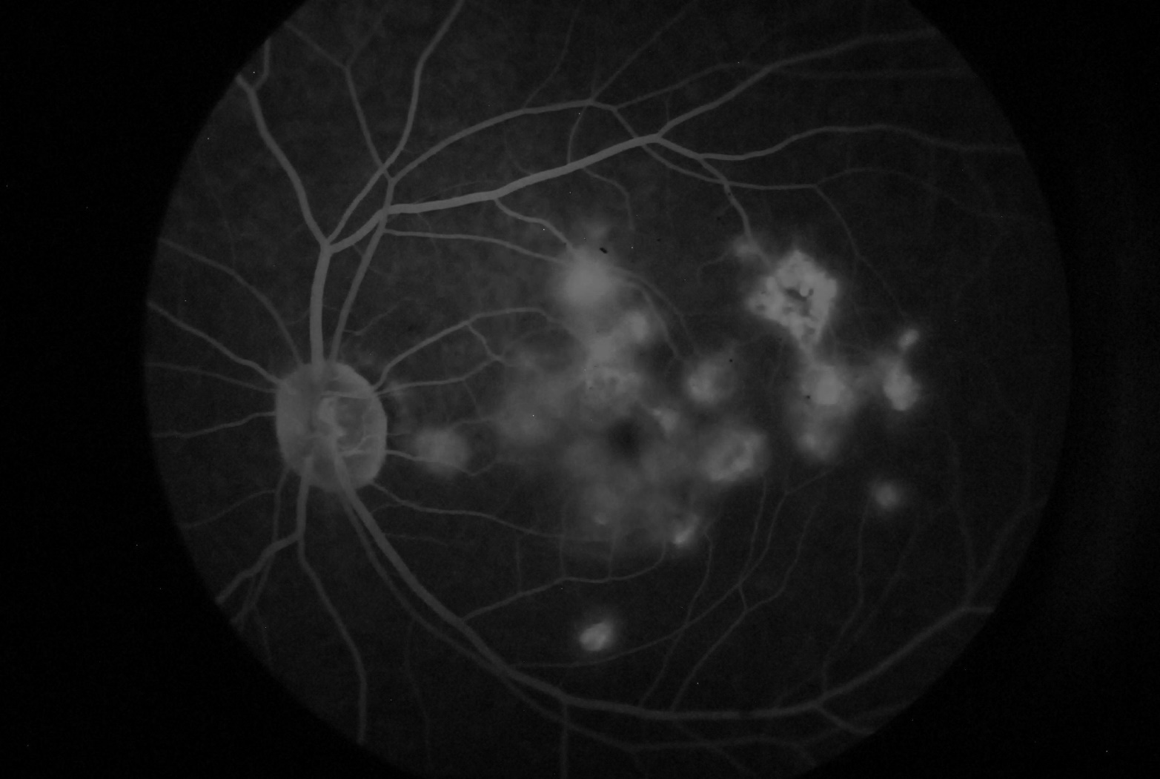
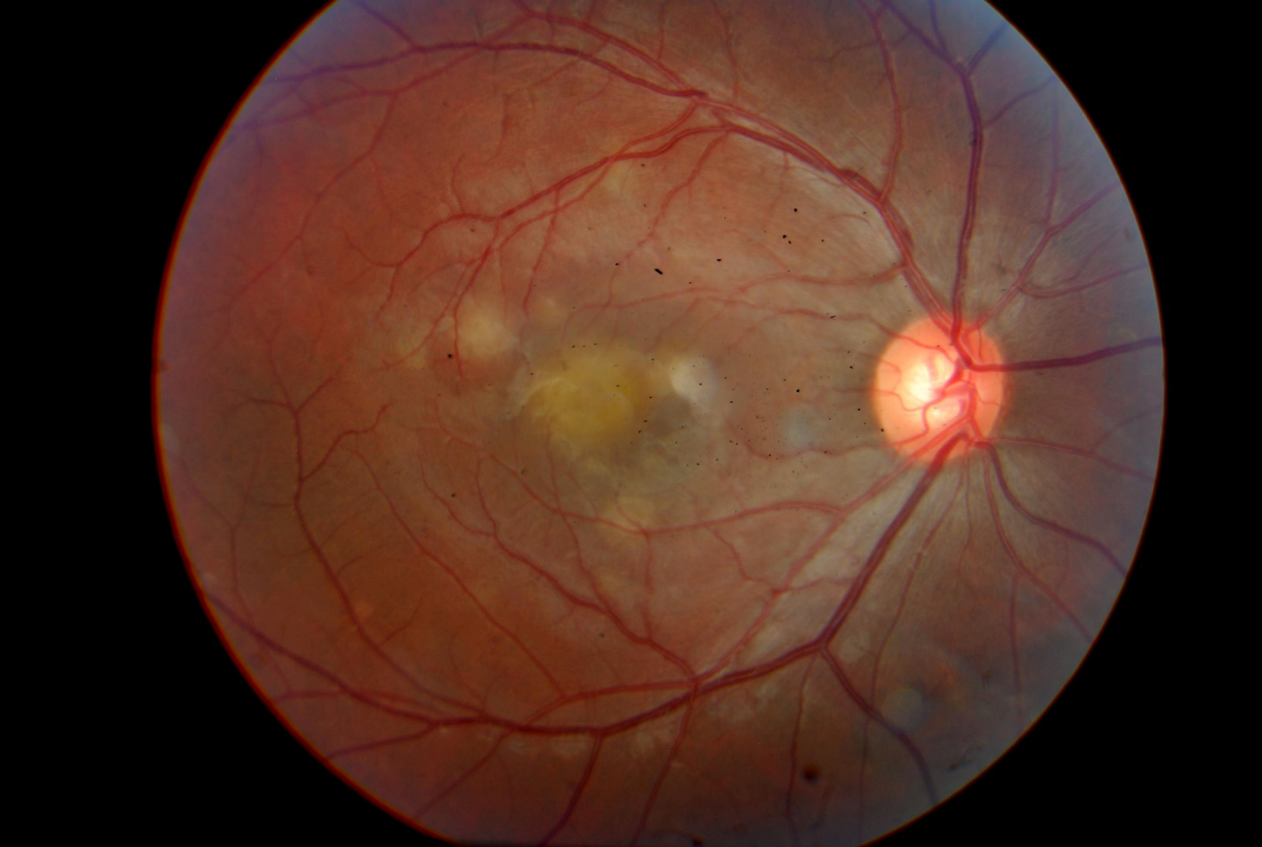
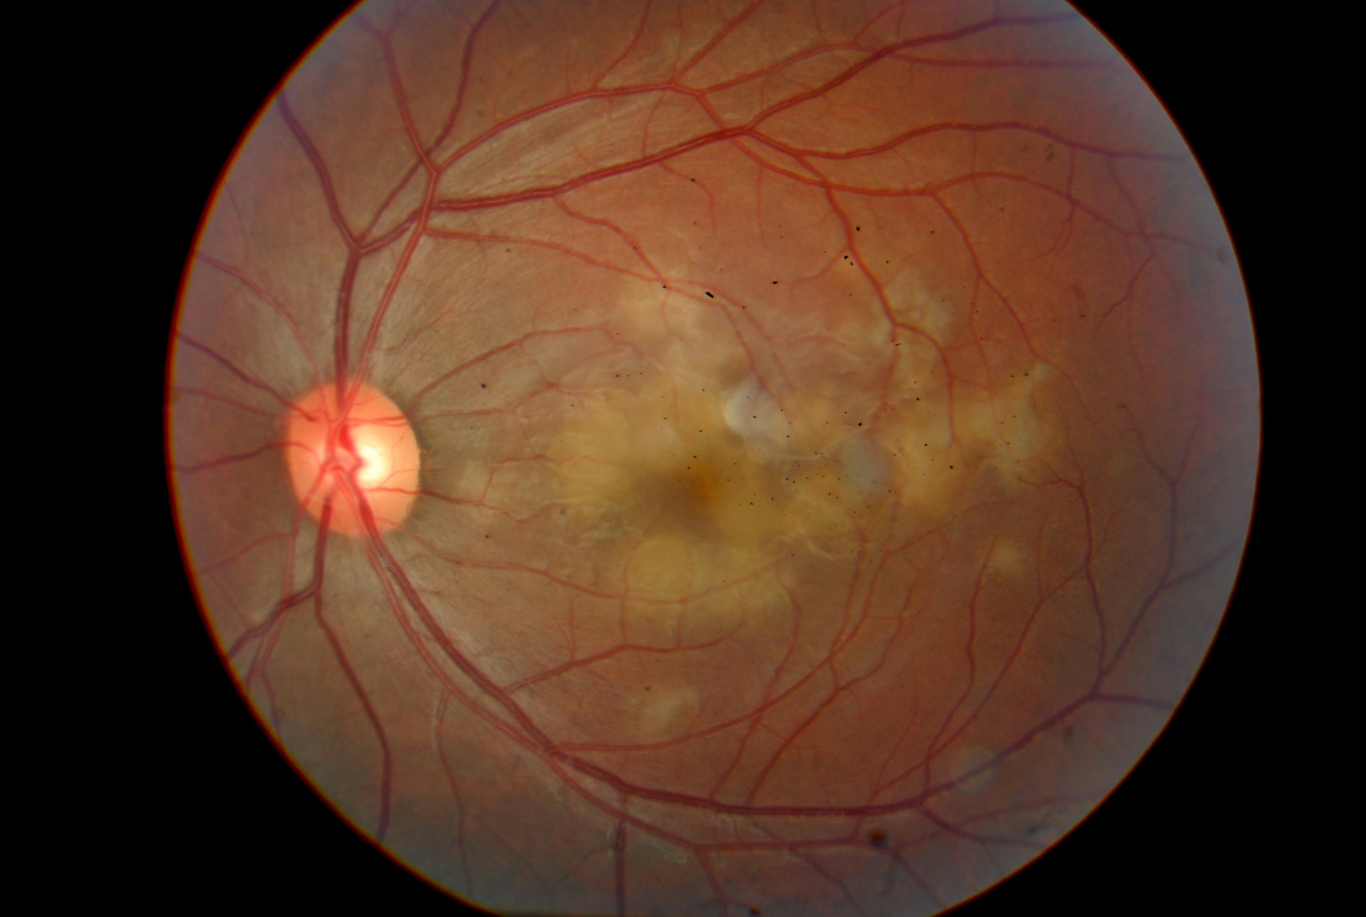
ACUTE POSTERIOR MULTIFOCAL
PLACOID PIGMENT EPITHELIOPATHY (APMPPE):
CASE REPORT.
FALCÃO, V.C.²; OGLIARI, L.F.C.¹ ; FILHO,V.M.A,¹; CARVALHO, T.A²; FIGUEIREDO, T.C.S.²; TOCHETO, B.B.^{²;}FEDERICI, F.B.N.³; COSTA, M.A.N³
¹ Resident of Ophthalmology – Dr. João Penido Burnier Foundation
² Retina and Vitreous Fellowship – Dr. João Penido Burnier Foundation
³ Heads of the Retina and Vitreous sector – Dr. João Penido Burnier Foundation
PURPOSE
The APMPPE is a syndrome characterized by the appearance of multiple creamy-white plaque-shaped lesions located on the RPE. This entity generally affects young men and women, previously healthy, between the second and third decades of life. In most cases, the disease is bilateral and can affect the second eye in a few days. Patients experience rapid visual loss and may be accompanied by symptoms such as metamorphopsia, photopsy and paracentral scotomas
CASE REPORT
D. A. S., male, caucasian, 22 years old, born and living in Campinas - SP, seeks eye care for complaints of visual haze in both eyes for 3 days. Reports a history of flu-like symptoms for 7 days. Previously healthy. No ophtalmological or family history of note. At the initial examination, he presented visual acuity in Right Eye (OD) 20/40q and Left Eye (OS) 20/60q (whitout correction) . The biomicroscopy of both eyes was normal. Fundoscopy of both eyes presented a pinkish optic disc of normal dimensions, unaltered vessels, change in macular brightness with yellowish-white spots at the posterior pole, without vitreitis and applied retina. Retinography (Photo 1 and 2), Angiography (Photo 3 and 4) and macula OCT were requested, as well as laboratory tests and sorologies. Based on these informations, some diagnostic hypotheses were suggested, such as MEWDS, Arbovirus and Pigmental Placoid Multifocal Acute Posterior Epitheliopathy (APMPPE).
Patient returns after 7 days with negative serologies results for arboviruses such as Dengue, Chikungunya, Zika and Yellow Fever. Negative tests for HIV 1 and 2, Syphilis, Hepatitis B and C, Bartonella, Tuberculosis, Toxoplasmosis and rheumatological sorology. At this point, it was decided to start Prednisone 40mg/day orally and a new return in 15 days. The patient returns, reporting improvement in visual symptoms, with VA in both eyes 20/25 (without correction). At this moment, the retinography was repeated and showed a decrease in the yellowish-white lesions in the posterior pole. After performing imaging and laboratory tests, the diagnostic hypotheses of Acute Posterior Multifocal Placoid Epitheliopathy (APMPPE) was decided.
DISCUSSION
The clinical finding that characterizes this pathology is the presence of multiple yellowish-white placoid lesions in the RPE, especially located in the Posterior Pole. Even a third of patients develop flu-like symptoms before visual manifestations. The size of the lesions is variable, but in most cases it does not reach an optical disk diameter. Mild vitreitis, retinal vasculitis, papillitis, exudative retinal detachement, hemorrhage and retinal neovascularization may be associated eye findings.
Active lesions begin to resolve a few days after appearance of the first eye symptoms, giving rise to areas of atrophy and hyperpigmentation of the RPE.
The visual prognosis of patients affected by APMPPE is usually good, but changes such as scotomas and permanent low vision may occur. It is important the accurate diagnosis of this pathology by means of imaging and laboratory tests, in order to differentiate it from another diseases that present themselves in a similar way initially, thus not delaying its treatment and monitoring.
BIBLIOGRAPHY
1- Gass JDM. Acute Posterior Multifocal Placoid Pigment Epitheliopathy. Arch Ophthalmol. 1968;80(2):177–185. doi:10.1001/archopht.1968.00980050179005
2- Fiore T, Iaccheri B, Androudi S, Papadaki TG, Anzaar F, Brazitikos P, D'Amico DJ, Foster CS (2009) Acute posterior multifocal placoid pigment epitheliopathy: outcome and visual prognosis. Retina 29:994–1001
3- Yanuzzi, L.A. et al, Atlas de Retina, 2 edição, Elsevier,; 2019
Photo 3: Angiography of the Right Eye
Photo 4: Angiography of the left Eye
Photo 1: Retinography of the right eye
Photo 2: Retinography of
the left eye

