Slide 1
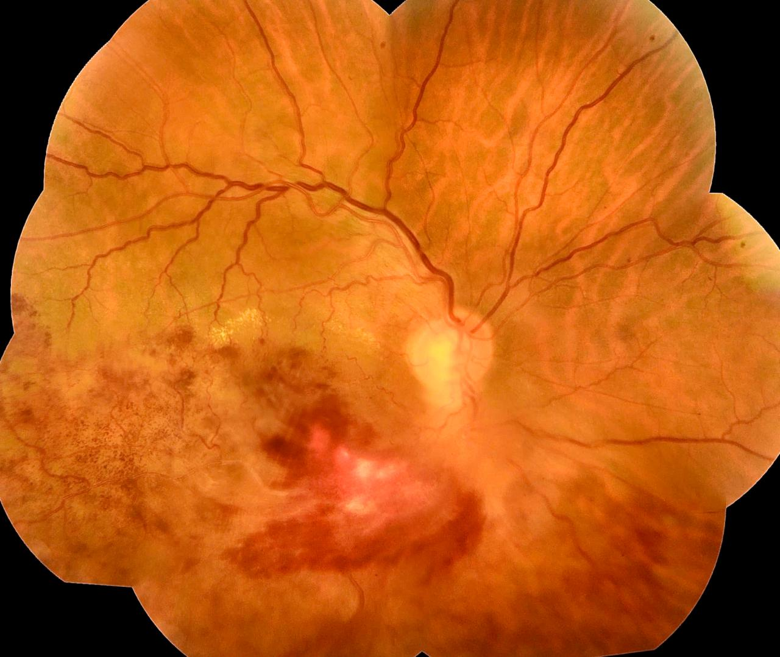
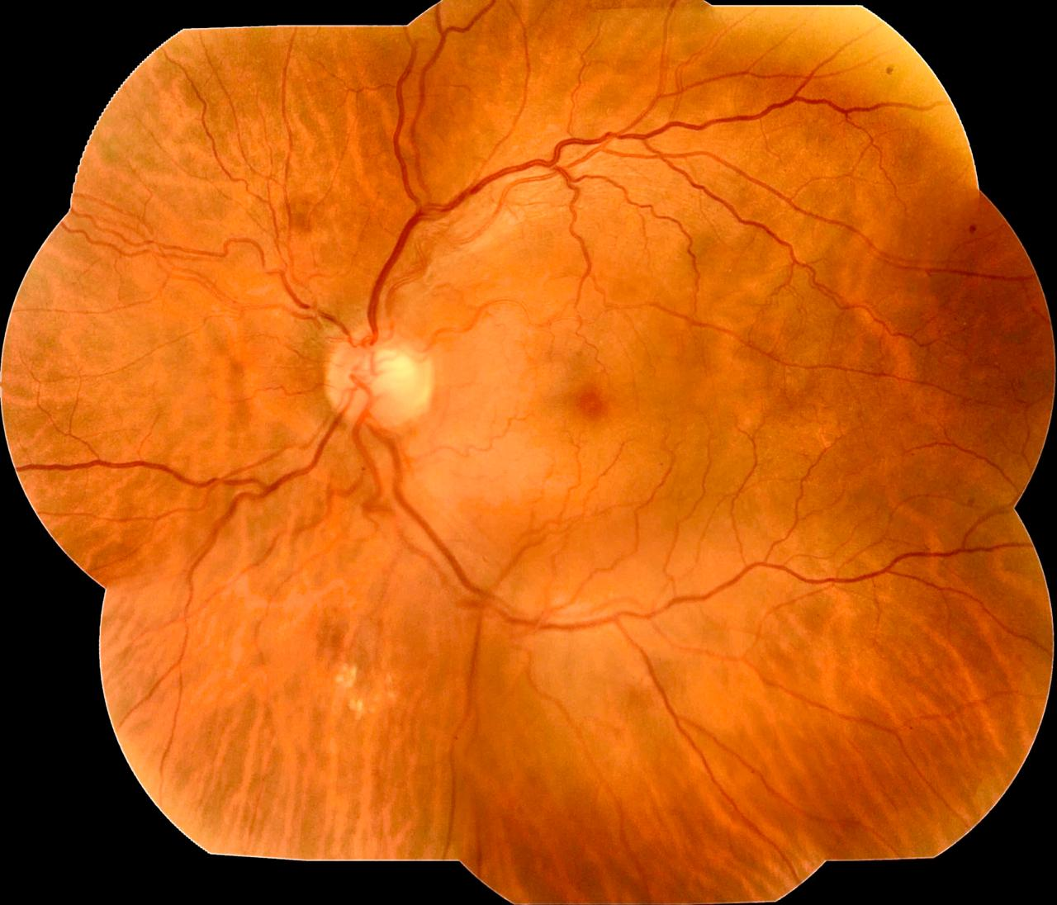
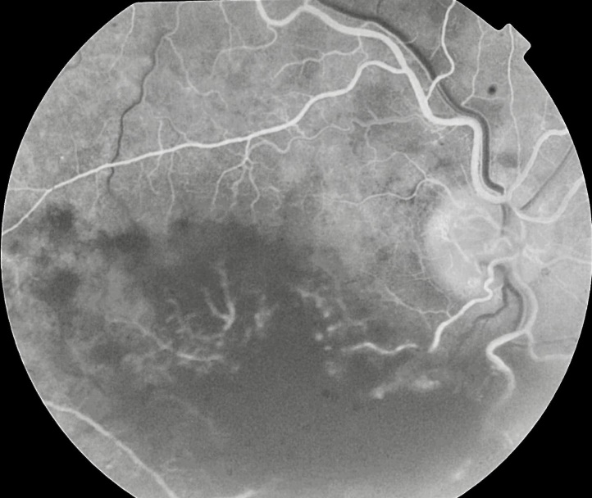
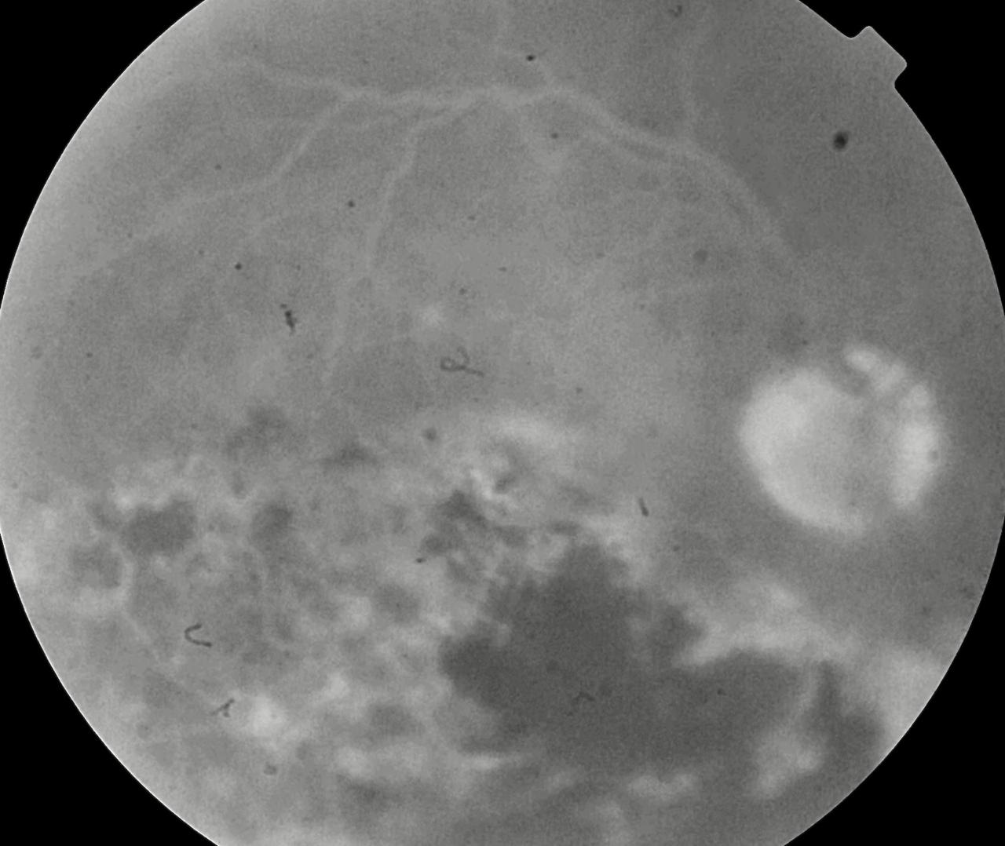
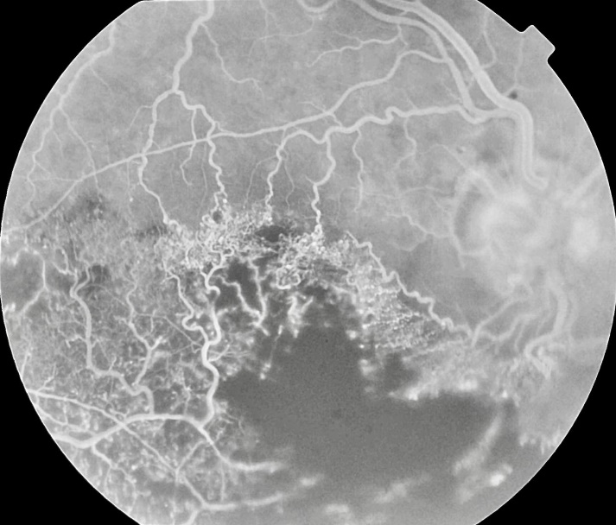
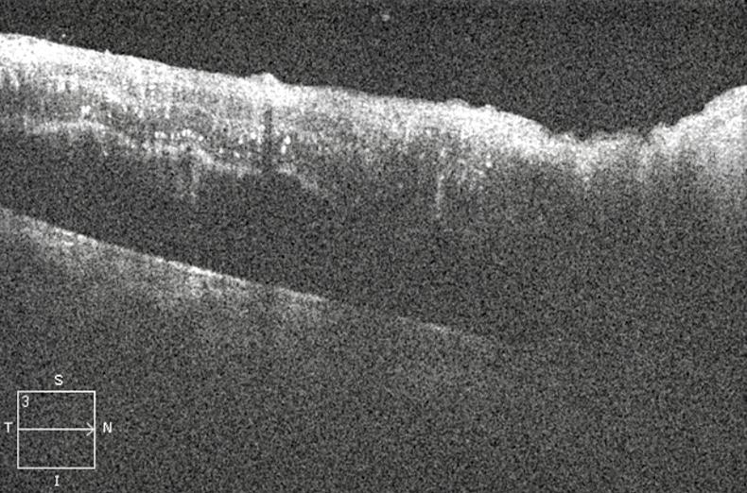
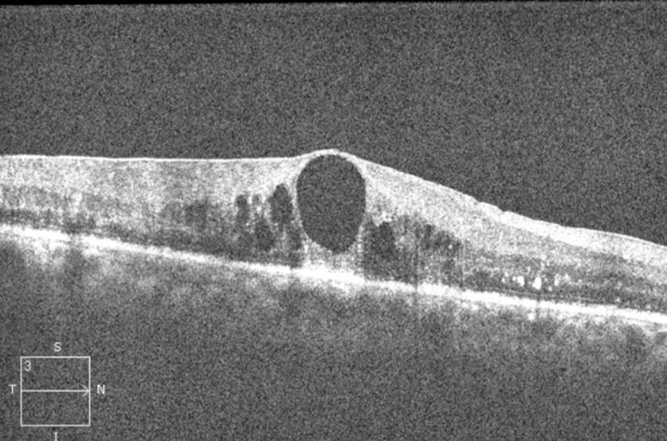
Hemi-retinal Vein Occlusion: A Case Report.
Nathália Nishiyama Tondelli ¹, Rafael Garcia², Paulo Henrique Horizonte², Henrique Leber², Luciano Fuzzato Filho², Fernanda Salata Antunes³, Gabriella Marranghello Mingione¹, Mariana da Rocha Martini³, André Marcelo Vieira Gomes
⁽¹⁾ First year resident of Instituto Suel Abujamra; ⁽²⁾ First year Retina and Vitreous fellowship student of Insituto Suel Abujamra; ⁽³⁾ Second year resident of Instituto Suel Abujamra; ⁽⁴⁾ Chief of Retina and Vitreous Fellowship program of Instituto Suel Abujamra.
PURPOSE
Fundoscopy revealed retinal hemorrhages throughout the inferior retinal hemisphere of the right eye. Fluorescence angiography showed extensive areas of vascular non-perfusion in the inferior retinal quadrants. The spectral domain OCT demonstrated a cystoid macular edema in the left eye. His IOP was normal in both eyes. Anterior segment examination was bilaterally unremarkable. The patient is being currently treated with intravitreal anti-VEGF therapy, with gradual improvement of vision.
To describe a case of hemi-retinal central vein occlusion.
INTRODUCTION
Retinal vein occlusions are divided according to the location of the occlusive event. They can be classified as branch retinal vein occlusion, hemi-retinal vein occlusion (HRVO) and central retinal vein occlusion (CRVO). Visual loss is usually due to macular edema and retinal ischemia. Risk factors include diabetes mellitus, hypertension, hyperlipidemia, glaucoma and smoking. It is known that HRVO is clinically related to CRVO. The underlying pathophysiology is a congenital anatomic variation: a two-trunked central retinal vein in the anterior part of the optic nerve. As in the CRVO, an occlusion of one of these trunks can occur, causing a HRVO.
Fig. 1 and 2: retinography of the both eyes.
DISCUSSION
HRVO has a clinical evolution, prognosis and therapy comparable to OVCR. Thus, complications such as macular edema and neovascular glaucoma should be promptly addressed. Follow-up is dependent on the clinical picture. In the current era of anti-VEGF injections, monthly follow-up is needed with OCT for monitoring treatment response and planning therapy. Intravitreal steroids may be considered in some cases. If neovascularization develops, retinal pan-photocoagulation must be performed.
METHODS
Medical record review.
Fig 3, 4 and 5: Fluorescence angiography of the right eye.
BIBLIOGRAPHY
RESULTS
1- Basic and Clinical Science Course 2016-2017 American Academy of Ophthalmology.
2 - Agarwal, P, et al. A rare case having hemi-retinal artery occlusion in one eye and hemi-retinal vein occlusion in the other: Diverse manifestations of retinal vascular occlusion. Indian J Ophthalmol. 2019 Feb; 67(2): 273–274.
3 - Loukovaara S, et al. A Case of Abnormal Lymphatic-Like Differentiation and Endothelial Progenitor Cell Activation in Neovascularization Associated with Hemi-Retinal Vein Occlusion. Case Rep Ophthalmol. 2015 May-Aug; 6(2): 228–238
4 - Rosa AAM - Retinal vein branch occlusion. Arq. Bras. Oftalmol. vol.66 no.6 São Paulo Nov./Dec. 2003
A 65-year-old man presented with sudden painless vision loss in his right eye. The best corrected visual acuity was 20/200 in the right eye and 20/20 in the left eye. He had a history of arterial hypertension and had been a smoker for 40 years.
Fig 6 and 7 Spectral Domain OCT of the right eye before and after injections of Anti-VEGF.
Notes:
purpose, methods, results and discussion

