Slide 1
RETINA START - Clinical Case
TALITHA B AGUIAR
RETINA FELLOW 1 – Ribeirão Preto School of Medicine, University of São Paulo, Ribeirão Preto
BRAVS 2020

Slide 2
ID: Female, 65y, housemaid
Floaters, photopsia and progressive blurred vision in left eye for the past 3 days. There was no trauma or pain complaining.
BRAVS 2020 – Talitha B Aguiar

Slide 3
PH: Hypertension. Denies tuberculosis, sexual or other infections. Denies animal contact or recent trips.
OH: NWN
FH: Son and husband diagnosed with leprosy. She had BCG vaccine for this reason. Reported edema and hyperemia at the injection site for 3 days.
BRAVS 2020 – Talitha B Aguiar

Slide 4
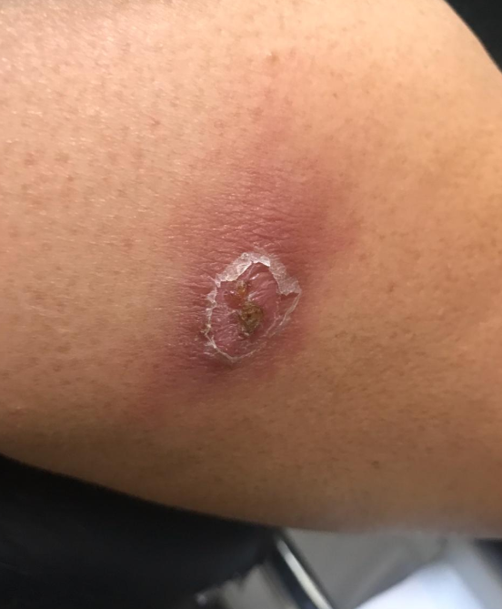
Physical exam
BRAVS 2020 – Talitha B Aguiar

Slide 5
Ocular exam
VA OD: 20/30
OS: 20/80
BIO OD: Clear cornea, nuclear cataract 2+
OS: Clear cornea, normal depth anterior chamber, with clear content, nuclear cataract 2+, rare cells in anterior vitreous
IOP OD: 14 mmHg
OS: 13 mmHg
BRAVS 2020 – Talitha B Aguiar

Slide 6
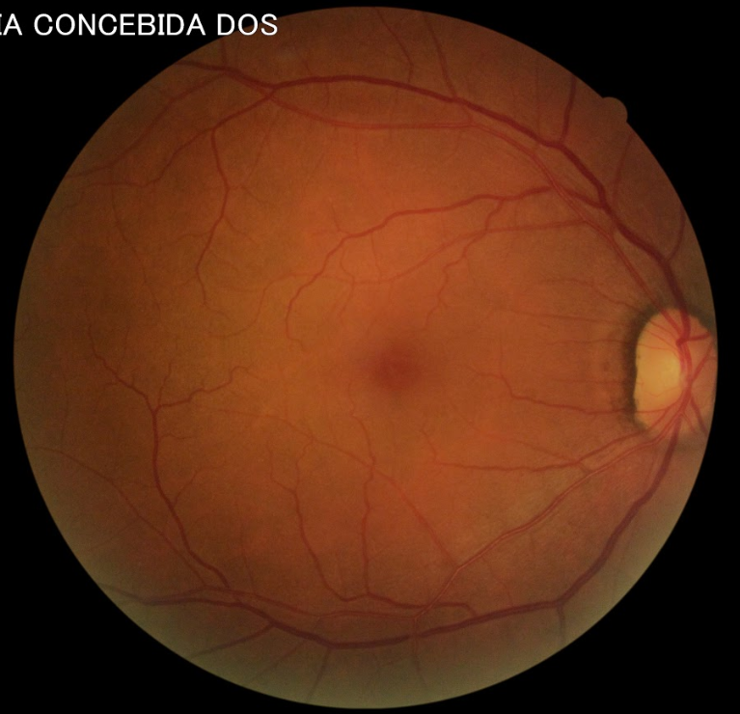
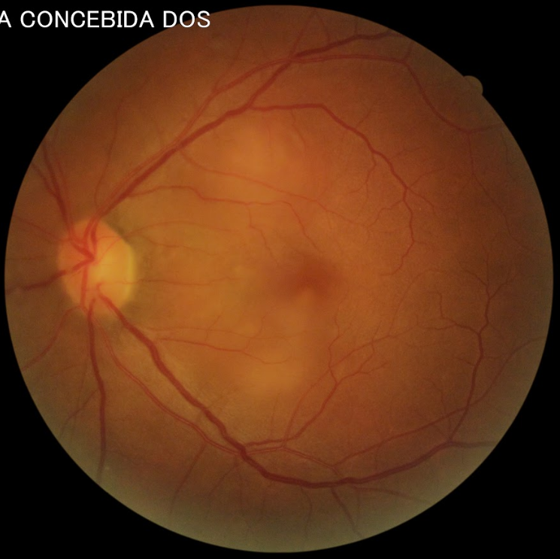
BRAVS 2020 – Talitha B Aguiar

Slide 7
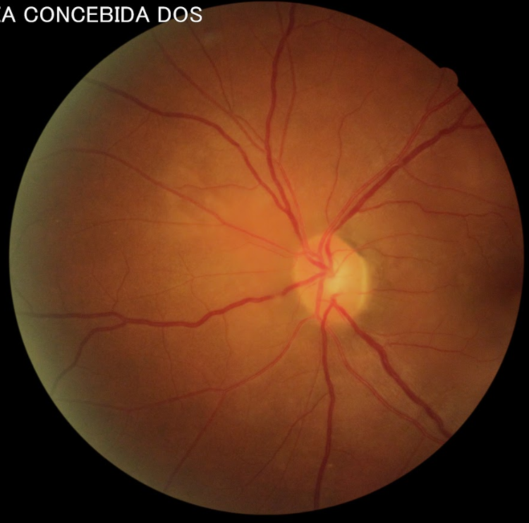
BRAVS 2020 – Talitha B Aguiar

Slide 8
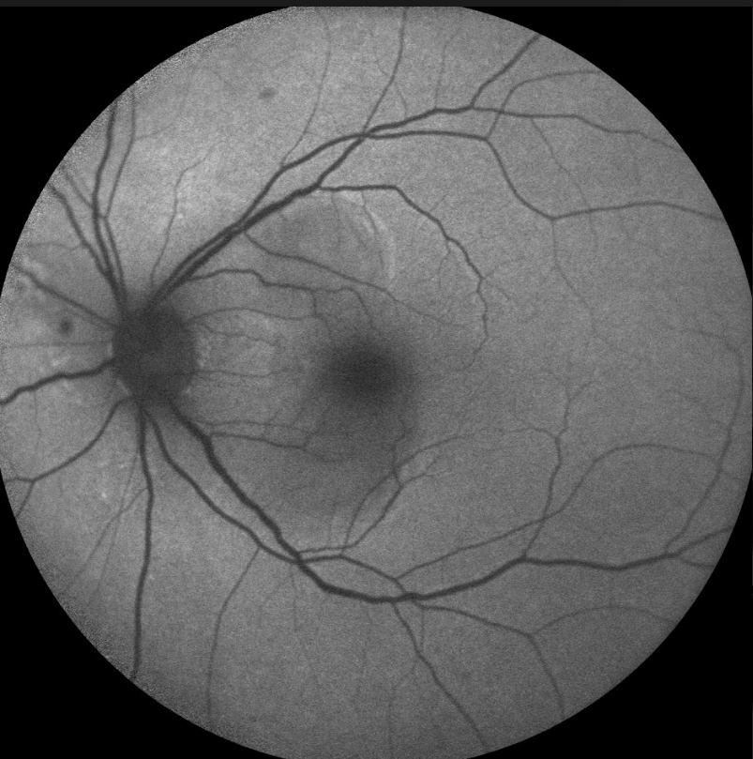
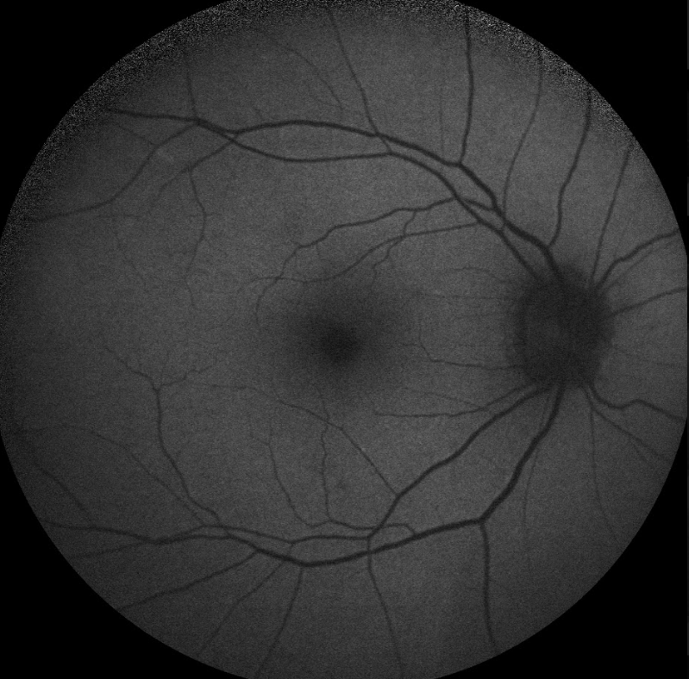
BRAVS 2020 – Talitha B Aguiar

Slide 9
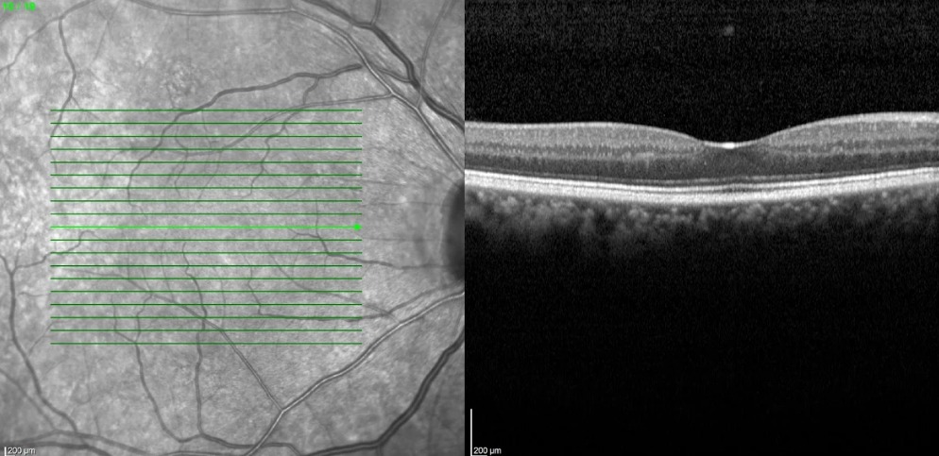
Right eye SD-OCT
BRAVS 2020 – Talitha B Aguiar

Slide 10
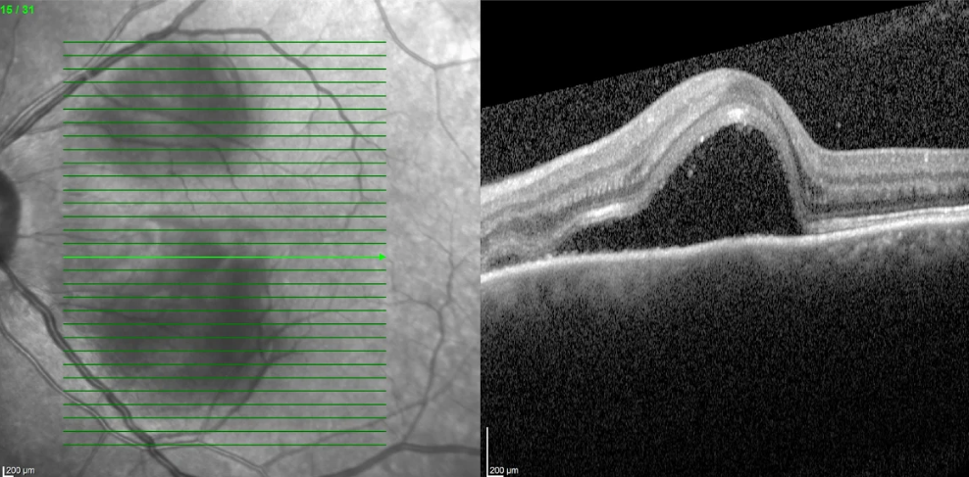
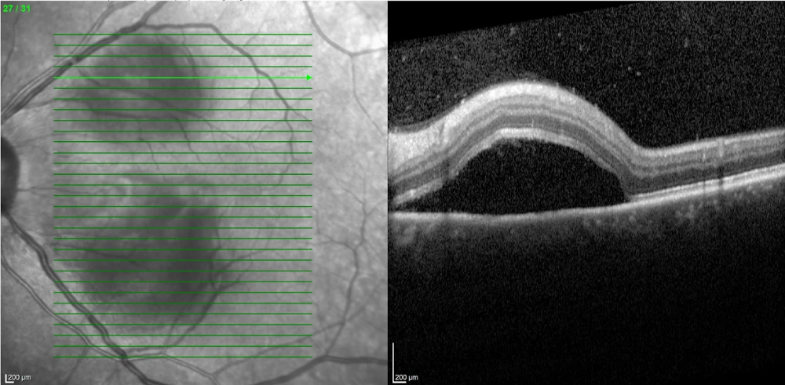
Left eye SD-OCT
BRAVS 2020 – Talitha B Aguiar

Slide 11
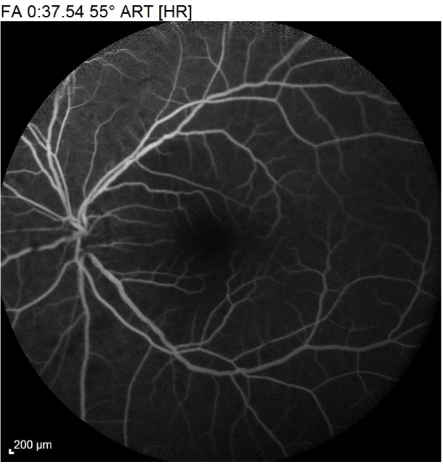
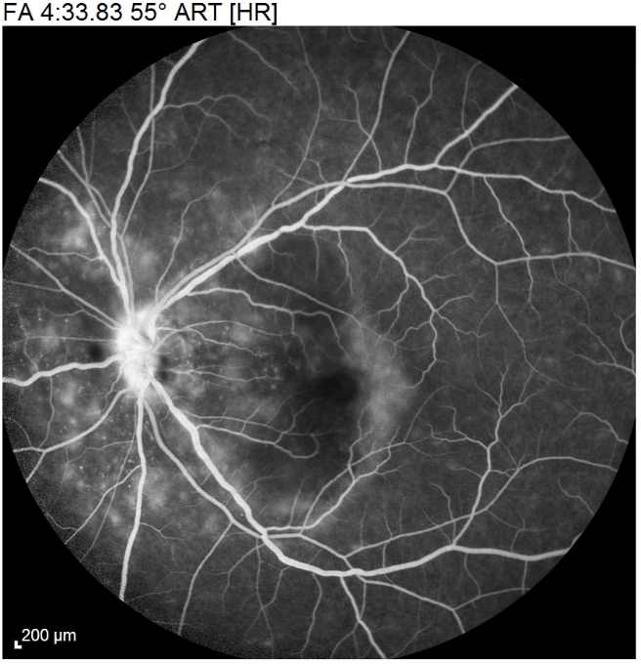
Left eye fluorescein angiography
BRAVS 2020 – Talitha B Aguiar

Slide 12
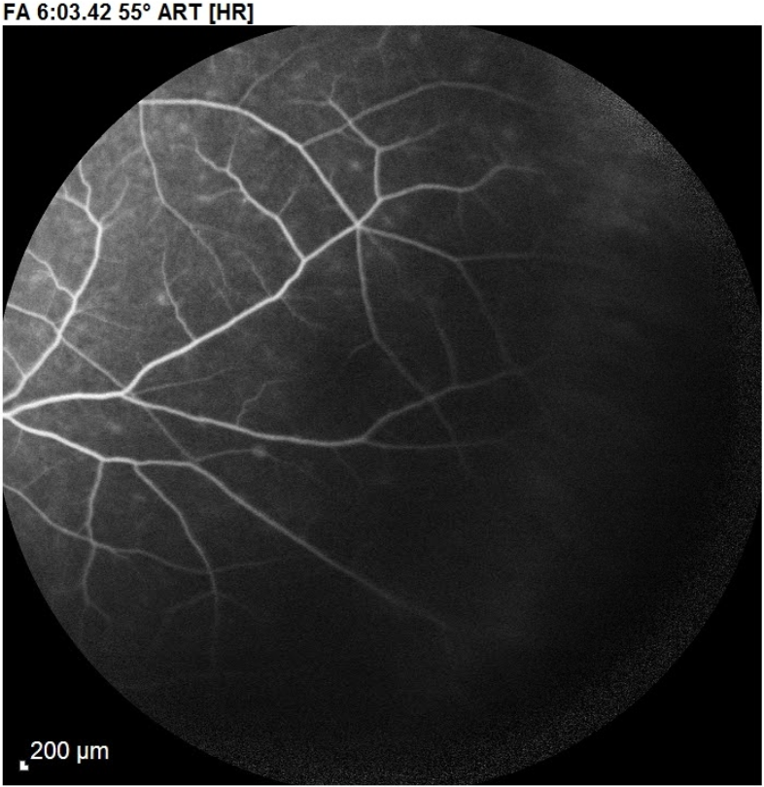
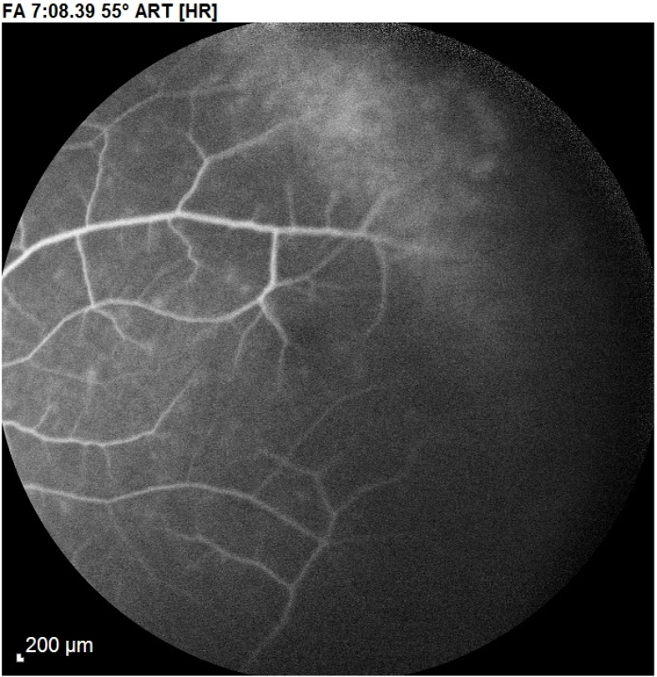
Left eye fluorescein angiography
BRAVS 2020 – Talitha B Aguiar

Slide 13
And the fellow eye?
BRAVS 2020 – Talitha B Aguiar

Slide 14
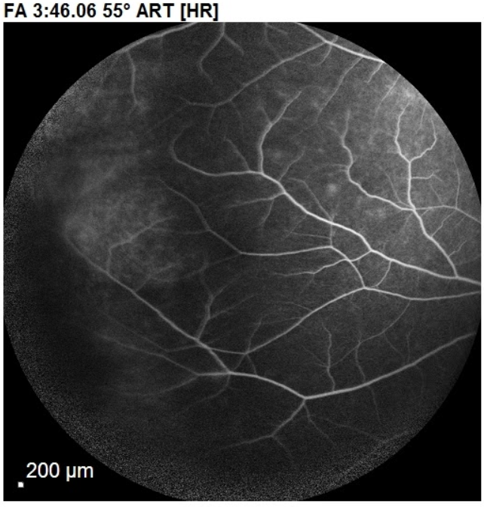
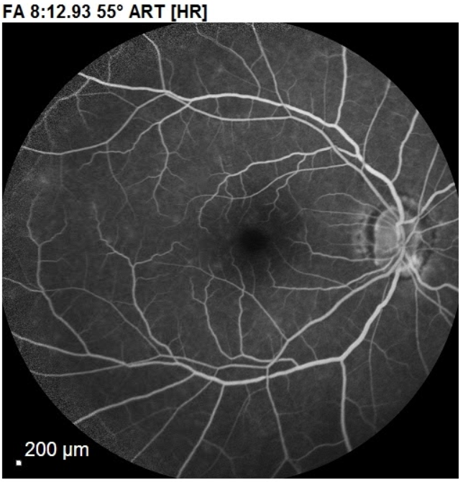
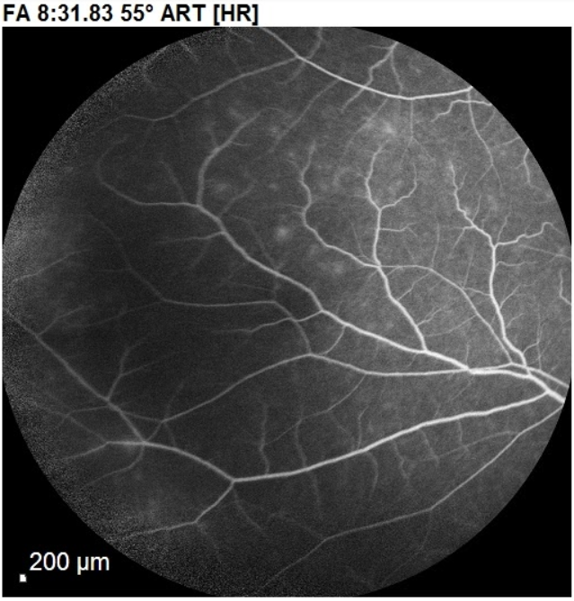
Right eye fluorescein angiography
BRAVS 2020 – Talitha B Aguiar

Slide 15
Diferential Diagnosis
Vogt-Koyanagi-Harada Syndrome
Masquerade Syndrome
Central Serous Chorioretinopathy
Tuberculosis
Sifilis
EPPMA
MEWDS
BRAVS 2020 – Talitha B Aguiar

Slide 16
Systemic investigation
Toxoplasmosis: IgG and IgM negative
VDRL/ Ft-ABS: Negative
HIV: Negative
Cytomegalovirus: IgG and IgM negative
Hepatitis: Negative
VHS and C-reative protein: Negative
Torax X Ray: NWN
BRAVS 2020 – Talitha B Aguiar

Slide 17
Vaccine associated uveitis The autoimmune/inflammatory syndrome induced by adjuvants (ASIA)/ Shoenfeld’s syndrome
BRAVS 2020 – Talitha B Aguiar

Slide 18
Follow up
Patient was treated with 80mg/day oral Prednisone
BRAVS 2020 – Talitha B Aguiar

Slide 19
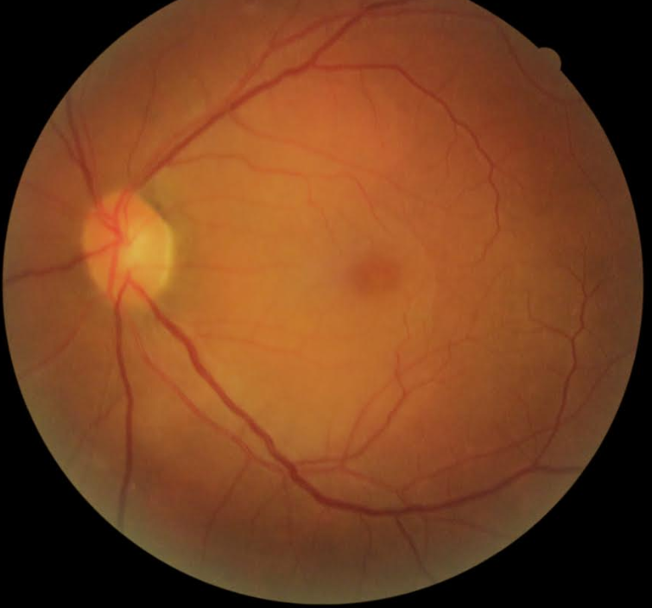
Baseline 5 days after treatment
BRAVS 2020 – Talitha B Aguiar

Slide 20
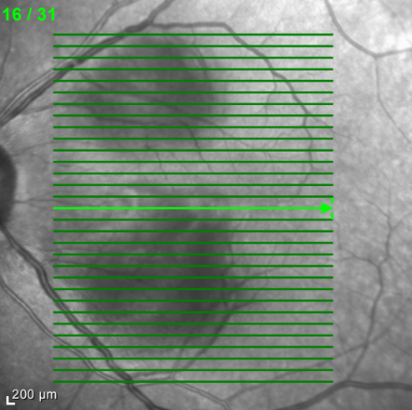
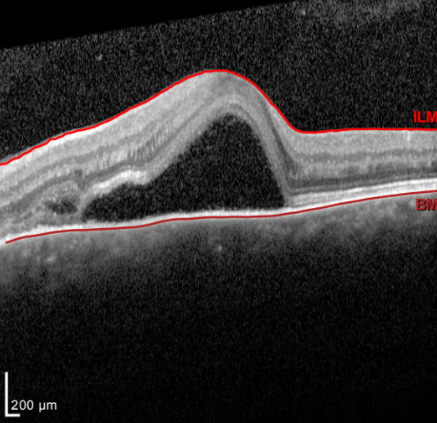
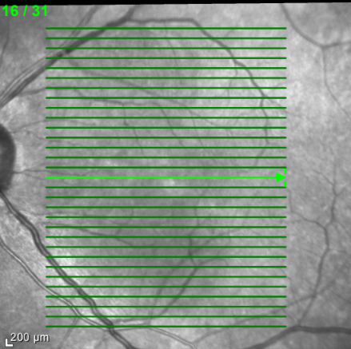
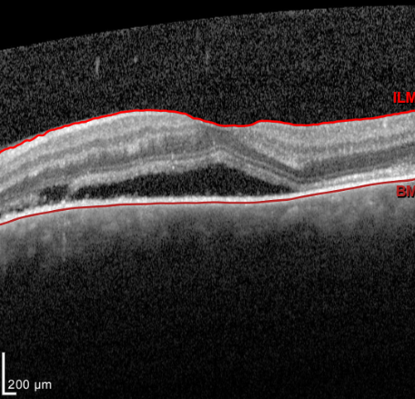
Baseline
VA: 20/80
5 days after treatment
VA: 20/50
BRAVS 2020 – Talitha B Aguiar

