Slide 1
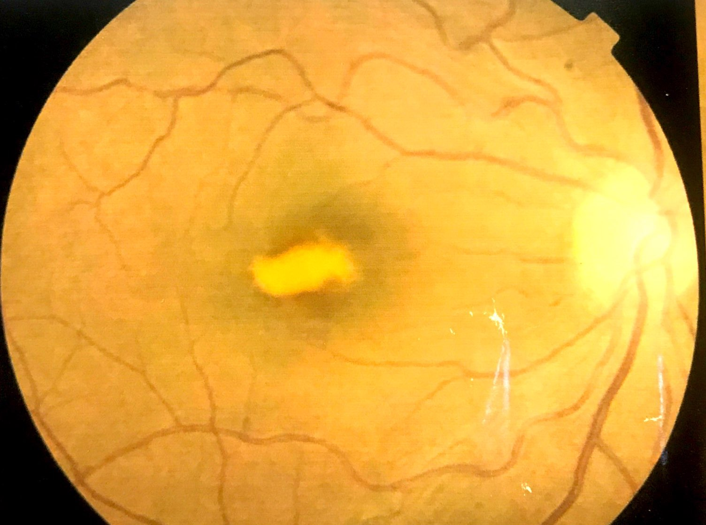
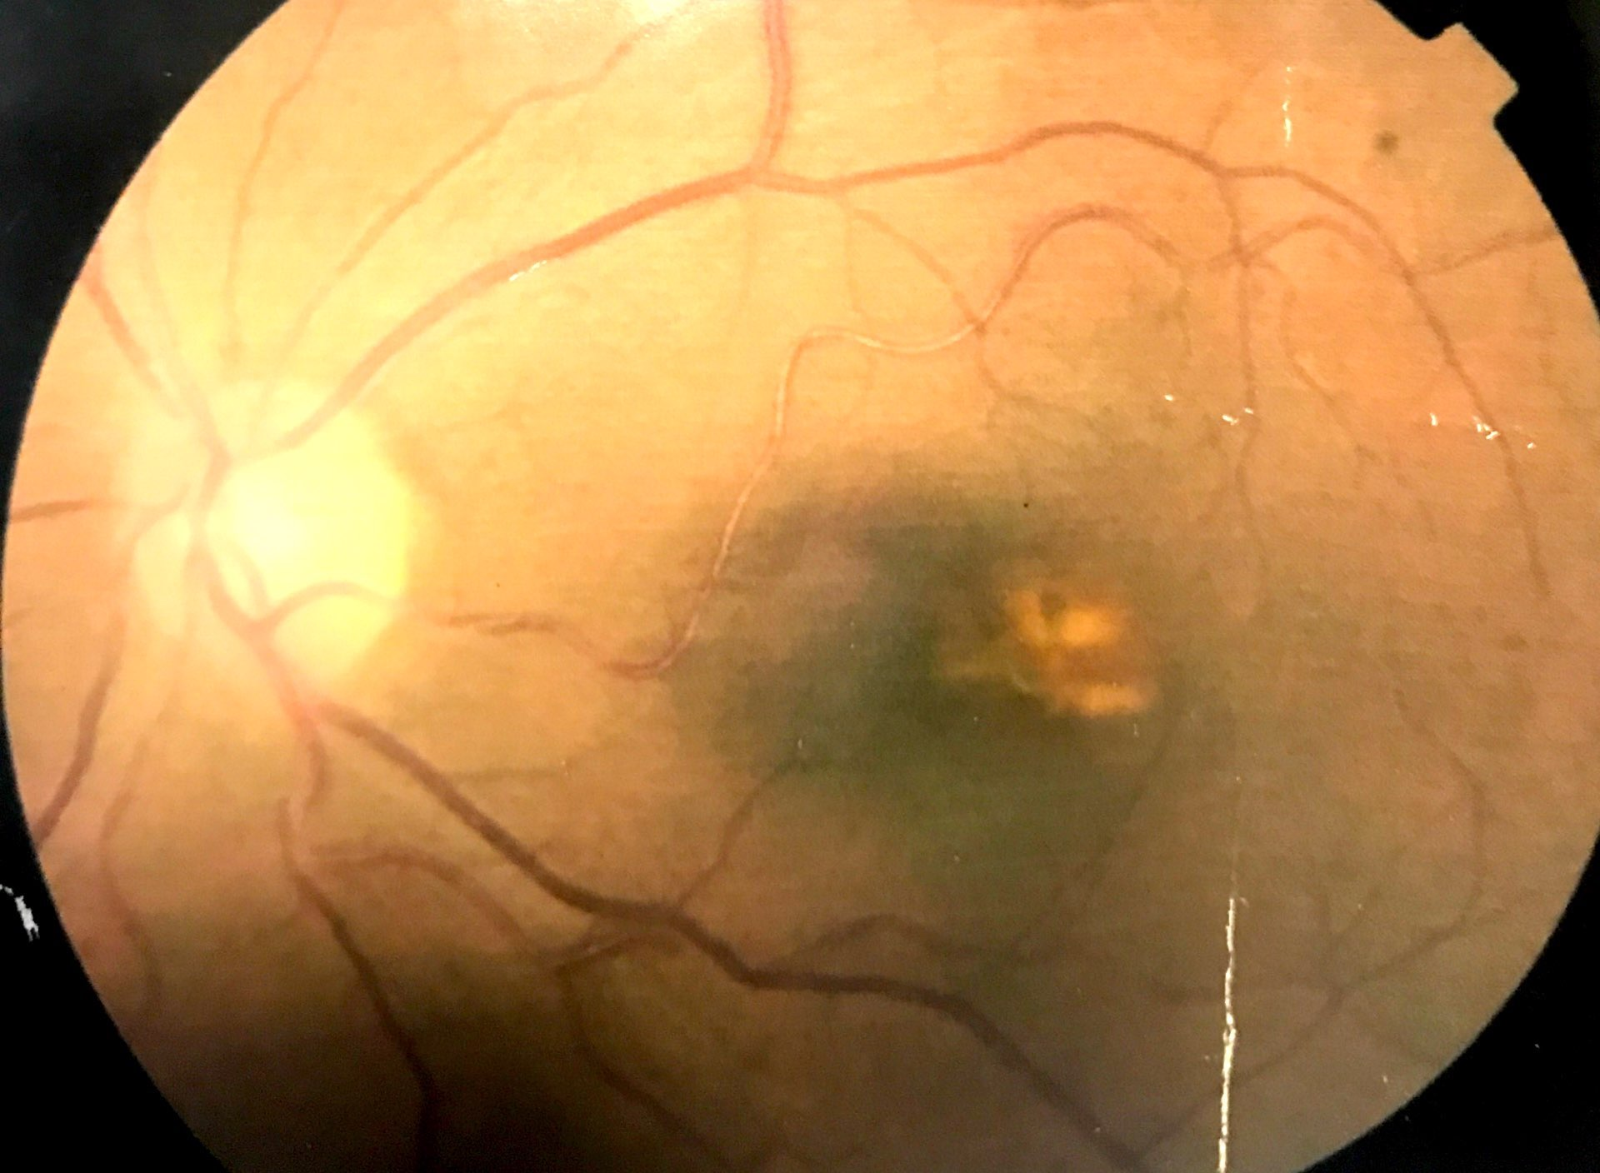
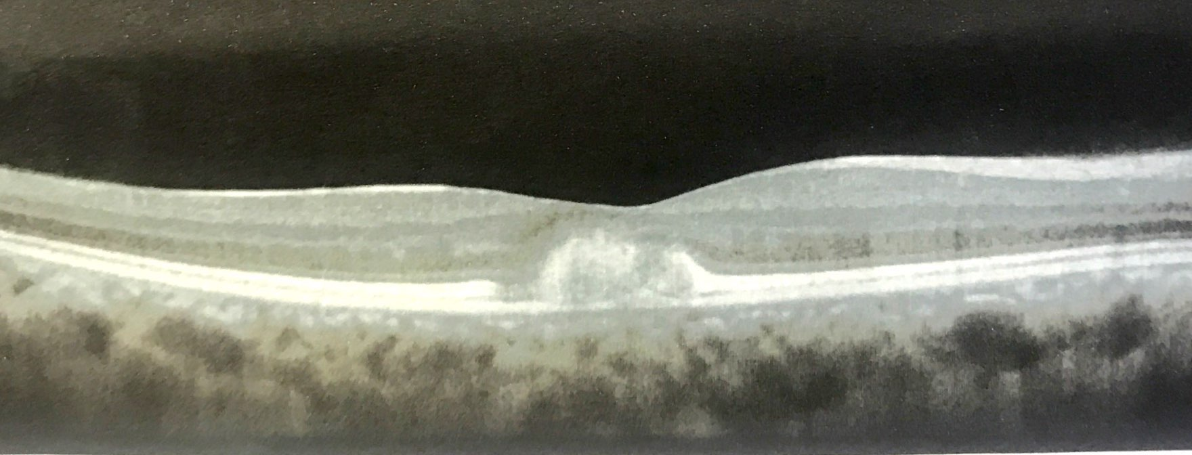
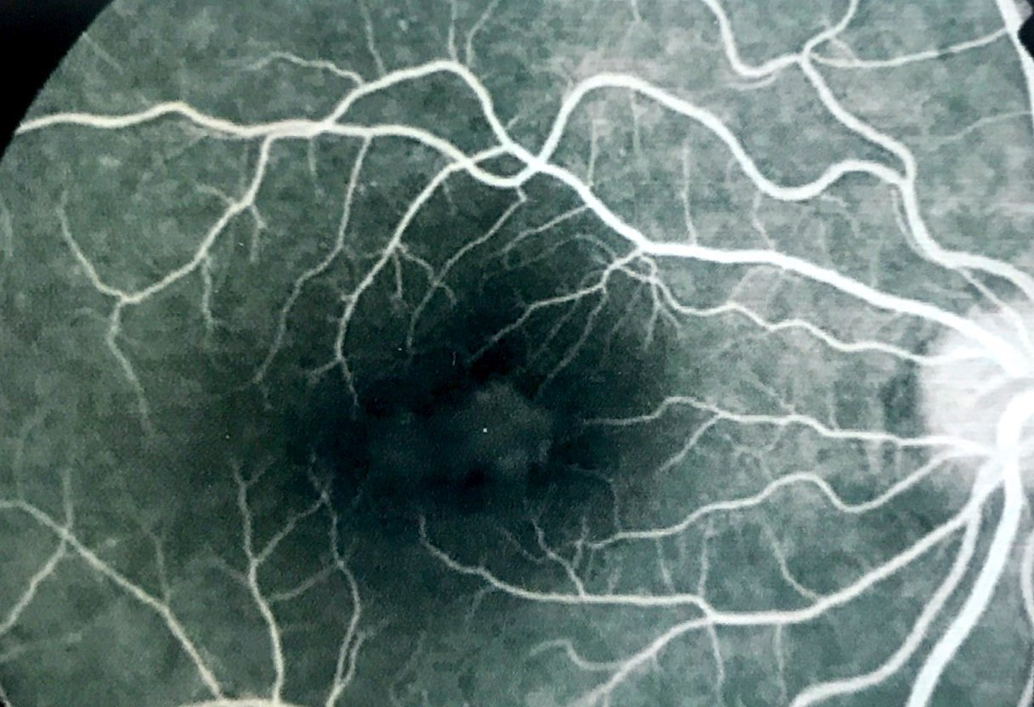
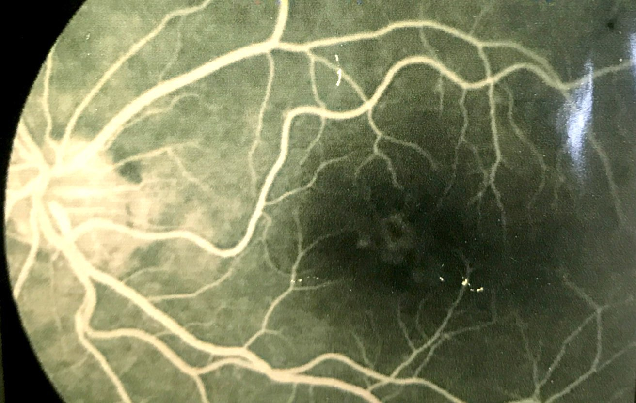
Best Disease in a kidney Transplant Patient
Carolina Maria Barbosa Lemos ,Paulo Henrique Horizonte,Rafael Garcia,Walther de Oliveira Campos Neto,Beatriz Mello Mencaroni,Andréia Novelli,Nina Rosa Konichi da Silva, André Marcelo Vieira Gomes
PURPOSE
Fluorescein angiography: Preserved filling time,presence of an area of hyperfluorescence by staining and impregnation in the macular region
To describe a case of Best disease.
INTRODUCTION
DISCUSSION
The term viteliforme,derived from the latin vitellus (egg yolk), is used to describe the fundoscopic findings of yellowish and oval subretinian deposits(1). Best vitelliform macular dystrophy ( BVMD) is one of the most common macular dystrophies, typically presents in childhood. Its characteristic presentation is by bilateral fundus changes of egg-yolk appearance at the macula in both eyes. Retinal pigment epithelium (RPE) is primarily affected.The terminal can complicate with choroidal neovascularization(1,2).
According to a study by Beridan,K e col at University of Debrecen, Hungary,88% patients undergoing kidney transplantation suffer some demage to eye tissue(3). The most frequent is reduction RNFL thickness. Followed by keratoconjunctivitis sicca,cataracts,glaucoma,retinal drusen and hypertensive retinopathy(3). Our patient does not have any of the manifestations related to kidney transplantation and his fundoscopy is the typical phenotypic manifestation of Best vitelliform macular dystrophy (BVMD) without choroidal neovascular membrane (CNVM), so needs no treatment. Regular follow up is vital for early detection of complications, especially CNVM. The CNVM may regress spontaneously also, but the visual outcome may be better with anti-VEGF agents(3). In our case, the patient did not have choroidal neovascular membrane and was chosen for follow-up.
Fig. 1 and 2: retinography of the right eye and left eye
METHODS
Medical records review
Fig 3 and 4 : OCT of the right and left eye
RESULTS
A 30 years old patient with kidney transplantation for 5 years and progressive bilateral visual loss.Her best corrected visual (BVC) was 20/100 in the right eye and 20/60 in the left eye. Fundoscopy of both eyes showed yellowish lesion with vitelliform aspect badly delimited in fovea . The OCT showed disruption in ellipsoid zone and hyperreflective deposits. Autofluor:area of hyperautofluorescence in the macular region.
BIBLIOGRAPHY
1- Basic and Clinical Science course 2016-2017 – American Academy of Ophthalmology
2-Iannaccone A, Kerr NC, Kinnick TR, Calzada JI, Stone EM. Autosomal recessive best vitelliform macular dystrophy: report of a family and management of early-onset neovascular complications. Arch. Ophthalmol. 2011 Feb;129(2):211-7
3-Berindán K, Nemes B, Szabó RP, et al. Ophthalmic findings in patients after renal transplantation. Transplant Proc 2017;49:1526–9
Fig 5 and 6 : Fluorescein angiography od right and left eye
Notes:
purpose, methods, results and discussion

