Slide 1
SERPIGINOUS CHOROIDITIS
Santa Casa de Belo Horizonte
Letícia Torres Elias Silva
Rafael Mourão Agostini
Wilton Feitosa de Araújo
Luis Felipe da Silva Alves Carneiro
Gabriella Faria Lopes
Renata de Sousa Carneiro
Nadine Fernandes da Silva
Isabella Vieira de Oliveira

Slide 2
CASE REPORT
NAR, female, 47 yo
Attended at Santa Casa Belo Horizonte in 2018
Bilateral low visual acuity for several years
Regular follow-up with an ophthalmologist
Diagnosis of toxoplasmosis
Bactrim F and oral prednisone → no improvement of symptoms
BCVA: 20/40 OD and 20/50 OS
Medical History: diabetes, high blood pressure, asthma

Slide 3
Previous exams 2003

Slide 4
Previous exams 2004

Slide 5
Previous exams 2015

Slide 6
2018

Slide 7
2018

Slide 8
2018
Normal blood count
Negative sorologies
Chest x-ray unchanged
PPD 20 mm
Treatment with rifampicin + isoniazid + pirazinamid + etambutol
After treatment → BCAV 20/30 OD and 20/40 OS

Slide 9
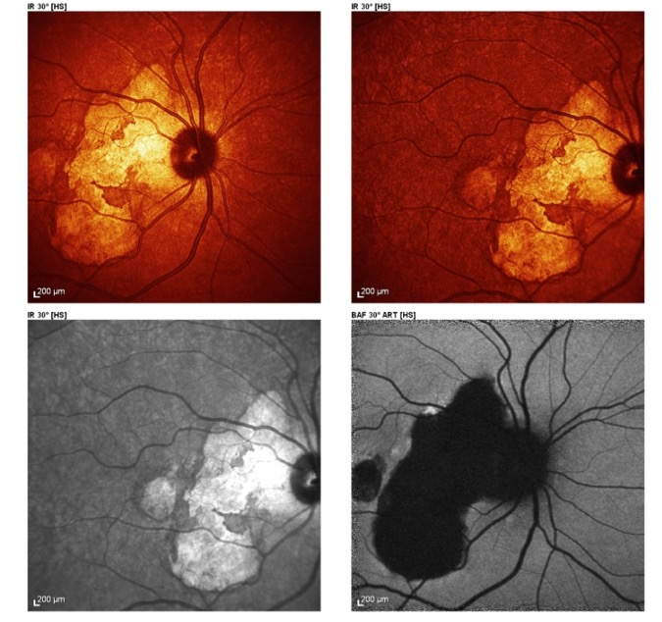
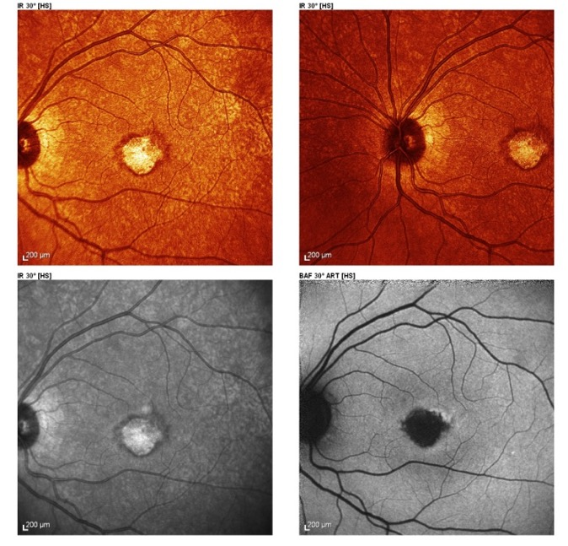
2019
Worsening VA OS
BCVA: 20/30 OD and counting fingers OS

Slide 10
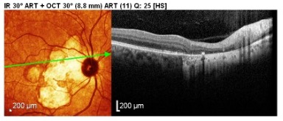
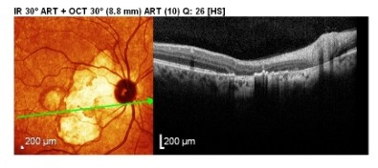

Slide 11
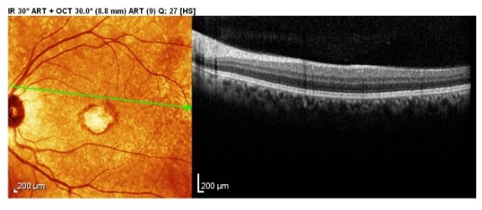
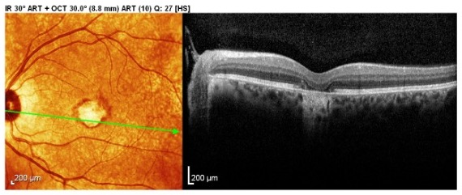

Slide 12
Discussion
Serpiginous coroiditis
Tuberculosis x auto immune
Treatment?

Slide 13
Thank you!
leticiatorreselias@gmail.com

