Slide 1
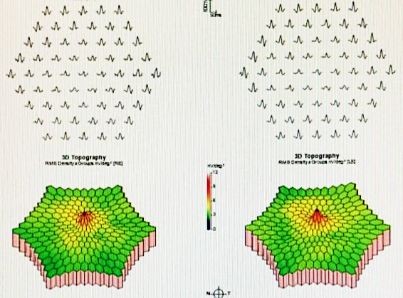
Spinocerebellar Ataxia Type 7 Associated with Macular Dysthophy
Mendonca, V M; Sodre, S L; Manente, M; Moreto, R; Huarachi, D R G.
Introduction
Spinocerebellar ataxia type 7 is a chronic neurodegenerative disease, autosomal dominant that affects polyglutamine with abnormal repetitions of CAG leading to neuronal and photoreceptor degeneration.
The onset occurs in adulthood with progressive cerebral ataxia and low visual acuity and may also show loss of the foveal reflex, vascular attenuation, macula with granular appearance and areas of pigmentary atrophy.
Case Report
R.R.S, male, 24 years old, complained of low visual acuity in both eyes for approximately one year associated with postural alteration.
Best corrected visual acuity was 0,63 and 0,80. External, anterior segment and ocular fundoscopic examinations were normal.
Optical coherence tomography showed accentuation of foveal depression and rarefaction of outer layer cells.
Full-field ERG showed asymmetric impairment of cones and rods with right eye being the most affected. Multi-focal ERG showed a decrease of foveal sensitivity in both eyes with greater incidence in right eye.
Brain MRI shows diffuse cerebral atrophy and the mutation analysis responsible for type 7 spinocerebellar ataxia was positive.
Discussion
In the report presented by Hugosson, T, et al, the multi-focal ERG was markedly reduced in cones of foveal region. According to Karam, A, et al the cones are initially affected, evolving to dystrophy of cones and rods.
Such case report is in agreement with the literature data, corroborating signs, symptoms and descriptions of complementary exams.
The facility of the study of the retina and the demonstration of changes in the OCT and visual field in pre-symptomatic phases suggests that, after further studies, such tests may be used as biomarkers in the future.
References
1 – Pietro B. Azevedo, Anastácia G. Rocha, et al. Ophthalmological and Neurologic Manifestations in Pre-clinical and Clinical Phases of Spinocerebellar Ataxia Type 7. The cerebellum. 2019.
2 – Therese H, Lotta G, et al. Macular Dysfunction and Morphology in Spinocerebelar Ataxia Type & (SCA7). Ophthalmic Genetics. 2009; 30: 1-6.
3 – Alice K, Yvon T. Molecular Mechanisms and Therapeutic Strategies in Spinocerebellar Ataxia Type 7. 2018: 197 – 218.
4 – Roslyn K. Manrique, Susana N, et al. Ophthalmic features of Spinocerebellar Ataxia Type 7. J Neuro-Ophthalmol. 2009; 29: 174-179

