Slide 1
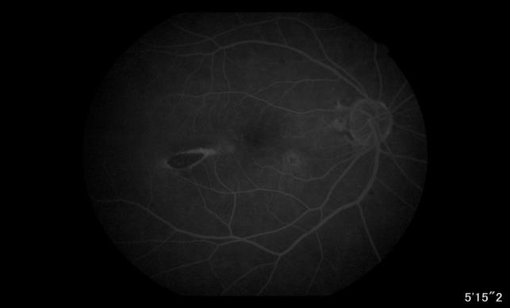
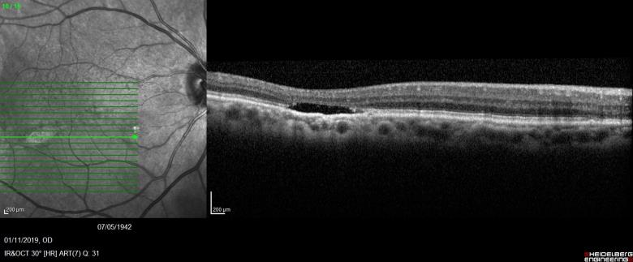
TORPEDO MACULOPATHY: A CASE REPORT
MARTIRES , F.M; SWIECH, T.I; CLEMENTE, R.S.M; SIVIERO, R.B.; MOTA, B.A.N.;
MIRANDA, J.F.O; MOREIRA NETO, C.A.; MOREIRA JR, C.A.;
INTRODUCTION
PICTURES
DISCUSSION
.
Torpedo Maculopathy, is a congenital and rare asymptomatic change of the retinal pigment epithelium (RPE), temporal to the macula.
This lesion is usually unilateral, torpedo-shaped, temporal to fovea. Visual Acuity is not affected, but it may be associated with other complications such as Central Serous choroidopathy and choroidal neovascularization. Therefore, it must be monitored periodically.
The nevus Solitary Pigmented Retinal Epithelium (torpedo maculopathy), first described by Roseman, Gass in 1992, is a rare congenital anomaly, with no known etiology, which produces a rupture of the layers of the outer retina.
It is suspected of being qualified with changes in the development of choroidal or ciliary vascularization. Several theories have been proposed to explain the pathogenesis of the lesion:
A) a reduction in the development of the nerve fiber layer along the horizontal raphe;
B) abnormal choroidal circulation or development of ciliary vasculature
C) the persistent developmental defect in the RPE of the fetal temporal bulge, which is an
aggregation of these cells that occurs between 4 and 6 months of gestation.
D) as a consequence of intrauterine chorioretinitis;
The patient is usually asymptomatic and does not affect visual acuity. The common lesion is unilateral, flat, torpedo-shaped, temporal to the fovea, with tail to the foveolar region. In the literature, descriptions with Sensorineural Detachment and Central Serous Choroidopathy have been described. There are some injuries described in the literature that evolve to choroidal neovascularization.
Differential diagnosis are: Chorioretinal scar, retinal trauma, congenital RPE hypertrophy, RPE hamartoma and retinal dystrophies.
Autofluorescence show a lesion with hyperautofluorescent borders due to the dysfunction of the RPE cells with the a hypoautofluorescent center, meaning atrophy of the RPE.
OCT shows an attenuation of the layers of the outer retina, due to loss of photoreceptors. OCT Angiography, on the other hand, shows a malformation of the RPE / Choriocapillary complex, which may change in the deep depths of the retina over time.
Microperimetry shows a reduced sensitivity of the retina along the lesion and remains stable with monitoring.
In summary, Torpedo Maculopathy is a congenital asymptomatic lesion that remains stable over the years and does not alter visual acuity. However, it must be monitored periodically due to the possibility of progress or progression to choroidal neovascularization.
1
1
1- OD Retinography
CASE REPORT
Female , 70 years old, comes to the Retina Service of Hospital de Olhos do Paraná in August/2017 with complaint of low visual acuity in the left eye (OS). Visual acuity in the right eye (OD): 20/30 and counting fingers at 1 meter in OS. Biomicroscopy in both eyes (OU): pseudophakic, without other changes. Patient deny any significant past medical or ocular history including infectious diseases or long-term exposure to retinotoxic drugs
On this occasion, Polypoidal Vasculopathy was diagnosed in OS through the Optical Coherence Tomography (OCT). Four Intravitreal Injections of Ranibizumab were performed in the OS which currently has visual acuity: 20/80.
In a routine examination in 2013, for evaluation of dermatochalasis, Binocular indirect ophthalmoscopy revealed a temporal scar alteration to the macula. No changes were observed in the OS exam. The visual acuity in both eyes was 20/25. In 2014, Phacoemulsification with intraocular lens implant surgeries were perfomed in both eyes. After the surgeries, she presented a visual acuity of 20/20 in both eyes.
She returned in October/2019 to perform na Angiography in both eyes.
2
2- OD Angiography
REFERENCES
3
Choroidal Neovascularization in Torpedo Maculopathy Assessed on Optical Coherence Tomography
Angiography. Parodi MB, Romano F, Montagna M, Albertini GC, Pierro L, Arrigo A, Bandello F.
2.Morpho-functional evaluation of torpedo maculopathy with optical coherence tomography angiography and
microperimetry. Grimaldi G, Scupola A, Sammarco MG, Marullo M, Blasi MA.
3. Swept-Source Optical Coherence Tomography Angiography Findings in Torpedo Maculopathy. Ali Z, Shields CL,
Jasani K, Aslam TM, Balaskas K.
4. Torpedo maculopathy with serous detachment of retinal pigment epithelium. Arcos-Villegas G, Valor-Suarez C,
Ruiz-Medrano J, Valverde-Megías A, Flores Moreno I, Donate López J.
5. Torpedo Maculopathy Associated with Choroidal Neovascularization. Jurjevic D, Böni C, Barthelmes D, Fasler K,
Becker M, Michels S, Stemmle J, Herbort C, Zweifel SA.
3 - OD Optical Coherence Tomography (OCT)

