Slide 1
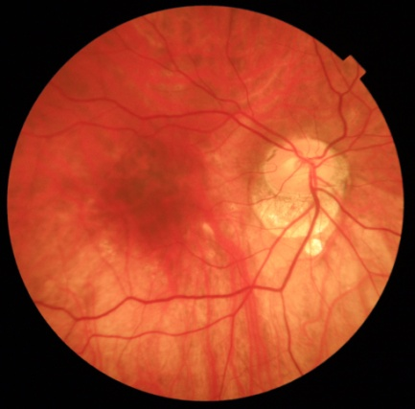
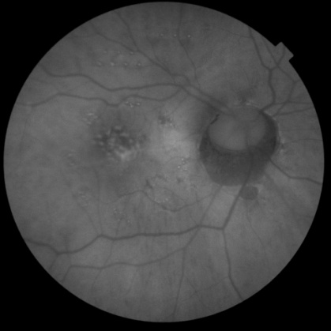
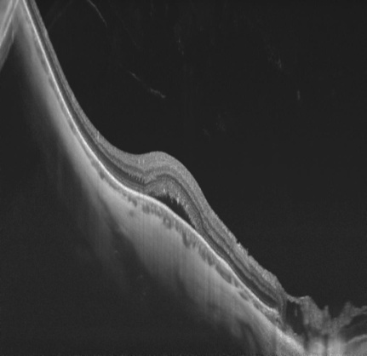
Cupuliform Maculopathy: A Case Report
This paper aims to report a case of a patient with cupuliform maculopathy seen in the city of Fortaleza / Ce.
Case report
Female patient, 48 years old, mixed race, administrator, born in Fortaleza and coming from São Paulo, attends for an ophthalmological consultation complaining of recent right eye (OD) metamorphopsies, denying pain and other symptoms. The pacient denied trauma and continuous medicine use. She reported refractive surgery for high myopia correction in both eyes in 1997 and subretinal neovascular membrane (MNVSR) in the left eye in 2015. On examination, he presented visual acuity in OD 20/50 and in OE 20/25. Fundscopy of the right eye: change in brightness and macular relief. The macular OCT showed a dome-shaped macula, with subfoveal fluid and thickening of the sclera
Aflibercept was applied to the right eye without change the visual acuity. After 2 months, aldactone VO 50mg / day was prescribed with the new visual acuity in OD 20/40. After 1 month, and Endpoint Management with 20% power with Pascal Laser was performed. The patient returned to a new consultation after 3 months, with with 20/25 visual acuity in both eyes.
Conclusion
Cupuliform maculopathy was described by Gaucher et al in 2008 as a convexity of the macular area associated with differences in sclera thickness in myopia with posterior staphyloma. Elevation of the macular area encompasses retina, RPE and choroid, usually within the concavity of a posterior staphyloma. Can manifest uni or bilateral. Its pathophysiology remains unknown and is questioned if it is caused by vitreous traction or choroidal thickening. OCT is of great importance in the diagnosis of this pathology. Patients should be followed every 6 months to monitor for possible complications, the most common being serous retinal detachment. Neither Anti VEGF nor PDT are effective in treating subretinal fluid.

