Slide 1
BILATERAL ENDOGENOUS ENDOPHTHALMITIS ASSOCIATED WITH INFECTIVE ENDOCARDITIS
Felipe Muralha MD
UNIFESP/EPM

Slide 2
Medical History
Male, 57 years old, white
Low visual acuity in both eyes for four days

Slide 3
Medical History
History of present illness: Four days ago, progressive onset of low visual acuity in both eyes, worse in the right eye, not associated to pain. No history of ocular trauma.
Past Medical History: Hadn’t been to any medical appointments in many years. Had begun treating lower urinary tract infection with ceftriaxone four days ago (symptoms of dysuria, fever and altered mental status) in another service.
Past Ophthalmologic History: Unremarkable

Slide 4
Ophthalmologic exam
 | Right Eye | Left Eye
Visual Acuity | Counting fingers at 1 meter | 20/200
Anterior Biomicroscopy | Conjunctival hyperemia 1+, clear cornea, hypopyon < 1mm, AC cells 1+, phakic | Conjunctival hyperemia 1+, clear cornea, hypopyon < 1mm, AC cells 1+, phakic
IOP (mmHg) | 22 | 20

Slide 5
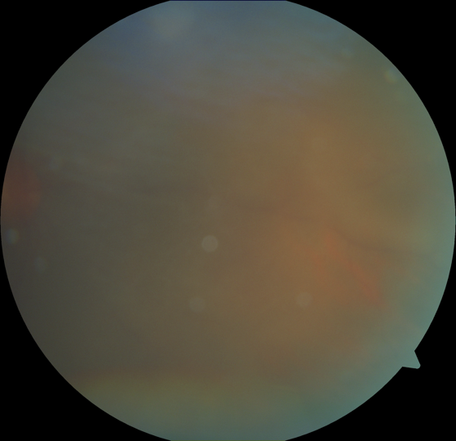

Slide 6
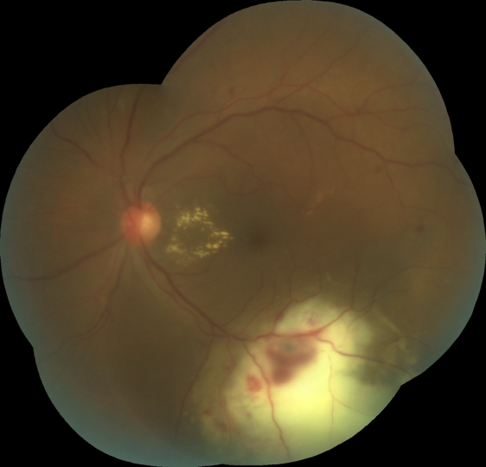

Slide 7
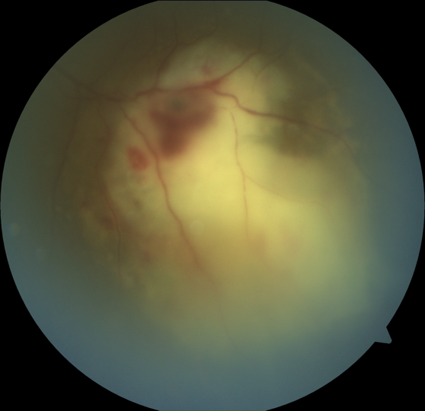

Slide 8
Diagnostic Hypothesis
Bilateral panuveitis
Infectious
Tuberculosis
Syphilis
Toxoplasmosis
Cytomegalovirus
Bilateral Endophthalmitis
Neoplasic
Metastasis
Retinal Vasoproliferative tumor
Central Nervous System Lymphoma
Masquerade syndrome

Slide 9
Management
Vital signs
Laboratory workup
Blood glucose
Serologies for toxoplasmosis, syphilis, HIV
ESR, CRP
PPD test
Cranial and orbital CT scan
Ocular ultrasound OU

Slide 10
Management
Blood pressure: 82 x 64
Blood glucose: 811 mg/dL
Pulse rate: 96
Respiratory rate: 36
Oxygen saturation on room air: 95%
Body temperature: 36,7°C
Leukocytes: 22400 cells
CRP: 239
ESR: 13
VDRL and treponemic tests: negatives
Toxoplasmosis IgG 592 // IgM NR
CMV IgG 500 // IgM NR
HIV negative
PPD 17 mm
Cranial and orbital CT scan: NR

Slide 11
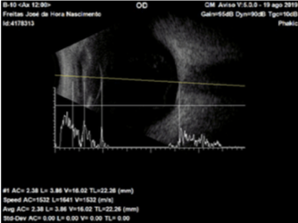
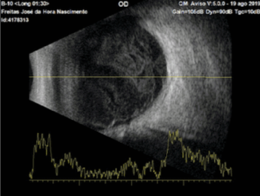
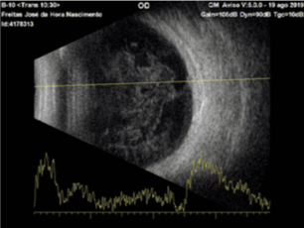
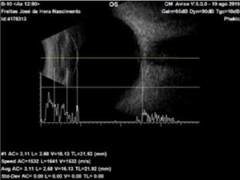
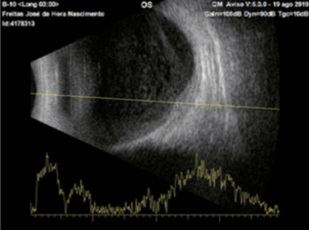
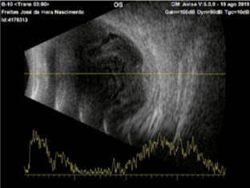
Right Eye
Left Eye

Slide 12
Management
Clinical emergency room: hyperglicemic hyperosmolar state (secondary to diabetes)
Hemoculture: MRSA (Meticilin resistant Staphylococcus Aureus) from two sites
Investigation for sepsis site
Transesophageal echocardiogram
Chest CT scan
Abdominal ultrasound

Slide 13
Management
Clinical emergency room: hyperglicemic hyperosmolar state (secondary to diabetes)
Hemoculture: MRSA (Meticilin resistant Staphylococcus Aureus) from two sites
Investigation for sepsis site
Transesophageal echocardiogram - Endocarditis
Chest CT scan
Abdominal ultrasound
Hospitalization at the infectious diseases infirmary
Intravenous vancomicin for 30 days

Slide 14
Follow up – 4 weeks
 | Right Eye | Left Eye
Visual Acuity | 20/25 | 20/25
Anterior Biomicroscopy | Clear conjunctiva, clear cornea, no AC reaction, phakic | Clear conjunctiva, clear cornea, no AC reaction, phakic
IOP (mmHg) | 16 | 15

Slide 15
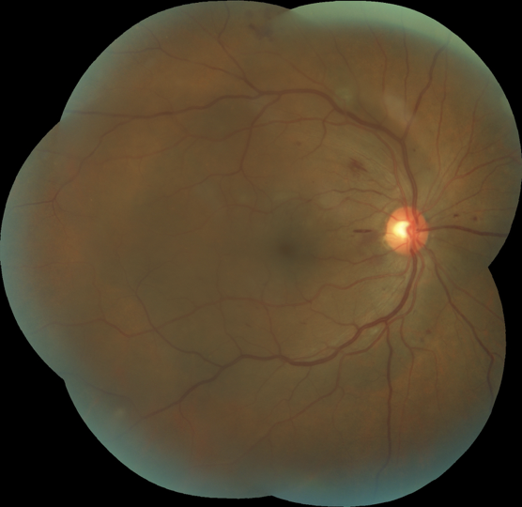

Slide 16
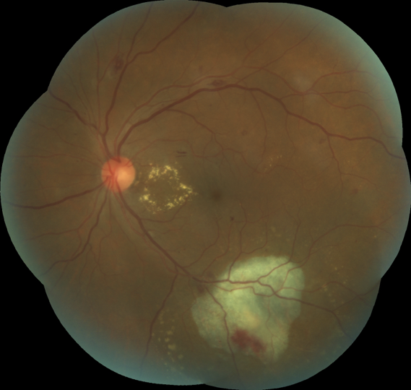

Slide 17
Before
After

Slide 18
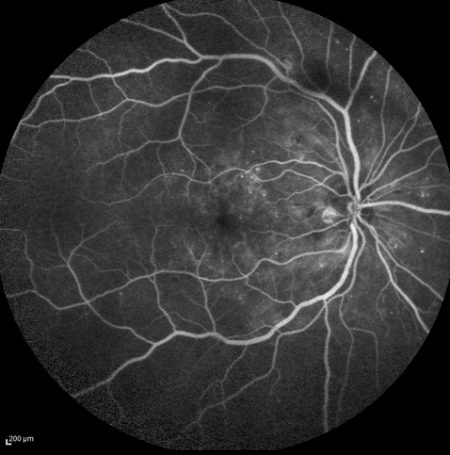

Slide 19
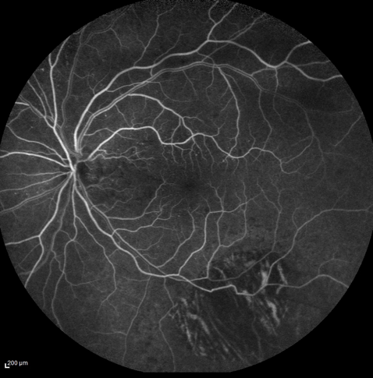

Slide 20
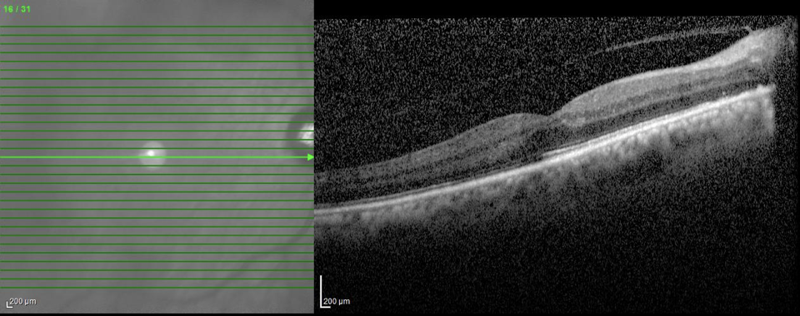

Slide 21
