Slide 1
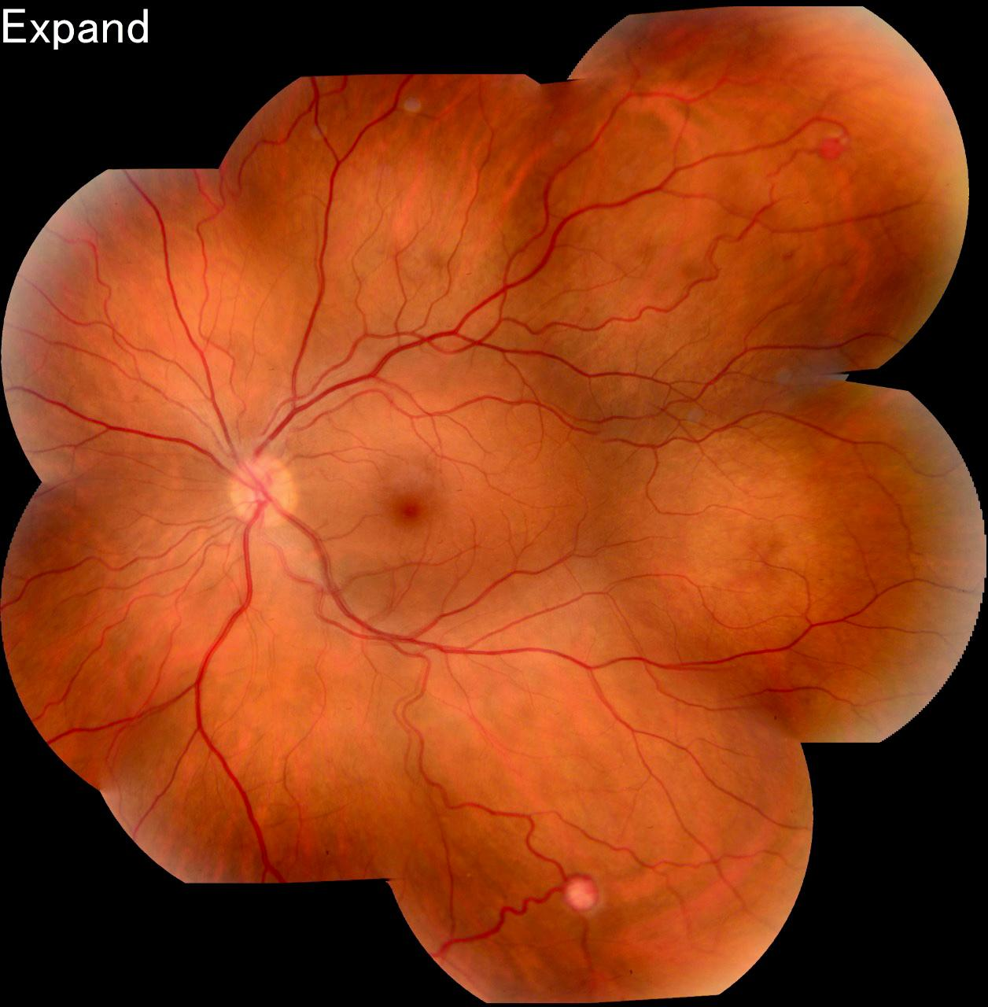
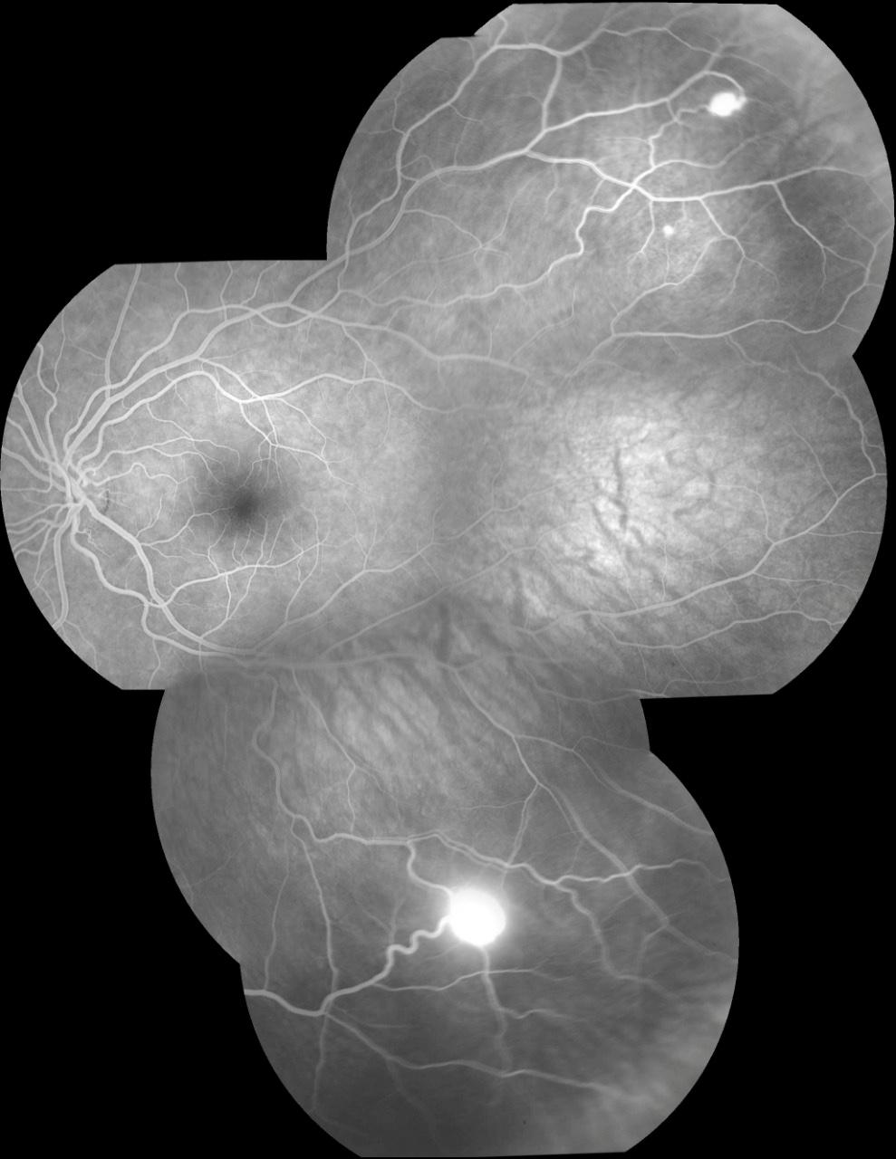
Von Hippel Lindau Syndrome: A Case Report.
Beatriz Mello Mencaroni¹, Raimunda Cristina Mendonça Freire de Oliveira²; Andréia Novelli¹; Rafael Garcia²; Paulo Henrique Horizonte²; Fernanda de Castro Rollo Sampaio²;Guilherme Daher G. M. Reis²; André Marcelo Vieira Gomes³
⁽¹⁾ First year resident of Instituto Suel Abujamra; ⁽²⁾ First year Retina and Vitreous fellowship student of Insituto Suel Abujamra; ⁽³⁾ Chief of Retina and Vitreous
PURPOSE
The treatment for this patient was focal laser photocoagulation. In more advanced stages, cryotherapy and enucleation may be considered. However, in asymptomatic cases, therapy is only a clinical follow-up of the injury.
1
2
To describe a case of Von Hippel Lindau Syndrome.
INTRODUCTION
DISCUSSION
Von Hippel Lindau is an autosomal dominant disease, with 90% penetrance, caused by a change in the VHL gene on chromosome 3p25-26. It has a predilection for tumors of the retina and the CNS. The most common tumor in patients is capillary hemangioma of the retina, causing significant visual impairment. Renal cell carcinoma is a major cause of high mortality from the disease.
Retinal hemangioblastoma is present in up to 59% of cases of the disease. The symptoms of visual deficit are due to its complications, such as: retinal detachment, macular edema, glaucoma, uveitis, among others.
VHL disease also affects the CNS, with the appearance of hemangiomas in the cerebellum and spinal cord, causing headache. Pheochromocytoma, a rare benign tumor of the adrenal medulla, can lead to the production of catecholamines, which can cause palpitations, headaches and sweating. Tests such as fluorescent angiography are useful for diagnosis, revealing tortuous vessels and capillary hemangiomas. Photodynamic therapy can lead to improved visual acuity.
Fig. 1 and 2: retinography of the left eye
4
METHODS
3
Case report carried out at the Suel Abujamra Institute in 2018 of a 31-year-old patient with a complaint of progressive low visual acuity in the left eye. The tests were performed for the case and the patient's gestational time for treatment was waited for the next 2 years. She referred to previous neurological surgery, two years ago, to remove two cerebral hemangiomas.
BIBLIOGRAPHY
1- Basic and Clinical Science Course 2016-2017 American Academy of Ophthalmology.
2. Gatti, R; Pereira, M. A. A; Neto, D. G. Von Hippel-Lindau Syndrome. Arq Bras Endrocrinol Metab, v.43,n.5, São Paulo.1999.
3. Salim, D. K. Continuous angiogenesis inhibition in the treatment for von Hippel-Lindau-related hemangioblastomas of retina and spinal cord.J Oncol Pharm Pract. 2019, dec; 25(8): 2049-2051.
RESULTS
Angiography of the left eye revealed an area of upper and lower temporal hyperfluorescent accumulation without leakage, compatible with capillary hemangioma.
Fig 3: retinography of the left eye
Fig 4: Fluorescence angiography of the left eye
Notes:
purpose, methods, results and discussion

