Slide 1
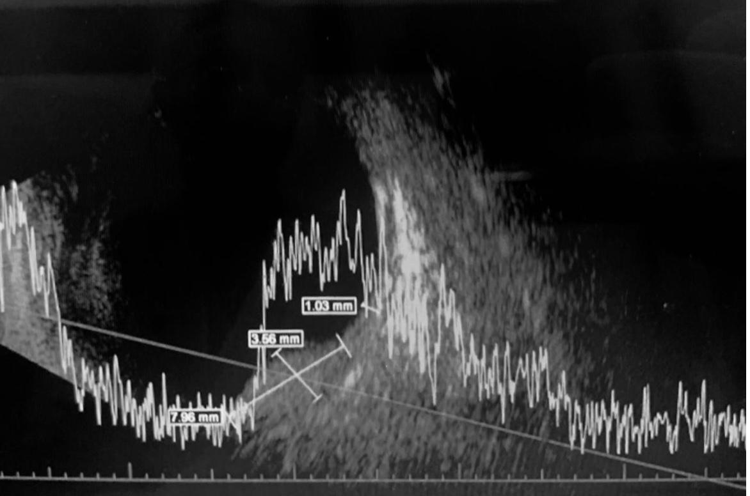
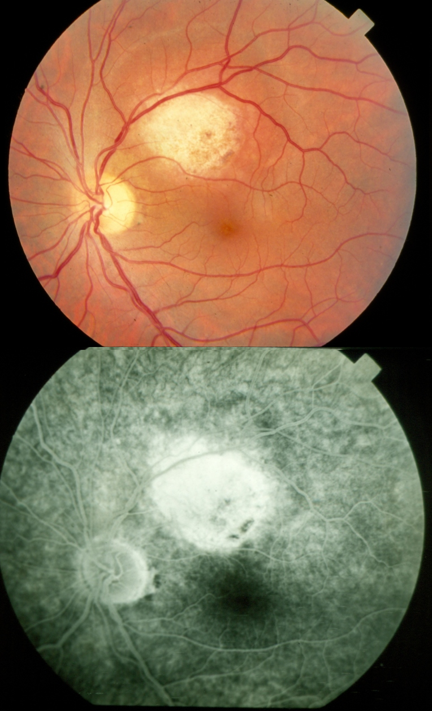
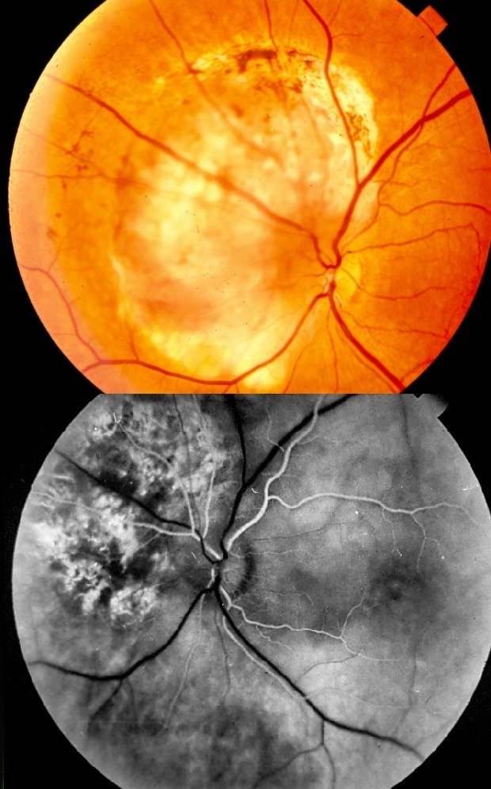
CIRCUMSCRIBED CHOROIDAL HEMANGIOMA: A SERIE OF CASES
Andréia Novelli; Paulo Henrique Horizonte; Angelo S. De Francesco Figueiredo; Vitor G. Essi Monticuco; Anésio Ruiz Netto; Beatriz M. Mencaroni; Raimunda Cristina M. F. de Oliveira; André Marcelo V. Gomes.
Instituto Suel Abujamra
PURPOSE
The AF showed hyperfluorescence due to staining circumscribing the elevated lesion. USG showed an elevated choroid lesion with medium/high intensity echoes. Kappa angle and posterior acoustic shadow were not seen (Image 5). The spectral domain OCT imaging demonstrated a hyporeflective round-shaped retinal elevation.
Our diagnosis was a CCH without complications and we decided to maintain clinical follow-up for both patients.
Image 5
To report two cases of circumscribed choroidal hemangioma in a 60-year-old patient and a 63-year-old patient.
INTRODUCTION
Choroidal hemangioma is a is a relatively rare, benign hamartomatous disorder that occurs in two distinct clinical forms: a circumscribed form that is almost always isolated and nonsyndromic; and a diffuse form that is usually part of the Sturge-Weber syndrome. The circumscribed choroidal hemangioma (CCH) presents itself as a rounded mass in the choroid, with a red-orange color, usually in the posterior pole. Typically, the lesion can vary from 3 to 7 mm in diameter and 1 to 3 mm in thickness.
The clinical diagnosis is complemented with optical coherence tomography (OCT), ultrasound (USG) and fluorescein angiography (AF). When symptomatic, they can cause low visual acuity due to serous detachments or degenerative changes in the retinal pigment epithelium (RPE) overlying the lesion. The prognosis varies according to the presence or absence of complications.
IMAGES
DISCUSSION
Some asymptomatic cases of CCH can be observed. The treatment is directed toward visual loss related to secondary retinal detachment, glaucoma or other complications. In such cases, photodynamic therapy with verteporphyrin (PDT), associated or not with intravitreal anti-VEGF and radiotherapy are some options. PDT is currently regarded as the treatment of choice for such lesions.
Visual impairment can range from none to total blindness according to the associated complications. In cases of significant visual loss, optical aids can be used in order to provide a better quality of life to affected patients.
Image 1
Image 2
METHODS
Medical record review.
RESULTS
We report two cases of CCH in patients aged 60 and 63 yo who came for routine eye examination. Both had no complaints of low visual acuity and did not report associated diseases. Fundoscopy revealed a nodular, circumscribed, orange-colored lesion in the upper temporal region of the right eye (Image 1 and image 2).
BIBLIOGRAPHY
1. American Academy of Ophthalmology – http://www.aao.org/.
Image 3
Image 4
Notes:
purpose, methods, results and discussion

