Slide 1
Posterior uveitis: Refractory multifocal choroiditis
SANTA CASA DE MISERICÓRDIA DE BELO HORIZONTE
Ana Gabriela Flori Chagas
Janaína Miranda Guimarães
Rafael Mourão Agostini
Luis Felipe da Silva Alves Carneiro
Wilton Feitosa de Araújo

Slide 2
Clinical case
MMF, female, 45-year-old, from Belo Horizonte
Low visual acuity OS for 30 days.
Patient denies comorbidities and ophthalmological antecedents
 | OD | OS
VA | 0,6 | 0,1
BIO | RCA - | RCA -
RM | images | images

Slide 3
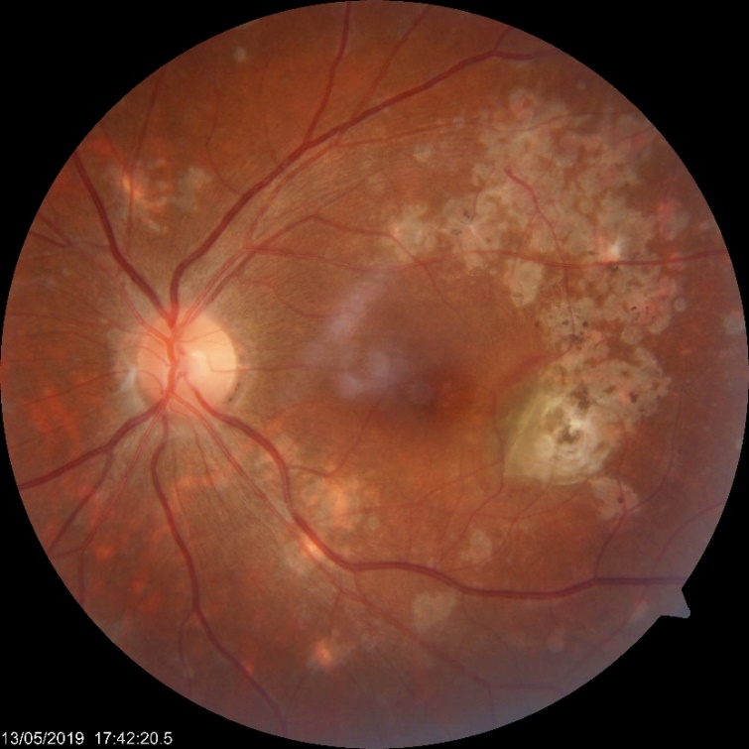
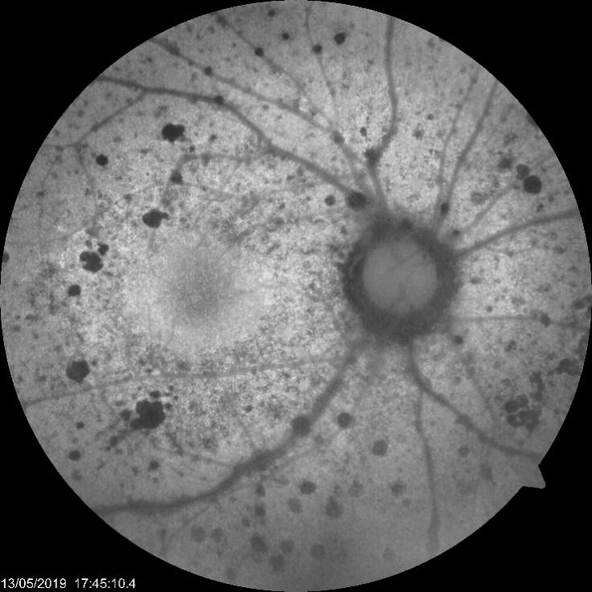
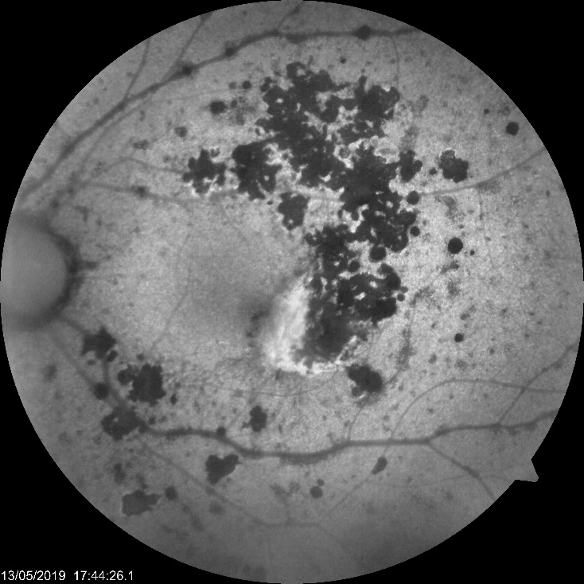
Retinography on admission

Slide 4
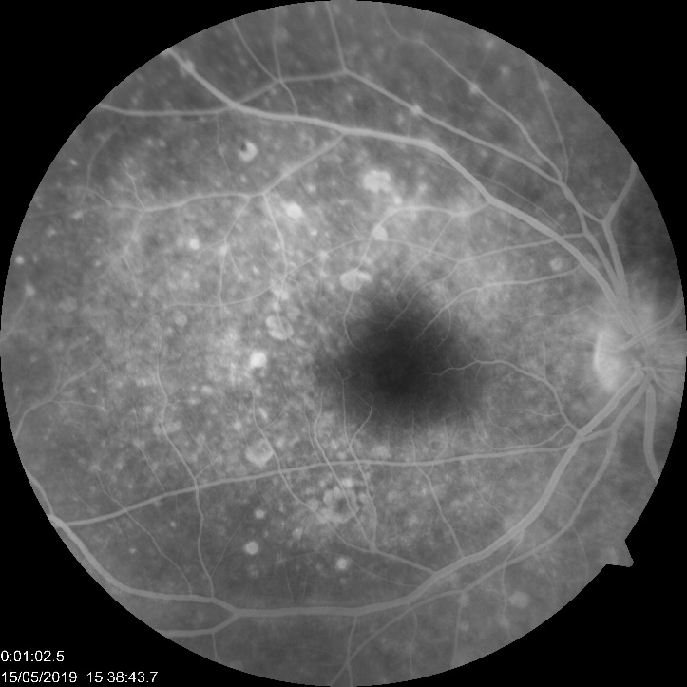
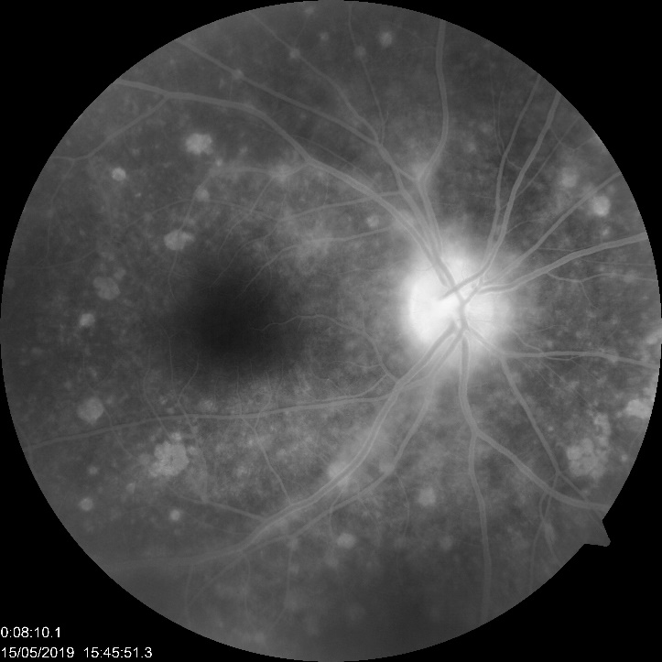
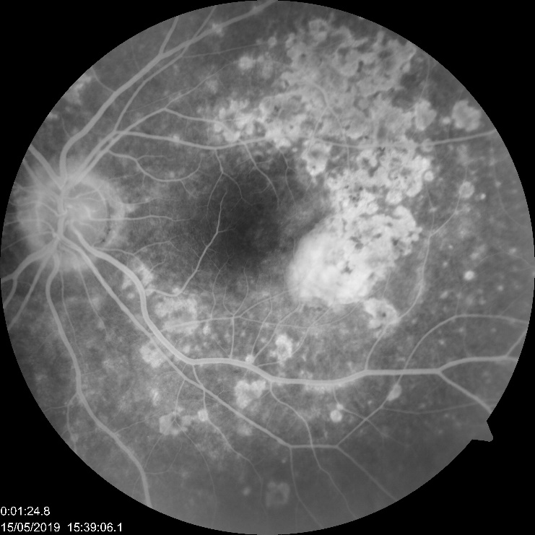
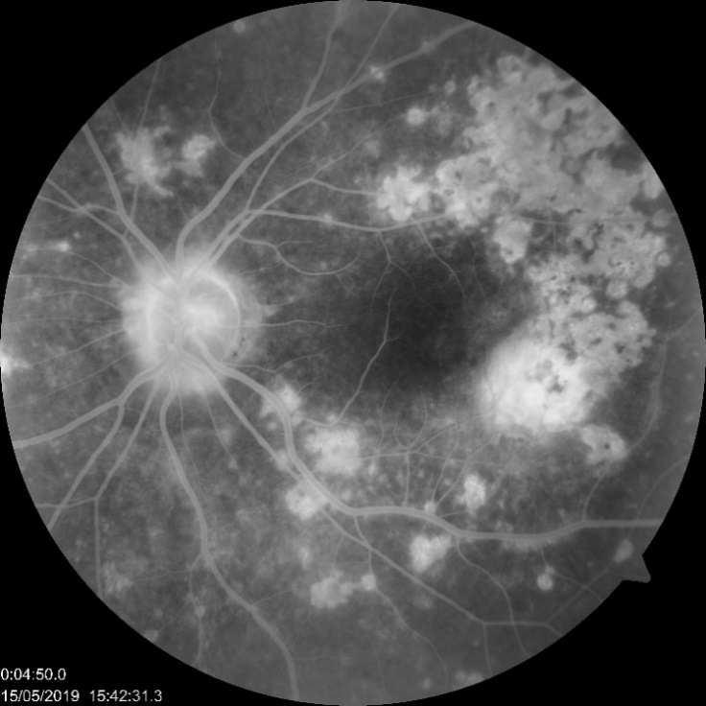
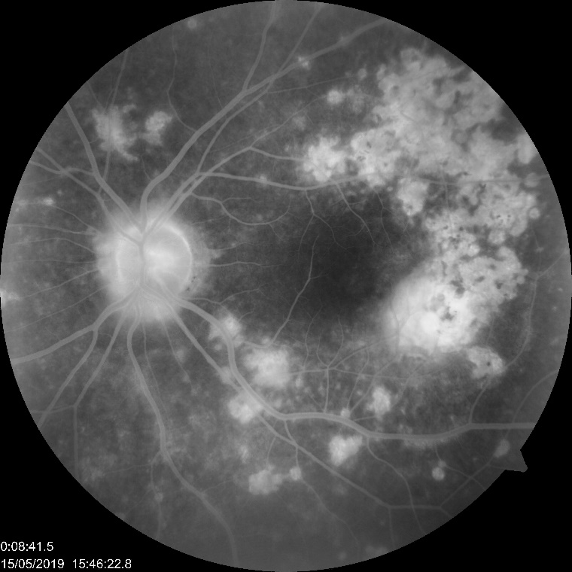
Fluorescein angiography on admission

Slide 5
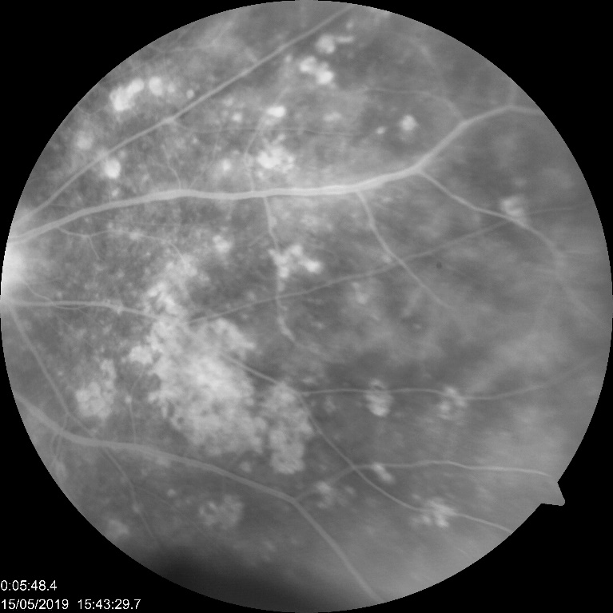
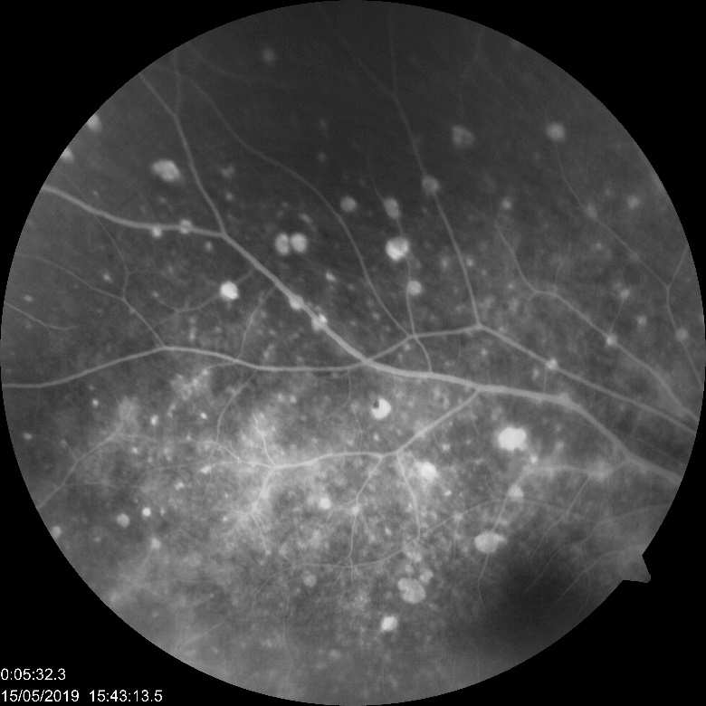

Slide 6
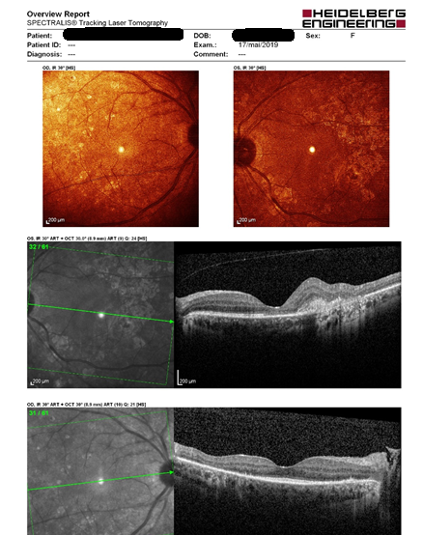
OCT on admission

Slide 7
Clinical case
Screening for infectious diseases
VDRL 1:128
FTA ABS +

Slide 8
She was referred to the another hospital for hospitalization and treatment of neurosyphilis with crystalline penicillin for 14 days
After treatment VA : OD: 1.0
OS : 0.2

Slide 9
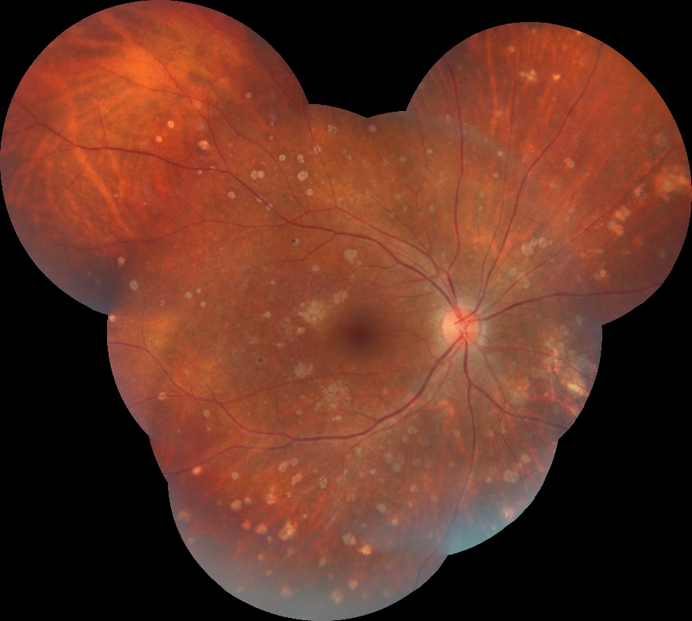
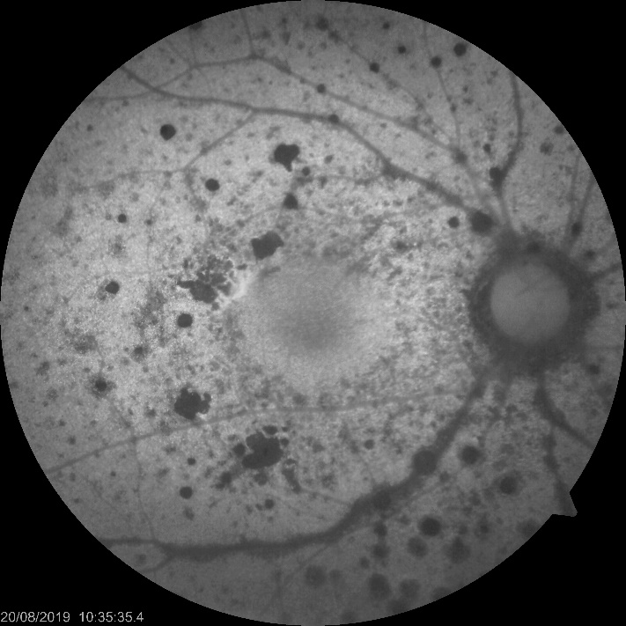
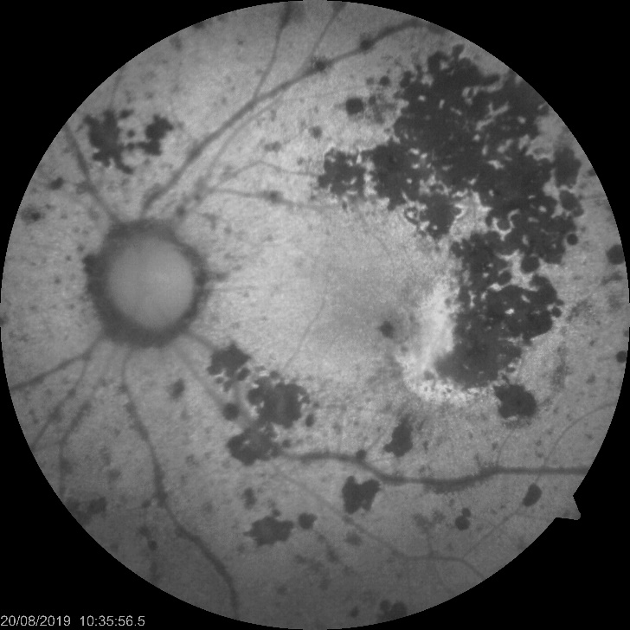
Later 3 months

Slide 10
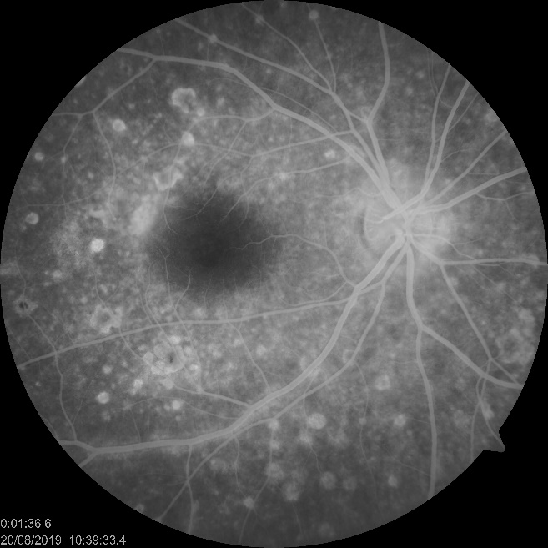
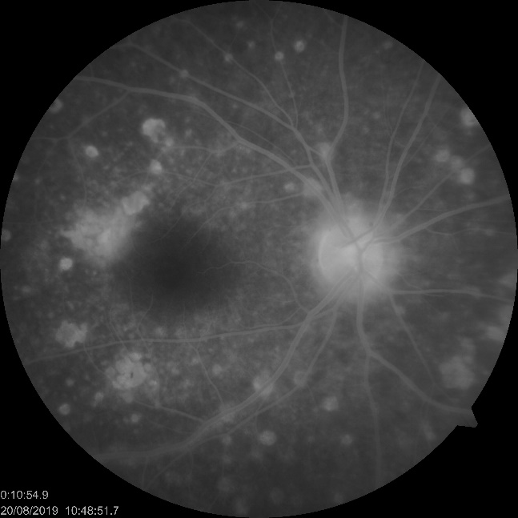
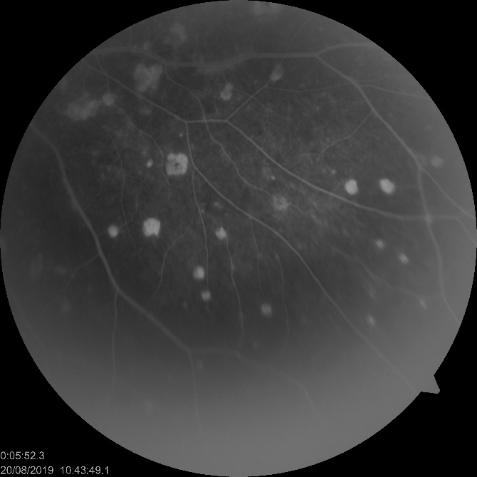
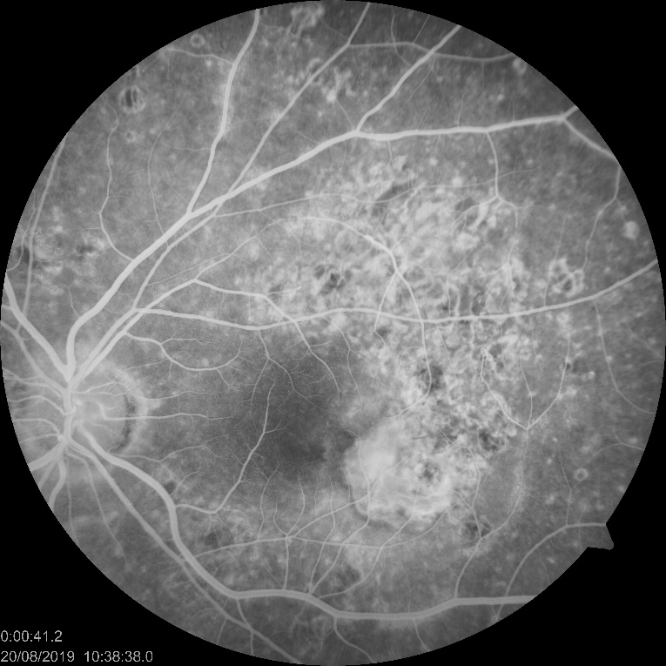
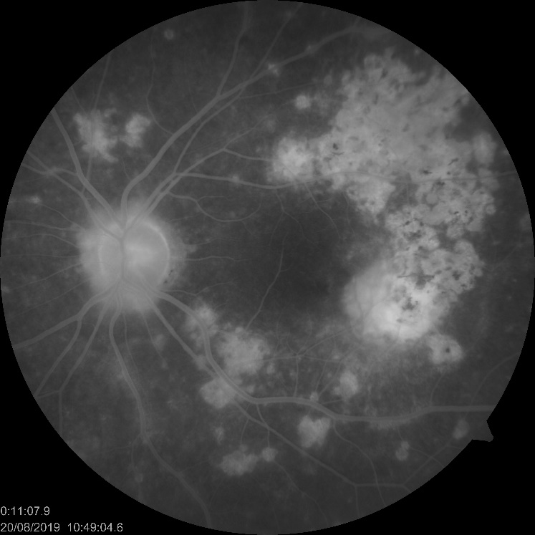
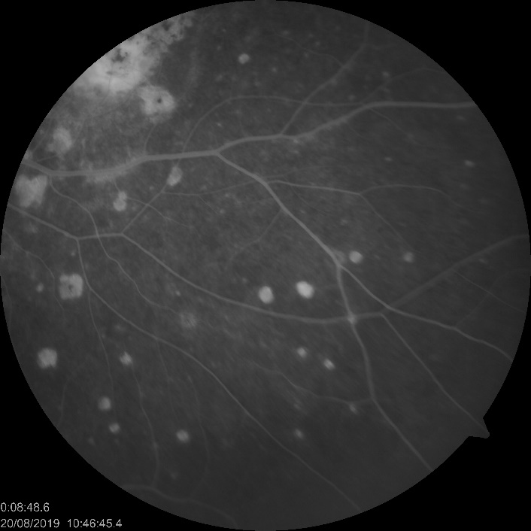

Slide 11
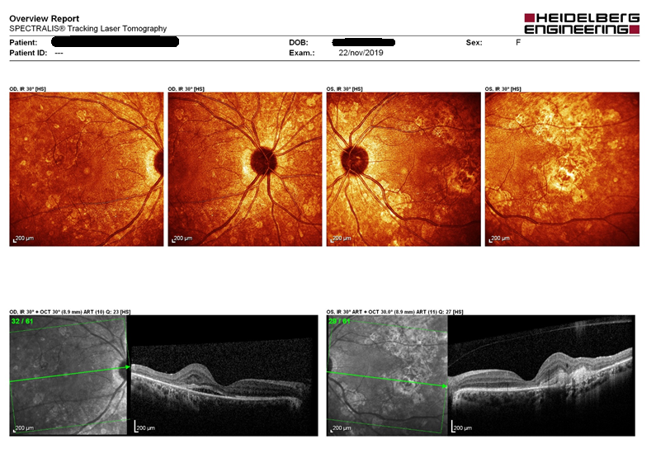
Low visual acuity OD VA: 0,6 OD/ 0,1 OS VDRL 1:32

Slide 12
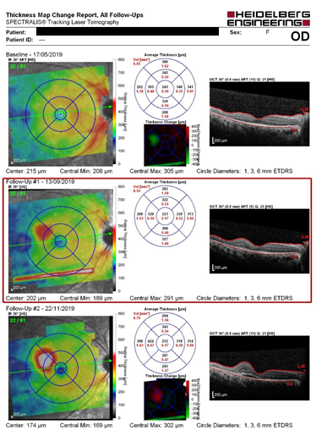
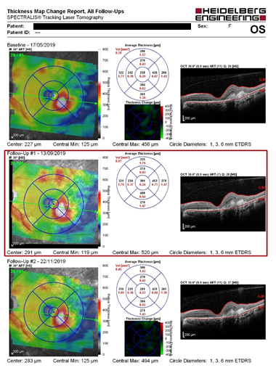
Patient still awaiting anti-VEGF OD
Evolution...

Slide 13
THANKS

