Slide 1
45th BRAVS Meeting Retina Start Clinical Case
Luis Filipe Nakayama, MD
Alex Treiger Grupenmacher, MD
Escola Paulista de Medicina - UNIFESP

Slide 2
Anamnesis
CC: subtle vision loss in the right eye for 4 days.
POH: unremarkable
PMH: Combined Oral Contraceptive Pill (Drosperinone 3mg and Ethinyl estradiol 0.03mg) due to Polycystic Ovary Syndrome for 5 months
PFH: unremarkable
Social History: unremarkable

Slide 3
Ocular examination
 | Right eye | Left eye
VISUAL ACUITY | 20/20 (-1.00De) | 20/20 (-1.00De)
SLIT LAMP EXAMINATION | Normal eyelids and eyelashes, clear cornea and conjunctiva, no anterior chamber reaction
INTRAOCULAR PRESSURE | 14 mmHg | 14 mmHg
PUPILS | NO RELATIVE AFFERENT PUPILLARY DEFECT

Slide 4
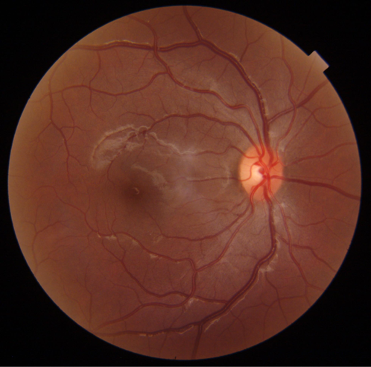
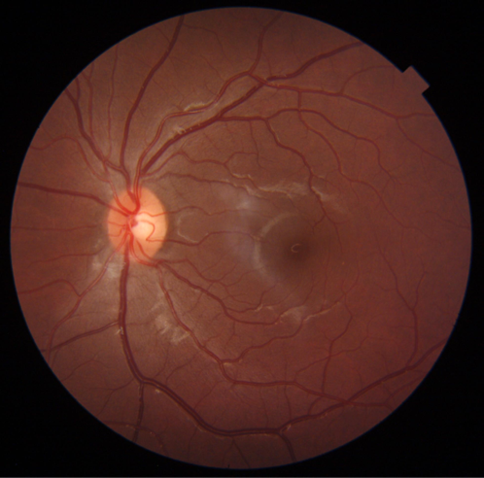
Unremarkable OU

Slide 5
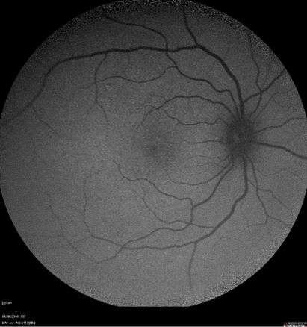
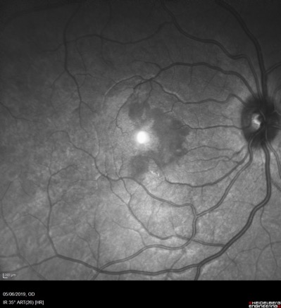

Slide 8
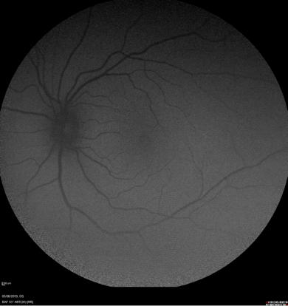
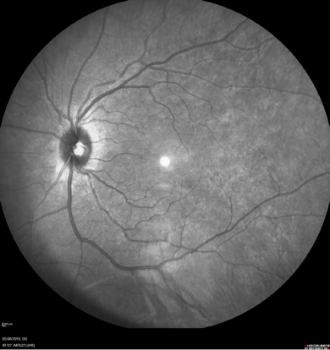

Slide 11
Diagnosis
Acute Macular Neuoretinopathy
Epidemiology
Symptoms
Pathophisiology
Treatment

Slide 12
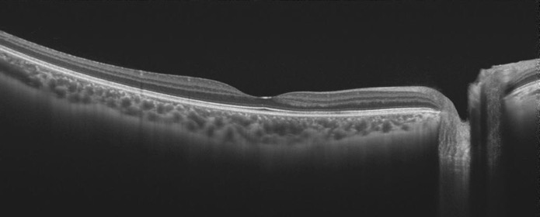
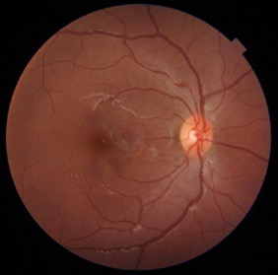
3 months follow-up

Slide 13
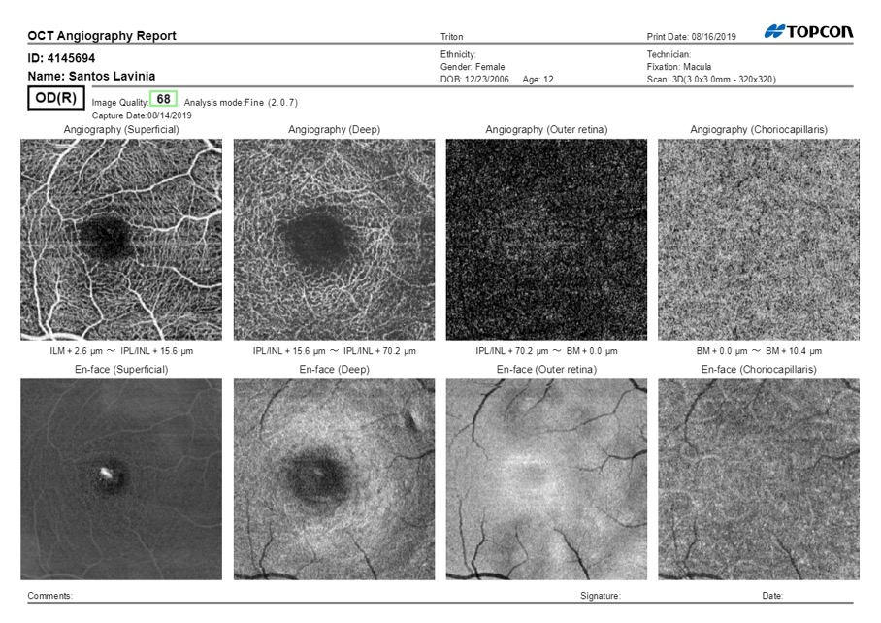

Slide 14
Discussion
Youngest literature report of AMN patient
Infra-red Fundus Retinography and OCT as best exams to identify lesions
3 month follow up with chronification of lesion

