Slide 1
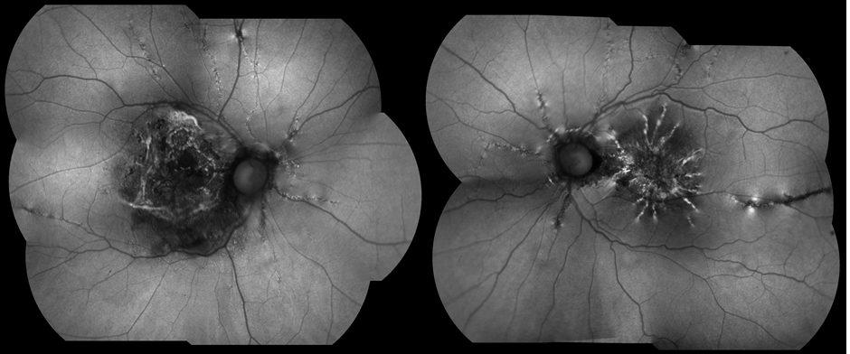
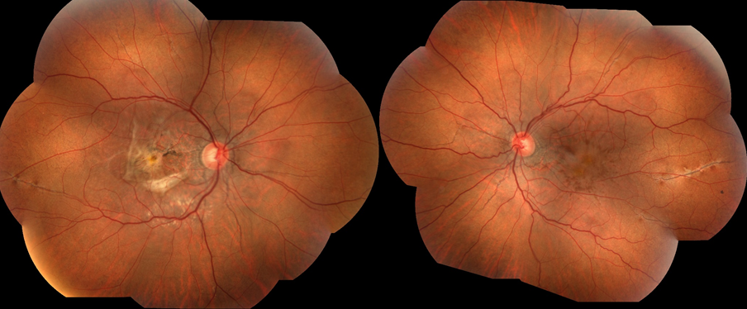
ANGIOID STREAKS: CASE REPORT
Andréia Novelli; Rafael Garcia; Paulo Henrique Horizonte; Raimunda Cristina M. F. de Oliveira; Henrique Monteiro Leber; Leonardo Cardoso; Nathália Nishiyama Tondelli; André Marcelo V. Gomes.
Instituto Suel Abujamra
PURPOSE
RESULTS
To report a case of angioid streaks in a previously healthy 76-year-old female patient.
A 76-years-old female patient presented for routine ophthalmologic check-up. She reported systemic arterial hypertension and denies other diseases or use of other routine medications.
Her best corrected visual acuity (BCVA) was 20/100 in the right eye and 20/50 in the left eye. Anterior segment examination was unremarkable. Dilated fundus examination of the right eye revealed areas of fibrotic macular scars and radial dark-brown lines emerging from the optic disc. Some small intraretinal hemorrhages were seen in the posterior pole of the left eye (Image 1). AS could be observed bilaterally. The FAF showed hyperautofluorescent lines in a radiating fashion emanating from the optic nerve (Image 2).
We ruled out systemic conditions related with AS. We chose to keep monitoring her every six months with fundoscopy and complementary exams to detect any associated complications.
INTRODUCTION
Angioid streaks (AS) are bilateral, narrow, irregular, and deep radiations in the retina, being wider at the origin of the optic nerve and reducing in as they branch. The number of streaks in an affected eye can vary from one to dozens. Angioid streaks can be orange, red, grey or brown in color and can be mistaken for retinal blood vessels.
AS result from crack-line dehiscences in Bruch’s membrane, which is abnormal in its structural composition, predisposing to these focal areas of ruptures. This process may occur spontaneously or due to blunt trauma.
It is associated with systemic diseases such as elastic pseudoxanthoma, Ehlers-Danlos, Paget's disease and hemoglobinopathies. The diagnosis is clinical and can be confirmed with the aid of fluorescein angiography (AF).
They are asymptomatic, when not associated with complications, such as intrarretinal hemorrhages and choroidal neovascularization (CNV). These complications must be rapidly identified and treated, in order to prevent visual loss.
Image 2
DISCUSSION
Despite being generally asymptomatic, and therefore not requiring specific treatment, AS can lead to complications.
CNV result from the growth of a fibrovascular tissue from the choroid to the retinal pigmented epithelium, causing subretinal hemorrhages and fluid accumulation, which is responsible for visual loss.
We highlight the importance of follow-up to determine whether there are associated systemic diseases or secondary eye complications, which require medical approach and treatment.
IMAGES
METHODS
BIBLIOGRAPHY
Medical record review.
American Academy of Ophthalmology – http://www.aao.org/.
Angioid streaks: A Comprehensive Review From Pathophysiology to Treatment - Chatziralli I, 2019, Jan.
Image 1
Notes:
purpose, methods, results and discussion

