Slide 1
Clinical Report
Felipe Ribeiro de Souza
Fellow Retina - HC FMUSP
Special Thanks:
Dra. Cleide Machado
Dra. Vera Castanheira
Dr. Sérgio L. Pimentel

Slide 2
Clinical Report
ID: I.L.R., 63 years old , female, caucasian, from São Paulo, SP
CC: Vision loss OS
HPI: Vision loss left eye 10 days ago, after vomiting episodes
POH:
LASIK 2003 (-6D)
Phacoemulsification OU 2016
PPVV + Scleral buckle OS jun/17 (RD + MH)
PMH: Breast cancer 2012, systemic arterial hypertension
MED: Sertraline, Atenolol, Artovastatin

Slide 3
Clinical Report
Ophthalmological Examination:
BCVA:
-1,00 ^ -1,25 x 80 (20/25)
Plane ^ -1,25 x 90 (20/100)
SLE OU: PSF OU, PCO 1+ OE
IOP: 10/13mmHg
Dilated Fundus Exam: Photos
Notes:
Não tem Retinografia inicial
Apenas descrição do FO

Slide 4
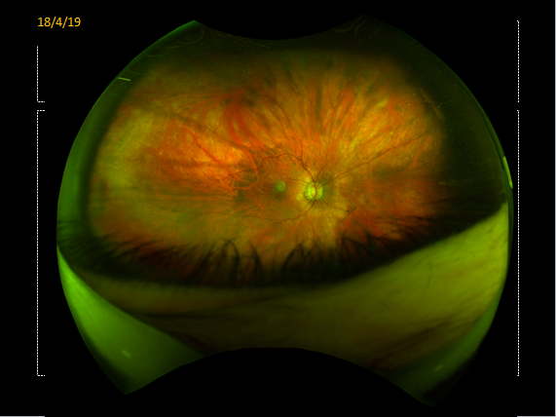

Slide 5
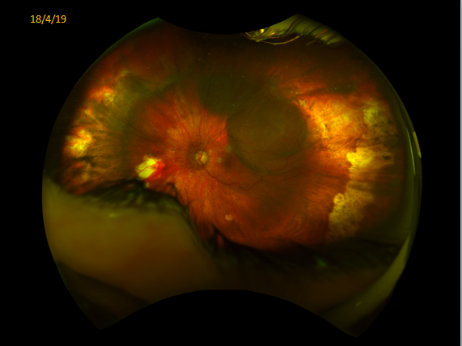
18/4/19

Slide 6
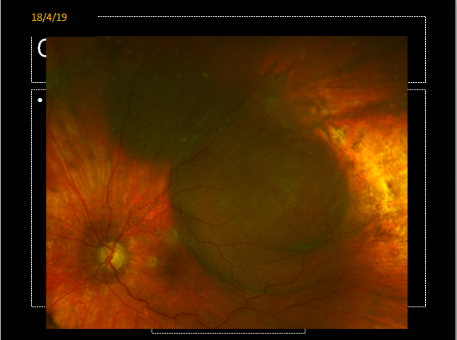
18/4/19

Slide 7
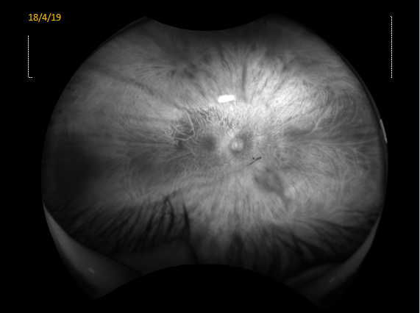
18/4/19

Slide 8
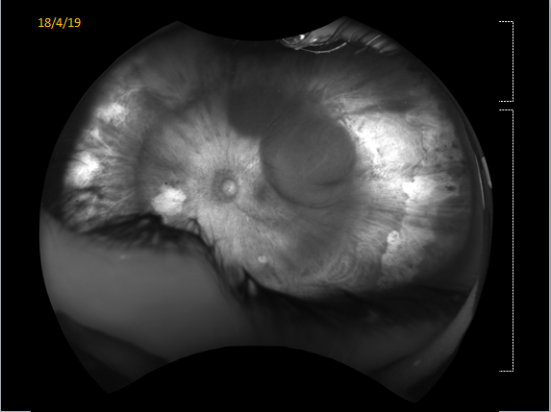
18/4/19

Slide 9
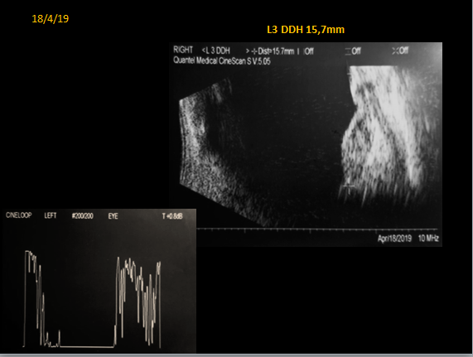
18/4/19
L3 DDH 15,7mm

Slide 10
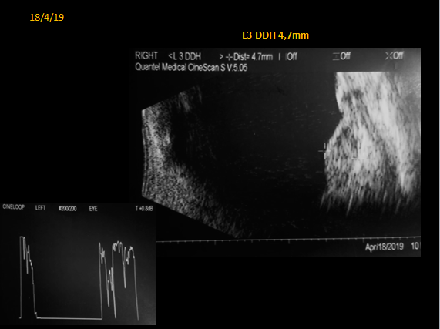
18/4/19
L3 DDH 4,7mm

Slide 11
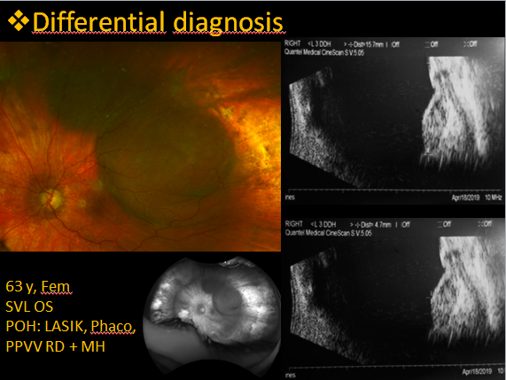

Slide 12
Differential diagnosis
Choroidal Melanoma
Spontaneous Suprachoroidal Hemorrhage Secondary to Valsalva Maneuver
Peripheral exudative hemorrhagic chorioretinopathy (PEHCR)

Slide 13
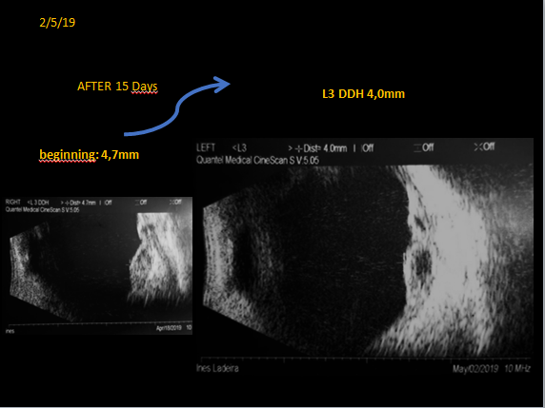

Slide 14
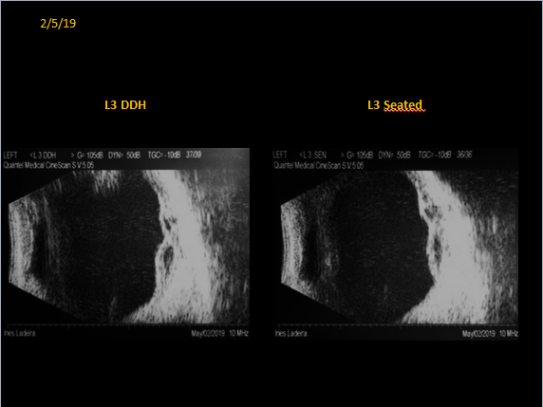
18/4/19

Slide 15
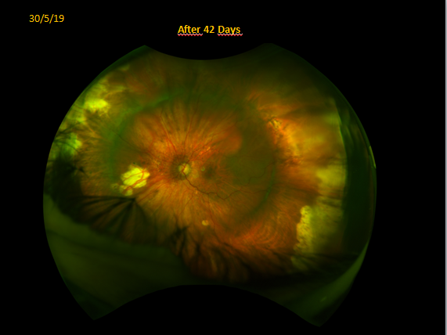
30/5/19
After 42 Days

Slide 16
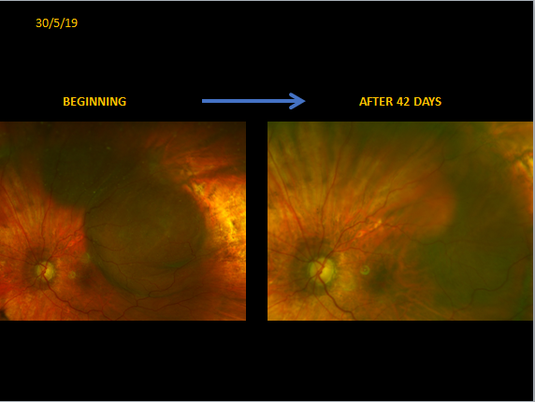
30/5/19

Slide 17
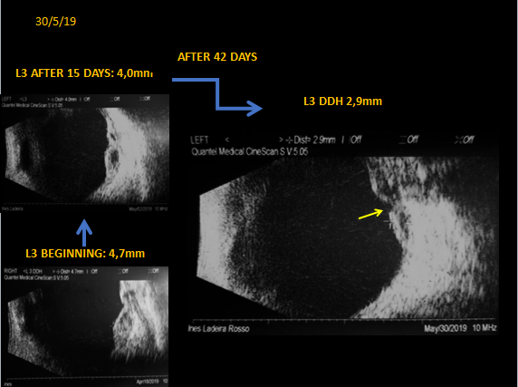

Slide 18
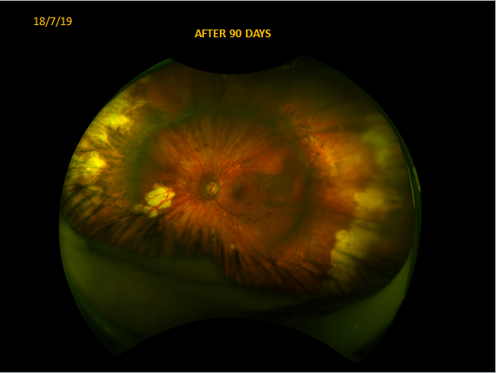
18/7/19

Slide 19
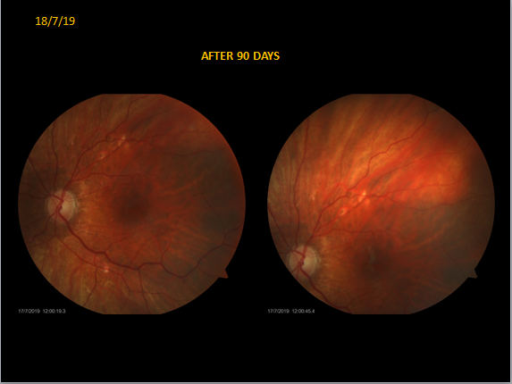
18/7/19
AFTER 90 DAYS

Slide 20
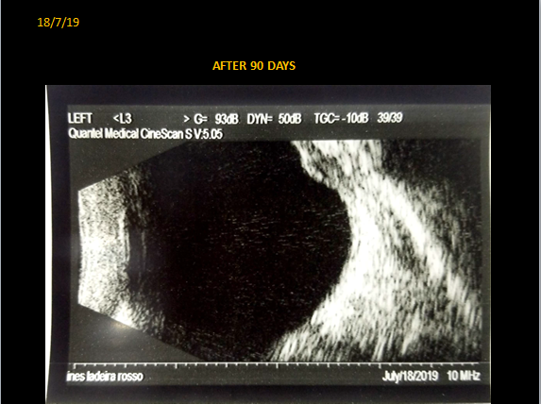
18/7/19

Slide 21
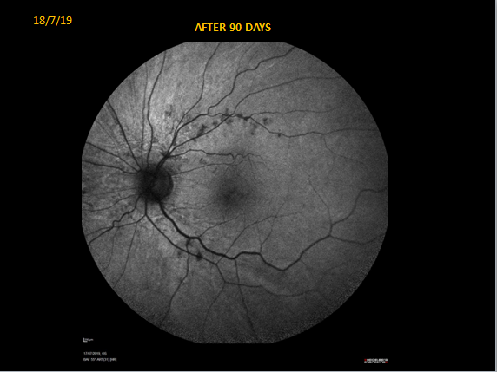
18/7/19
AFTER 90 DAYS

Slide 22
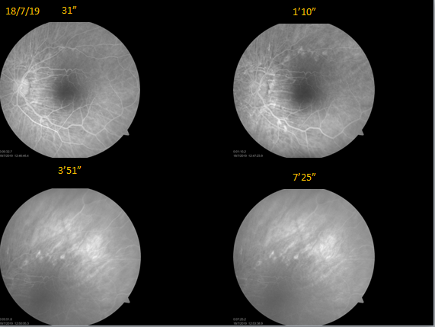
18/7/19
31”
1’10”
3’51”
7’25”

Slide 23
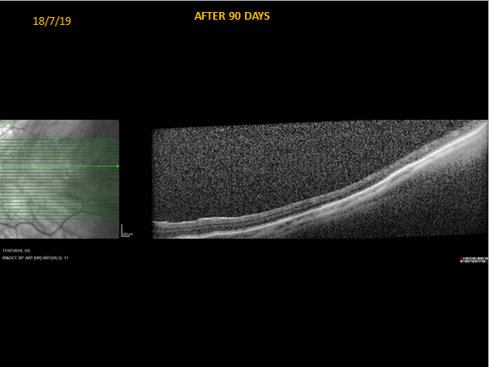
18/7/19
AFTER 90 DAYS

Slide 24
Spontaneous Suprachoroidal Hemorrhage Secondary to Valsalva Maneuver

Slide 25
Thank You

