Slide 1
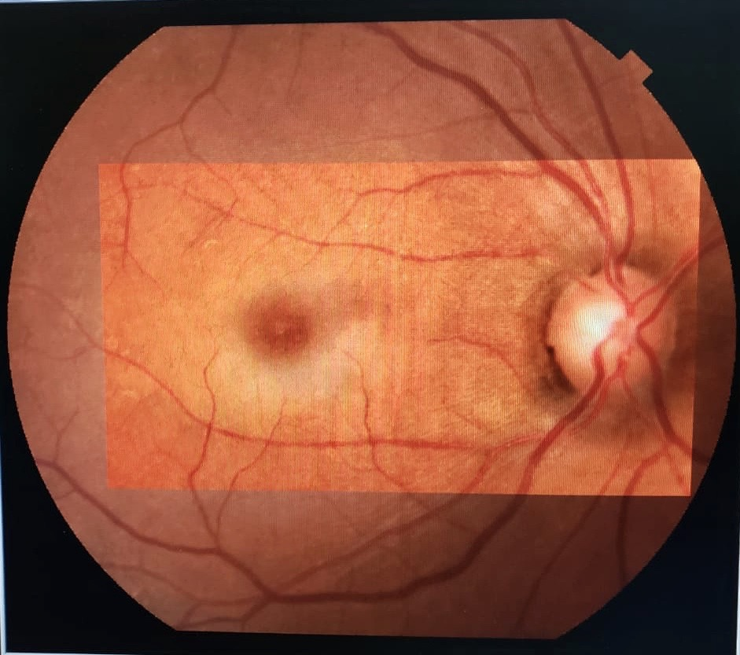
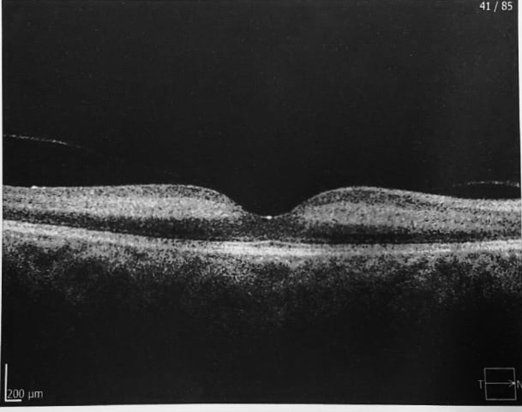
Isolated Cilioretinal Artery Occlusion After Cardiac Catheterization: A Case Report
Raimunda Cristina M. Freire de Oliveira; Fernanda C. Rollo Sampaio; Rafael Garcia;Paulo Henrique Horizonte; André Marcelo Viera Gomes; Luciano Fuzzato Filho; Henrique Monteiro Leber; Nina Rosa Konichi da Silva.
INTRODUCTION
RECORD
Central retinal artery occlusion (CRAO) is a very unusual event, corresponding to only 5% of all retinal artery occlusions. Cilioretinal arteries arise from the short posterior ciliary arteries of the choroid and contribute to the macular blood supply in approximately 20% of the eyes. The retinal arterial circulation can be obstructed at any point from the ophthalmic artery to the distal arterioles. The location of the obstruction determines the pattern of visual loss.
Medical record review.
DISCUSSION
Diagnostic may result in complications, such as neurologic events (stroke, transient ischemic attack), arrhythmias and vascular problems. The incidence of systemic cholesterol emboli after a percutaneous transluminal coronary angioplasty was reported to be around 2%. However, ocular complications after these procedures are extremely rare. Once a cholesterol embolism has been established, no effective specific treatment exists.
CASE REPORT
A 72-year-old black female patient presented with a history of sudden and painless vision loss in the right eye that occurred 4 days ago, while she was undergoing a coronary angioplasty. Her chief complain was a central dark persistent scotomma. She had been under treatment for arterial hypertension, hyperlipidemia and unstable angina. Ophthalmologic examination shows that her best corrected visual acuity was 20/600 on the right eye and 20/25 on her left eye. Anterior segment biomicroscopy was unremarkable. Fundoscopy of the right eye revealed moderate hypertensive retinopathy and a very circumscribed pale fovea. There was no cherry-red-spot sign. The spectral domain OCT showed hyperreflective bands at the level of the middle retina, sparing its outer layers. Fluorescein angiography could not be performed due to unstable angina. The clinical features were suggestive of an acute macular ischemia compatible with isolated cilioretinal occlusion.
Figura 1: Retinografia colorida
KEY WORDS
Cilioretinal artery occlusion; Coronary angiolplasty
REFERENCES
-Central retinal artery occlusion- Hayreh SS. Indian J. Ophthalmology 2018
-Willacy Halley. Retinal occlusion. www.patiente.con.uk/pdf/1992.pdf
Figura 2: OCT

