Slide 1
Multifocal coroidopathy an unusual case
Vicente Hidalgo Fernandes
Retina Service –Department of Ophthalmology
HC – FCM - UNICAMP

Slide 2
Clinical presentation
April 2019
Initial Presentation
Male, 70y
Chronic and progressive visual acuity reduction in both eyes, with recent worsening
No previous eye surgery or trauma

Slide 3
Clinical presentation
April 2019 - Physical examination
BCVA
0,15 // CF
Biomicroscopy
Anterior chamber formed, no evidence of inflammation
Phakic, cataract N1
IOP
14mmHg both eyes

Slide 4
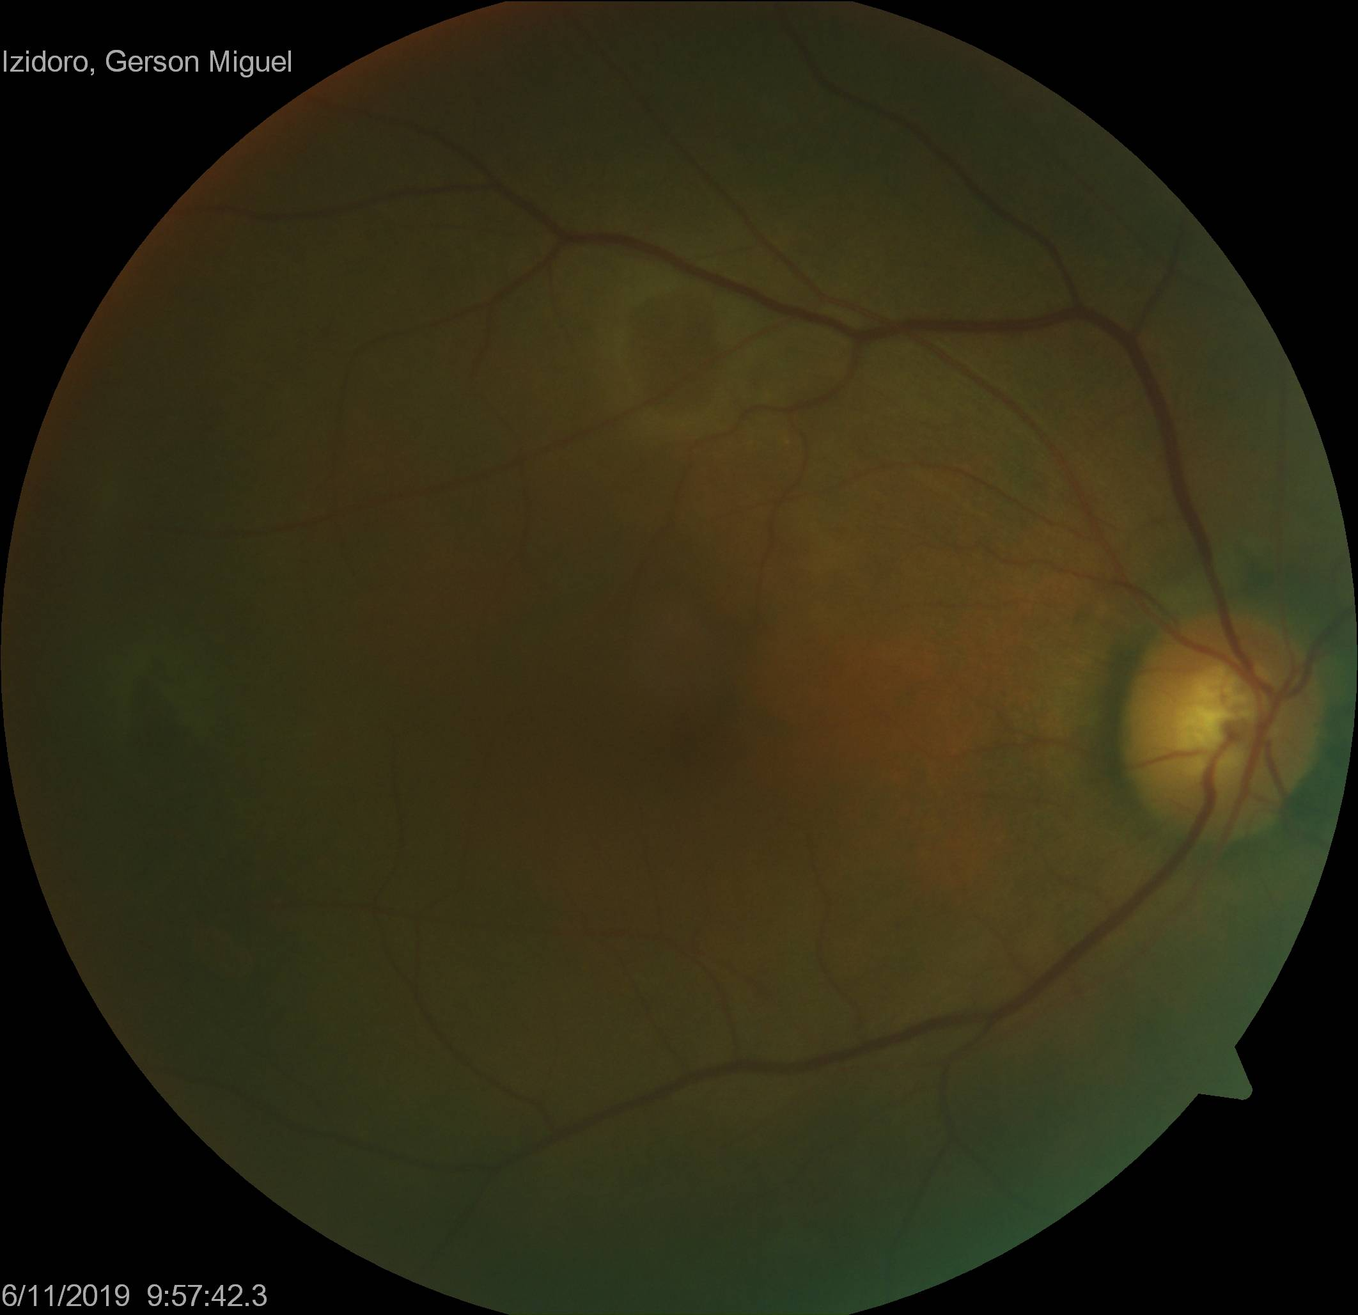
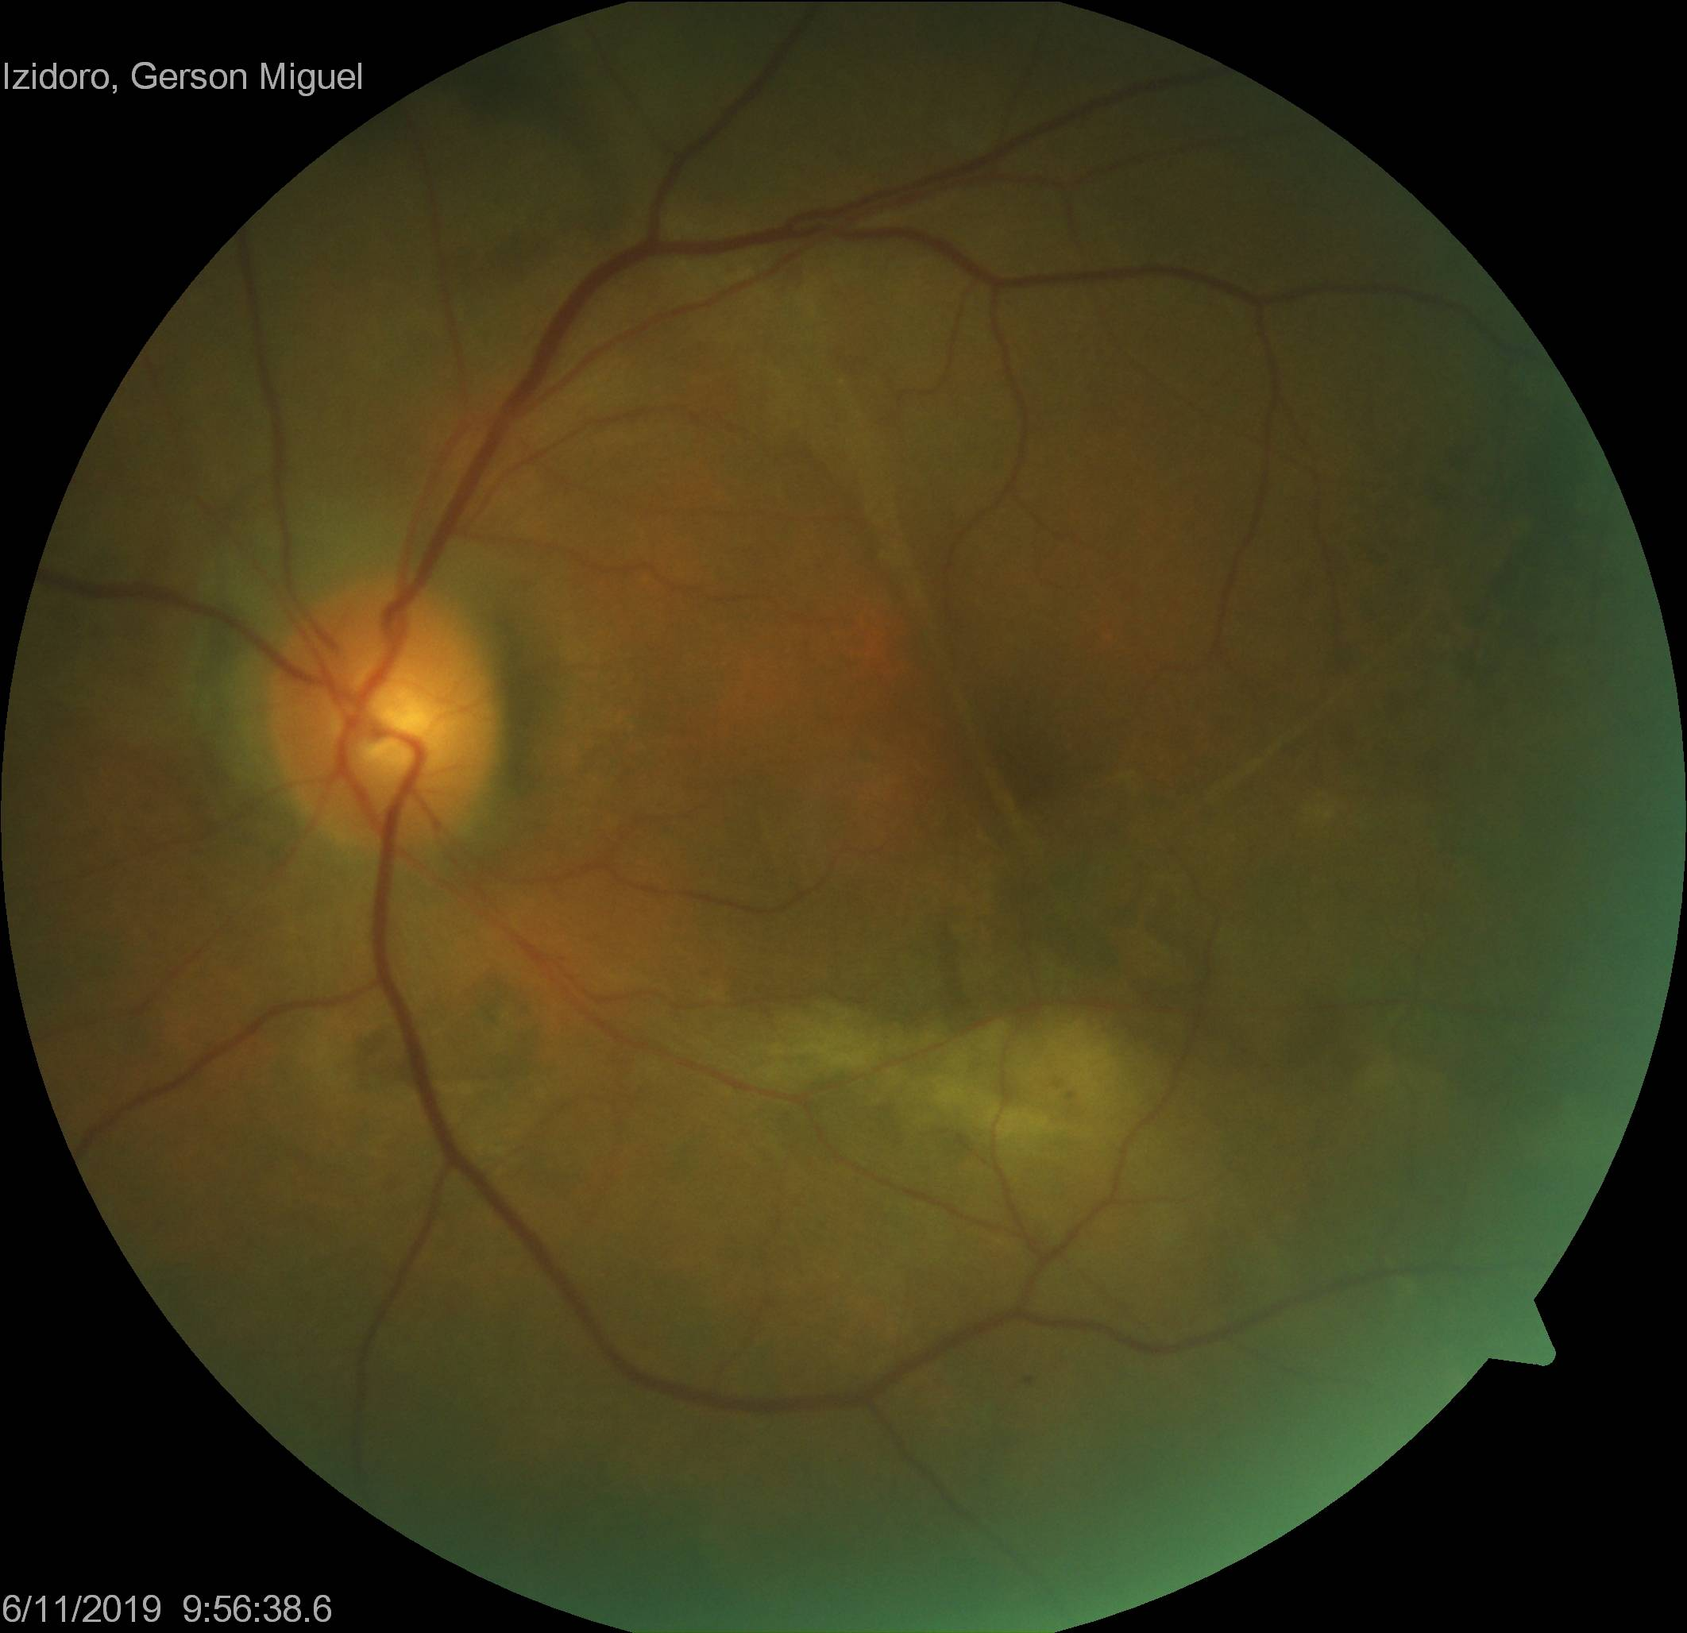
Clinical presentation Fundoscopy

Slide 5
Medical history
2016 / 2017
Difficult to control hypertension - Uses four classes of medications
Lower limb edema
Laboratory tests
Proteinuria 24h | 5,24g/24h (RV < 150) | Urine analysis | Prot 3+ / Hem 2+ c/ DE
Albumin / Creatine | 3904,25mg/g (RV < 30) | Creatine | 1,57 mg/dL (VR < 1,3)
Nephrotic Syndrome - Undetermined etiology

Slide 6
Medical history
2016 / 2017
Ophthalmological assessment at the time
BCVA: 0,4 both eyes
BIO: normal
Fundoscopy: Druses
Hypothesis: Non-exsudative AMD

Slide 7
Medical history
2016 / 2017
Etiology investigation
Syphilis - VDRL | NR | Schistosomiasis
Syphilis – FTA-ABS | Reagent | Xistoimune | Reagent
C3 e C4 | Reduced | Xistose | NR
Renal biopsy: Type I Membranoproliferative Glomerulonephritis
Hypothesis: MPGN I secondary to Schistosomiasis

Slide 8
Medical history
2018/2019
Edema decompensation → Anasarca
Corticosteroid - Prednisone 80mg/d
15 days → Ceased due to side effects
No record of hypertensive peaks at the time

Slide 9
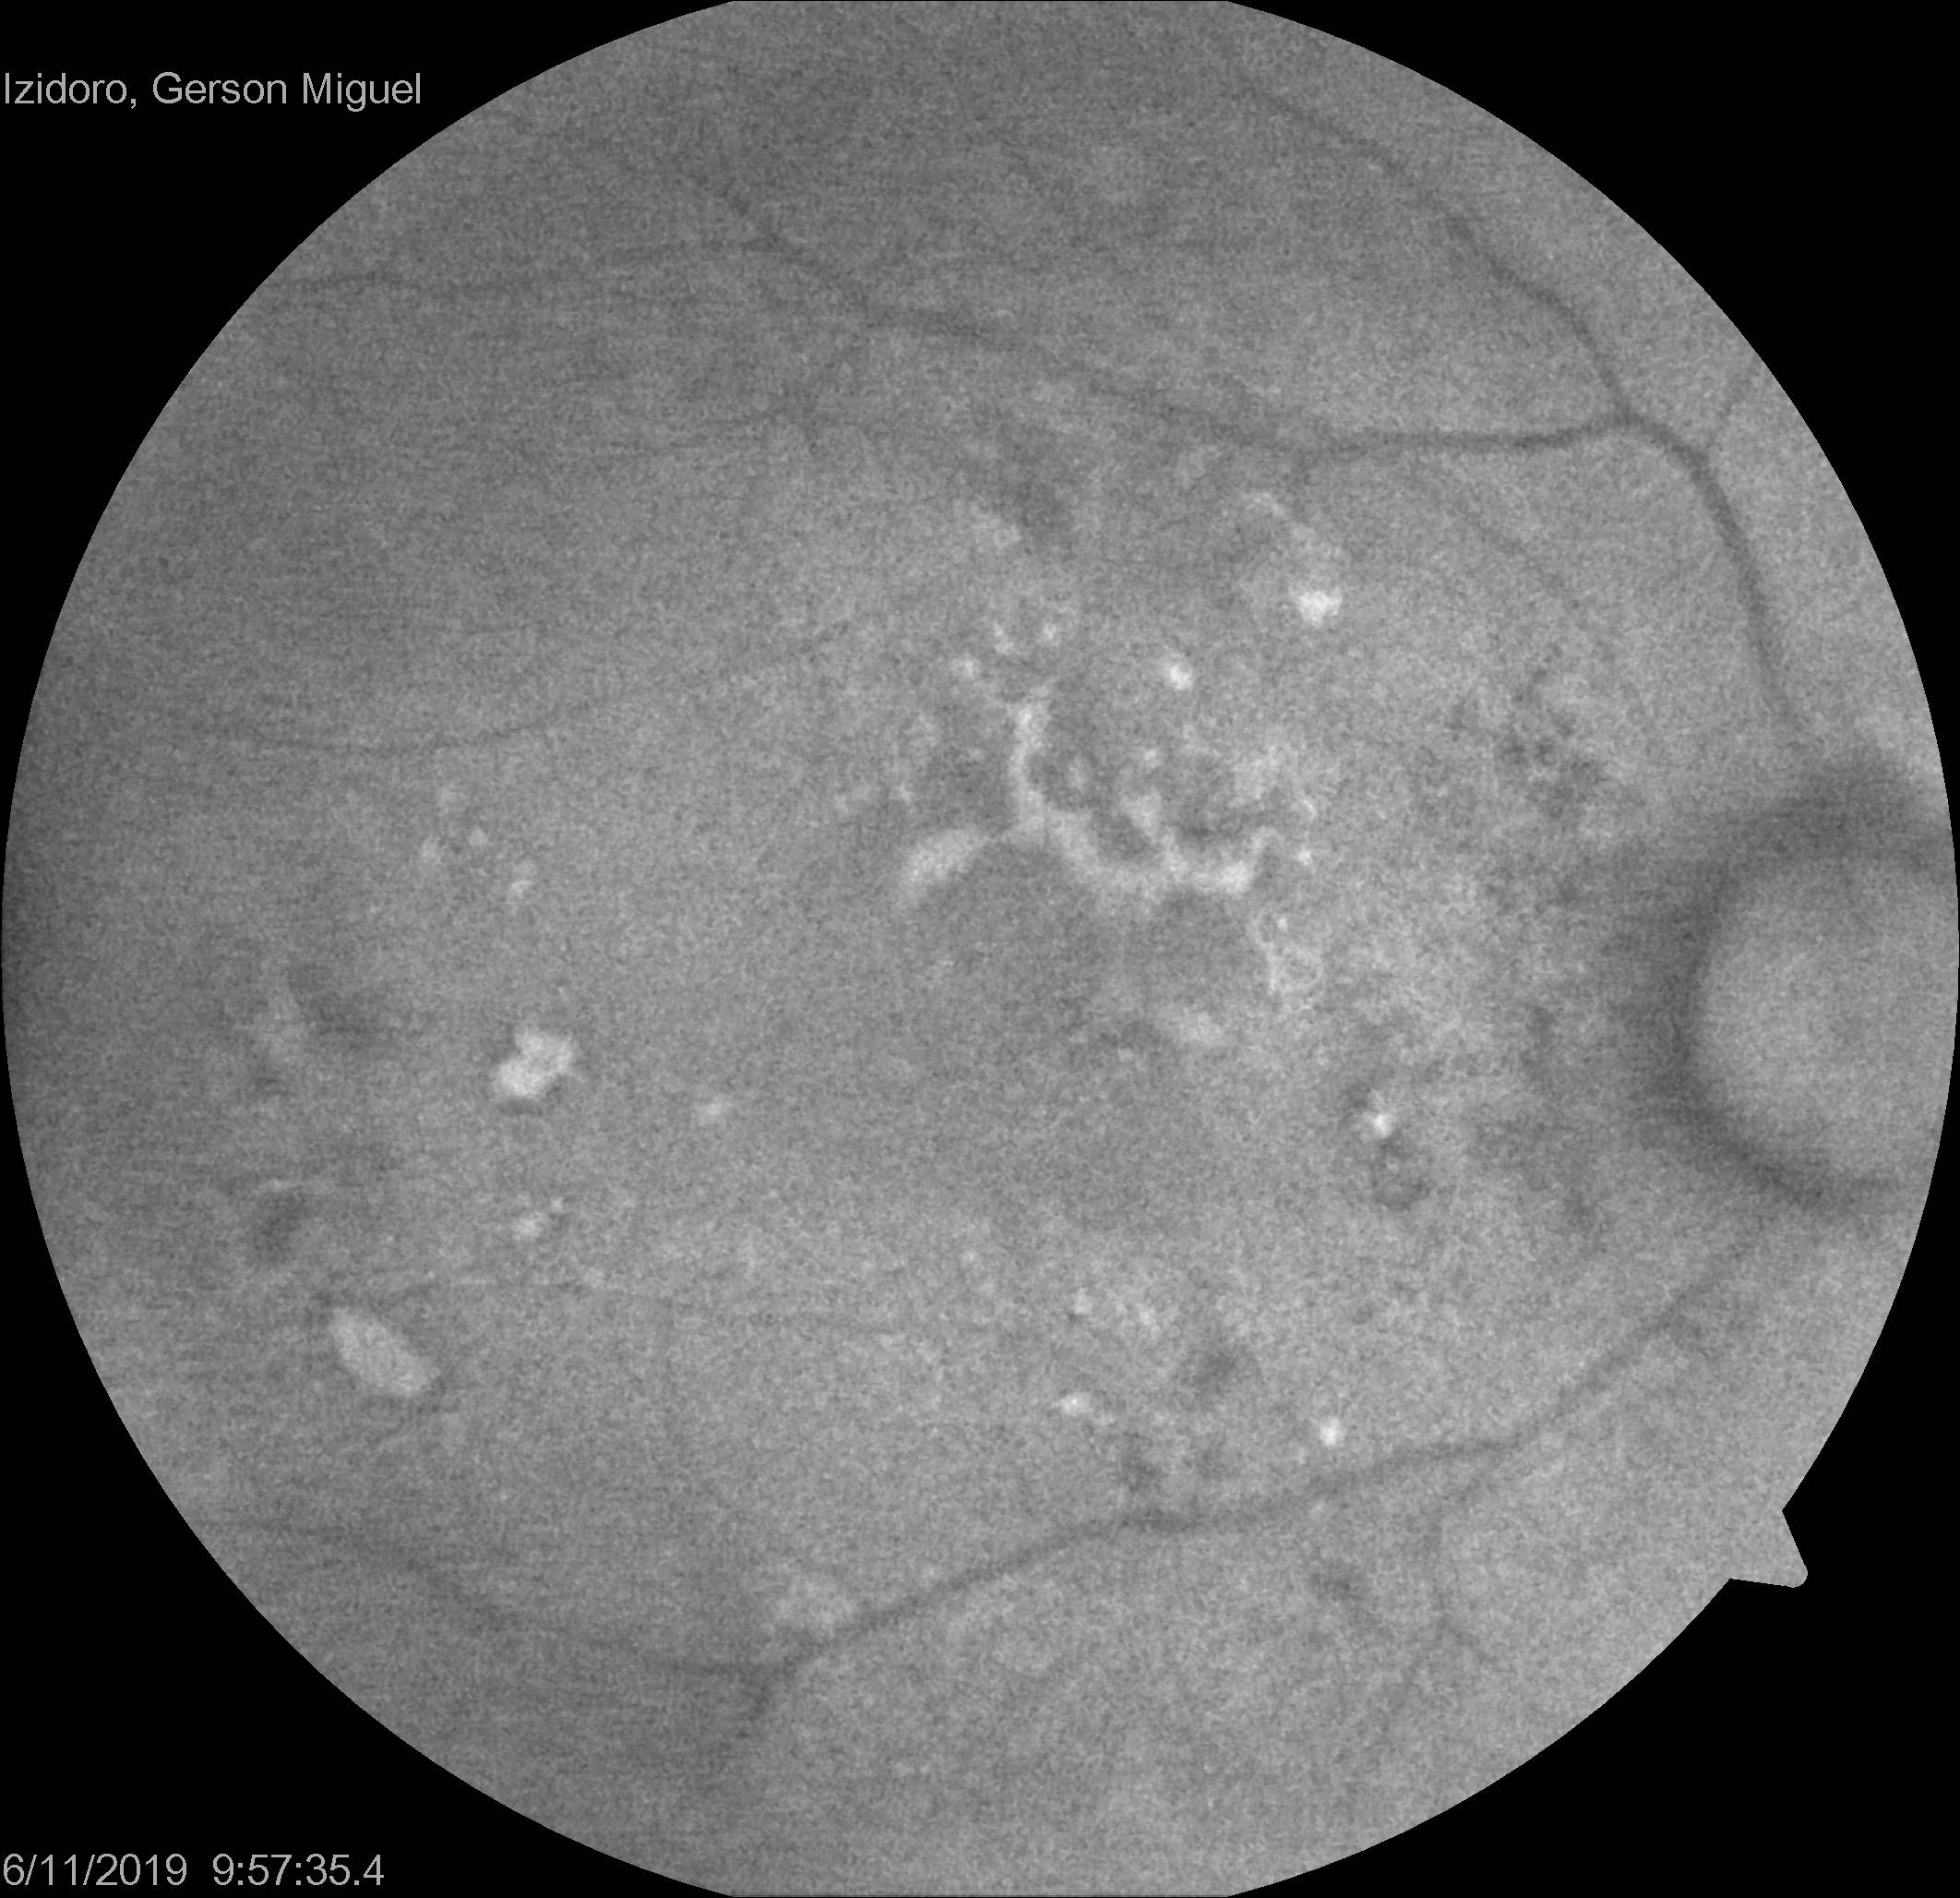
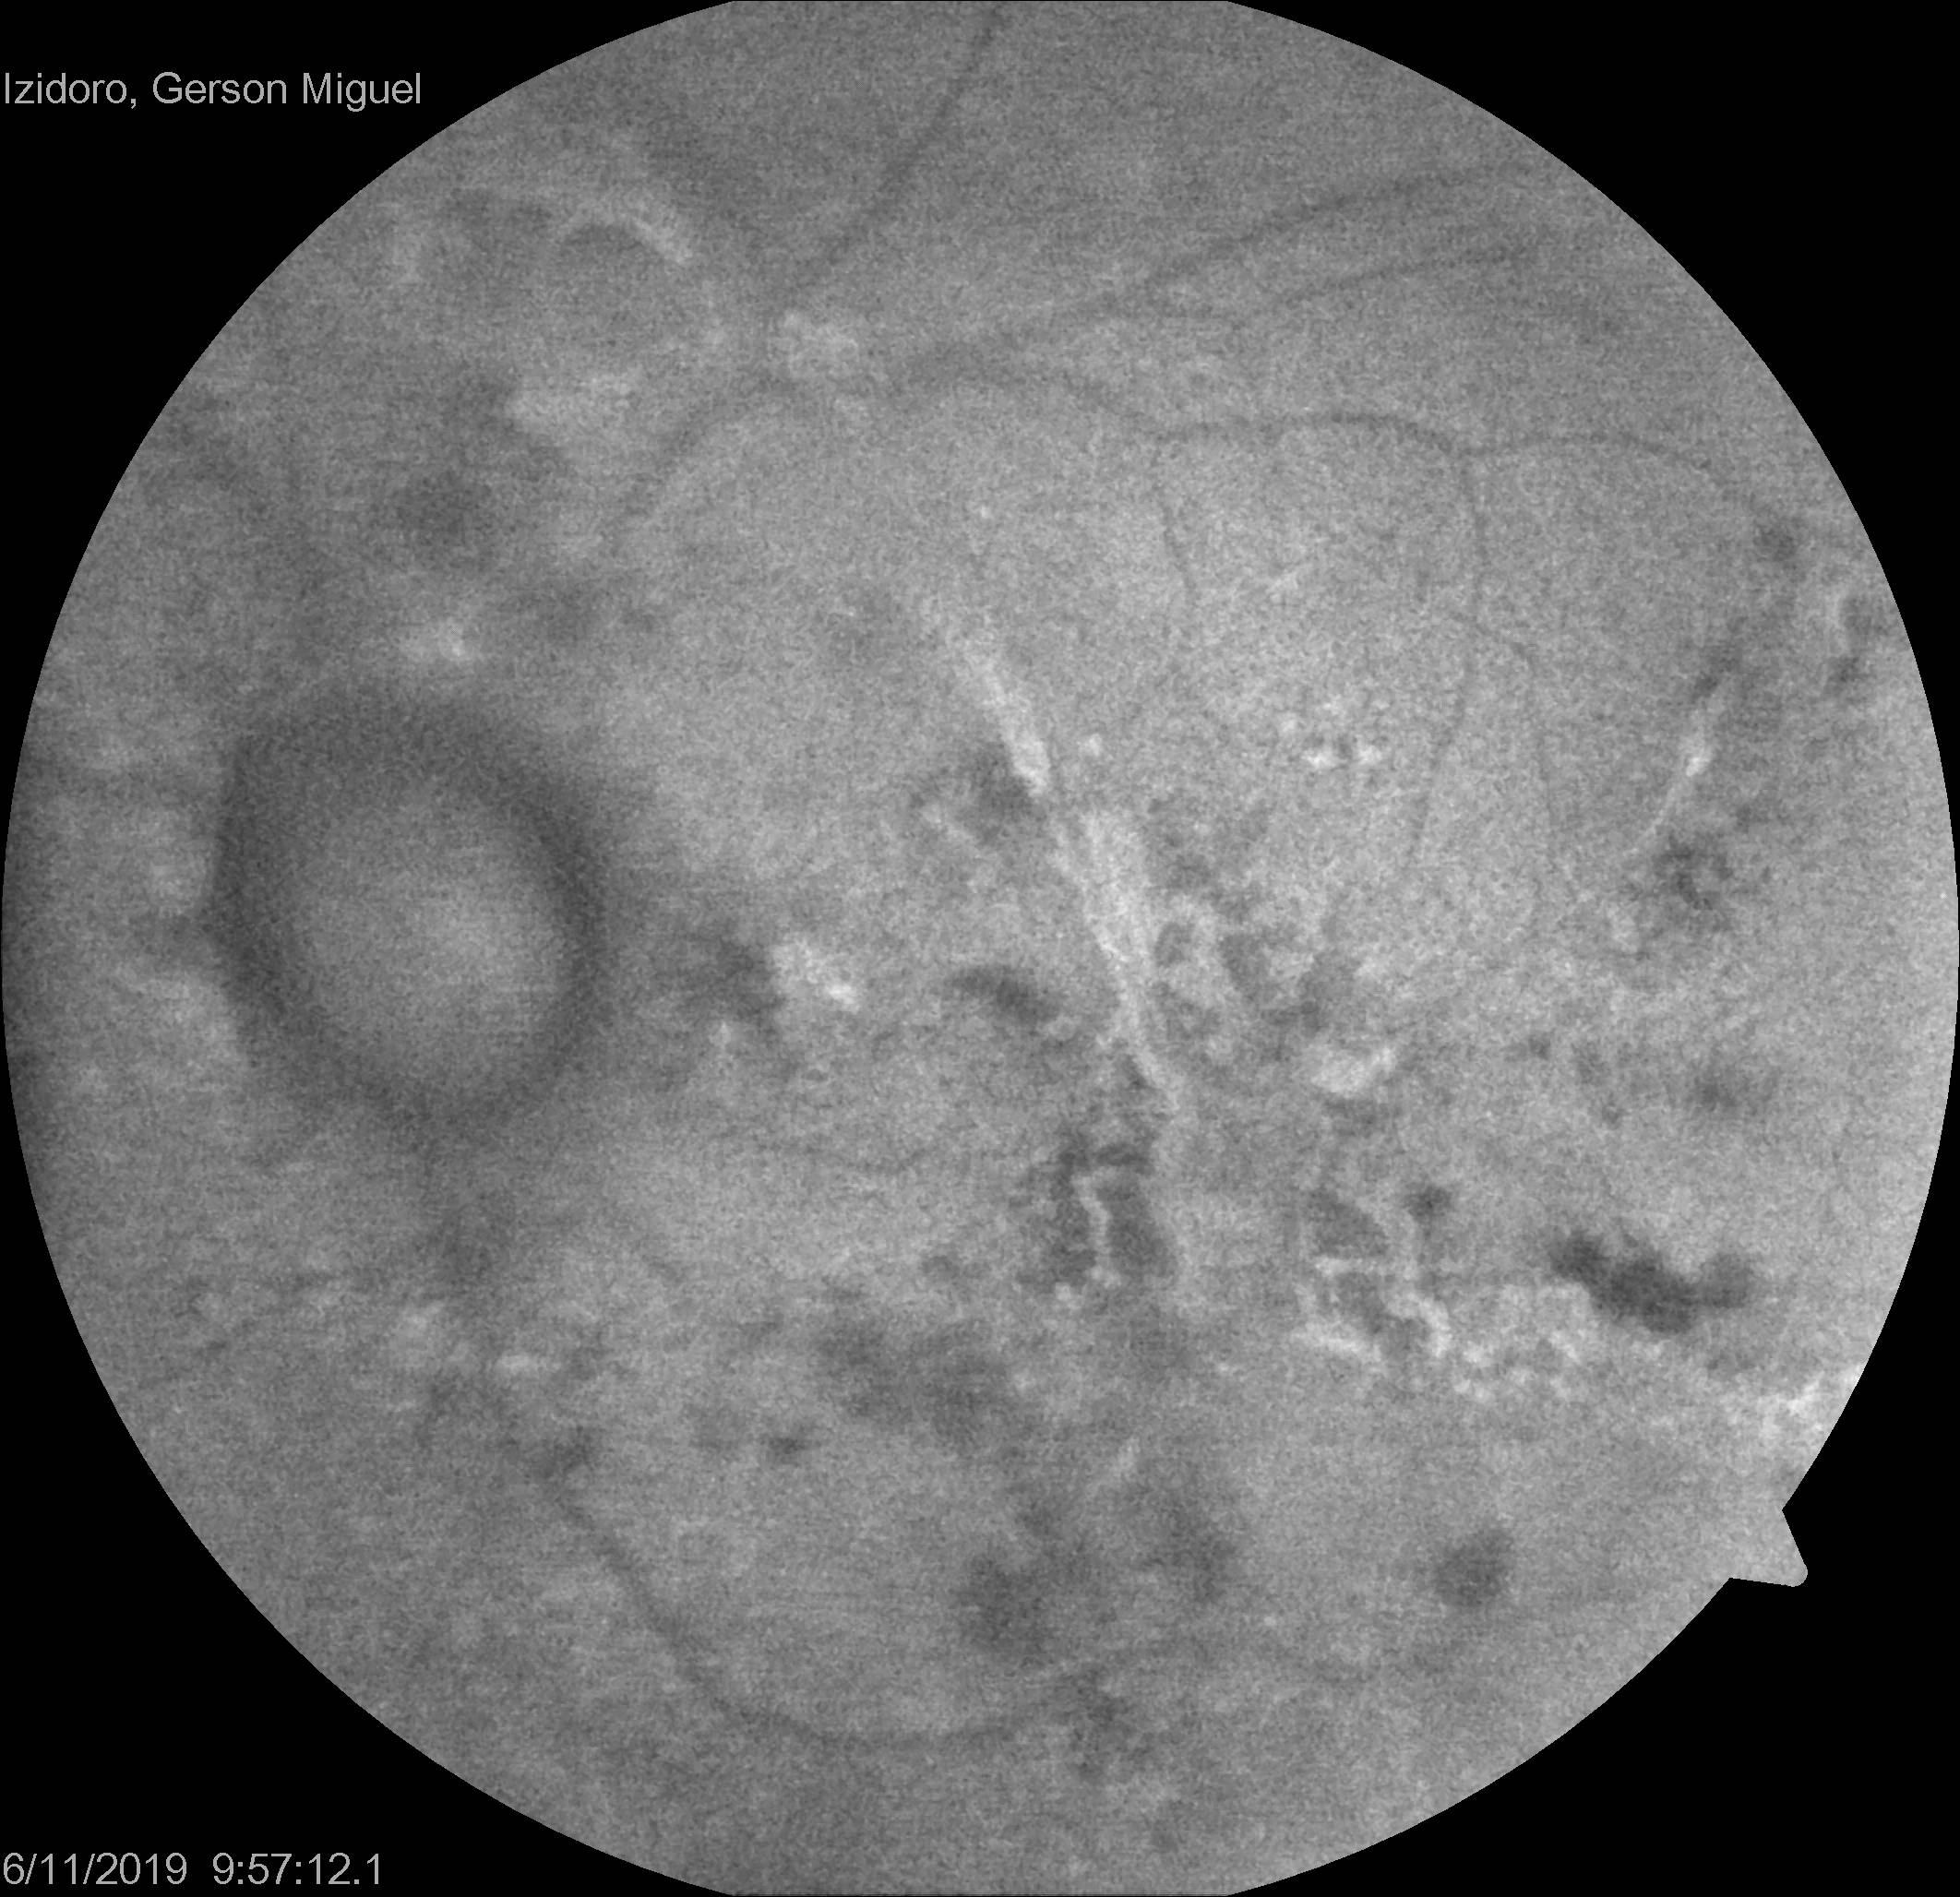
complementary exams fundus autofluorescence

Slide 10
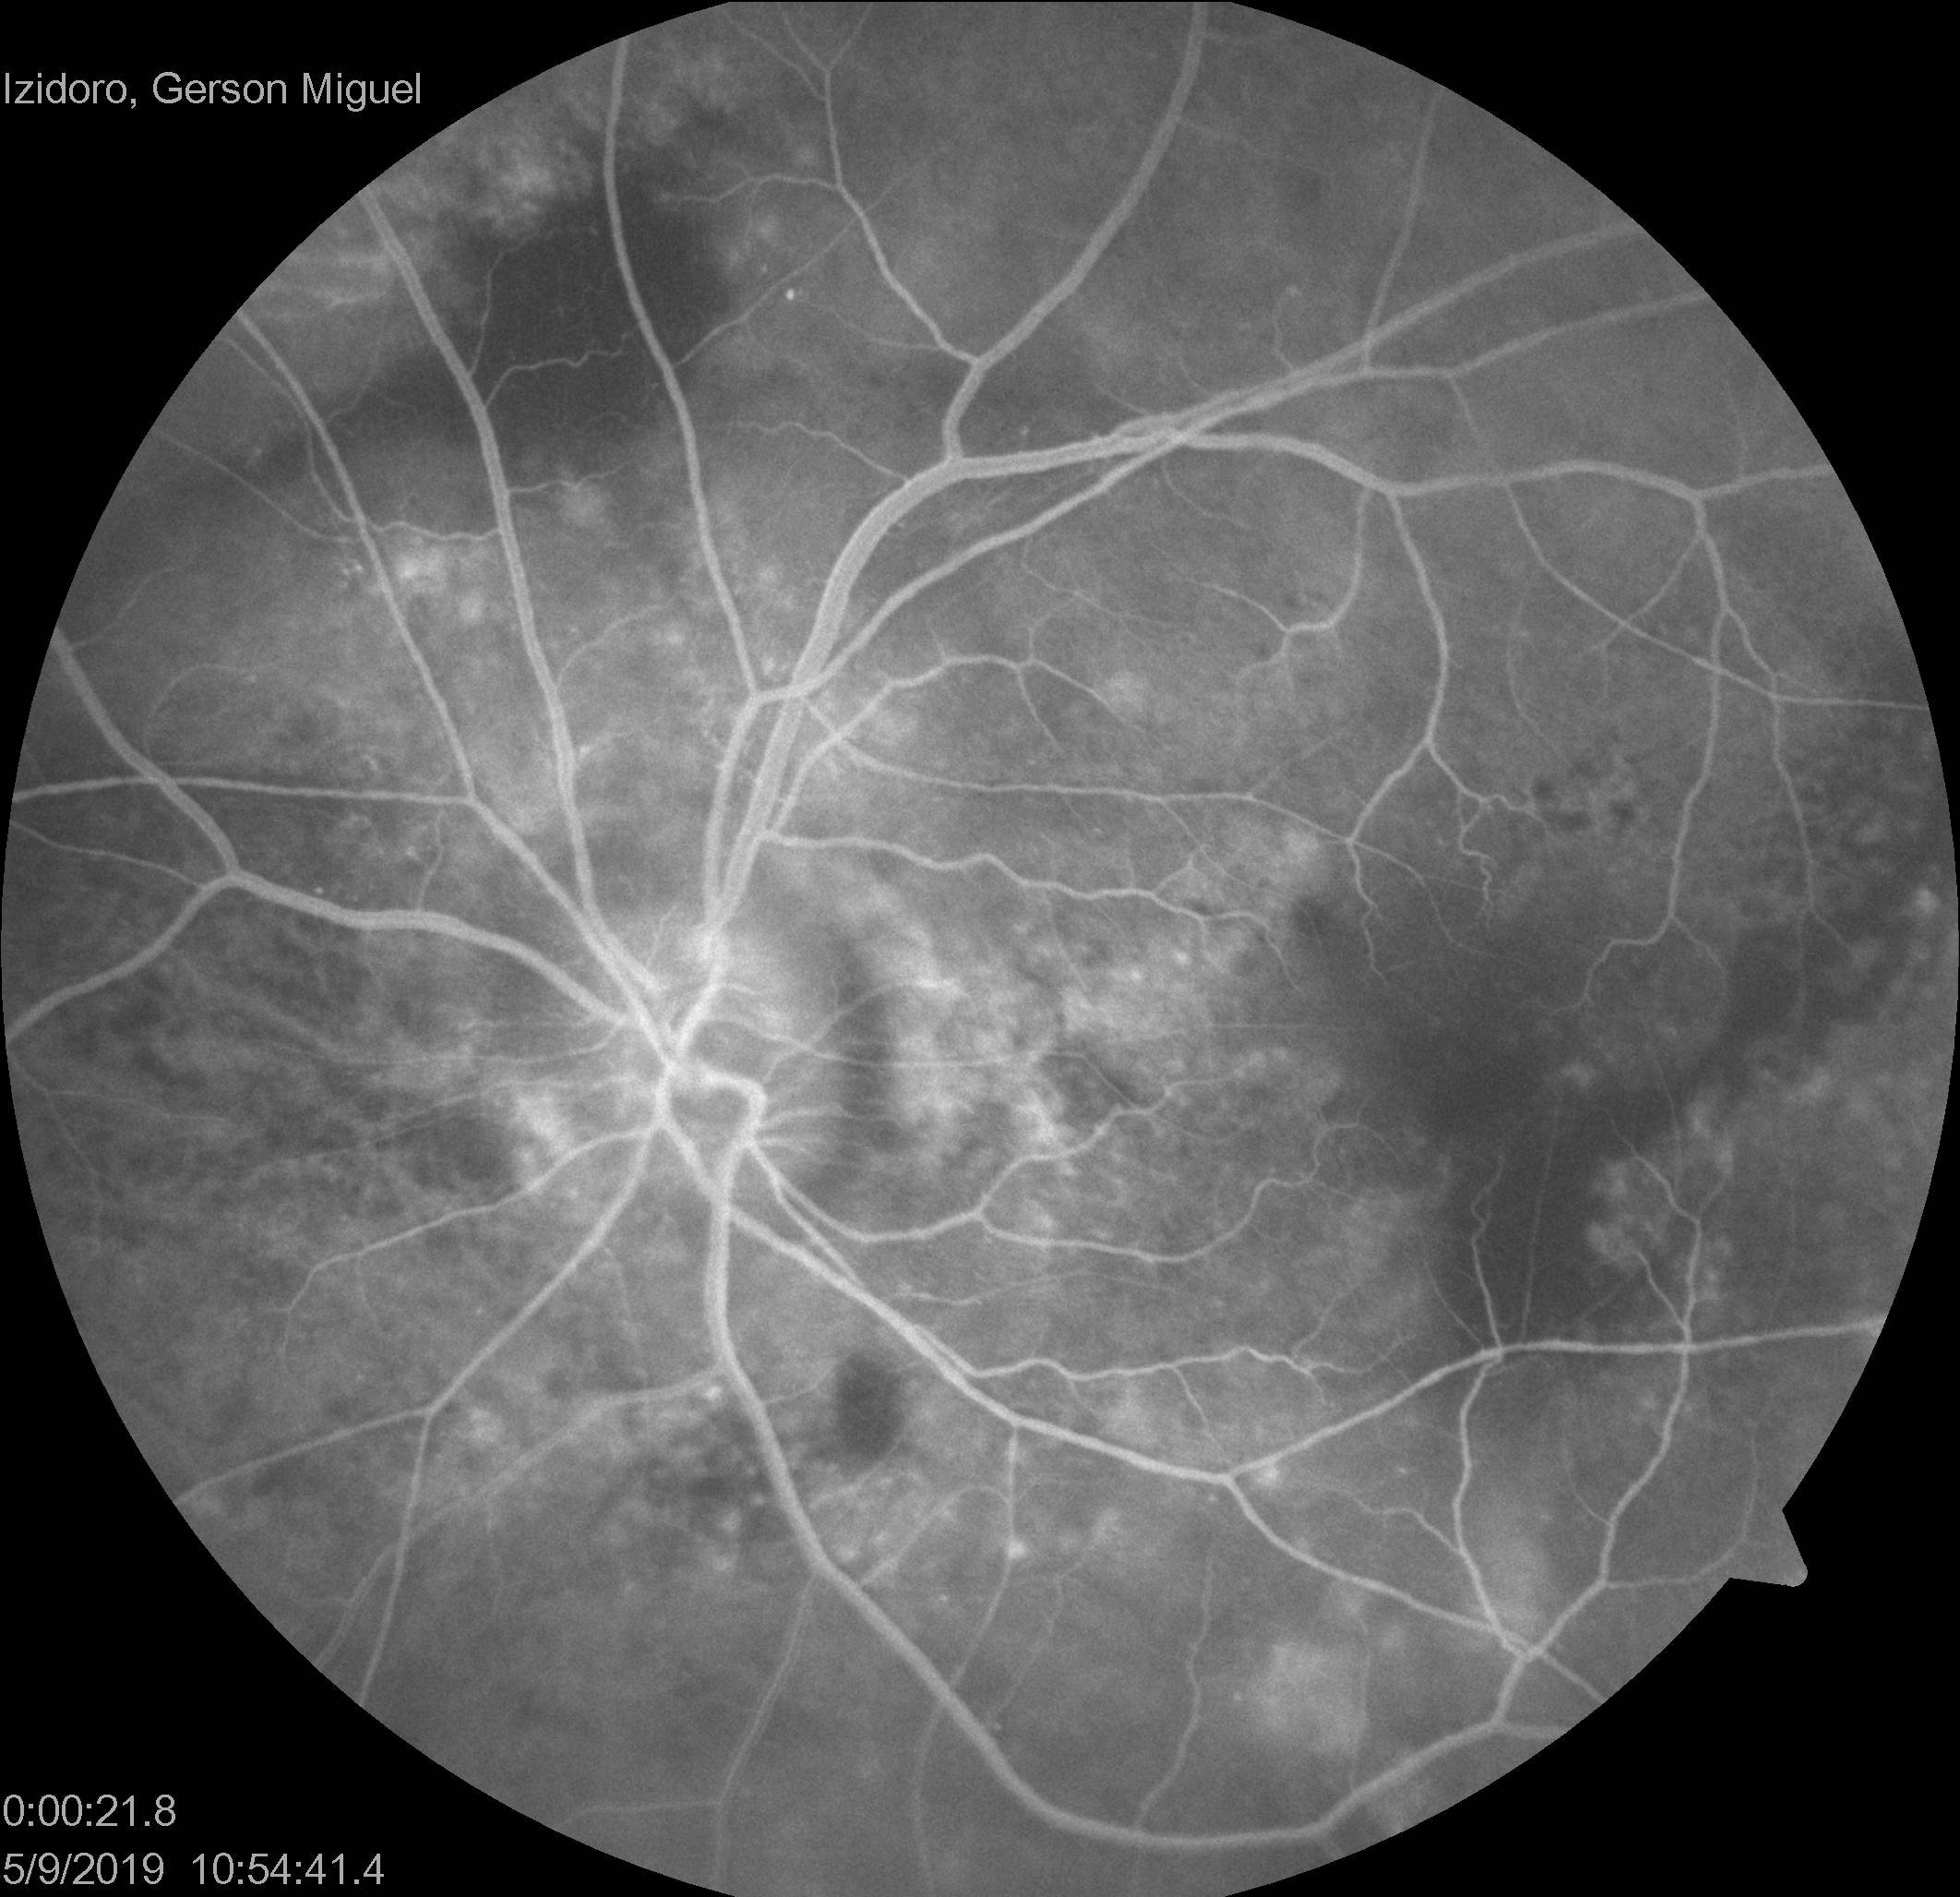
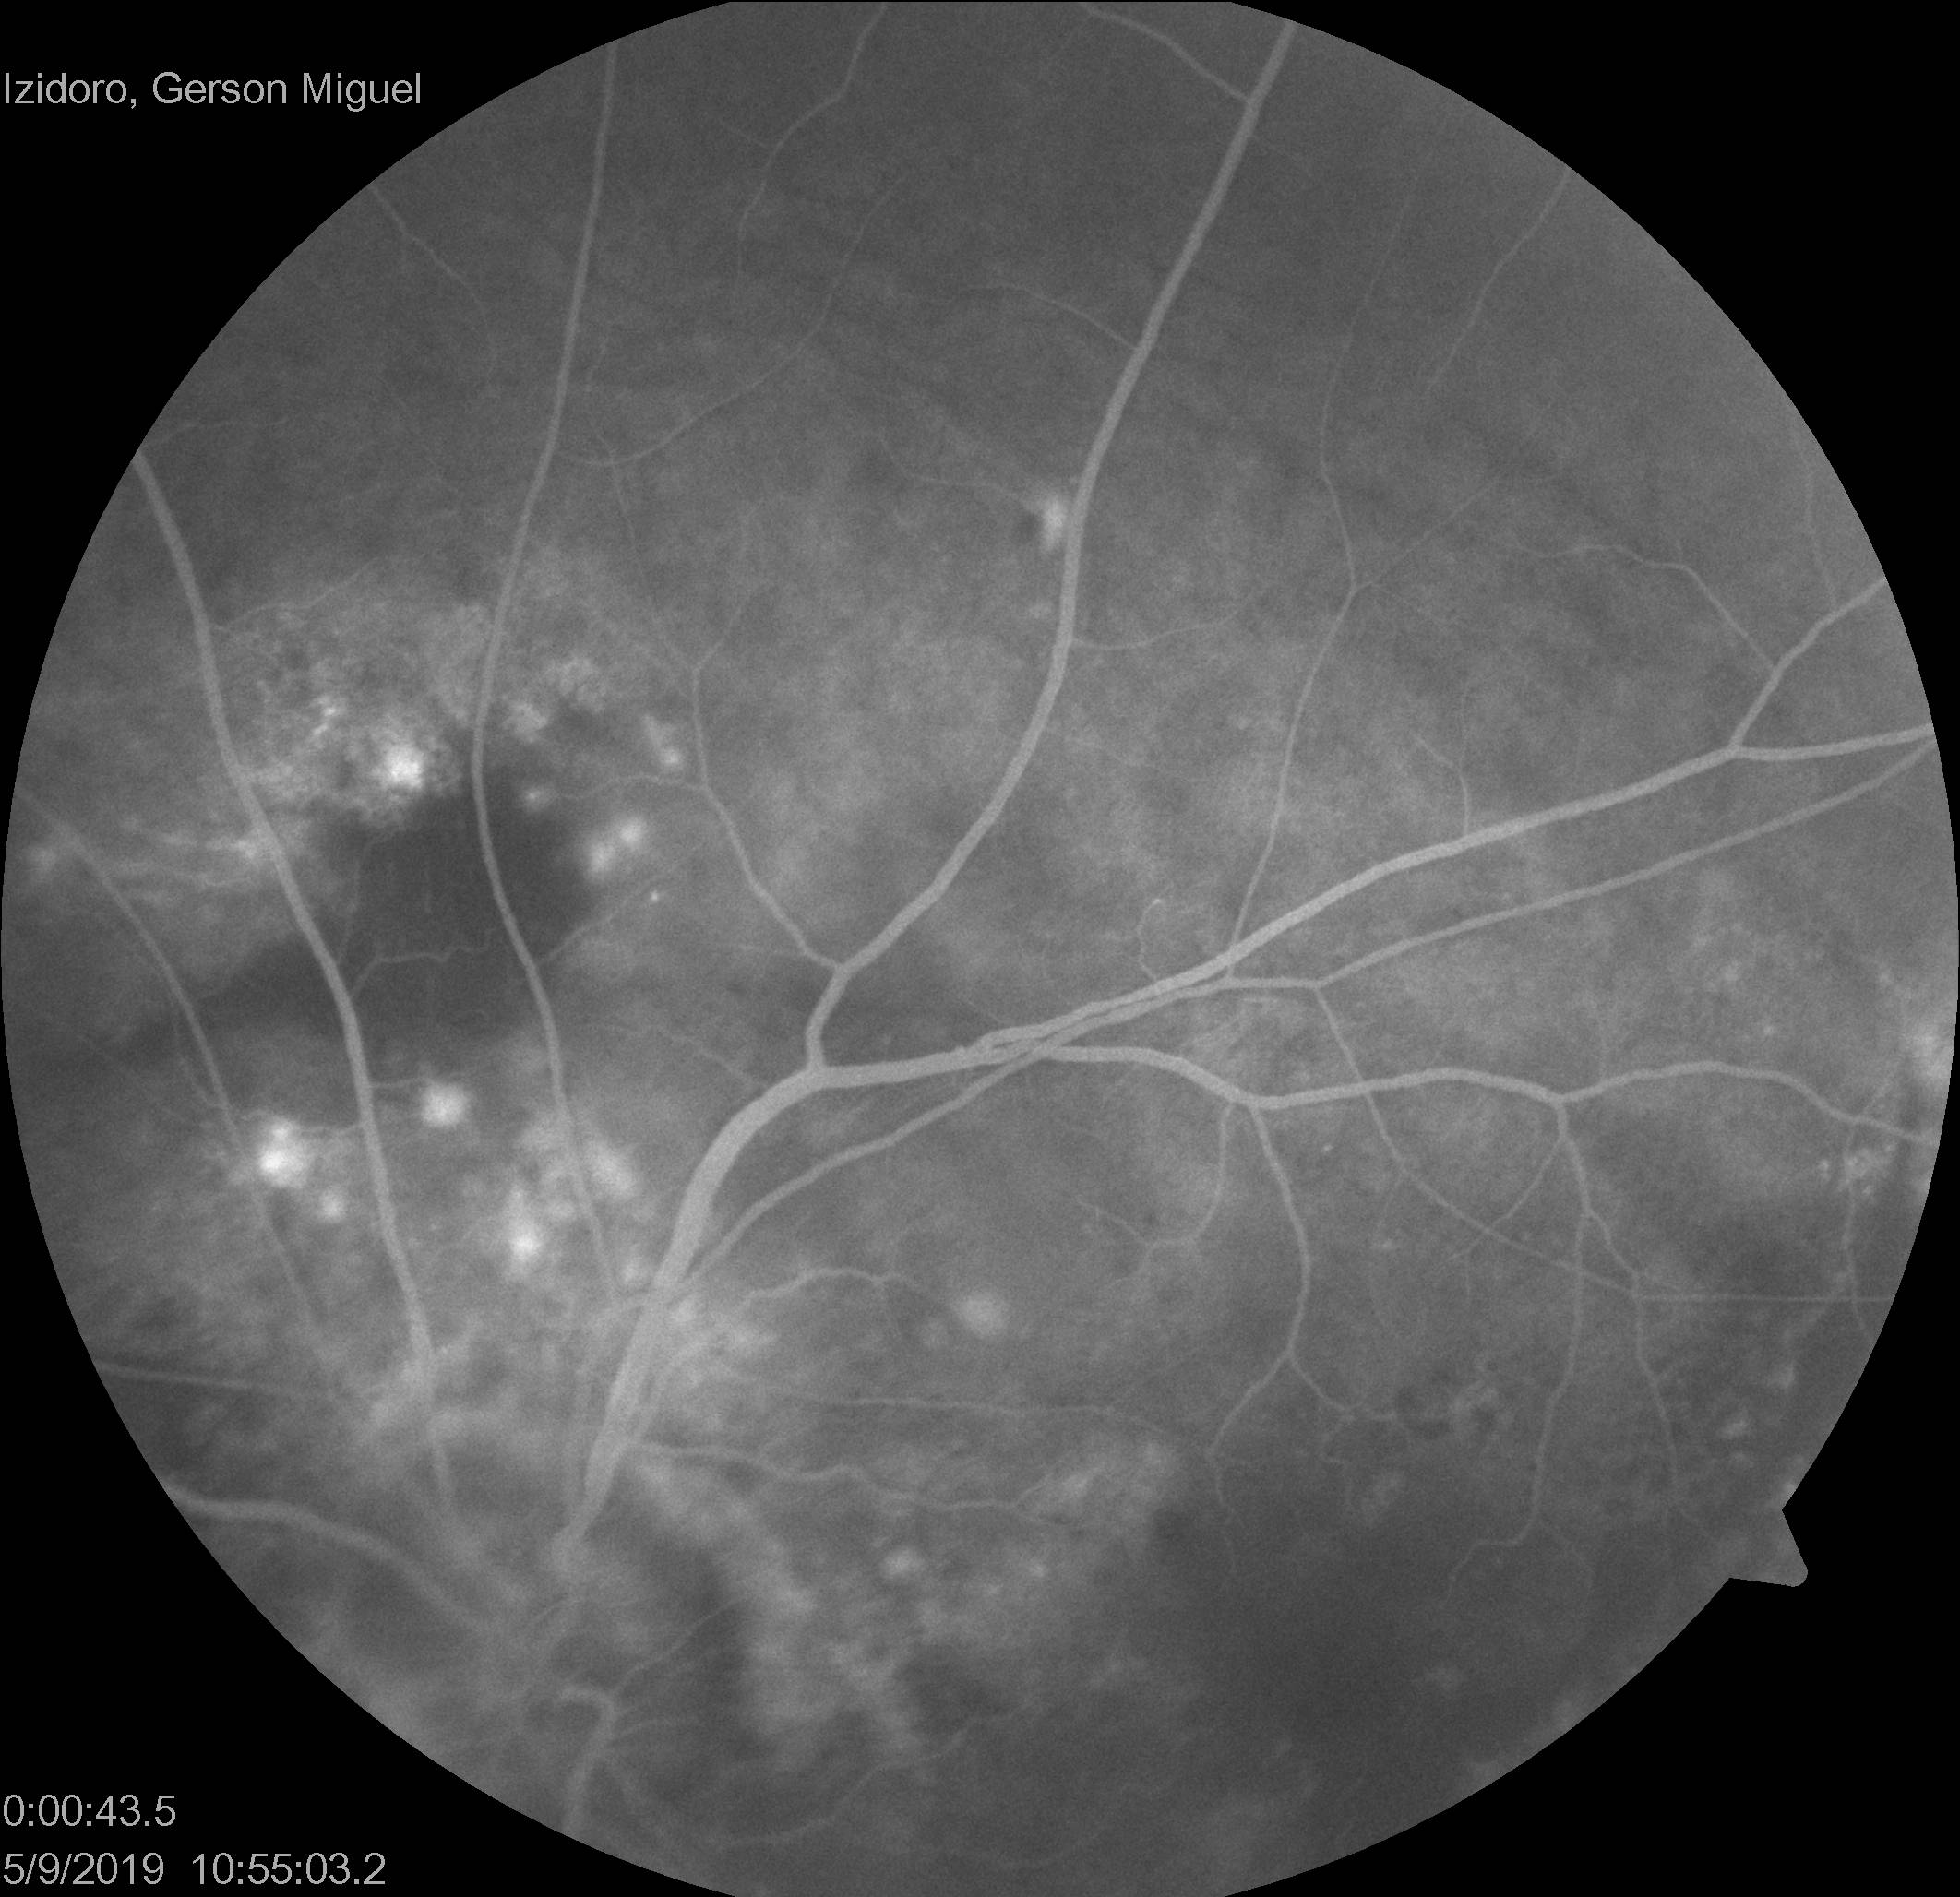
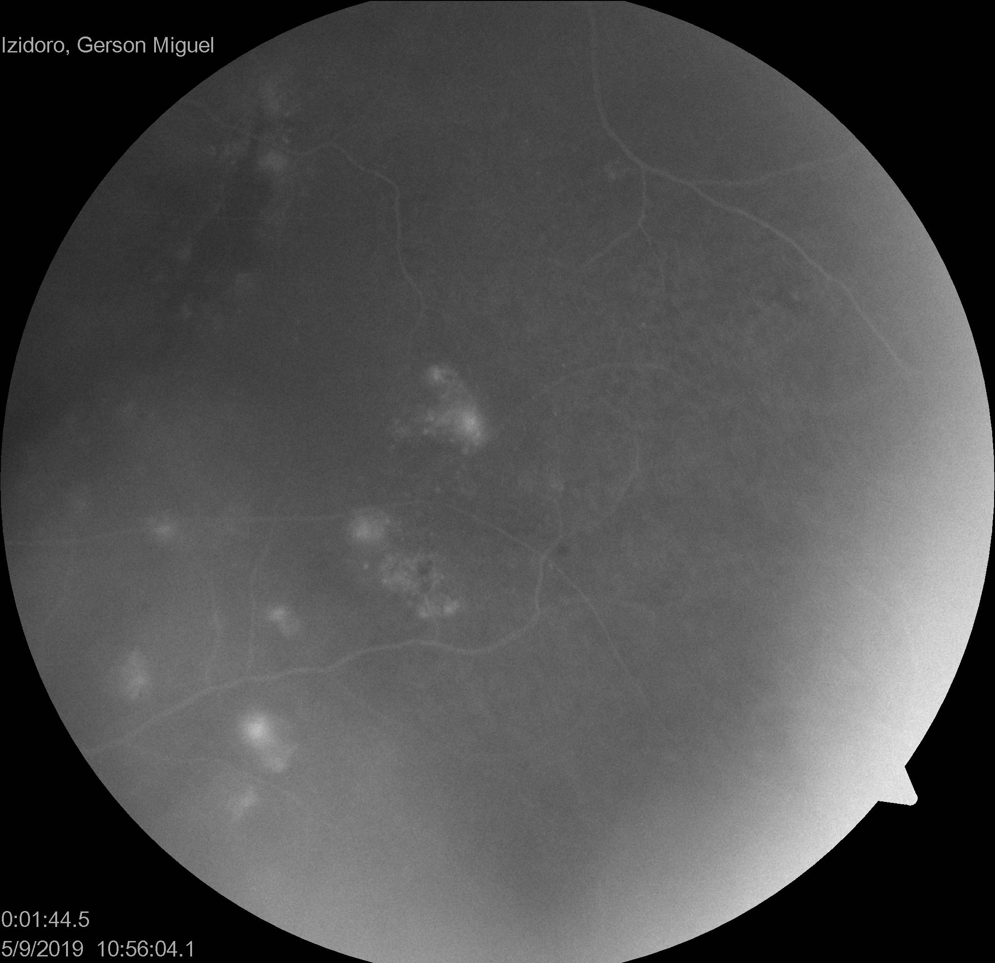
complementary exams Fluorescein Angiography
21 s
43 s
1:44 s

Slide 11
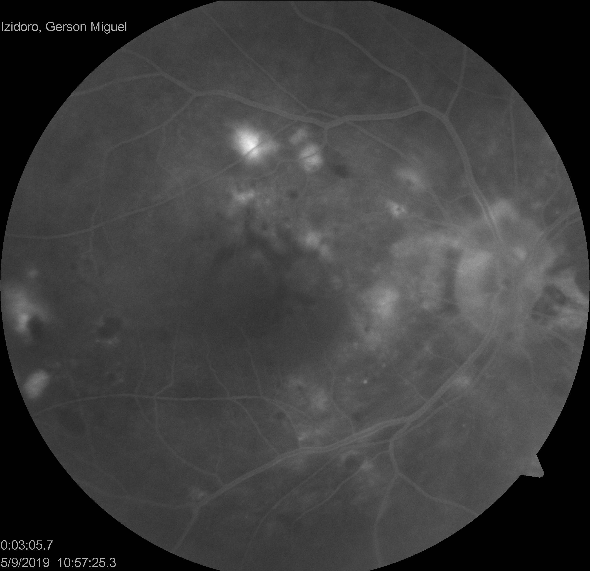
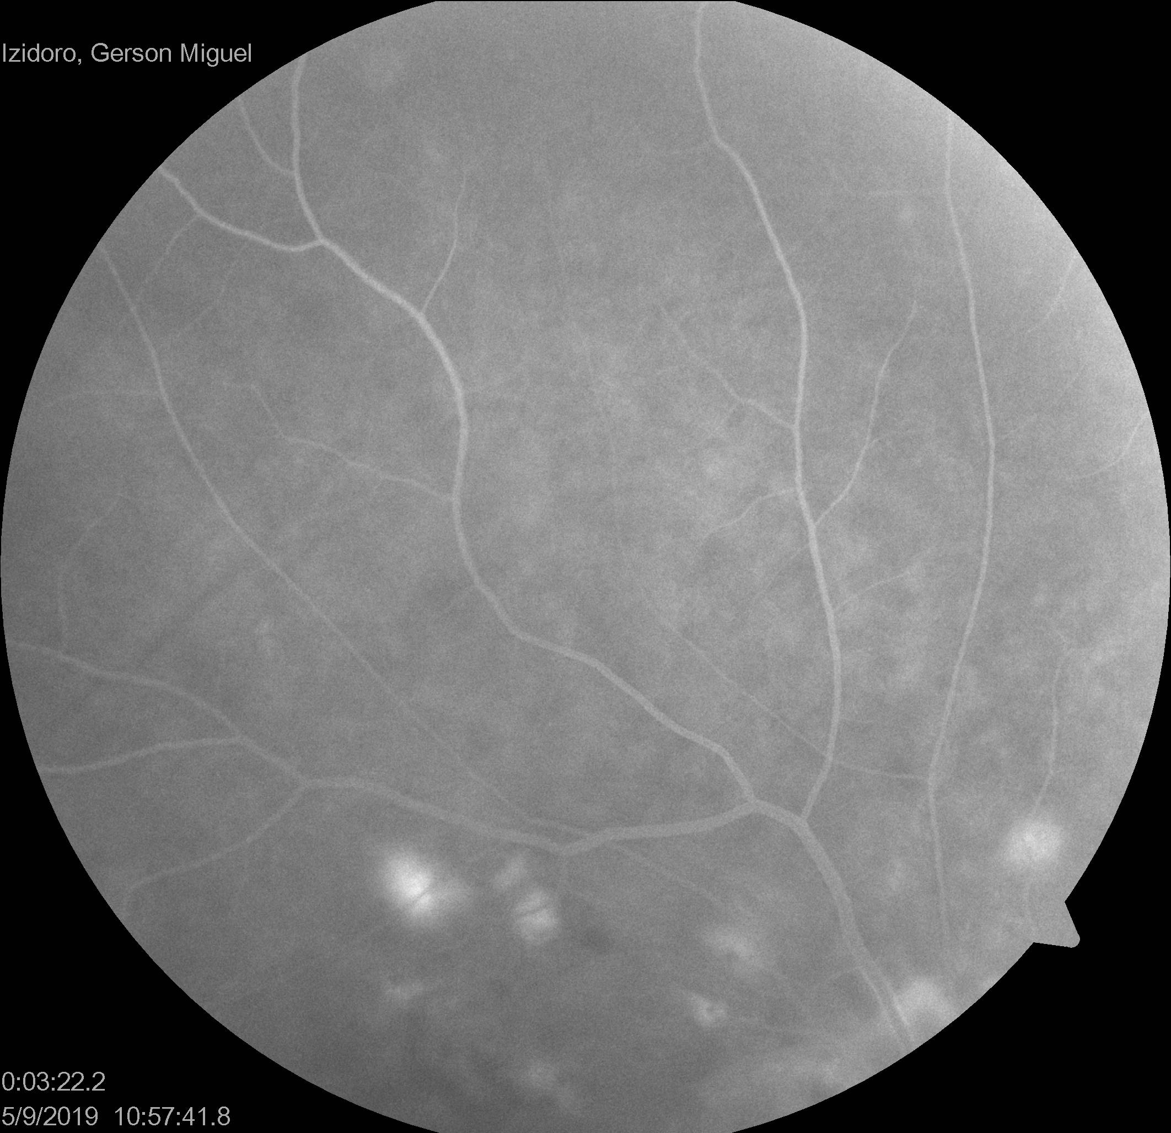
complementary exams Fluorescein Angiography
1:12 s
1:35 s

Slide 12
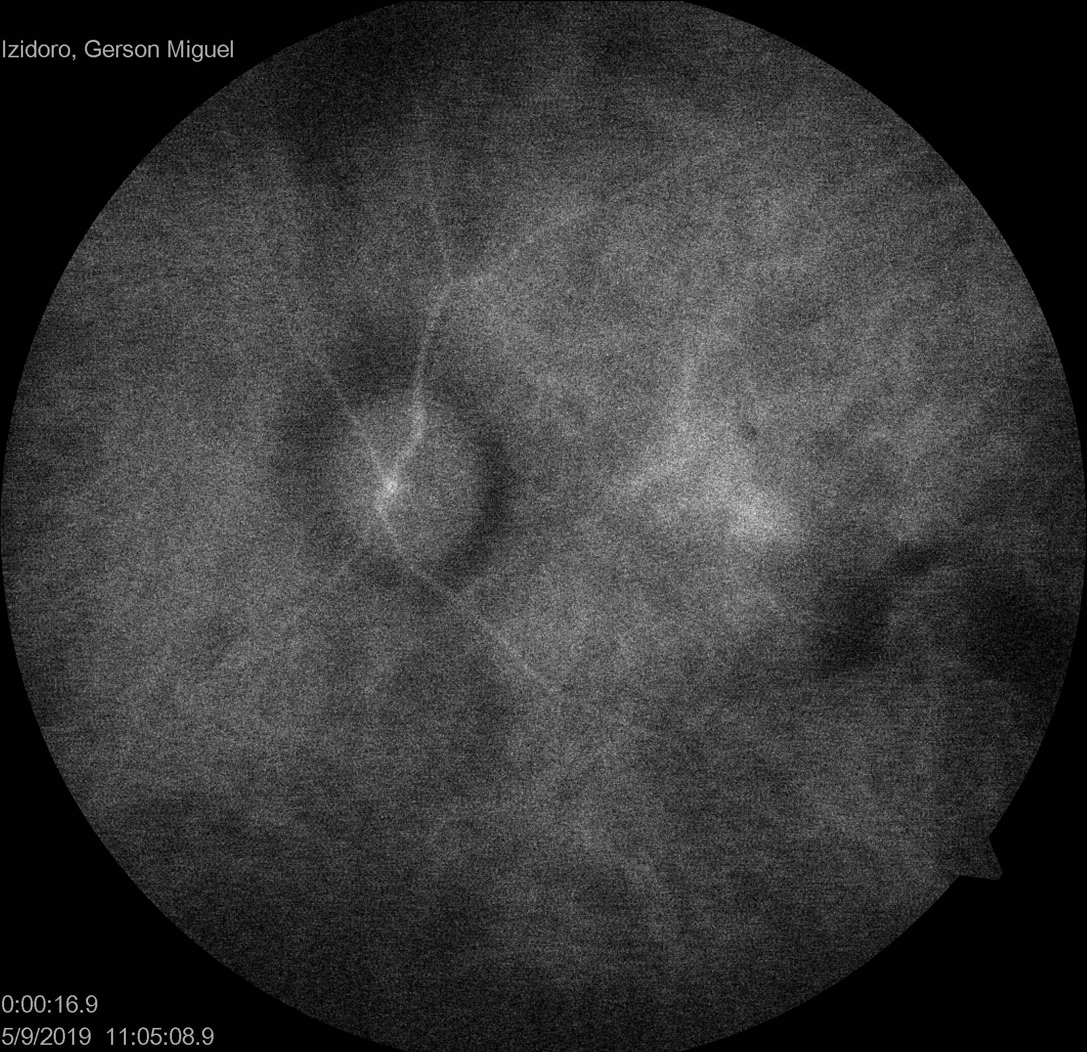
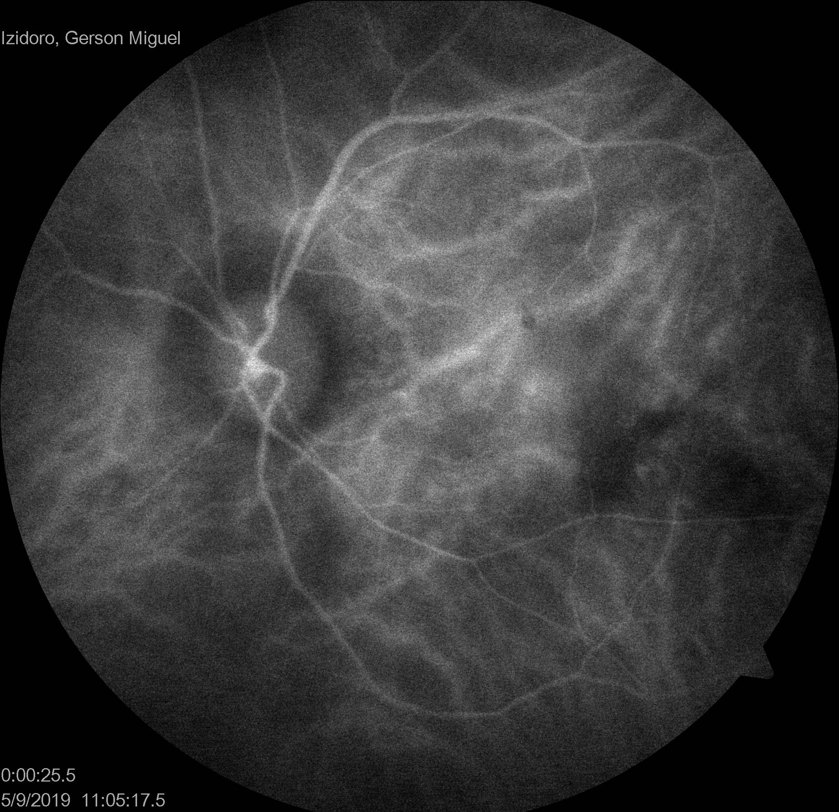
complementary exams Indocyanine green angiography
16 s
25 s

Slide 13
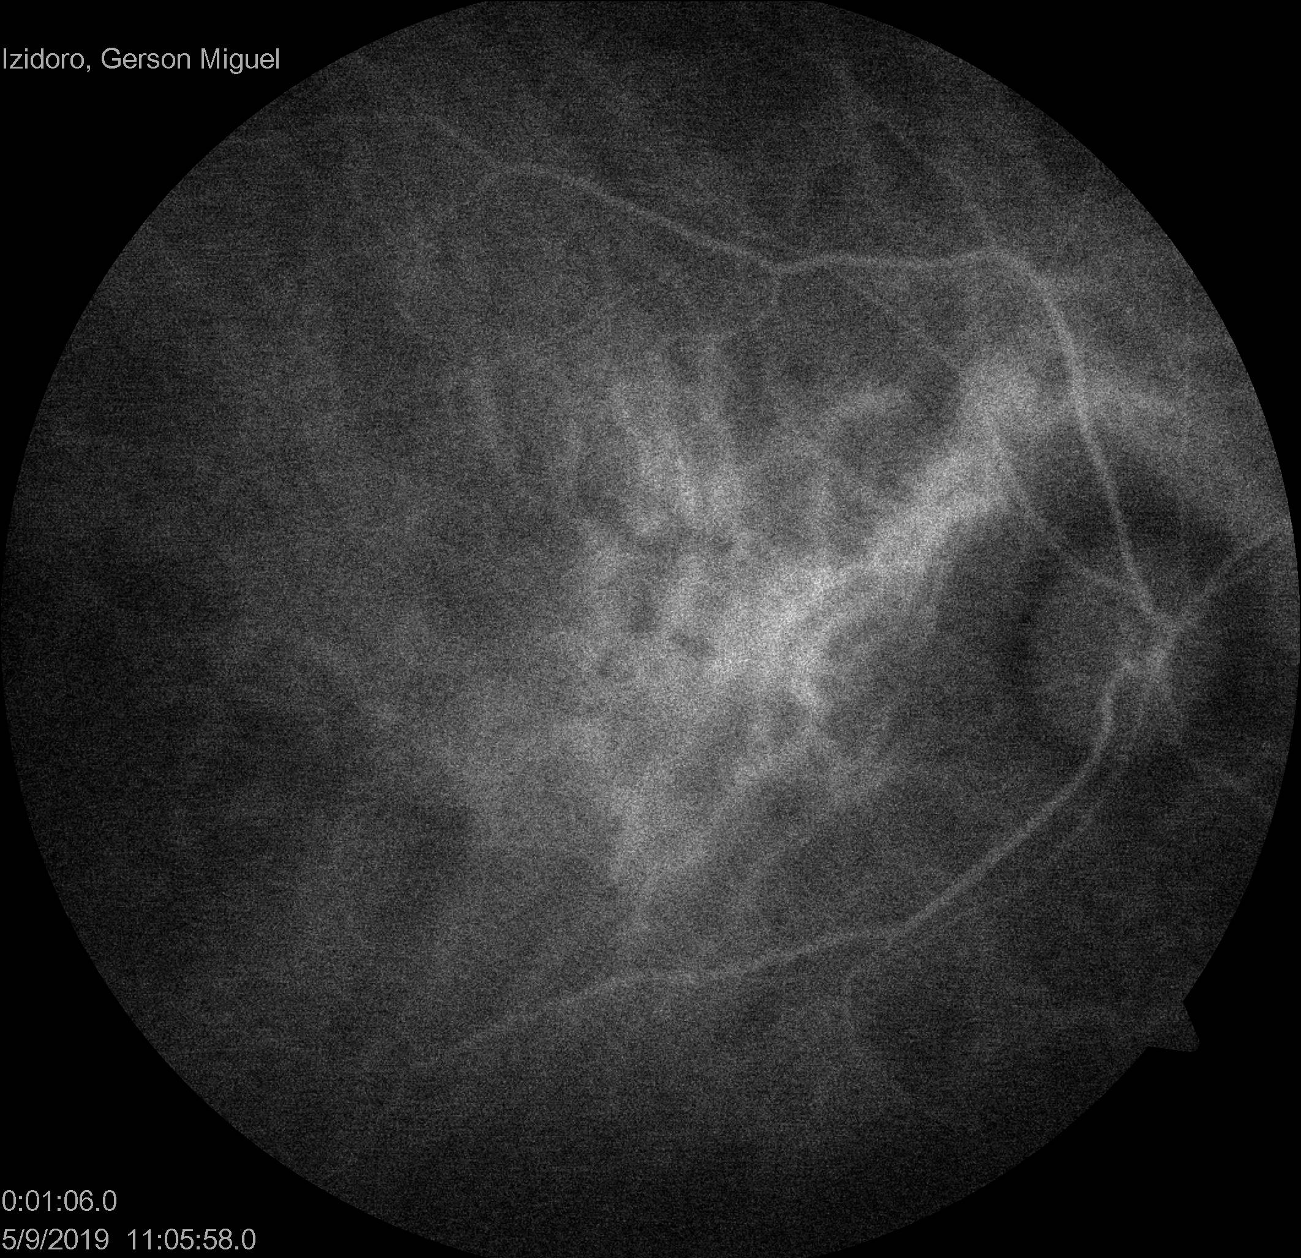
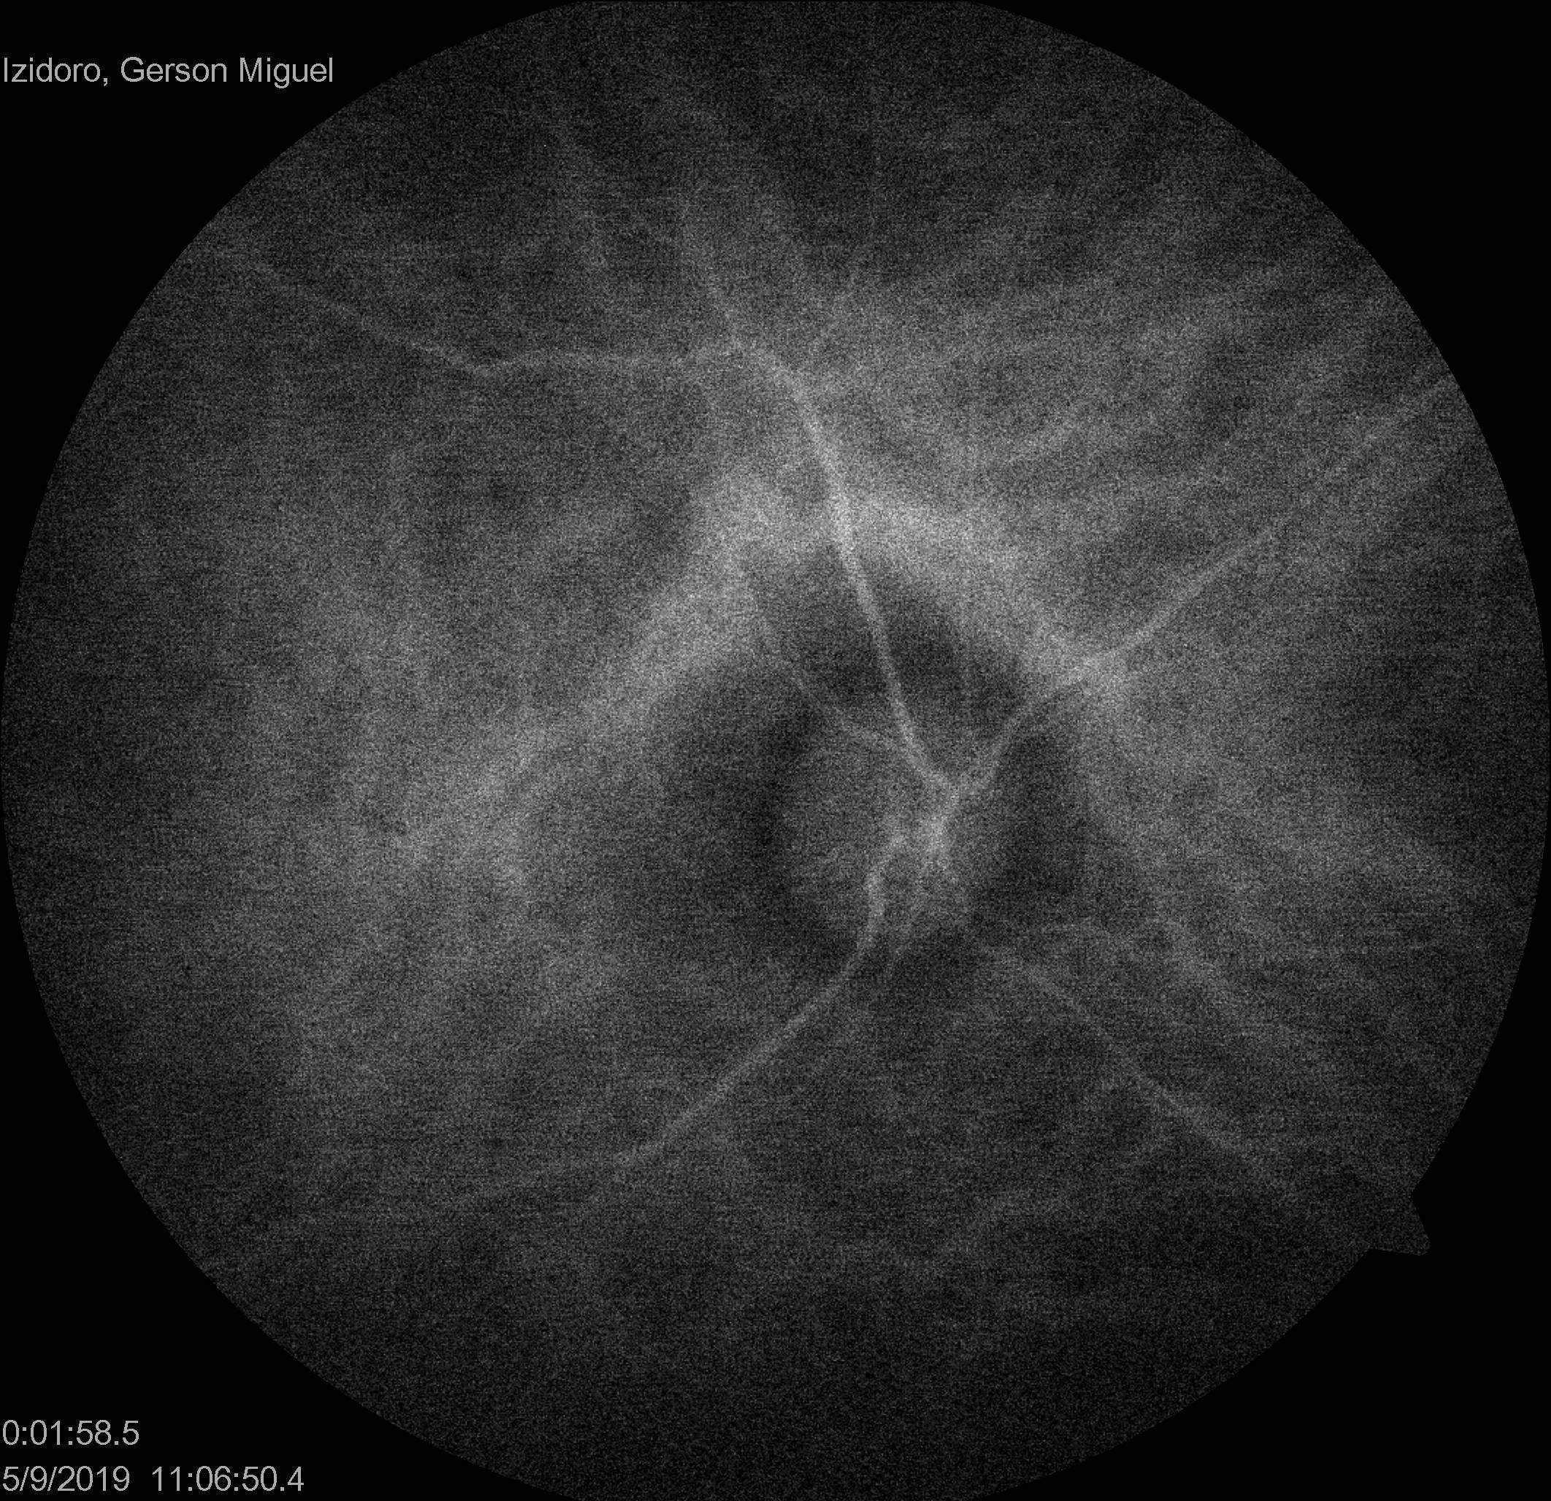
complementary exams Indocyanine green angiography
1:06 s
1:58 s

Slide 14
complementary exams optical coherence tomography

Slide 15
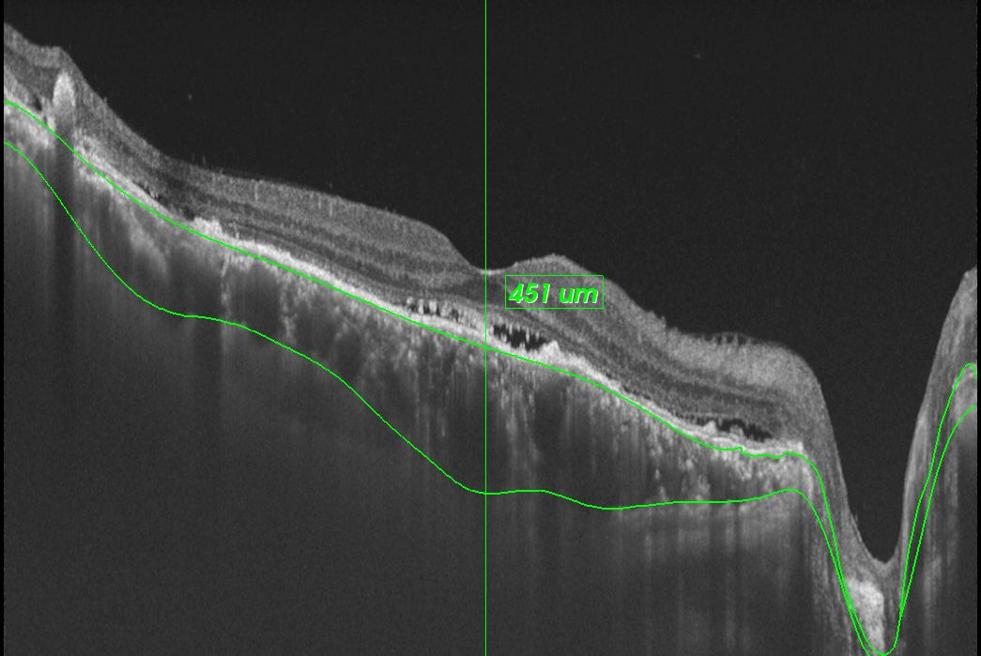
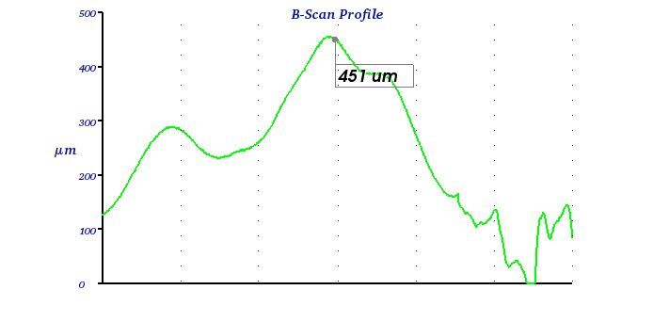
complementary exams optical coherence tomography

Slide 16
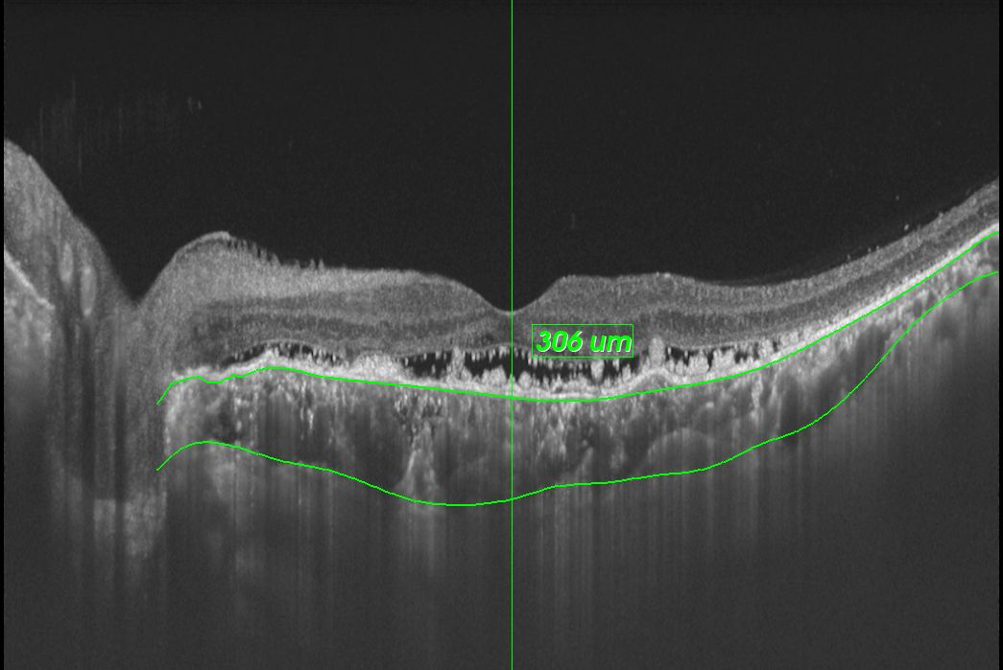
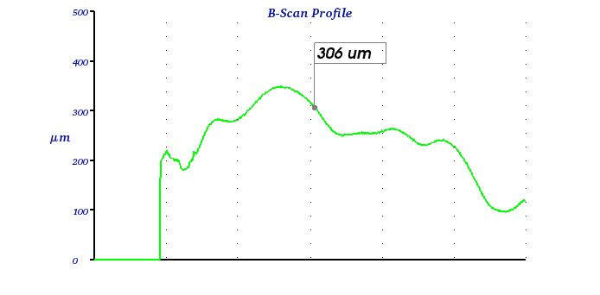
complementary exams optical coherence tomography

Slide 17
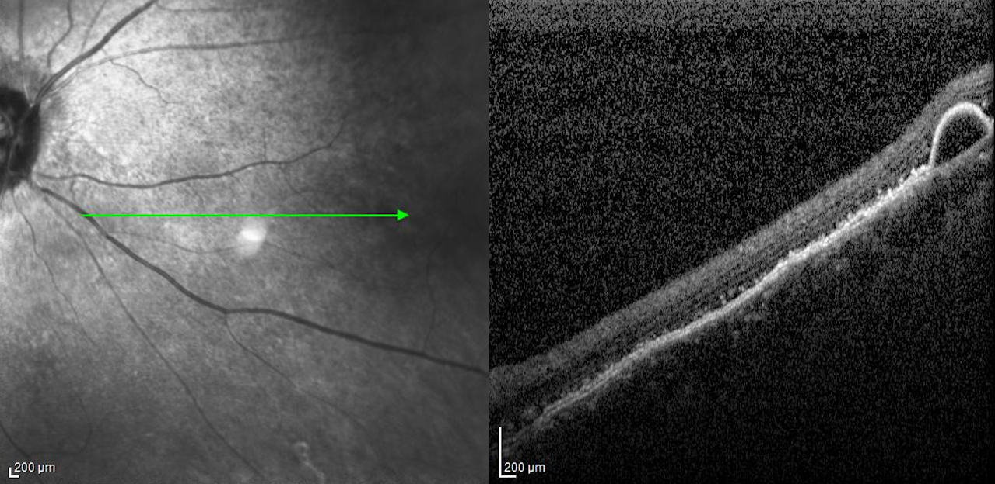
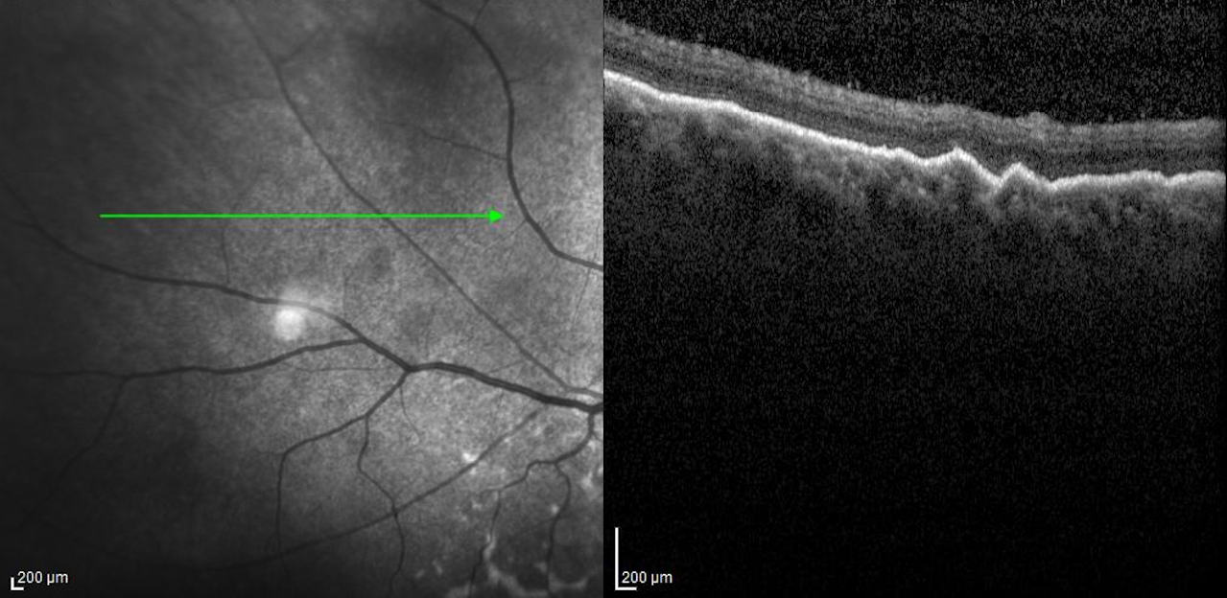
complementary exams optical coherence tomography

Slide 18
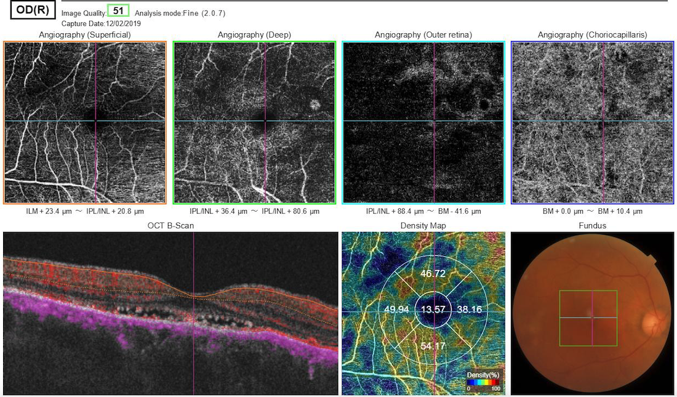
complementary exams oCT – angiography – Right Eye

Slide 19
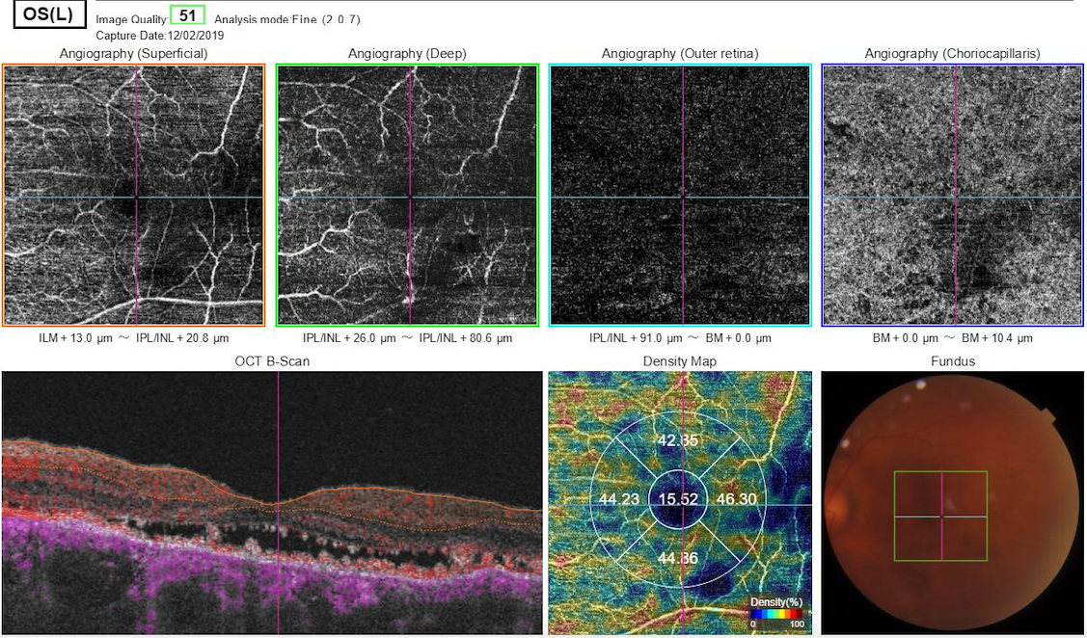
complementary exams oCT – angiography – left eye

Slide 20
Discussion
Multifocal central serous chorioretinopathy?
Schistosomiasis-related multifocal choroidopathy?
Polypoidal choroidal vasculopathy?
Hypertensive choroidopathy?

