Slide 1
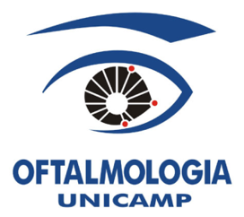
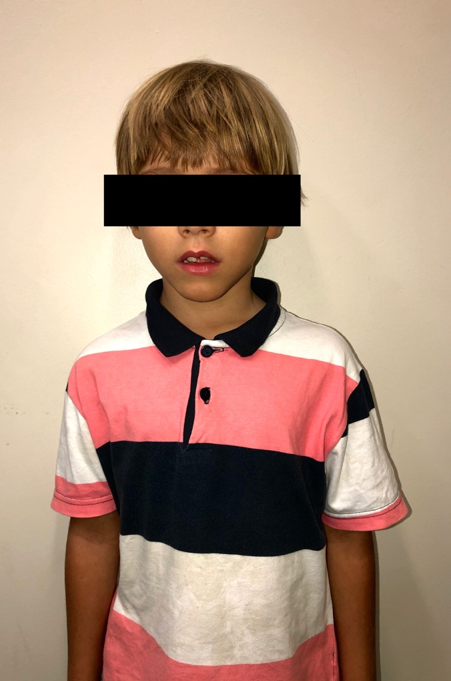
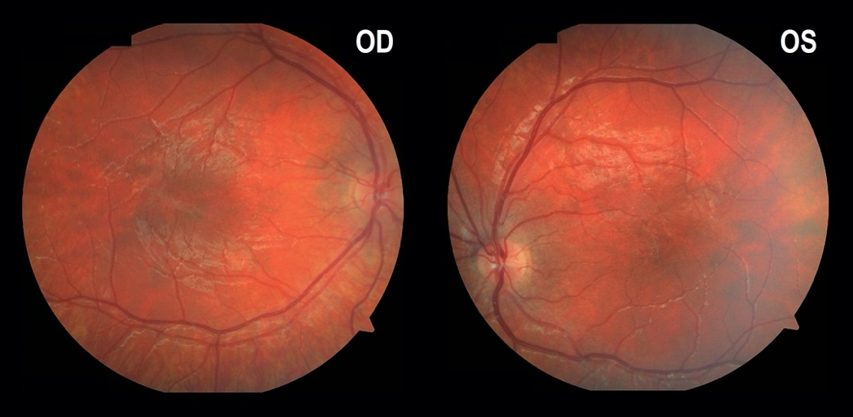
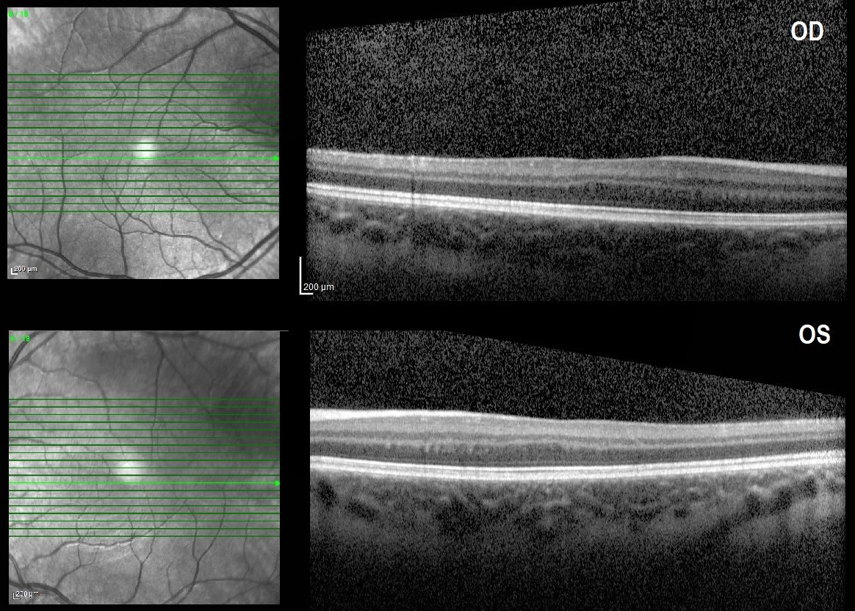
OCULAR ALBINISM AS A DIFFERENTIAL DIAGNOSIS FOR CONGENITAL NYSTAGMUS AND NORMAL PIGMENTATION OF THE IRIS, SKIN, AND HAIR
Camillo C. Gusmão; Arthur Favarato; Gustavo Pazeto; Roberto dos Reis; Guilherme Valadares; Vicente H. de Fernandes; Maurício A. Nascimento; Michel Berezovsky.
camillogusmao@gmail.com
DEPARTMENT OF OPHTHALMOLOGY OF THE UNIVERSIDADE ESTADUAL DE CAMPINAS (UNICAMP) – SÃO PAULO, BRAZIL
OBJECTIVE
We present a case of ocular albinism (OA) as a differential diagnosis for congenital nystagmus and normal pigmentation of the iris, skin, and hair.
While OCA can present different phenotypes with changes in the eyes, skin, and hair pigmentation, the other form may show only subtle changes in the fundus and nonprogressive visual impairment. Foveal hypoplasia is the most prevalent clinical feature, absent only in 1% of the currently published cohorts assessed with OCT. Misrouting of the decussating axonal fibers at the chiasm is also a common hallmark of both forms. Some authors suggest a correlation with the degree of hypopigmentation found in the other parts of the body with the visual outcome, but with many exceptions being reported.
As with our case, the presence of normal pigmentation on the skin, hair, and iris did not prevent severe foveal hypoplasia and low visual acuity.
CASE REPORT
A 9-years-old boy presented with a history of congenital nystagmus, low-angle esotropia, and no perinatal complications. The best-corrected visual acuity was 20/100 OU. The ophthalmic evaluation revealed no iris translucency, mild fundus hypopigmentation, and severe foveal hypoplasia observed on fundoscopy and OCT-examination. Skin and hair were normal pigmentated. His asymptomatic father (45-yrs) and brother (6-yrs) were also evaluated and found to present latent nystagmus and severe foveal hypoplasia. His father and mother were also second cousins.
CONCLUSION
We hope that this case will contribute to expanding the differential diagnosis of isolated OA in children with congenital nystagmus and normal skin color. The OCT can be particularly helpful in evaluating foveal hypoplasia.
DISCUSSION
Albinism is a congenital condition manly presented as one of two clinical forms: oculocutaneous albinism (OCA) or ocular albinism (OA). The first is an autosomal recessive disorder, with over seven different genes involved. The second is an X-linked genetic condition, with complex inheritance also being reported.

