Slide 1
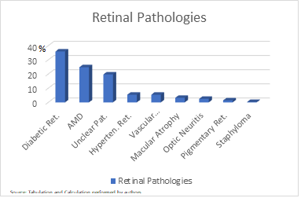
OBJECTIVE To characterize the epidemiological profile and demand for retinal pathologies in an ophthalmological reference service. METHODS Cross-sectional, retrospective analysis of medical care performed at the ophthalmology screening clinic of the residency program of the Instituto de Olhos de Goiânia - GO, in the second half of 2019, through the collection of data in medical records. These are elective consultations for the first appointment, sent through the state's primary health care network. The records used are recorded in medical records and records at the institution. The data were grouped considering variables of gender, age group, and diagnosis according to ICD-10. The study respects the ethical standards in research of the institution in question.
Eletive retinal pathologies demand in an ophthalmological reference service
Gabriel Matos Machado, Leandro Augusto Braga, Roberta Silva Amorim
RESULTS
Among the 2563 patients seen in the period, 278 (10.8%) had retinal pathologies. 177 (63.6%) were from the municipality of Goiania and 101 (36.3%) were referred from cities in the interior of the state. Regarding gender, 152 patients (54.6%) were female and 126 patients (45.3%) were male. The majority of consultations included patients over 50 years old, 260 (93.5%) patients.
The most prevalent diagnoses of retinal pathologies were diabetic retinopathy 100 (35.9%), followed by AMD 69 (24.8%) and unclear pathologies 55 (19.7%), hypertensive retinopathy and vascular occlusions, both with 15 (5.4%), atrophy macular 9 (3.2%), optic neuritis 7 (2.5%), pigmentary retinosis 4 (1.4%) and staphyloma 1 (0.3%). There were no patients included in more than one diagnostic group.
CONCLUSION
The study's findings are consistent with other studies. Some statistics that differ from the literature, such as hypertensive retinopathy, are justified due to milder cases, being discharged with medical instructions and not referred to the retina department. Knowing the demand and user profile of an ophthalmological service is fundamental, in order to enable preventive measures and resource optimization.

