Slide 1
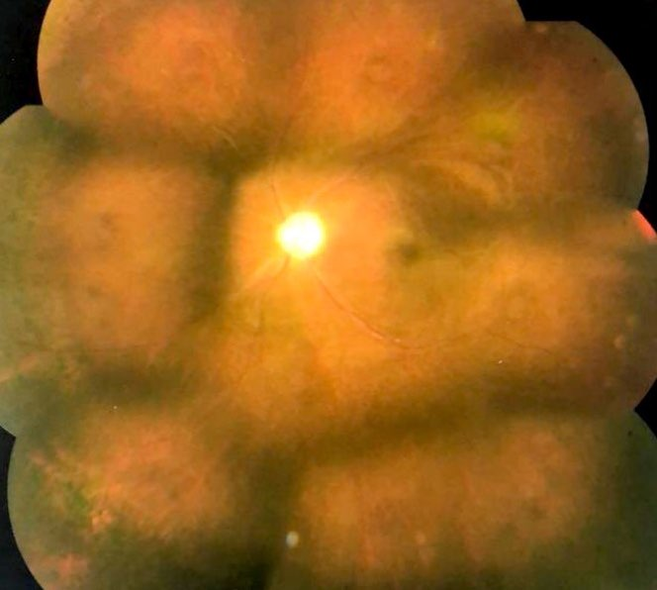
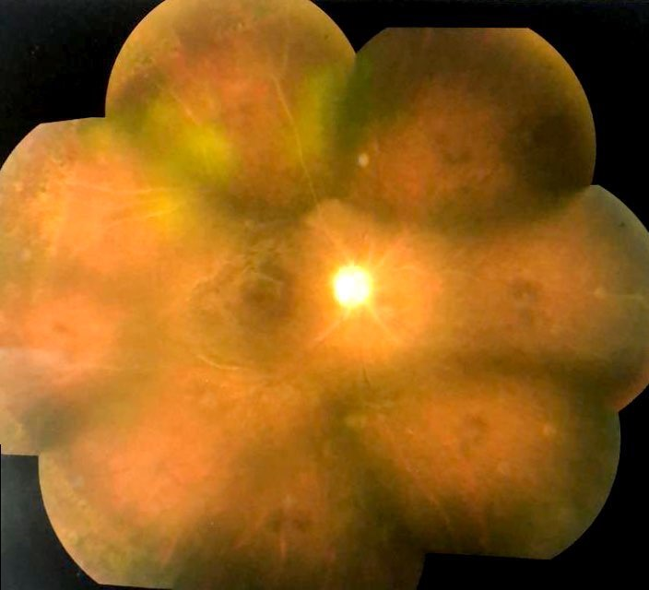
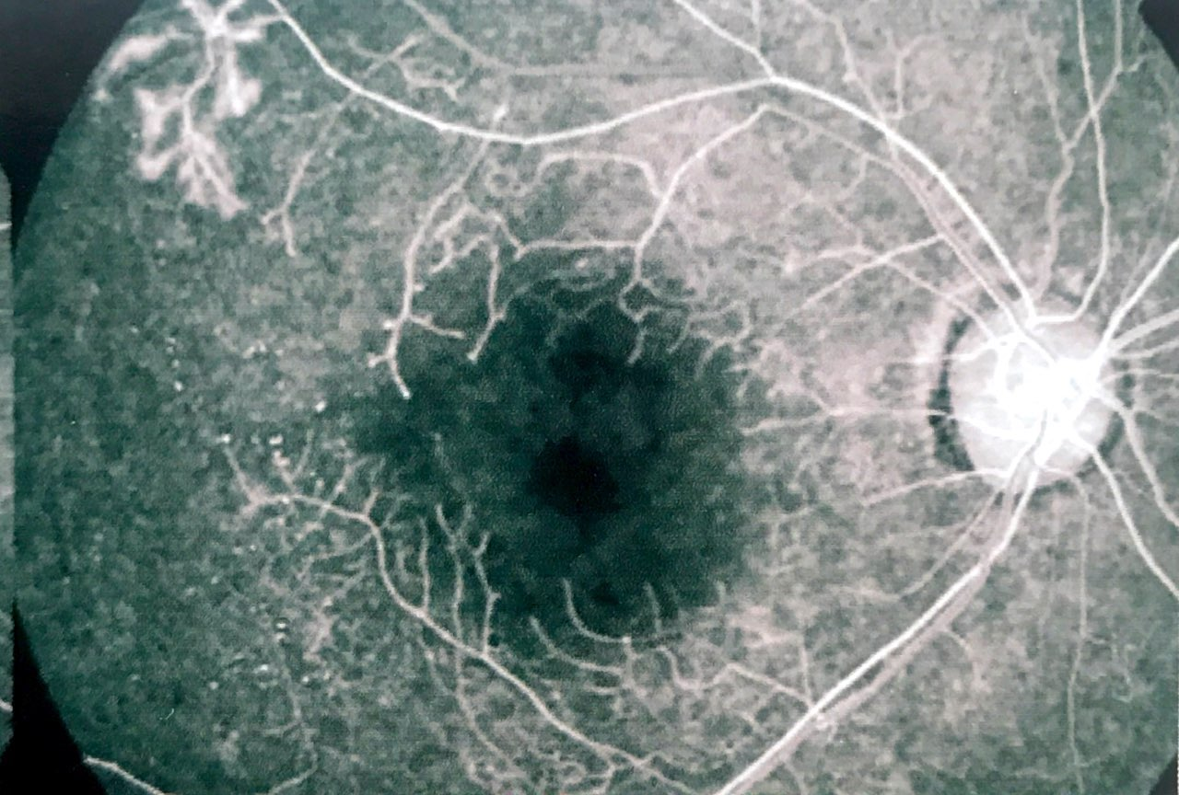
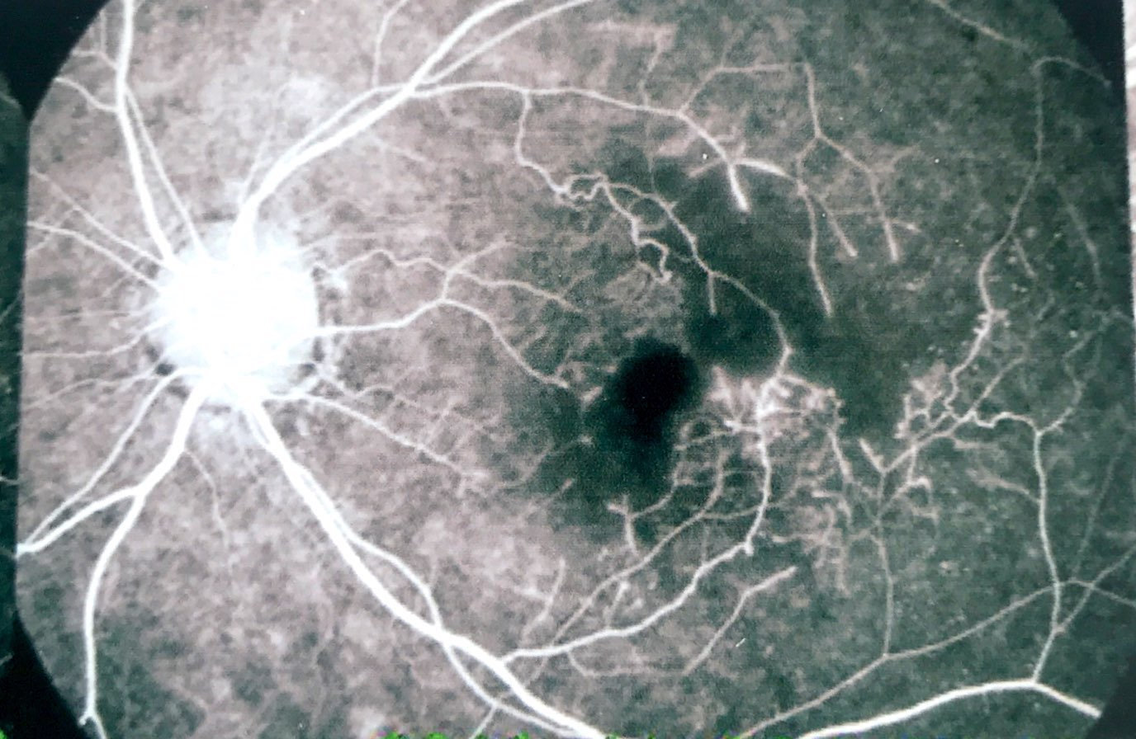
Bilateral vaso-occlusive retinopathy associated with systemic lupus erythematosus
Carolina Maria Barbosa Lemos ,Rafael Garcia,Paulo Henrique Horizonte, Fernanda Salata Antunes ,Amanda Venturini Arantes ,Tanaiara paganelli, Nathália Nishiyama Tondelli, André Marcelo Vieira Gomes
The OCT revealed atrophy of the retinal layers. Fluorescein angiography (FA) disclosed a wide area of vascular non-perfusion. PFC was performed in both eyes and anti-VEGF was applied to the left eye. There was an improvement of two lines in her BCVA of the left eye
PURPOSE
To describe a case of vaso-occlusive retinopathy.
INTRODUCTION
DISCUSSION
Systemic lupus erythematosus (SLE) is a chronic, autoimmune disease of the connective tissue. Ocular manifestations are not part of the classification criteria, however they can be observed in up to one-third of patients with SLE (1). The retinal vascular lesions generally consist of cotton-wool spots with or without intraretinal hemorrhages and occur in 3 to 29% of the patients. In addition, although rare, severe vaso-oclusive retinopathy can be seen(2).
Systemic Lupus erythematosus (SLE) can involve any region of the visual system. The presence of ocular manifestations should alert the clinician to the likelihood of the presence of disease activity elsewhere(3). One large prospective study showed that 88% of SLE patients with retinopathy had active systemic disease. The SLE patients who developed retinopathy had a lower overall survival rate as compared to patients without retinopathy over the same time period. Interestingly, in the case we report herein, the patient had a very severe ocular disease, but few systemic complications(1). Therefore, early recognition of this condition and adequate and timely treatment should be administered in patients with SLE in order to prevent visual system (2).
Fig. 1 and 2: retinography of the right eye and left eye
METHODS
Medical records review
RESULTS
A case of 31-year-old female patient with SLE and severe vascular occlusive retinopathy in both eyes. She presented progressive bilateral visual loss during the past few years and reported treatment with laser photocoagulation.Her best visual corrected (BVC) was 20/600 in the right eye and 20/50 in the left eye. Fundoscopy showed similar findings in both eyes: a pale optic disc, phantom vessels, ischemic retina and panfotocoagulation (PFC) scars .
BIBLIOGRAPHY
1-Radosavljevic, Aleksandra et al. Severe vaso-occlusive retinopathy associated with systemic lupus erythematosus. v. 73, n. 12, p.1164-1167, 2016.
2-Thomas Hwang, MD, PhD.Central retinal artery occlusion in a lupus erythematosus profundus patient.American academy of ophthalmology
3-Schachat,A.P.et al. Ryan’s retina.6.ed.Cleveland.Elsevier,2017.3v.
Fig 3, 4 and 5: Fluorescence angiography of the right and left eye
Notes:
purpose, methods, results and discussion

