Slide 1
Retina Start Clinical & Surgical Cases “Challenging case of retinal neovascularization”
Mariana Kawamuro, MD
Notes:
Viviane Inacio Pereira
4113307
Telefone 96221-6418

Slide 2
Anamnesis
ID: female, 32 yo, born and living in São Paulo, receptionist.
CC: low visual acuity in left eye (OS).
HPI: Progressive low visual acuity in OS, with sudden worsening of two days of history. Also, the patient presents progressive low visual acuity in OD.

Slide 3
Anamnesis
PMH:
Uneventful spontaneuous delivery 1 year ago
PFH: unremarkable
POH: unremarkable

Slide 4
Ophthalmological Exam
 | OD | OS
Visual acuity (pin hole) | 20/60 | Hand movement
Slit Lamp Exam | Clear conjuntiva, clear córnea, phakic, trophic íris, absense of celularity in the anterior chamber or vitreous.
Intraocular pressure (10 am) | 14 mmHg | 15 mmHg
Gonioscopy | Open angle (visible until ciliary band) 360º
Fundus Exam | Photos | Photos

Slide 5
OD

Slide 6
OD

Slide 7
OD

Slide 8
OS

Slide 9
Diagnostic Hypothesis
Retinal Neovascularization:
Diabetic Retinopathy
Infectious: Tuberculosis, Syphilis
Vascular: Falciform Anemia, IRVAN
Inflammatory: Sarcoidosis, Lupus, Behçet
Idiopathic: Eales Disease

Slide 10
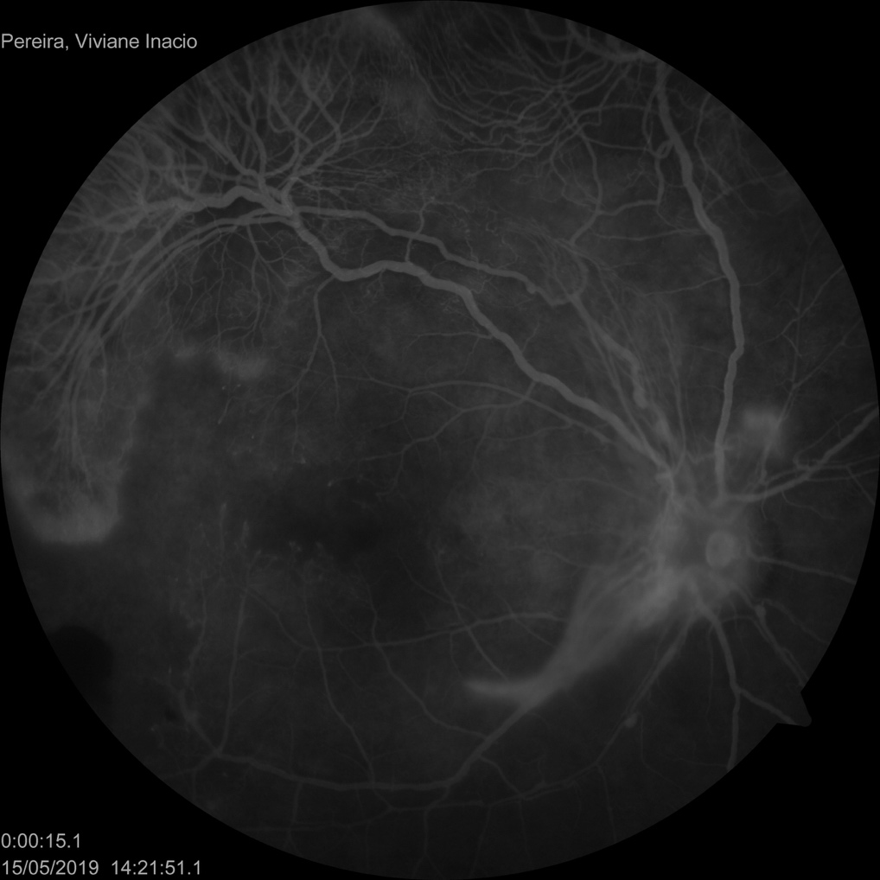
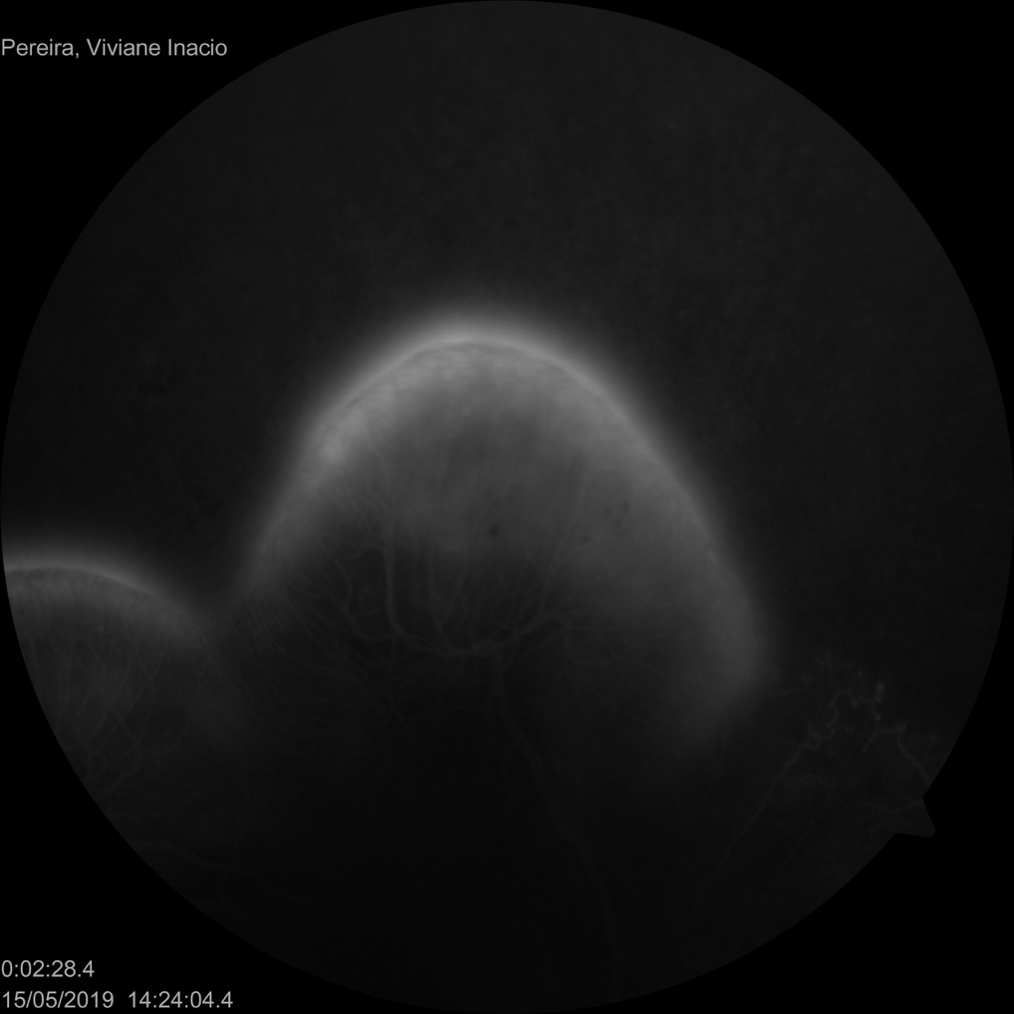
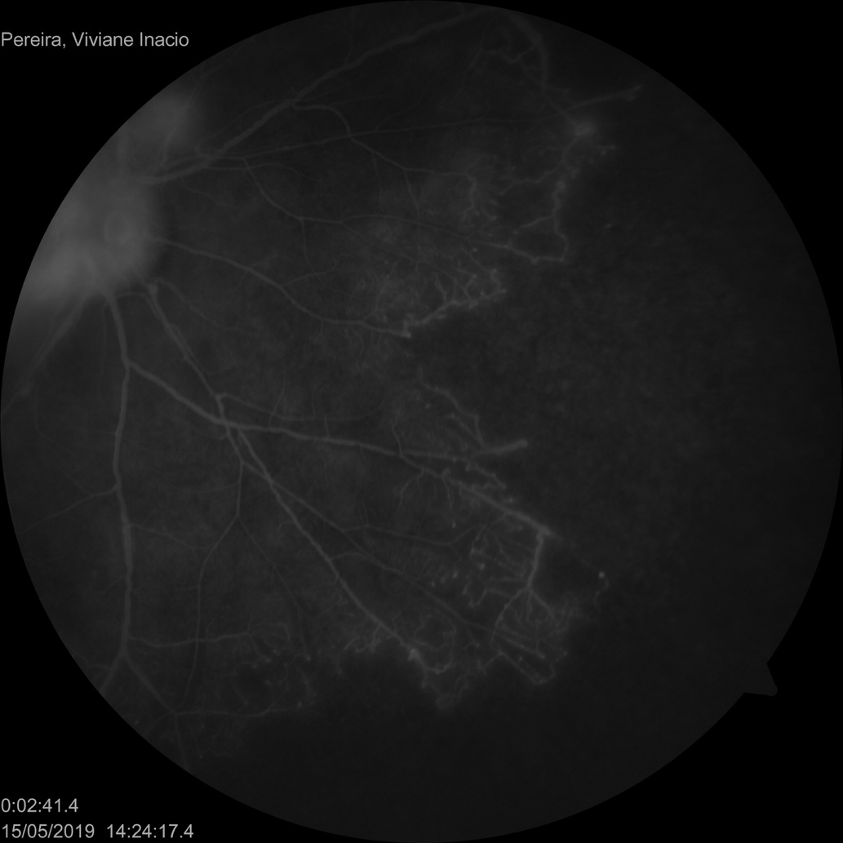
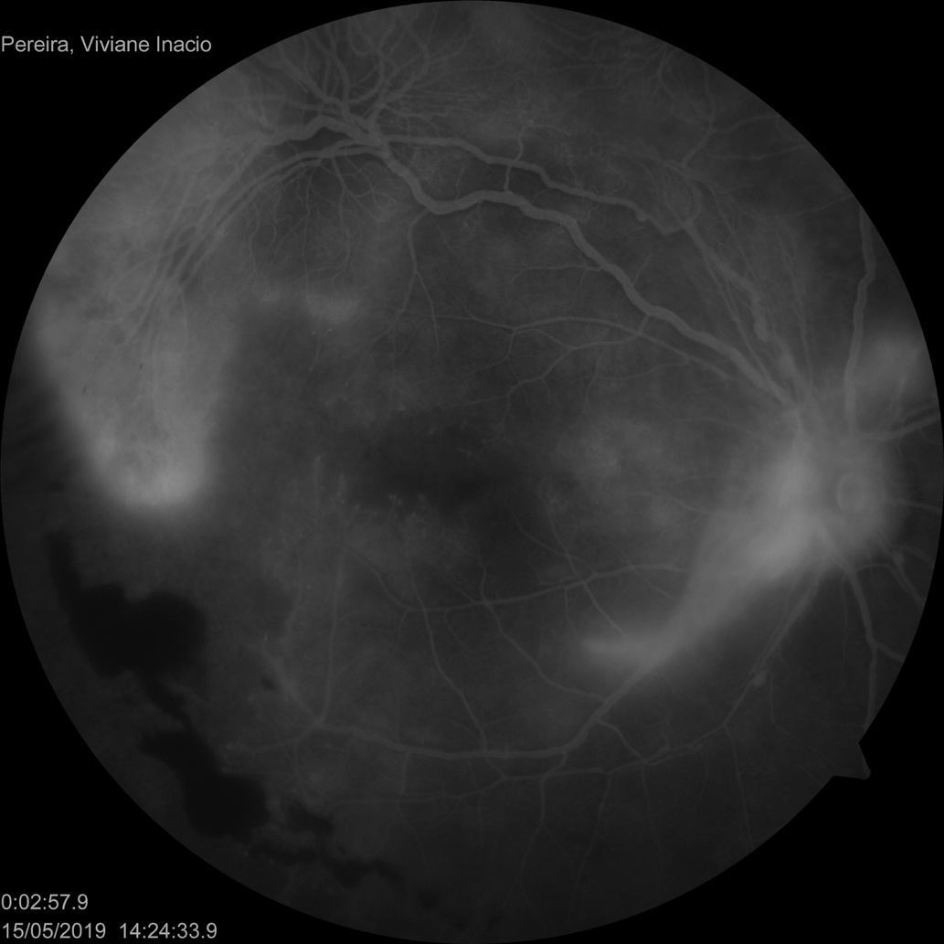
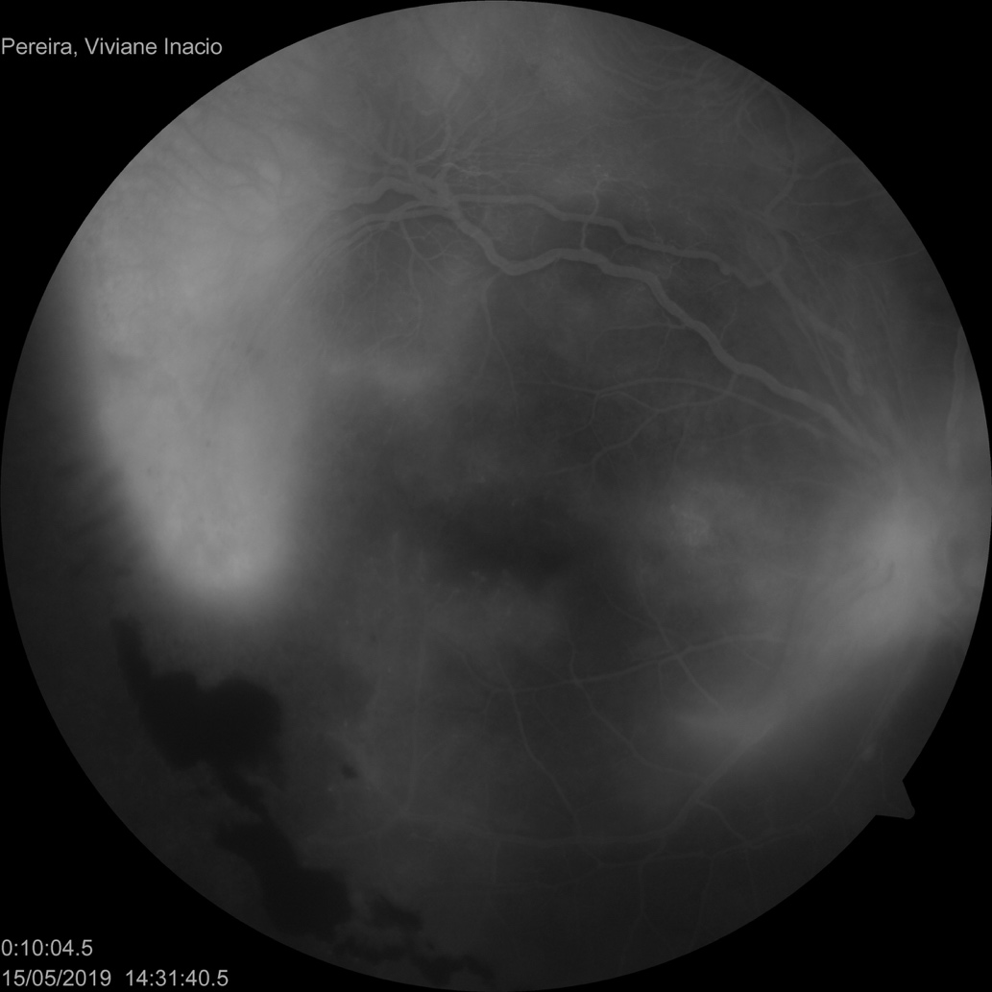

Slide 16
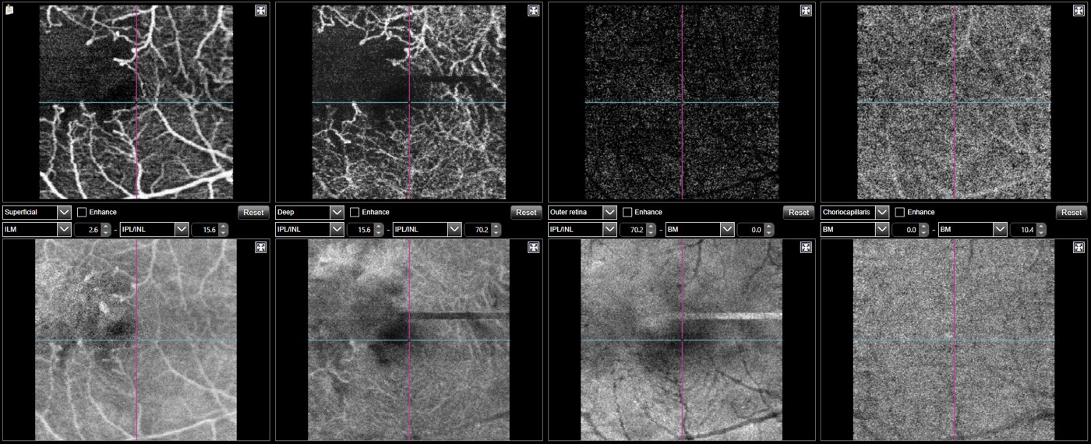

Slide 17
Laboratory Work-up
Hb1Ac 5,3% / blood glucose 88
Hemogram: normal
Na 141 / K 4,2 / Cr 0,73 / Ur 24
Toxoplasmosis serology: negative
HIV serology: negative
Syphilis serology: negative
PPD 0 mm
Urine: normal

Slide 18
Laboratory Work-Up
Rheumatoid Factor: negative
Positive Antinuclear Antibody: nuclear dense fine speckled ≥ 1:1280 (non-specific)
Anti-DNA: negative
Anti RNP, SM, RO e LA: negative
Antiperinuclear Antibody: negative
Hemoglobin Eletroforesis: HbA1 de 96,3% e HbA2 de 3,7%
Antiphospholipid Antibody: negative

Slide 19
Imaging Work-Up
Chest CT: normal
Head and Orbit MR Angiography: normal
Ecocardiogram: normal
Neck US Doppler: normal

Slide 20
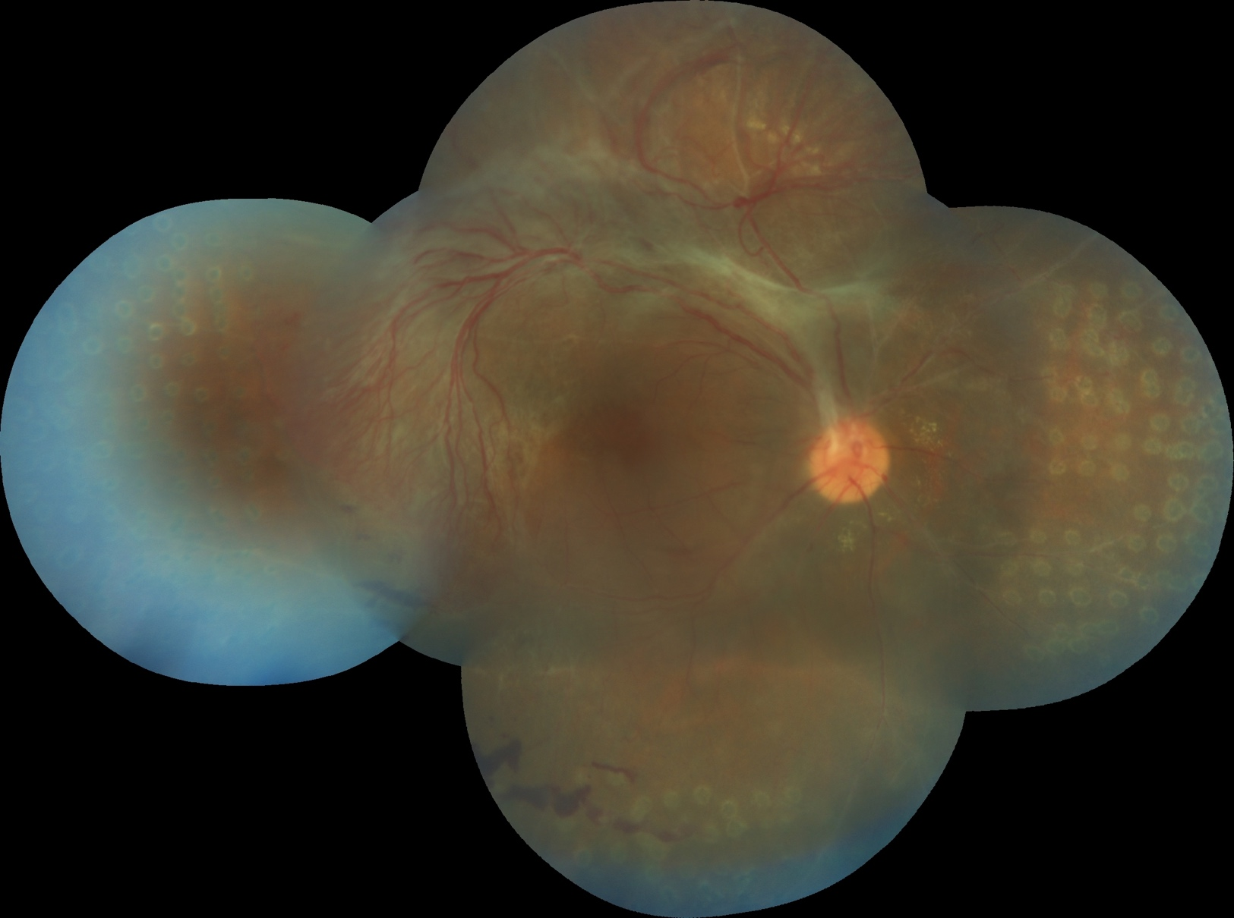
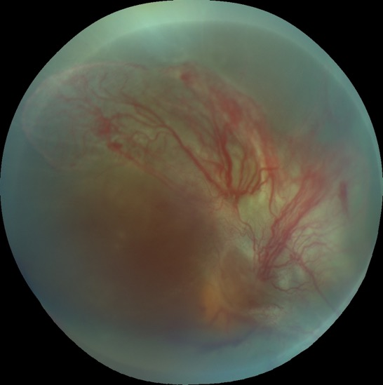
Management
OD: panretinal photocoagulation
OS: poor prognosis
OD: 20/70
OS: Hand Movement

Slide 21
OD
Vasculitis
Neuroretinitis

Slide 22
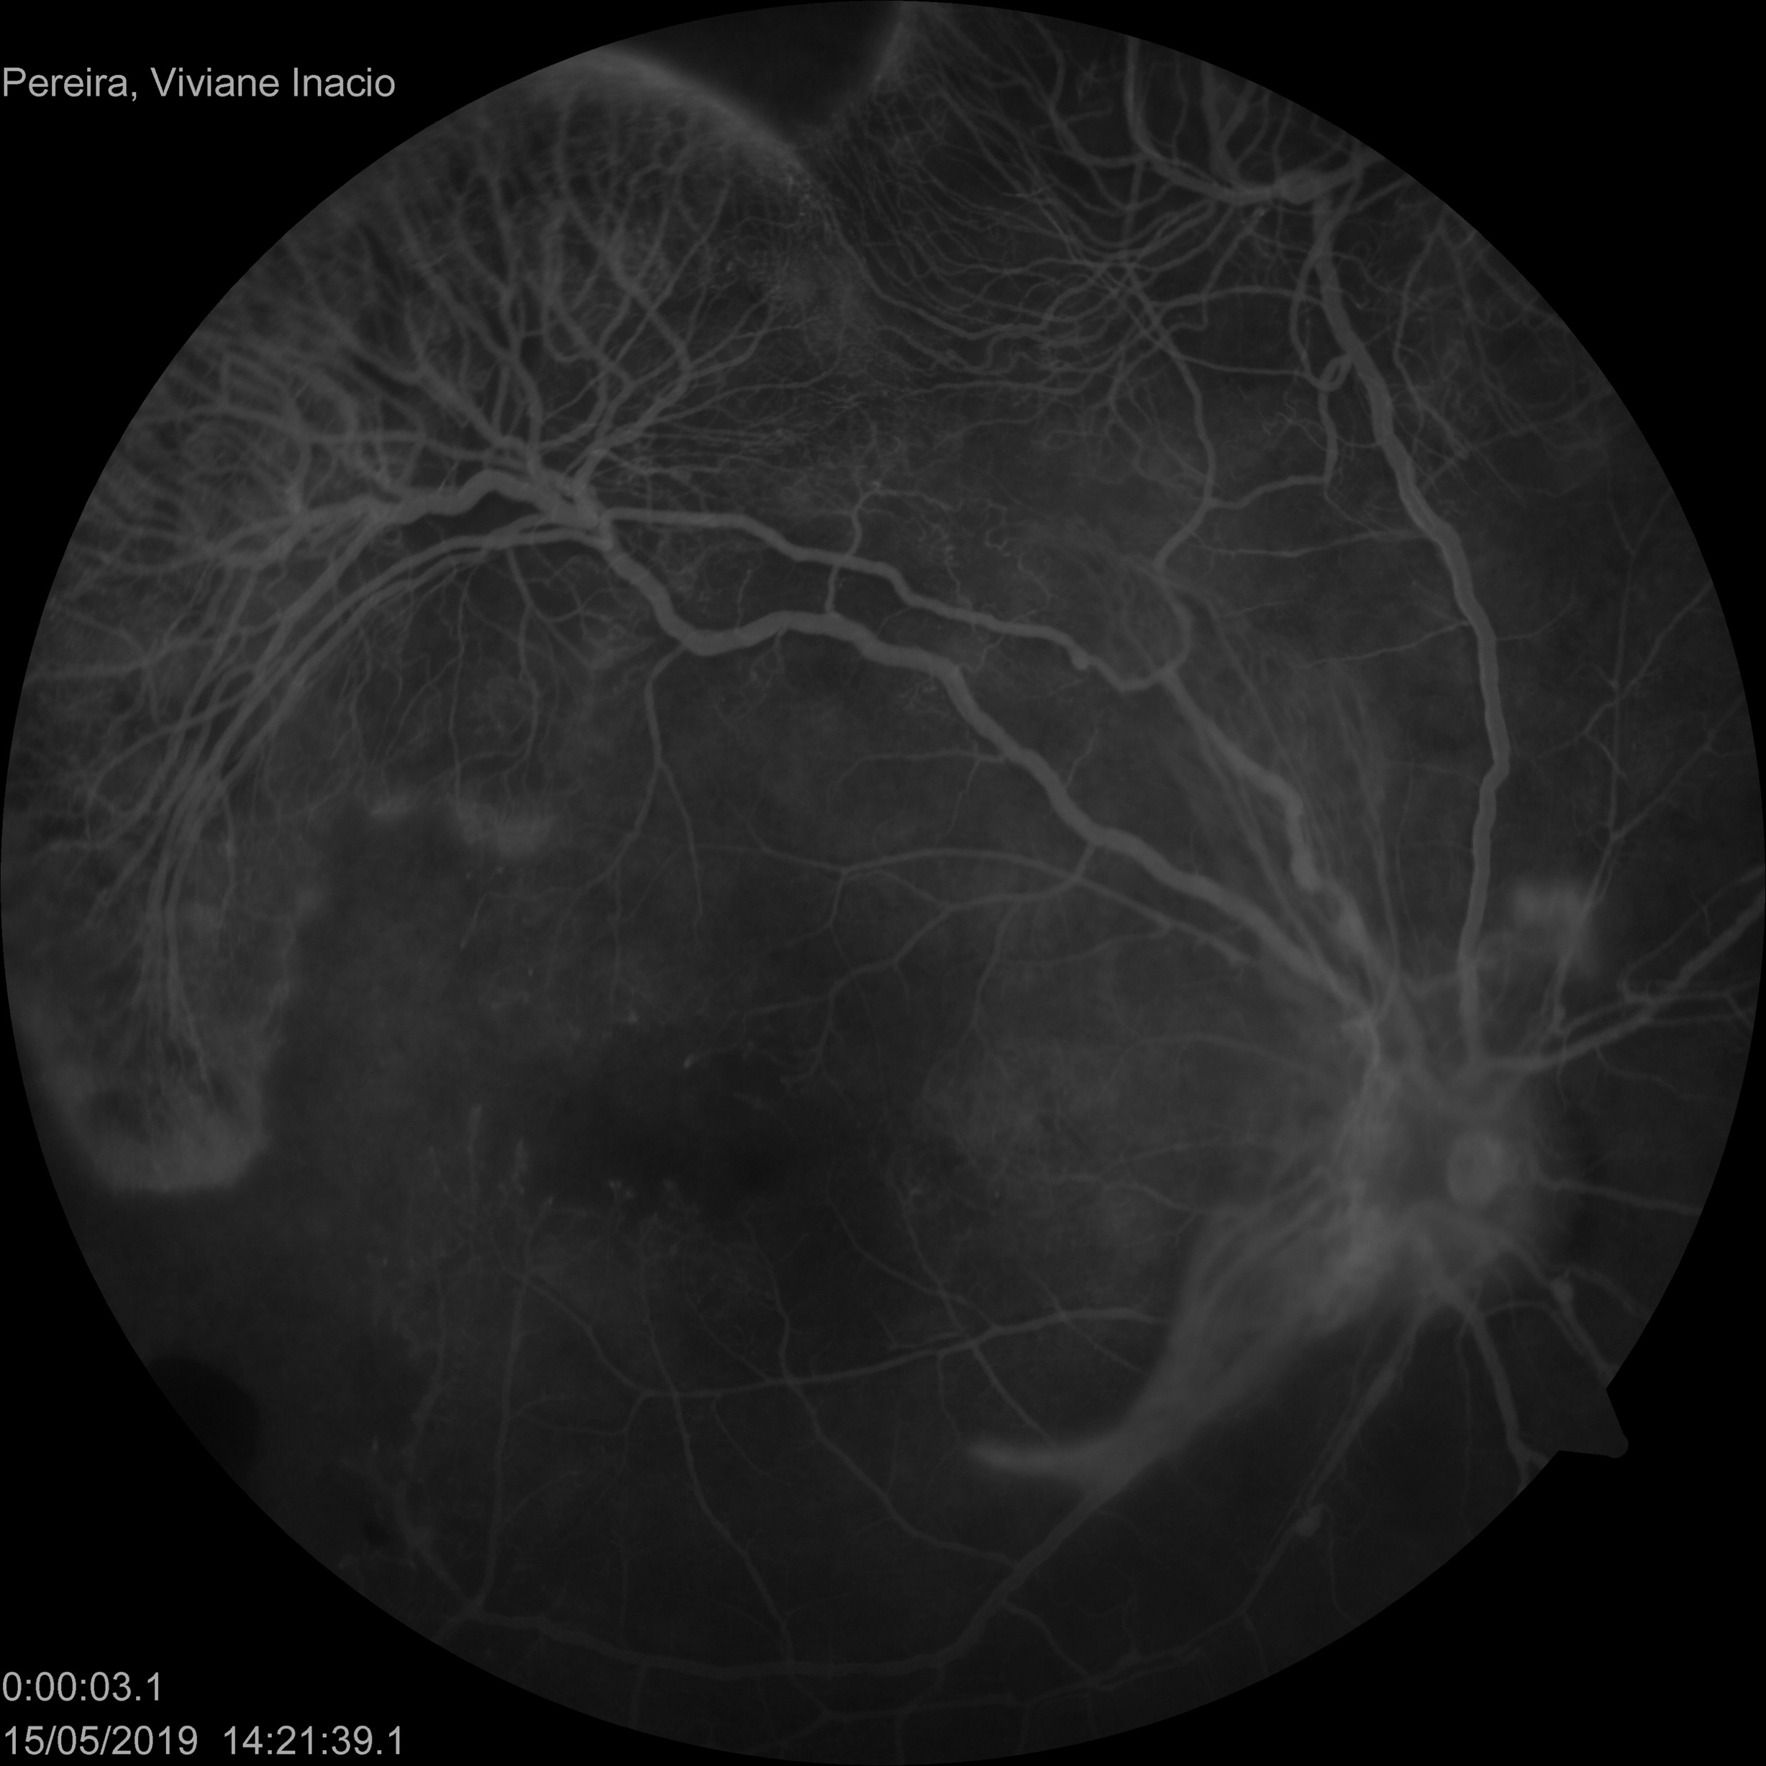
Aneurysms

Slide 23
Diagnostic Hypothesis
Vasculitis
Aneurysms
Neuroretinitis
IRVAN Syndrome

Slide 24
Thank you!

