Slide 1
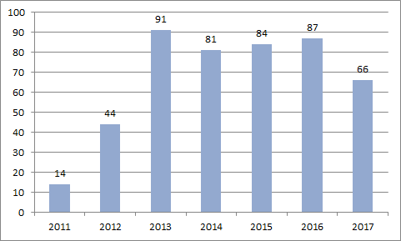
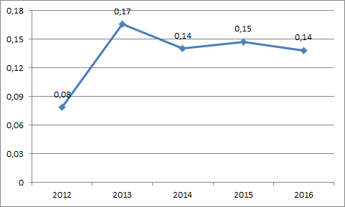
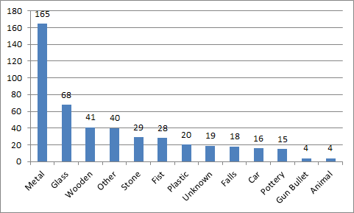
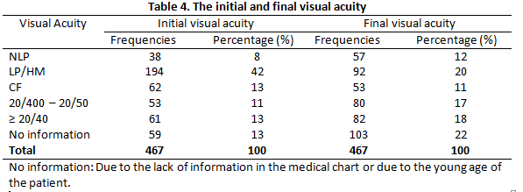
Epidemiological characteristics and visual outcome of patients hospitalized for Open-Globe injury in a Brazilian Hospital
Denadai L, Bergamo VC, Nakayama LF, Moraes, NSB
Unifesp Ethic Committee: 1271/2018
BACKGROUND
TABLES, GRAPHS AND FIGURES
Ocular trauma is one of the most common causes of monocular visual impairment and blindness worldwide (1). In majority, these traumas are preventable, can cause long-term disability, extreme psychological and emotional stress to victims and economic burden to society as well (2).
Ocular trauma presents distinct epidemiological and public health patterns according to socioeconomic and development country level.
Table 1. Open-globe trauma number of cases. 2011-2017
PURPOSE
This study objective was to provide epidemiological characteristics and visual outcome of patients hospitalized for open-globe injury in a Brazilian hospital, based on retrospective analysis of medical records.
Open-globe injury was defined, according to the Birmingham eye trauma terminology (BETT) (3), as a trauma that commits eye wall whole thickness, caused by a blunt or sharp agent.
Table 2. Open-globe trauma incidence. 2011-2017
METHODS
Retrospective study including all patients with ocular trauma evaluated at São Paulo Federal University emergency sector from May 2011 to August 2017. Only patients with open-globe injury were considered in this analysis.
Data collected included patient age, sex, cause of injury, length of time between injury and hospital attendance, initial visual acuity and best corrected vision at the last follow-up visit. All patients, except children with less than five years, had visual acuity measured with Snellen chart.
All cases required hospitalar admission and ocular surgery.
figure 1
figure 2
Table 3. Open-globe trauma material agent
figure 2
figure 3
figure 2
RESULTS
A total of 467 patients with unilateral open-globe injury were admitted to São Paulo Hospital between May 2011 to August 2017. 362 (77.52%) male patients and 105 (22.48%) female patients. Patients ages ranged from 8 months to 93 years old (mean of 34.97 ± 19.69 years old). The right eye was affected in 224 cases (48%) and the left eye in 243 cases (52%).
Cases distribution in the period are shown in Table 1. Between 2012 and 2016 there was an mean of 77.4 cases/year. Open-globe ocular trauma incidence in the São Paulo Hospital ophthalmology emergency room was smaller (0,08%) in 2012 and higher (0.14%) in 2016 (table 2).
The average time between injury and hospitalar care was 2.29 days (range from 1 to 120 days).
The causative agents were divided according to the trauma material (table 3). 35% of open globe trauma were caused by metal objects, 15 % by glass and 9% by wood. Fire gun bullet and animal trauma were causative agent in 1 % each.
425 cases (91%) had at least one outpatient medical follow-up after the surgery. Mean follow-up time was 13.49 months.
Initial and final visual acuity distribution is presented in the table 4. In 59 cases (13%) initial visual acuity was not informed in the medical chart or the vision cannot be tested due to the young age; The most common initial visual acuity was hand motion or light perception (42%). Only 13% of all cases had the initial visual acuity 20/40 or better. No light perception was presented in 8% of cases.
Hand motion or light perception was also the most common final visual acuity. Almost a third (35%) of patients had final visual acuity 20/400 or better and 12% of patients visual acuity were no light perception.
DISCUSSION
Our study analysed a large sampling that included the medical records of 467 cases of open-globe ocular trauma from 2011 to 2017.
The percentage of male patients (77.52% against 73.9%), the mean age (34.9 against 35.5 years old) and the main causative agent (metal) is corresponding to previous studies (4).
Late presentation of patients in our study, average of 2.29 days of time interval between injury and hospital attendance, has also been well reported in previous studies (5). Delayed presentation leads to prolonged inflammation and a greater risk of infection in these patients. Final visual acuity worse than 20/400 was presented 53% of the patients.
figure 4
figure 5
figure 6
figure 7
CONCLUSION
figure 8
Despite the fact that ocular trauma is an important cause of monocular blindness worldwide, scarce information is available. Our study provides insights on the epidemiology of open-globe ocular trauma in hospitalized patients in a Brazilian hospital and supports the findings that ocular trauma represents a significant cause of visual loss in this population.
figure 9
REFERENCES
Tielsch JM, et al. Time trends in the incidence of hospitalized ocular trauma. Arch Ophthalmol 1989.
Négrel AD, et al. The global impact of eye injuries. Ophthalmic Epidemiol. 1998.
Kuhn F, et al. The Birmingham Eye Trauma Terminology system (BETTS). J Fr Ophtalmol 2004.
Ying Q, et al. Characteristics and visual outcomes of patients hospitalized for ocular trauma in central China: 2006-2011. Int J Ophtalmol. 2015.
Oluyemi F. Epidemiology of Penetrating Eye Injury in Ibadan: A 10-Year Hospital-Based Review. Middle East Afr J Ophthalmology, 2011.

