Slide 1
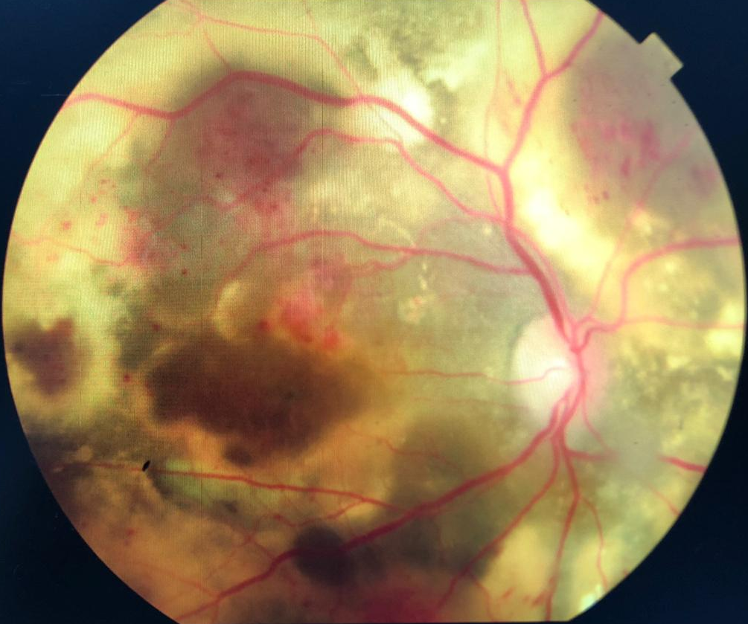
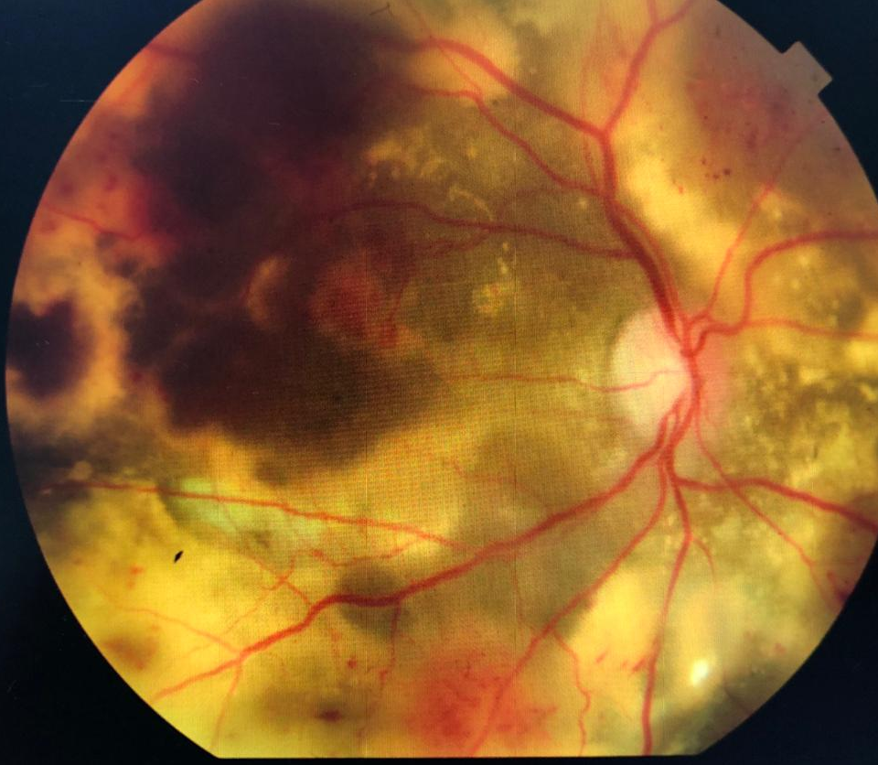
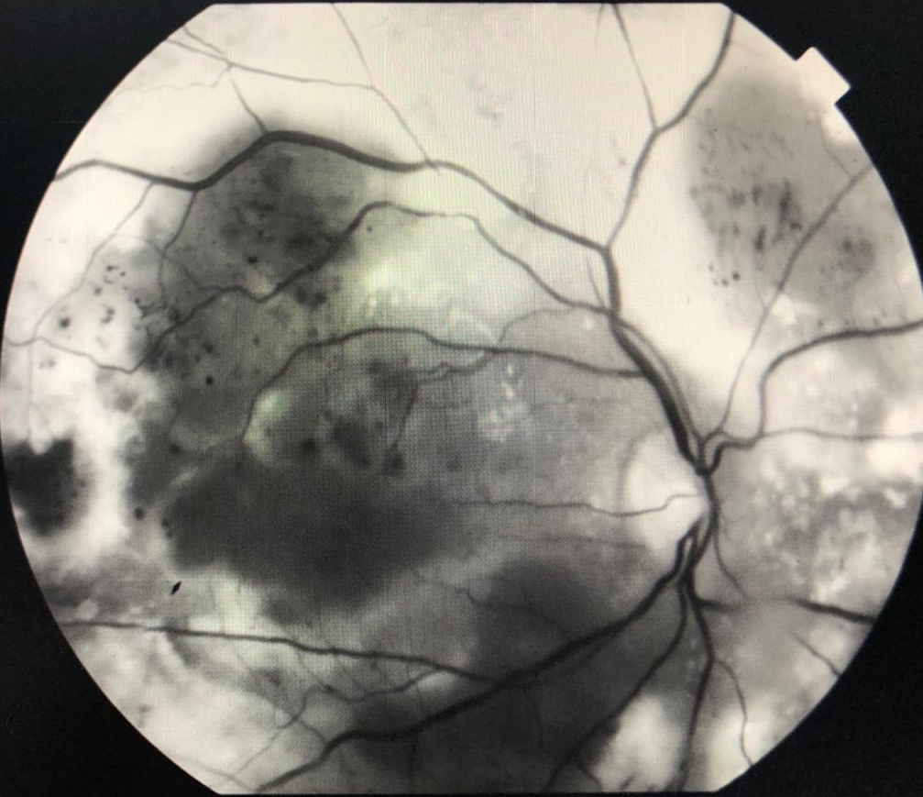
CASE REPORT OF IDIOPATHIC
JUSTAFOVEOLAR
TELANGIECTASIA IN A WOMEN
CARVALHO, T.A¹; BATISTEL, T.V.²; OGLIARI, L.F.C.²; FALCÃO, V.C.¹; FIGUEIREDO, T.C.S.¹; TOCHETO, B.B.^{¹;}FEDERICI, F.B.N.³; COSTA, M.A.N³
¹ Retina and Vitreous Fellowships of João Penido Burnier Foundation
² Resident of Ophthalmology of the João Penido Burnier Foundation
³ Heads of the Retina and Vitreous sector of the João Penido Burnier Foundation
PURPOSE
Macular telangiectasia, also known as idiopathic justafoveolar telangiectasia, is a rare ocular disease that can lead to blindness. Usually unilateral and male. This disease is characterized by abnormal retinal vascular dilatation and vessel dysfunction. Visual loss is mainly caused by macular edema and exudation. Based on clinical findings, high-speed indocyanine green angiography, optical coherence tomography (OCT), and demographics, Yanuzzi et al. proposed a classification into type I - telangiectasia Coats aneurismal type, and type II - perifoveais telangiectasias.
CASE REPORT
M. I. B. S. C., 57 years old, female, born in Rio Branco - Acre, coming from Campinas - SP. she entered the service in January 2020, complaining of progressive low visual acuity in her right eye 10 months ago, denying trauma, pain and other symptoms. No pathological history. With an ophthalmological background, she had cataract surgery in both eyes for thirteen years. On examination, she presented visual acuity of the forefinger fingers in the right eye and 20/20 with correction in the left eye. At biomicroscopy of both eyes without changes, intraocular pressure was 14mmHg in both eyes, and the fundoscopy of Right Eye: Normal optical disc, presence of diffuse exudate, with intraretinal hemorrhage mainly in the superior temporal arcade, areas of neovascularization ans 360 applied retina. Left Eye was without changes.
After clinical evaluation, anamnesis and imaging exams, the syndromic diagnosis of Justafoveolar Telangiectasia type 1 was reached. Laser photocoagulation and anti-VEGF injection in the right eye were thus indicated.
DISCUSSION
Macular telangiectasias is a rare ocular disease, most common in male, but in this case the patient was female. Type 1 idiopathic justafoveolar telangiectasia, considered a variant of Coats' disease, is located in the perifoveal region, and the decrease in visual acuity is due to macular edema. The accumulation of fluid in the layers of the retina is due to transudation from the wall of incompetent vessels. The evolution of this disease shows the onset of chronic macular edema with consequent irreversible structural changes in the retina.
Options for treating type 1 perifoveal telangiectasias include photocoagulation, intravitreal steroid injections, anti-VEGF agents, photodynamic therapy and thermotherapy. The treatment strategy depends on visual acuity, fluoresceinography, optical coherence tomography and retinal biomicroscopy.
REFERENCES
Yanuzzi, L.A. et al, Atlas de Retina, 2 edição. Elsevier, 2019
1. ABUJAMRA, Suel. Telangiectasias perimaculares idiopáticas. Rev. bras.oftalmol., Rio de Janeiro , v. 71, n. 4, p. 213-216, Aug. 2012 .
Photos: retinography of the rigth eye

