Slide 1
CLINICAL CASE A multimodal analysis of retinal arteriolar emboli
Delma Regina Gomes Huarachi
Fellow Retina and Vitreous - Unicamp

Slide 2
Case presentation - History
65 years old, white, female.
Complaint of sudden low vision in the left eye 4 months ago.
Past ophthalmic history:
None
Past medical history:
Epilepsy
Medications:
Gardenal

Slide 3
Ocular Examination
Visual Acuity
BCVA
Right Eye: 20/20 J1
Left Eye: 20/80 J2
Anterior segment examination
Normal in both eyes
Intraocular pressure
Right eye: 12
Left eye: 11

Slide 4
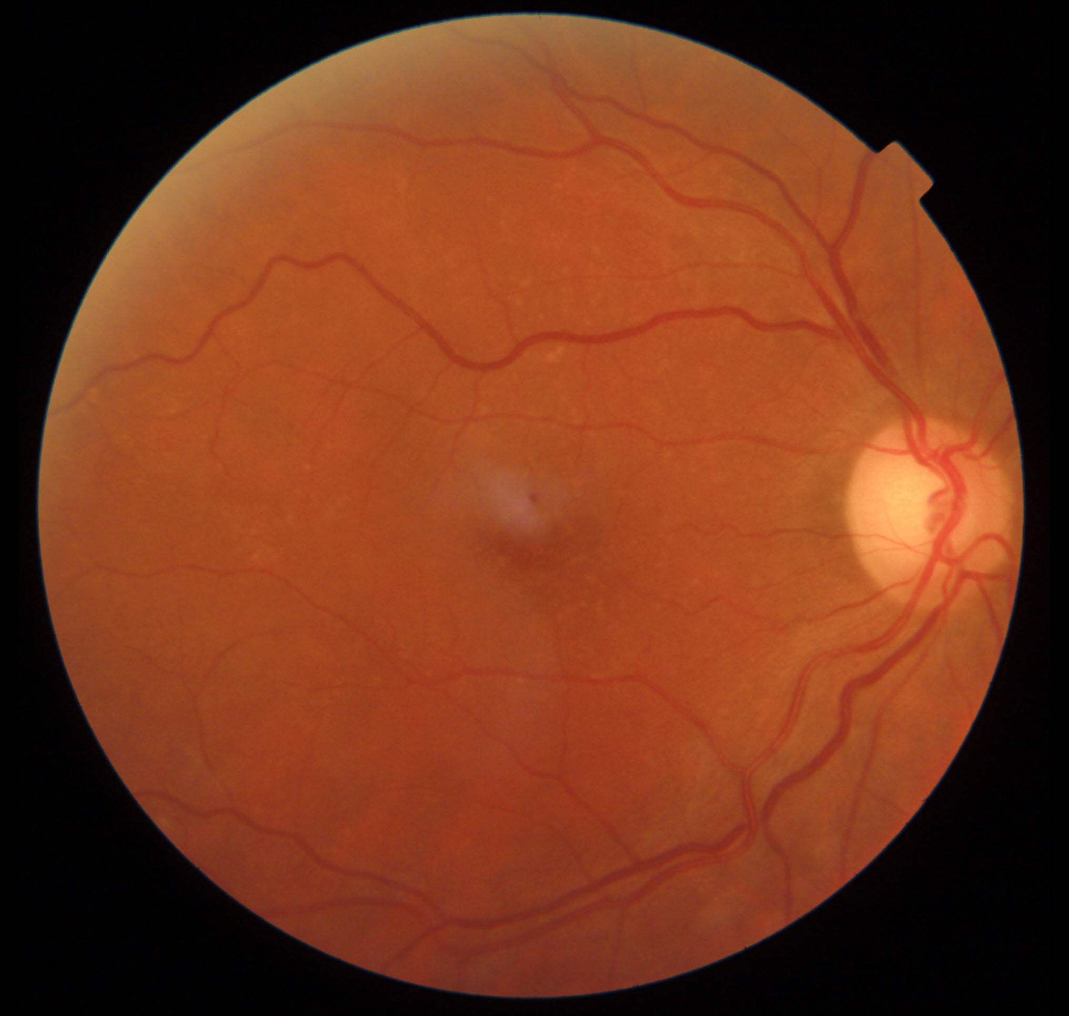
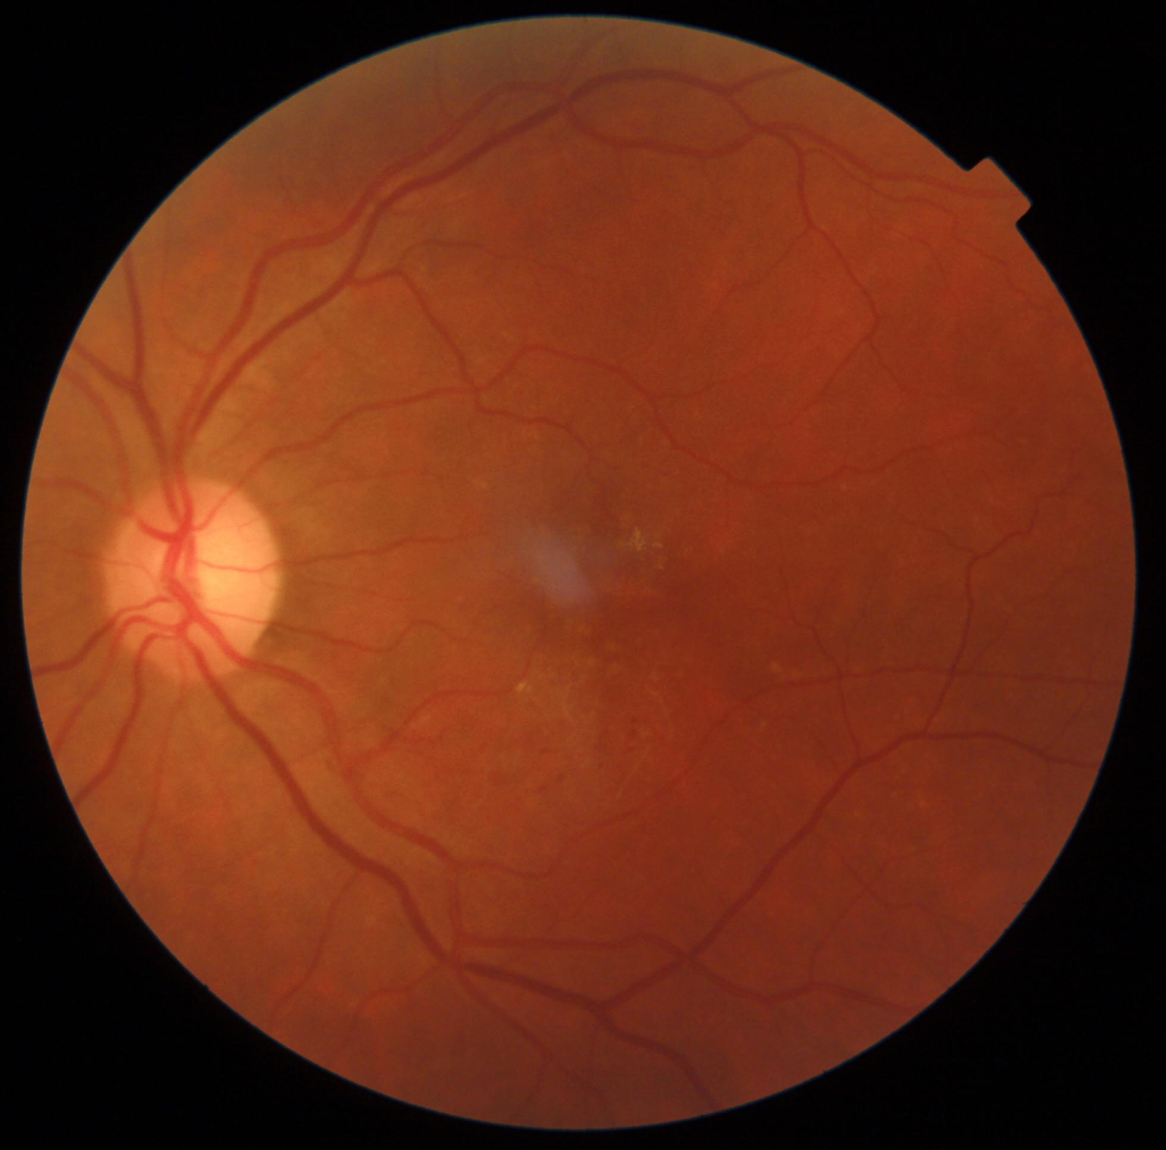

Slide 5
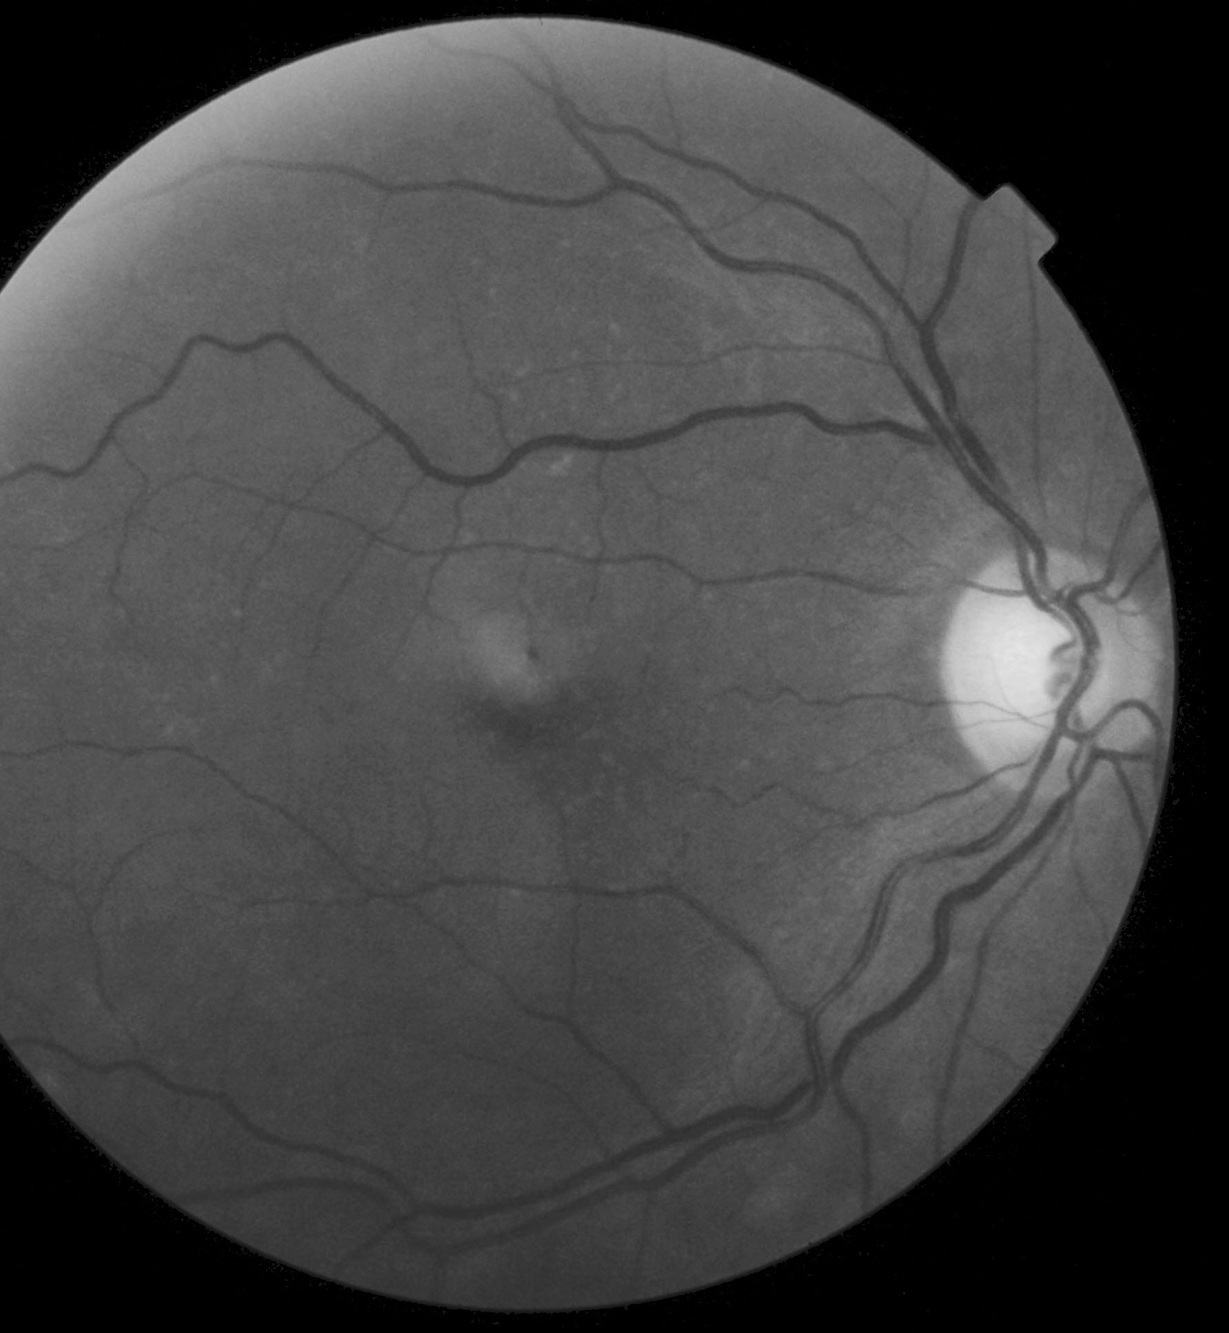
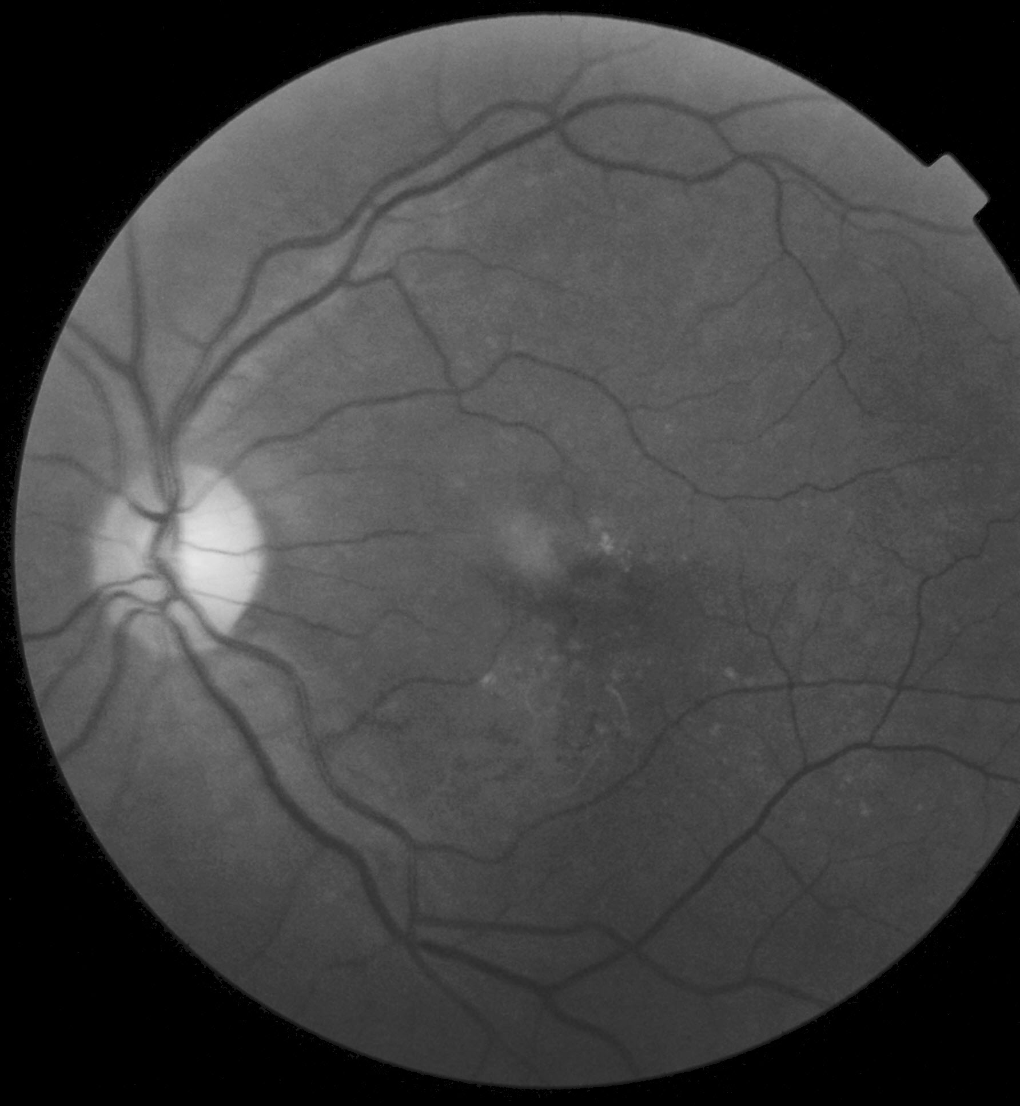

Slide 7
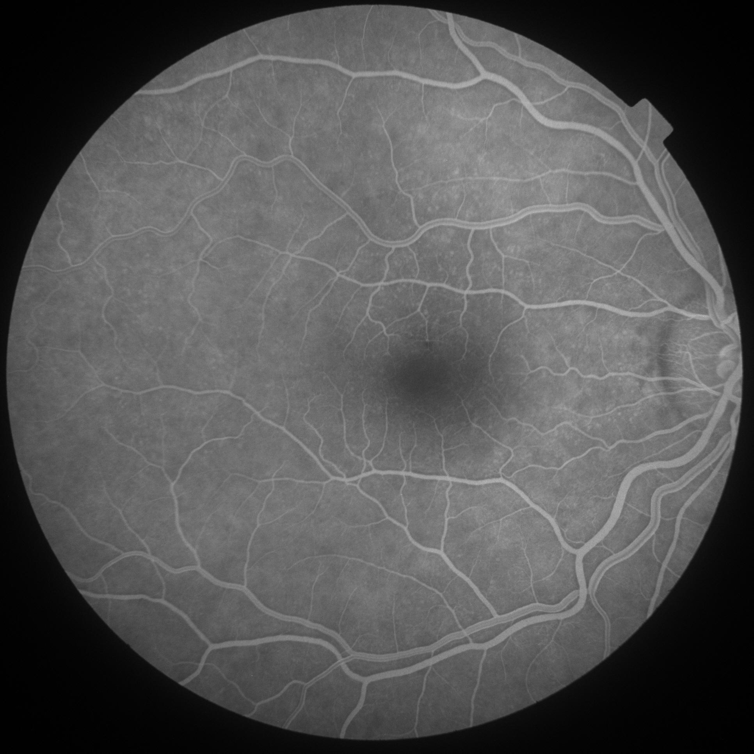
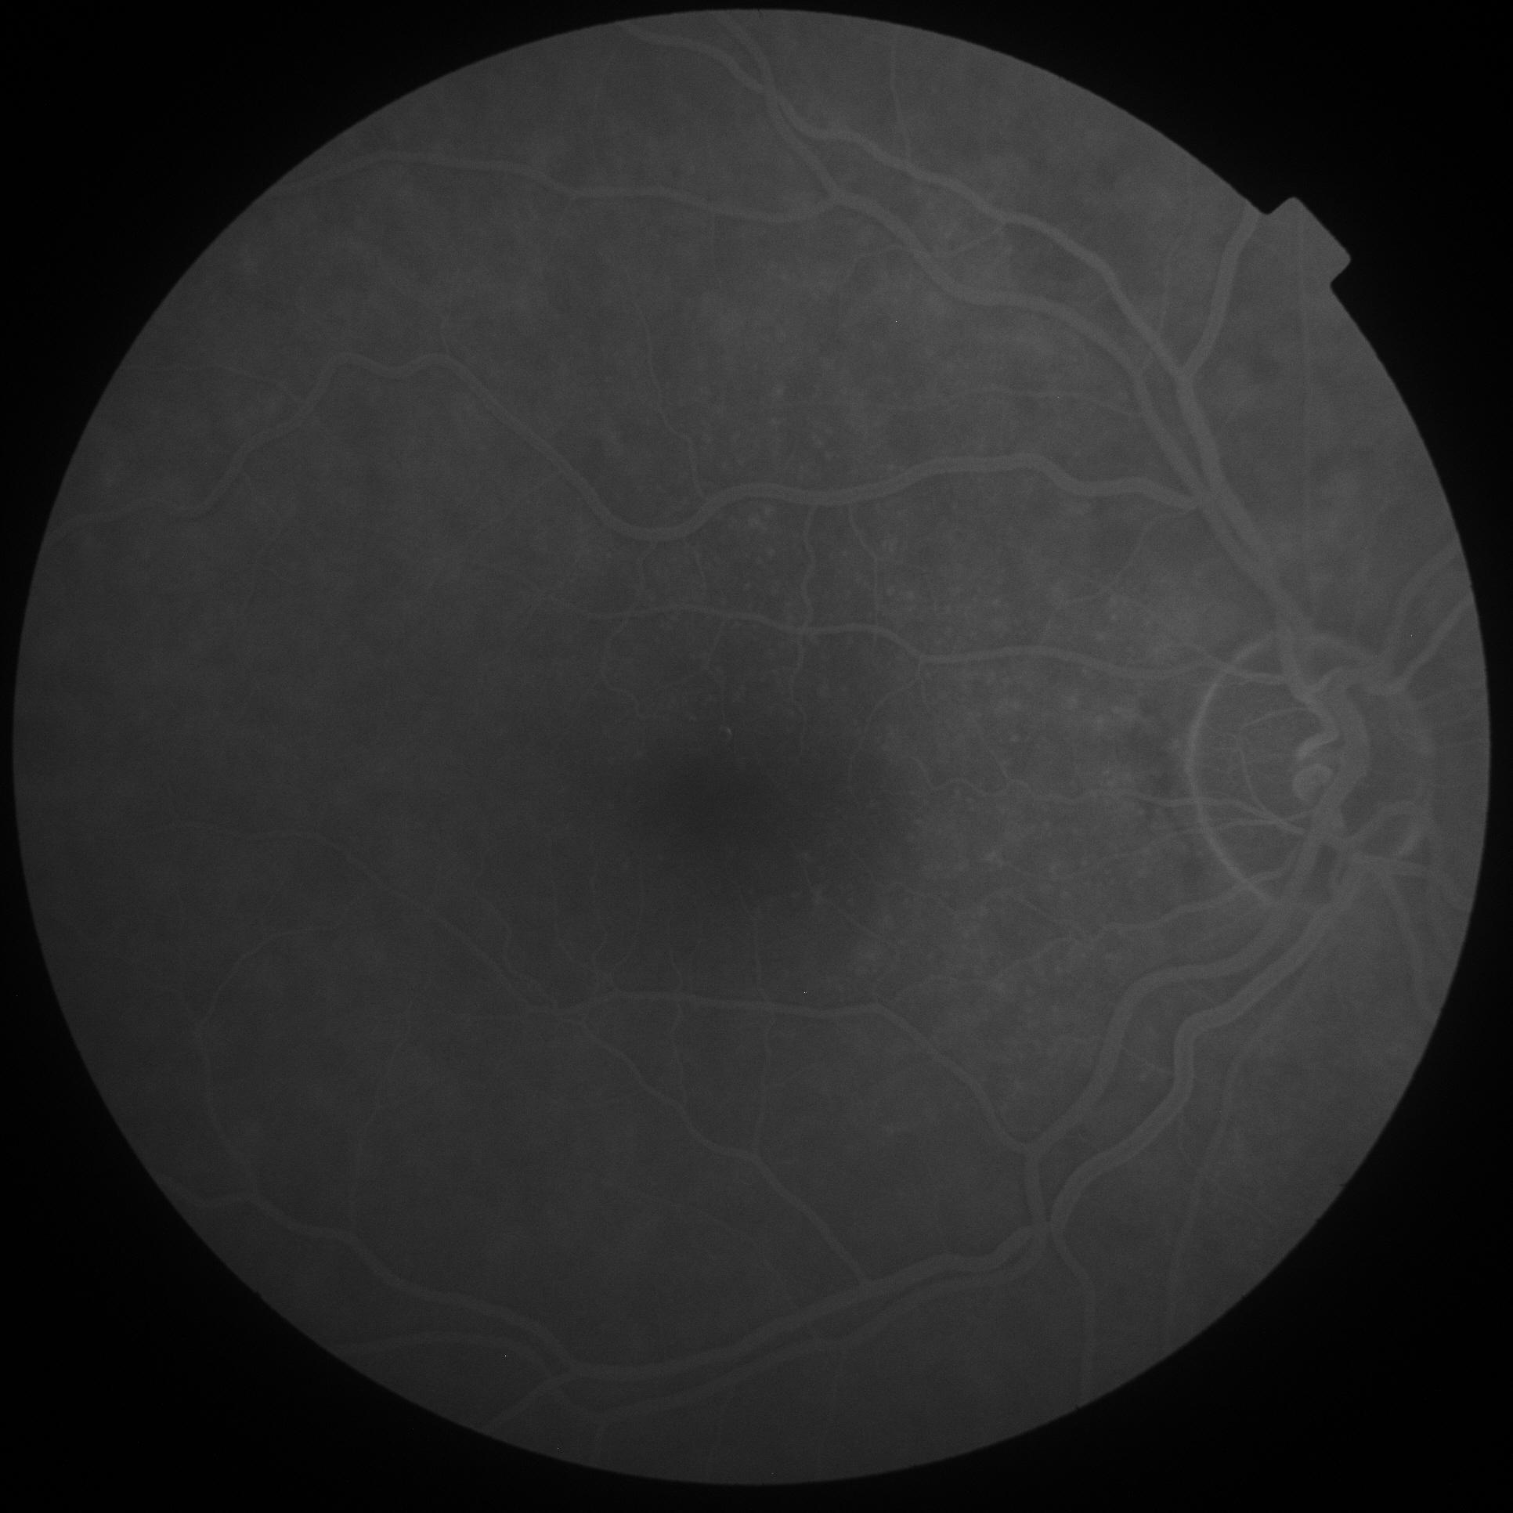

Slide 8
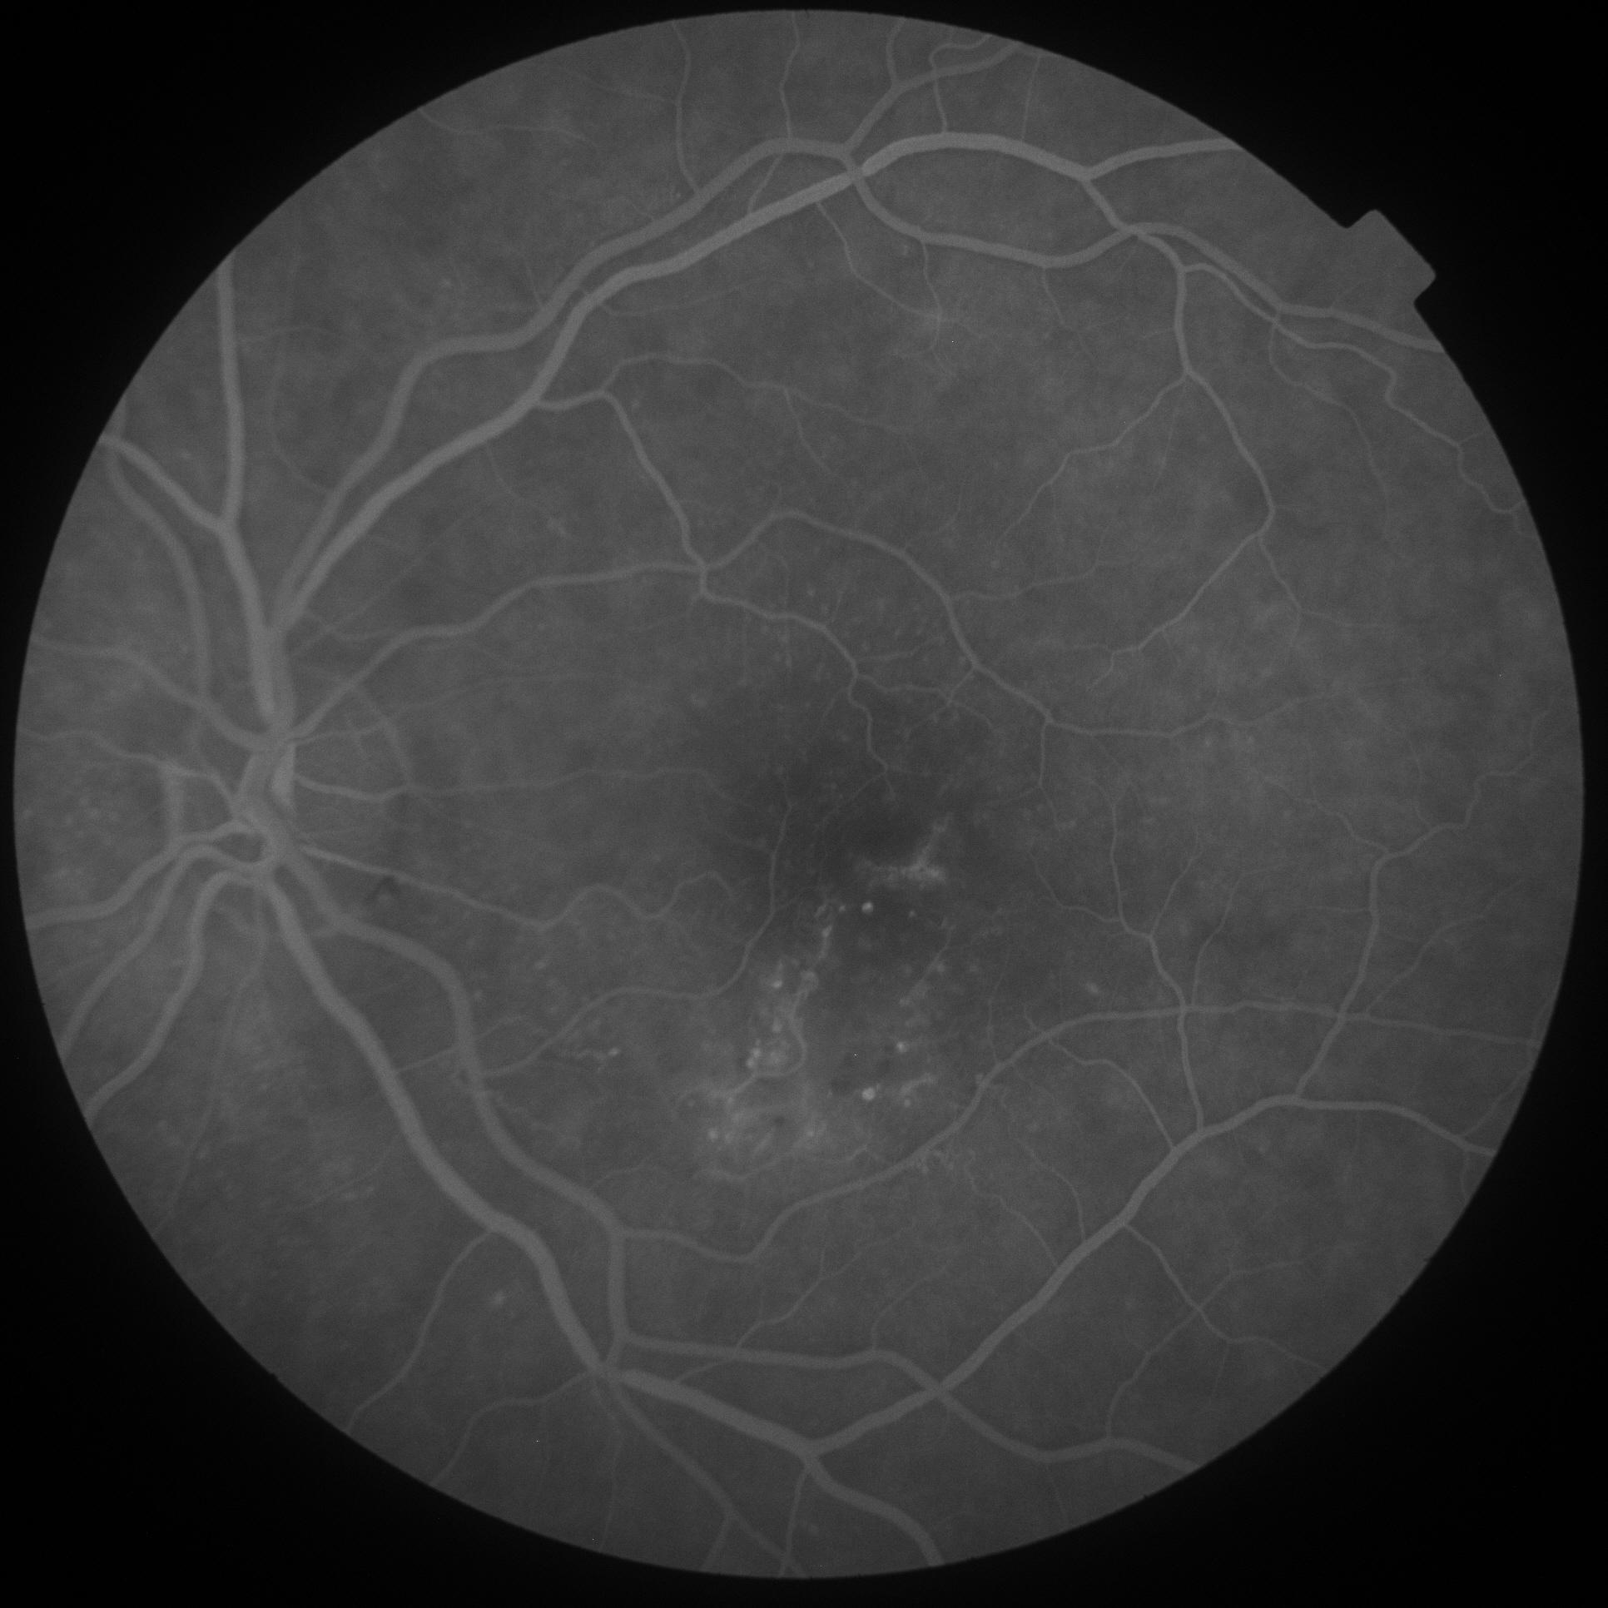
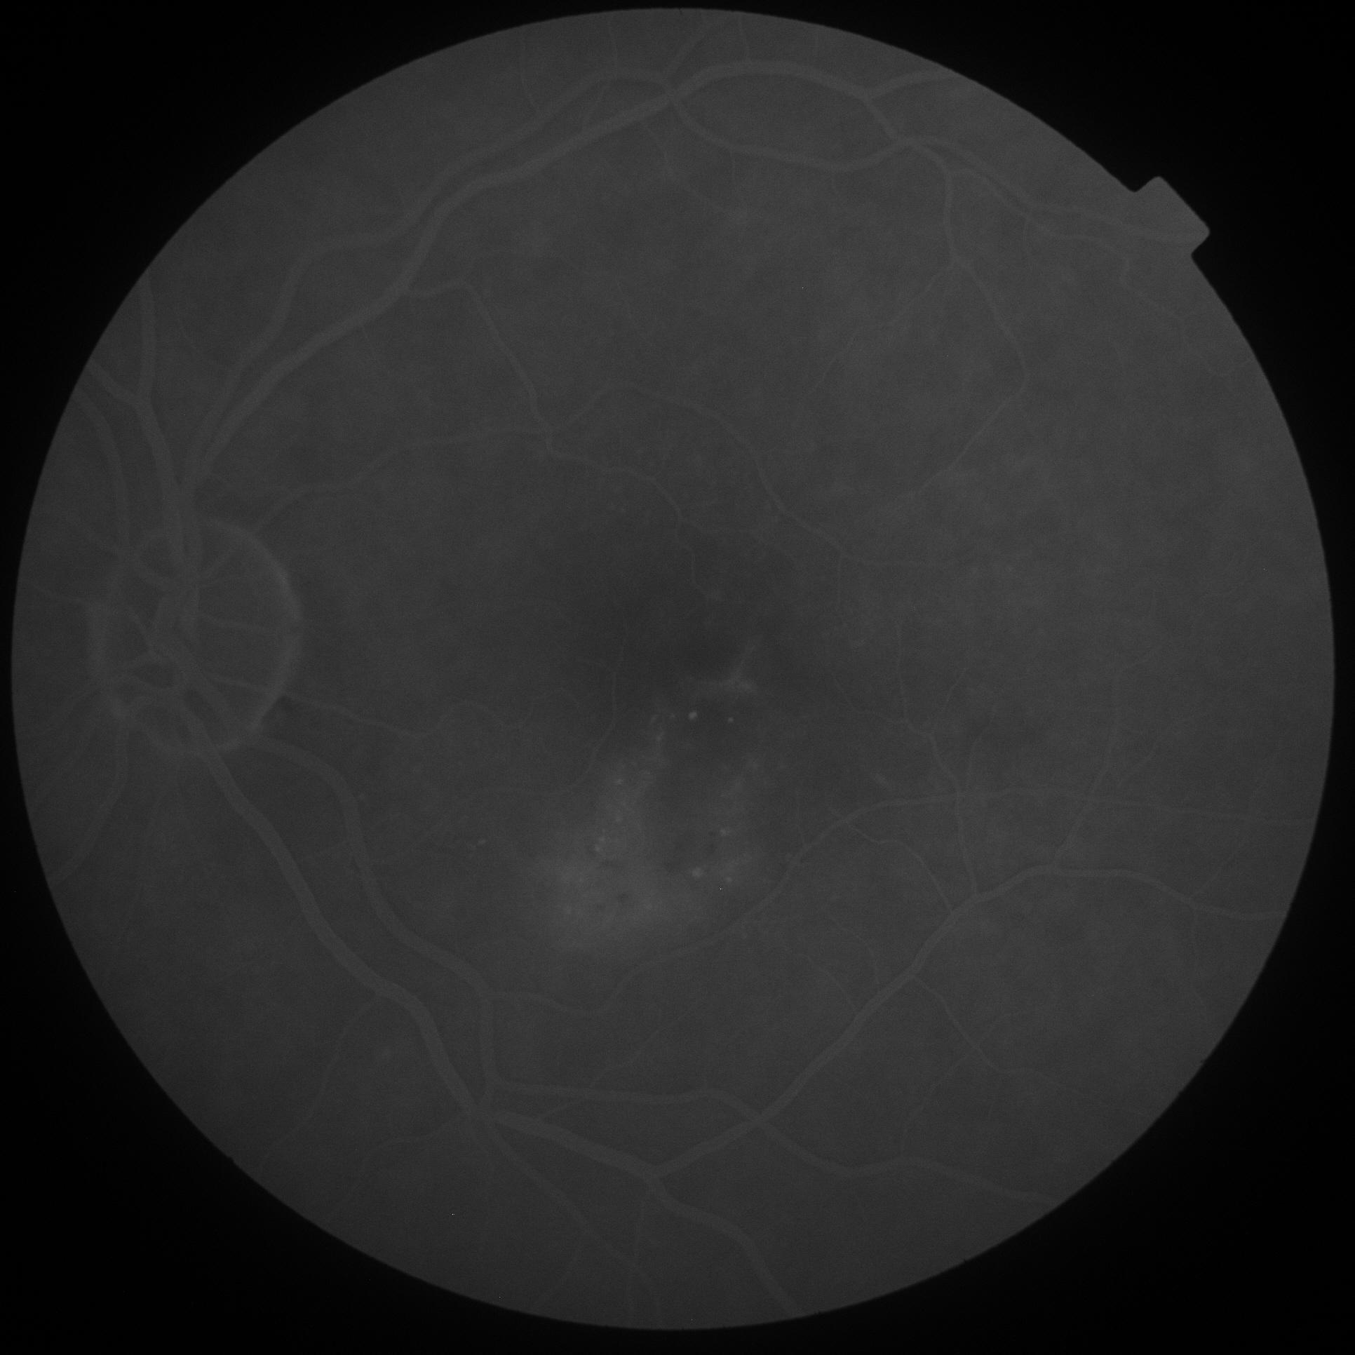

Slide 9
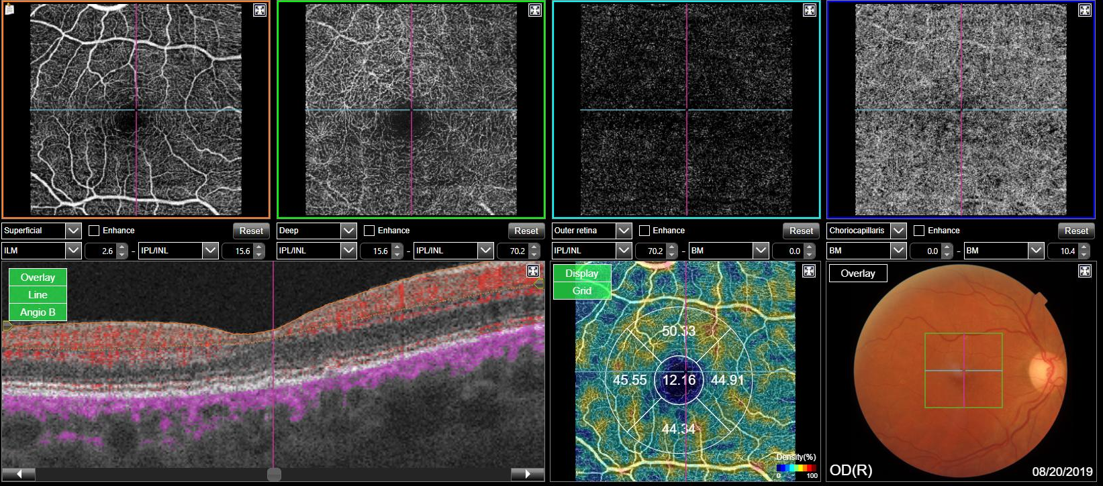

Slide 10
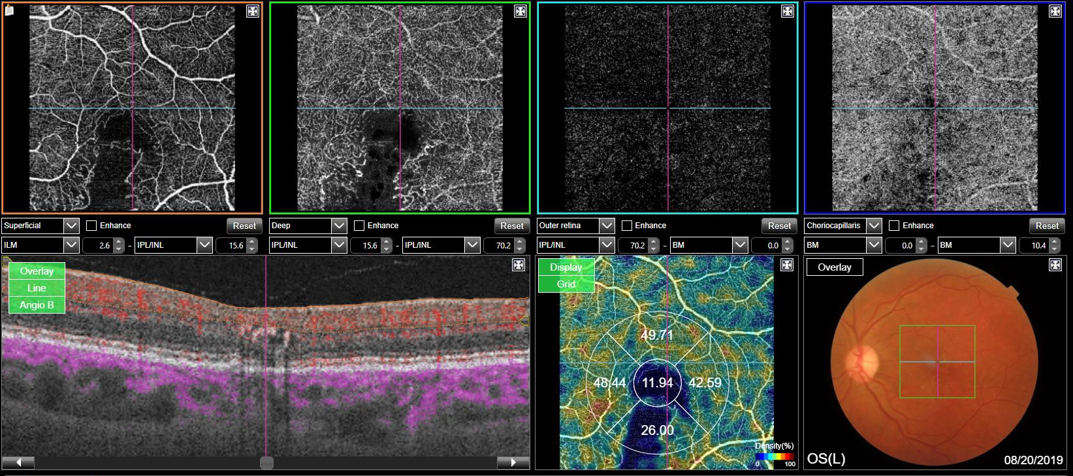

Slide 11
Diagnosis
Retinal Arteriolar Emboli
Management
An echocardiogram and a carotid doppler ultrasonography was requested.
The patient was referred to cardiovascular evaluation.
Maintain regular follow up

