Slide 1
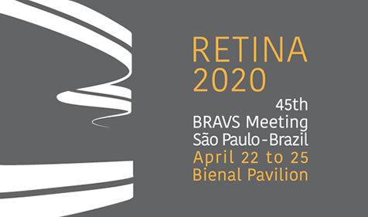
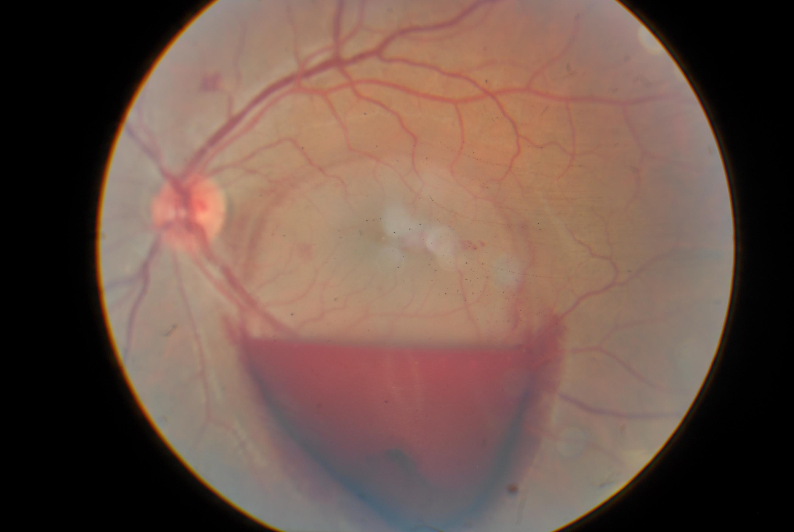
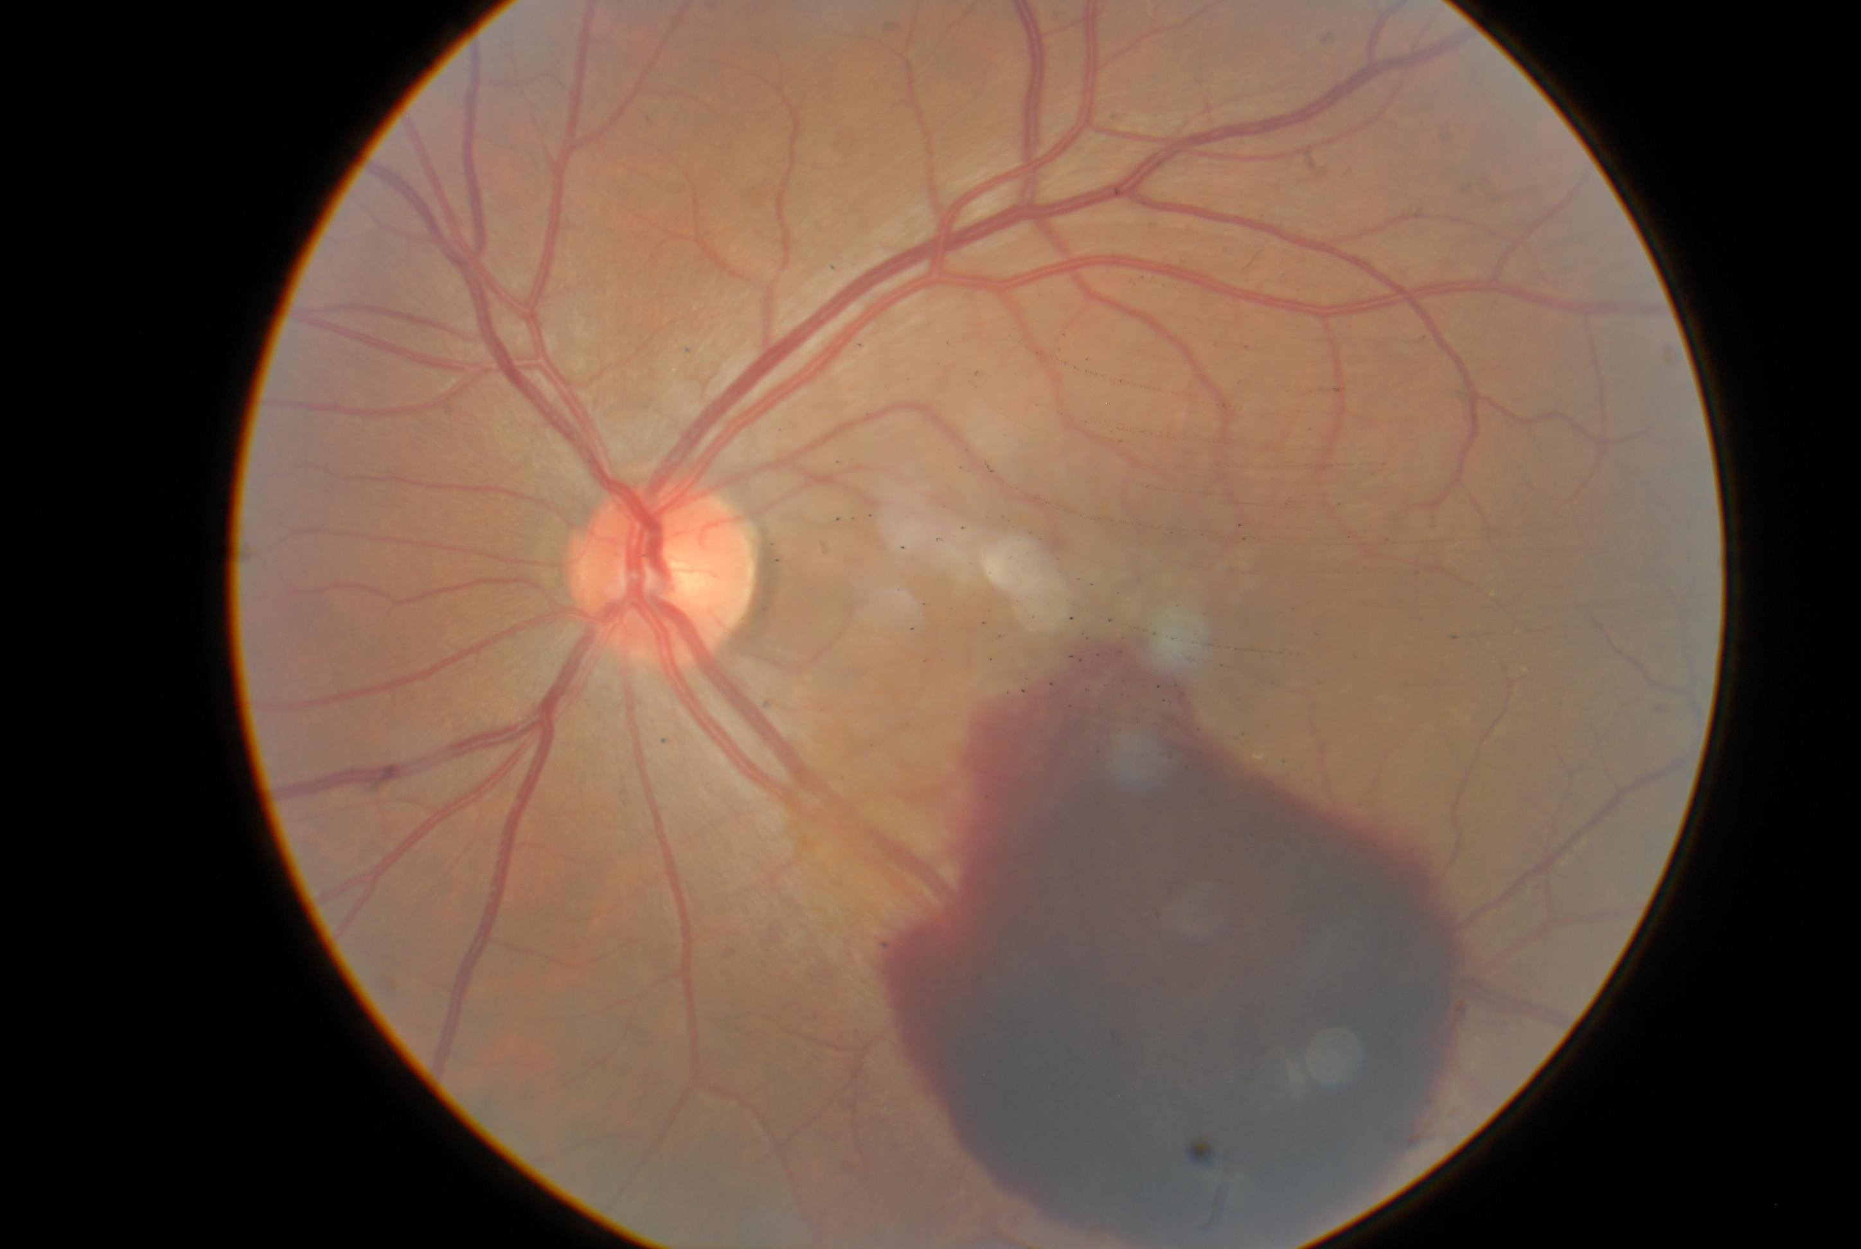
VALSALVA’S RETINOPATHY :
EXPECTANT APPROACH
FALCÃO, V.C.²; DECHICHI, P.¹; CARVALHO, T.A²; FIGUEIREDO, T.C.S.²; TOCHETO, B.B^{.2;} FEDERICI, F.B.N.³; COSTA, M.A.N³; RODRIGUES, N. B.³
¹ Resident of Ophthalmology – Dr. João Penido Burnier Foundation
² Retina and Vitreous Fellowships – Dr. João Penido Burnier Foundation
³ Heads of the Retina and Vitreous sector – Dr. João Penido Burnier Foundation
PURPOSE
Valsalva´s maneuver is a forced exhalation against glottis wich leads to a increased intra thoracic pressure. The sudden increased intraocular venous pressure can lead to a preretinal bleeding. Pacients refer sudden and painless visual loss after activities related to Valsalva´s Maneuver (coughing, vomiting and weight lifting, for example).
METHODS
Case report of male pacient, with literature review.
RESULTS
Male, 32 years old, complains about a dark spot in left eye vision in the past hour. Pacient had unremarkable medical history and no trauma history. His Best Corrected Visual Acuity was 20/20 in right eye and counting fingers at 15cm in left eye. He had no alterations in anterior biomicroscopy in both eyes and a normal fundoscopy in right eye. In left eye he presented a preretinal hemorrhage covering the macula and microhemorrhages in nasal retina. (Photo 1) An expectant approach was chosen, resulting, after 2 days, in improvement of the visual acuity of the left eye to 20/40, with fundoscopy showing a decrease in the area of ​​pre-retinal hemorrhage. After 30 days pacient returned with Visual Acuity (best corrected) of 20/20 in right eye and 20/30 in left eye even with a the persistante of the preretinal hemorrhage, but now the blood weren’t covering the macula. A new retinography was taken showing the good prognosis in this case even with no specific treatment. (Photo 2)
CONCLUSION
The management of Valsalva’s retinopathy can vary depending on the time of hemorraghe, pacient need of getting back to normal activities, disponibility of equipment (Yag Laser or Surgery). The most usual approach is expectant with good recoverying of visual acuity in 6 weeks. The membranotomy with Yag Laser or Krypton Laser should be done within the first week, before the formation of blood cloths. Using LASER procedures in Valsalva Retinopathy is proved to improve visual acuity in less time but there are no difference in long term results.
Photo 1 : Left eye retinography (first day)
Photo 2: Left Eye Retinography (after 30 days)

