Slide 1
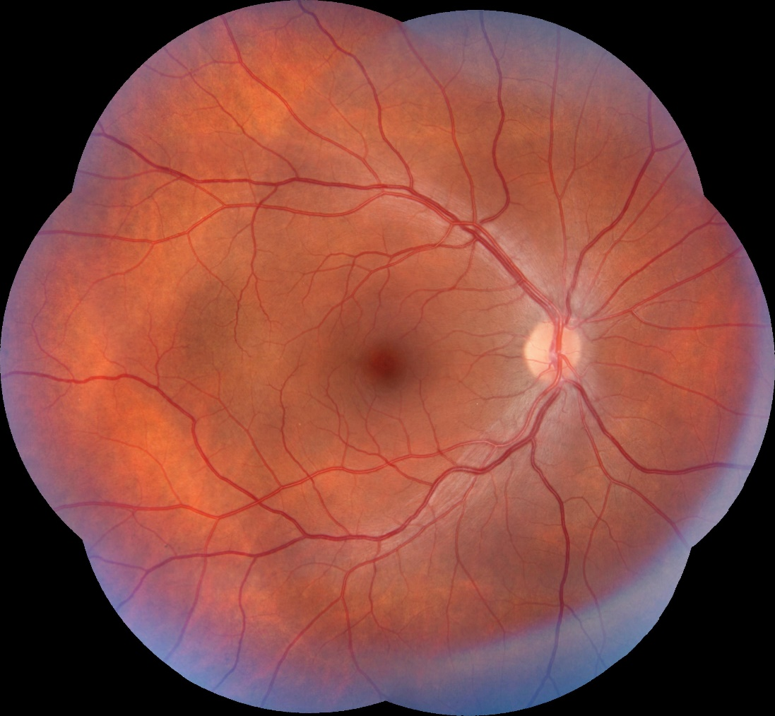
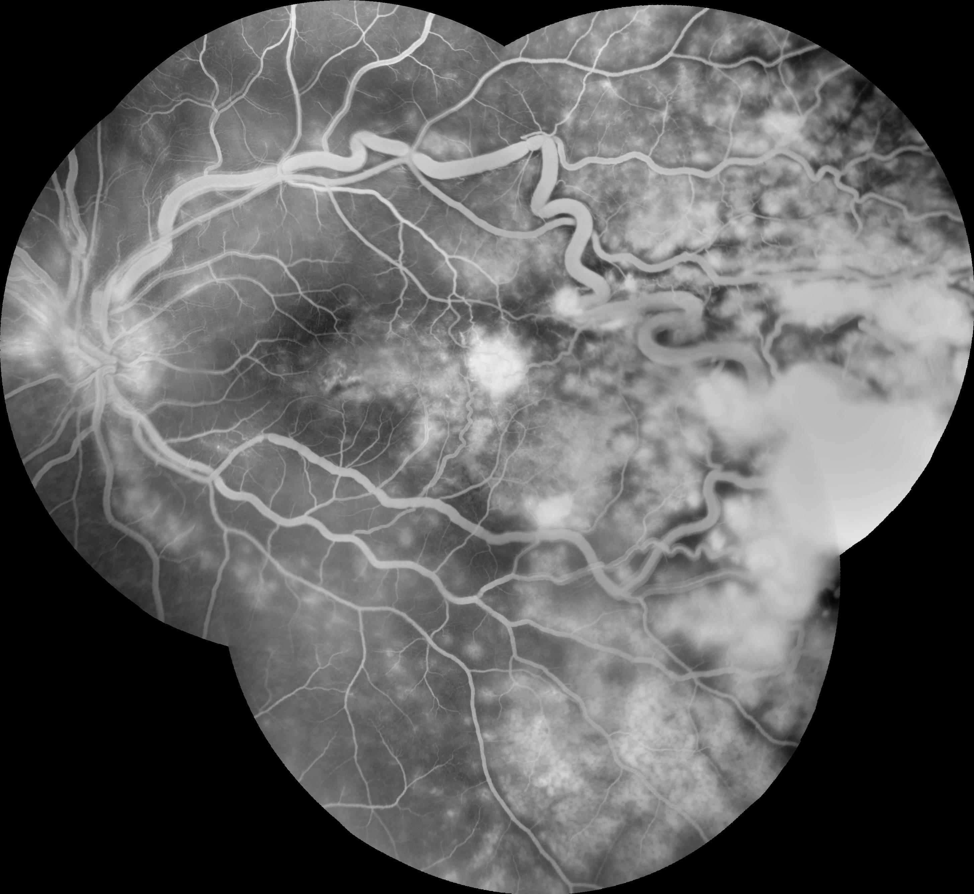
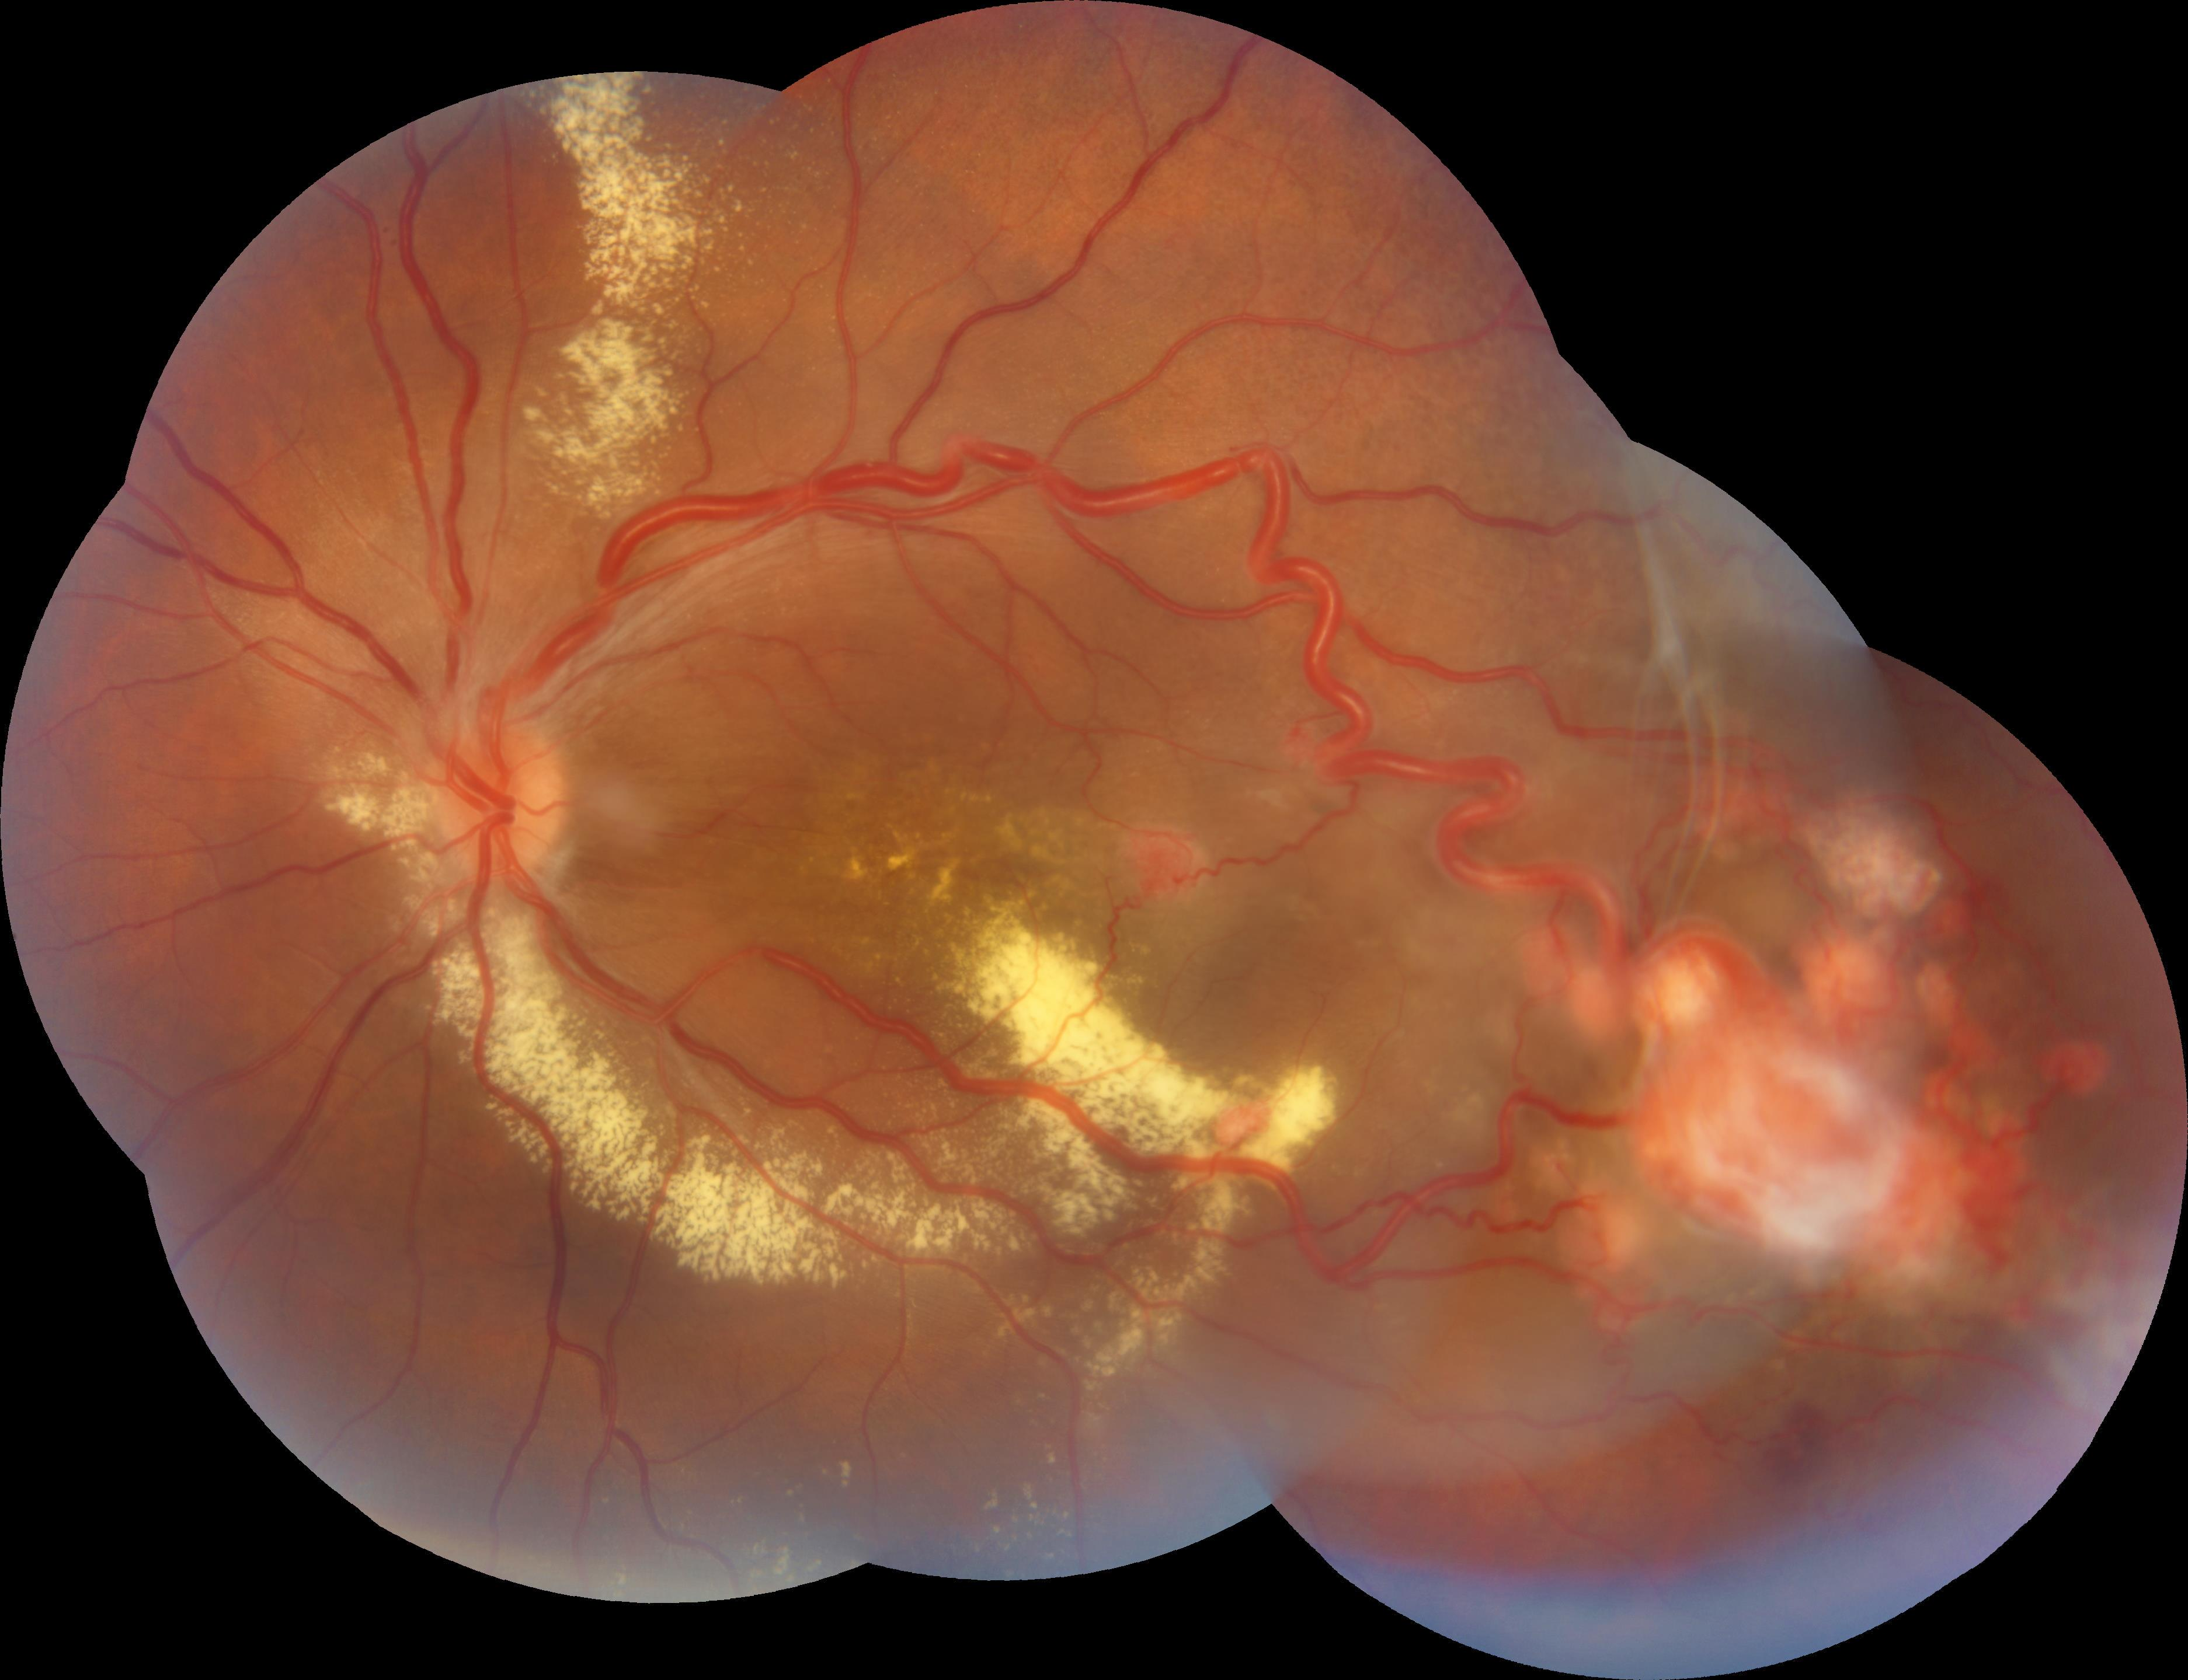
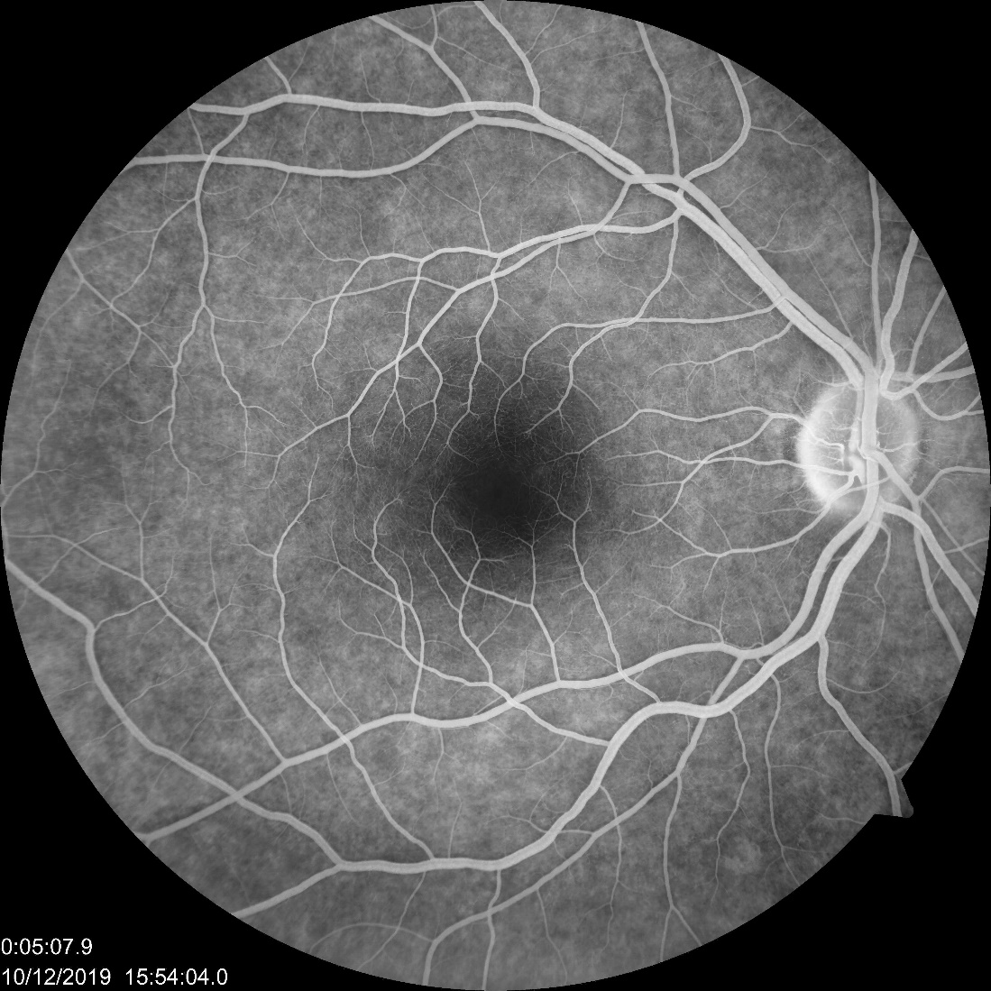
Retinal Capillary Hemangioblastoma: Case report
Weider Oliveira Silva¹, Paulo Kin Takara¹, Nathale Valente Santiago⁴, Akiyoshi Oshima^{2,3}
1 – Retina and Vitreous Chair Ex-Fellow, Ophthalmology Deparment of the Hospital do Servidor Público Estadual de São Paulo
2 – Attending physician and Preceptor of the Retina Chair of the Ophthalmology Deparment in the Hospital do Servidor Público Estadual de São Paulo
3- Head of Retina and Vitreous Chair, Ophthalmology Deparment of the Hospital do Servidor Público Estadual de São Paulo
4 – Ex Resident of the Department of Ophthalmology of the Hospital do Servidor Público Estadual de São Paulo
INTRODUCTION
Purpose: To report a case of Unilateral Retinal Capillary Hemangioblastoma.
Retinal capillary hemangioblastomas (RCH) (also known as retinal angiomas) can be a a sign of a von Hippel-Lindau (VHL) disease although they may also be observed as an isolated entity without systemic involvement. RCH is the most frequent and earliest manifestation of the VHL disease and therefore an ophthalmologist is often involved in the care of these patients.
A 29-YO male was referred with incidental low vision in the OS for 3 months.
His vision was 20/25 OD, 20/1000 OS.
His fundoscopic examination revealed a reddish, circular mass in the mid-periphery with large feeder vessels, ample retinal and macular oedema and large exsudation in the OS.
His OCT showed a significant Cystoid Macular Oedema and the Angiogram revealed inumerous hyperfluorescent hotspots and intense leakage in the tumor site.
His past medical history revealed outpatient visits to nephrology due to a Nephrotic Syndrome episode during his teenager years.
He was referred for Neurological evaluation with no abnormal findings. Patient, to date, has not yet returned for laser photocoagulation and Intravitreal injection treatment prescribed.
Ophthalmologic Examination:
BCVA: OD = 20/25 and OS = 20/1000
CASE REPORT
D
B
A
RETINOGRAPHY
OD (Image A):
Within normal limits
OS (Image B):
Pseudo-Papiloedema
Large tortuous Feeder vessels aporting reddish, roundish group of mass lesions in the mid temporal periphery.
Serous Retinal Detachment is observed, affecting the macula, and extensive exsudative deposits are found along the inferior temporal arcade.
C
ANGIOGRAPHY
OD (Image C)
Within Normal Limits
OS (5’)(Image D) :
Nerve Staining, Inumerous leakage spots, Cistoide macular and peripheral oedema (Infero Temporal), Intense leakage temporally.
E
F
OCT
OD (Image E):
Within Normal Limits
OS: (Image F): Epirretinal Membrane,
Significant Cystoid Macular Oedema, loss of normal neurossensorial architecture pattern, loss of subfoveal ellipsoid layer, hiperreflective subfoveal deposits
DISCUSSION
Retinal capillary Hemangioblastomas (RCH) are highly vascularized tumors that typically present as a red, round, circumscribed mass, more commonly in the midperiphery (85%) or less commonly juxtapapillary (15%).^{1,2} When peripheral, they are often in the superotemporal or inferotemporal quadrants and can easily be found by following their feeder vessel extending from the optic nerve.¹
The majority of RCHs are solitary (66%) but they can also present as multiple lesions (33%).²⁻⁴ They demonstrate no sex, racial or laterality predilection.¹ While RCHs are most commonly endophytic in presentation and portray the classic round mass in the inner retina, they may also be exophytic or sessile, varying in appearance.^{3,4} Juxtapapillary exophytic lesions are sometimes misdiagnosed as optic disc edema as they may blur
the disc margin.⁴ Most RCHs are asymptomatic and are, therefore, commonly diagnosed incidentally between the ages of one and 40 years, with a mean age of 25.¹⁻³ However, their secondary effects may elicit symptoms. Secondary complications include intraretinal and subretinal exudation in the vicinity of the hemangioma, uncommonly a macular star (a circular distribution of exudates around the macula) and rarely retinal or vitreous hemorrhage (less than 3%).³ Advanced cases may present with tractional or exudative retinal detachment.^{1,3,4} Symptoms in these instances may include loss of vision, flashes, floaters, photopsias and metamorphopsias.¹⁻³
1. Singh AD, Rundle PA, Rennie IG. Retinal vascular tumors. In: Singh DA,
Damato B, ed. Clinical Ophthalmic Oncology: Retinal Tumors. Berlin,
Heidelberg: Springer Berlin Heidelberg, 2014:17-34.
2. Turell ME, Singh AD. Vascular tumors of the retina and choroid: diagnosis
and treatment. Middle East Afr J Ophthalmol. 2010;17:191-200.
3. Singh AD, Shields CL, Shields JA. von Hippel-Lindau disease. Surv
Ophthalmol. 2001;46:117-42.
4. Kase S, Ishida S. Retinal capillary hemangioma in von Hippel-Lindau
disease: current concept, diagnosis and managements. J Trans Med
Epidemiolol. 2014;2:1010.
REFERENCES

