Slide 1
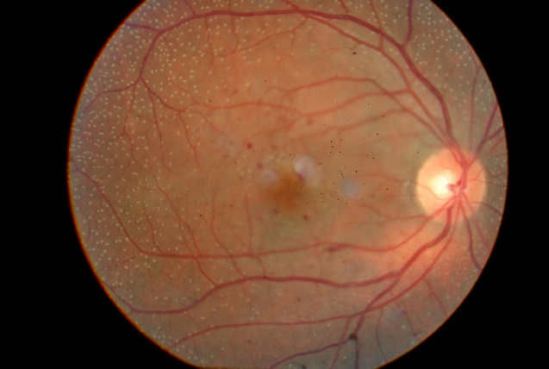
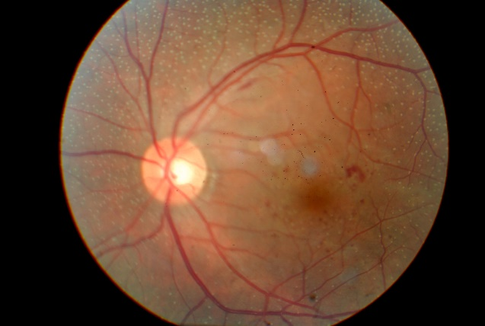
CONGENITAL STATIONARY NIGHT
BLINDNESS AND ITS DIFFERENTIAL
DIAGNOSIS WITH RETINAL FLECKS
CARVALHO, T.A²; FILHO,V.M.A,¹; FALCÃO, V.C.² OGLIARI, L.F.C.¹; FIGUEIREDO, T.C.S.²; TOCHETO, B.B.^{²;} FREDERICI, F.N.³; COSTA, M.A.N³
¹ Resident of Ophthalmology of the João Penido Burnier Foundation
² Retina and Vitreous Fellowships of João Penido Burnier Foundation
³ Heads of the Retina and Vitreous sector of the João Penido Burnier Foundation
PURPOSE
The term "flecked retina" was created to describe multiple yellow-white retinal lesions of varied sizes. Originally, the group was consisted of four diseases: Fundus albipunctatus, Fundus flavimaculatus, familial drusen, and Kandori retinal flecks. The diagnosis is made by associating alterations seen in the fundoscopy with the complete clinical examination of the patient and, in many cases, their relatives.
METHODS
Case report of a 36 year patient, with a literature review. We searched cases previously related in PubMed.
CASE REPORT
A. J. S., male, Caucasian, 36 years old, from Campinas - SP, arrives with a complaint of low vision and floaters. From a personal history, he had Type I Diabetes Mellitus for 15 years. From an ophthalmological background, he referred low night vision since preschool age. Visual acuity: Right eye (RE): 20/40 with best corrected visual acuity (BCVA). Left eye (LE): 20/40 with BCVA. In the biomicroscopy of both eyes, the conjunctiva was clear, the cornea was transparent, phakic. Fundoscopy of both eyes showed a pink optic disc, altered macular shine with perimacular microhemorrhages and diffuse whitish-yellow spots throughout the retinal periphery.
With clinical examination and retinography images, diagnostic hypotheses have been proposed, diseases that comprise the spectrum of retinal flecks, such as family druses, fundus flavimaculatus, and fundus albipunctatus. Examinations such as VF 24: 2, OCT and ERG were requested.
The ERG showed low response in the scotopic phase, with improved response after adaptation to the dark, directing the case to congenital stationary night blindness (CSNB - fundus albipunctatus).
DISCUSSION
Retinal fleck spectrum diseases are somewhat common in retinal outpatient clinics, or even in general ophthalmology. Its differentiation is complex, often requiring systemic evaluation, numerous complementary exams or even ophthalmological evaluation of family members.
Photo 1: Retinography of the right eye
Photo 2: Retinography of
the left eye

