Slide 1
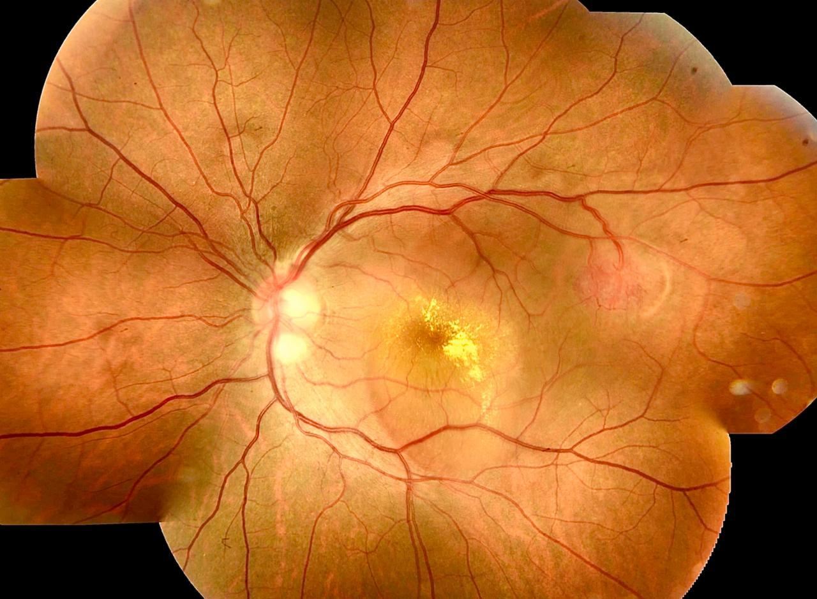
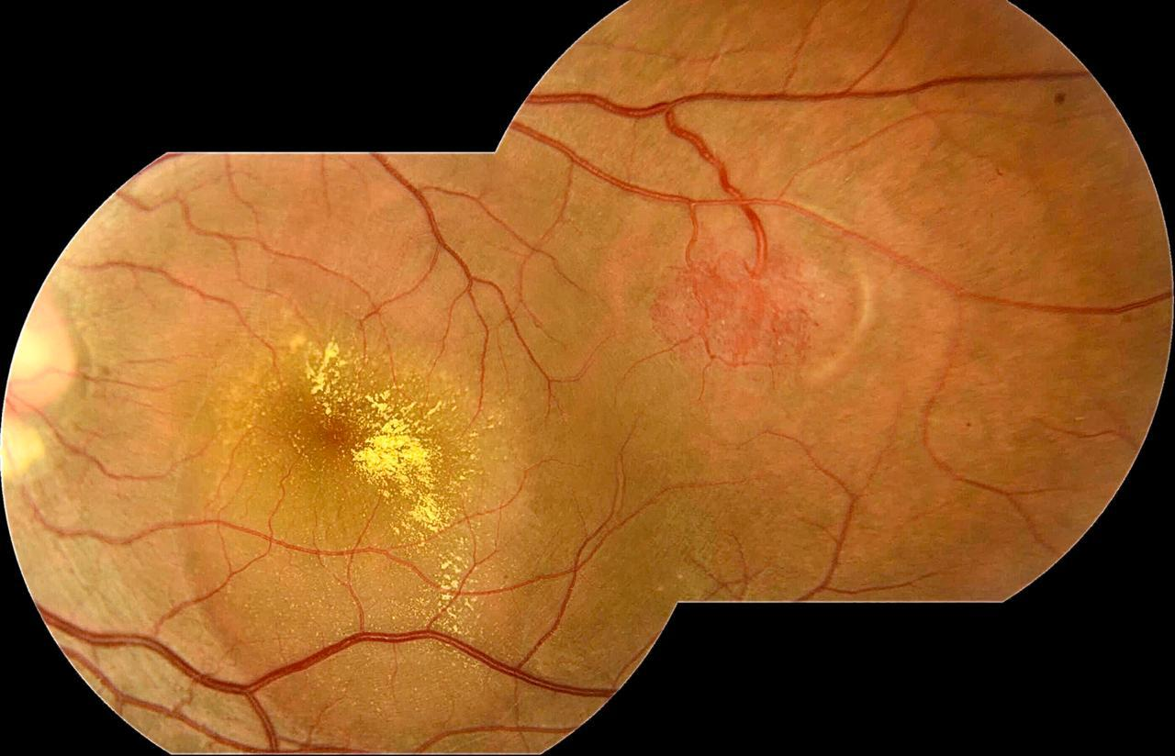
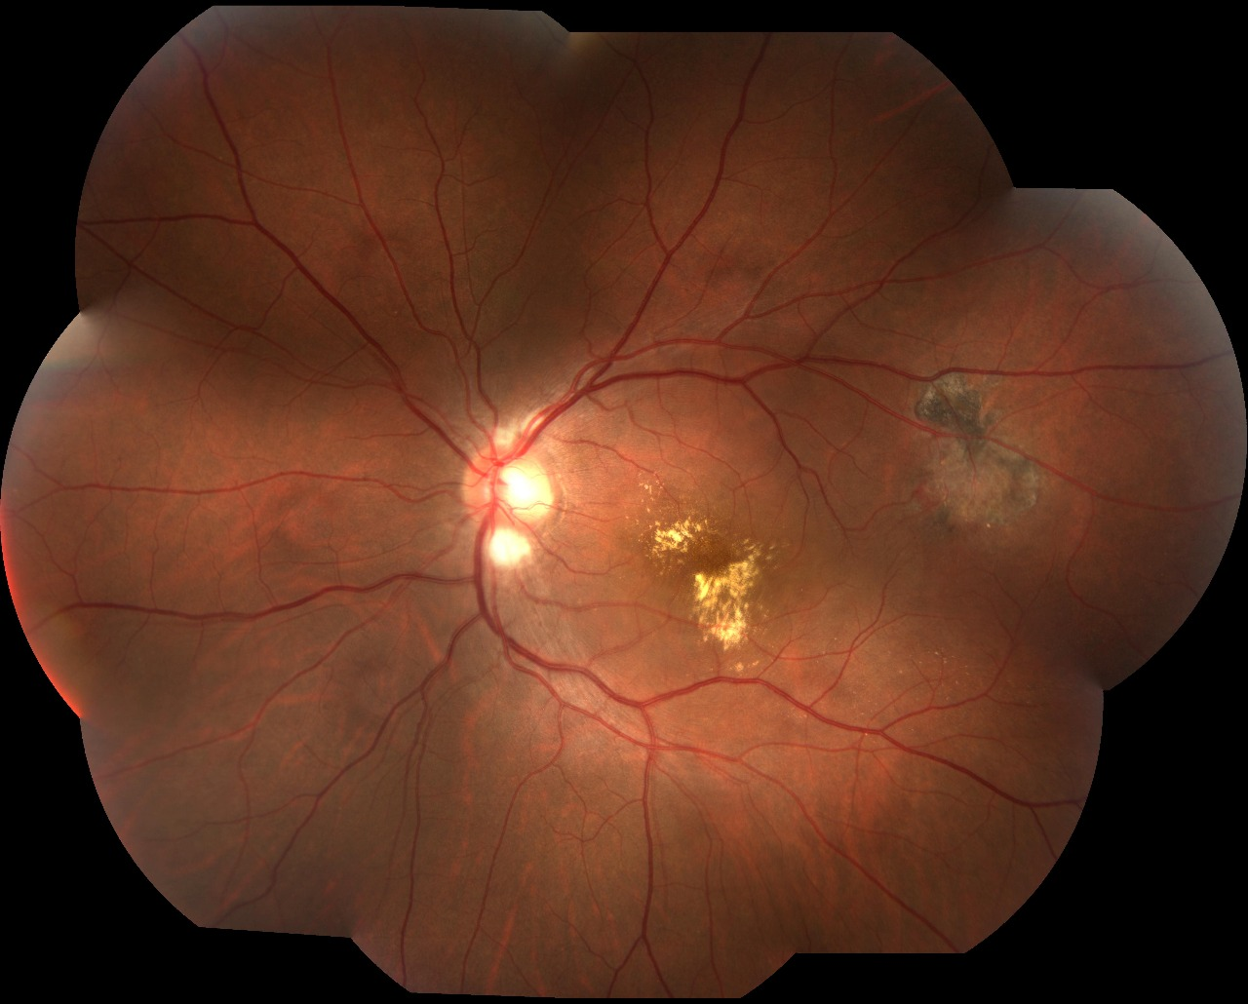
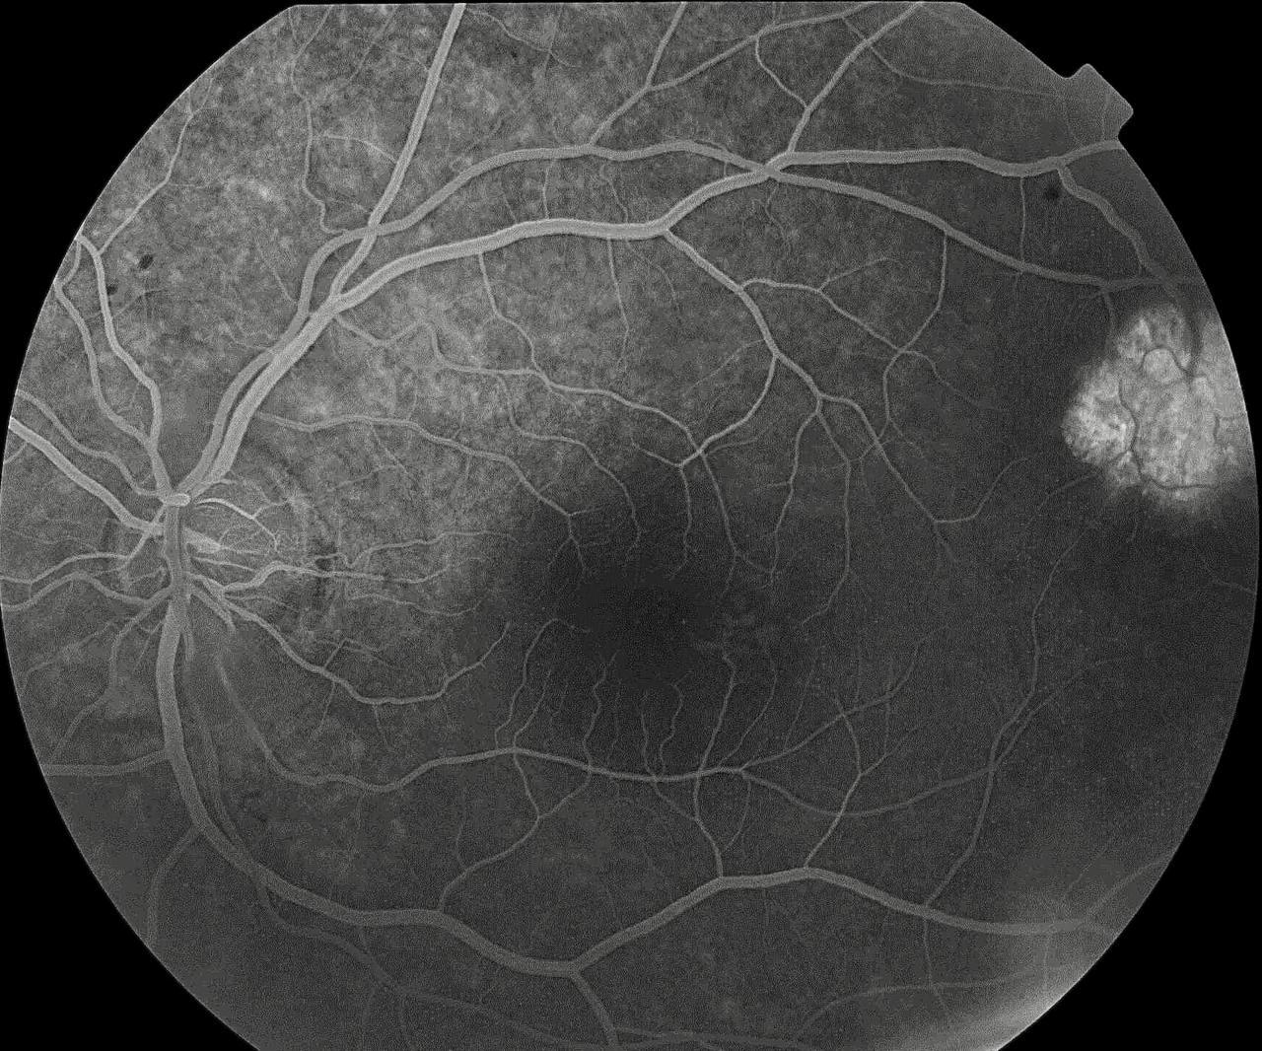
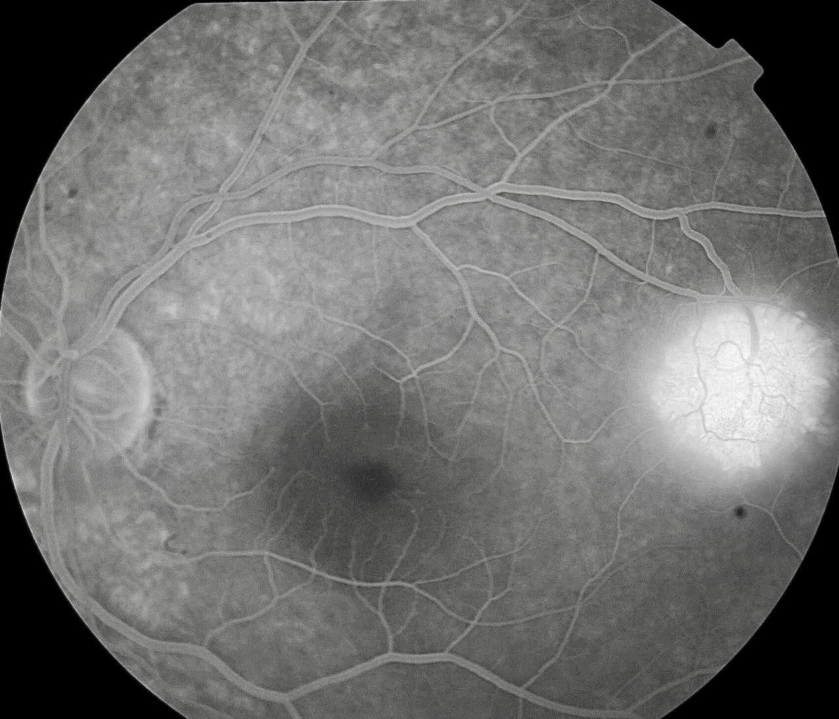
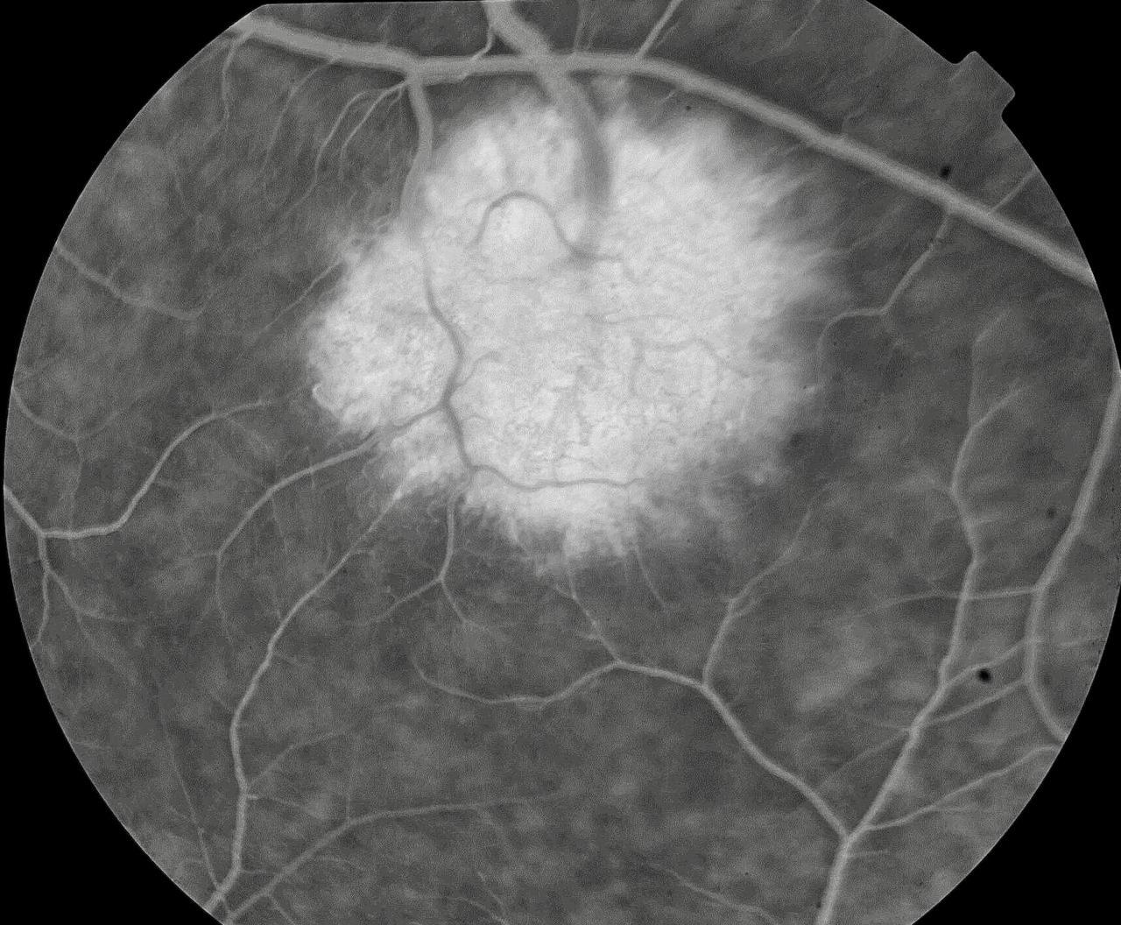
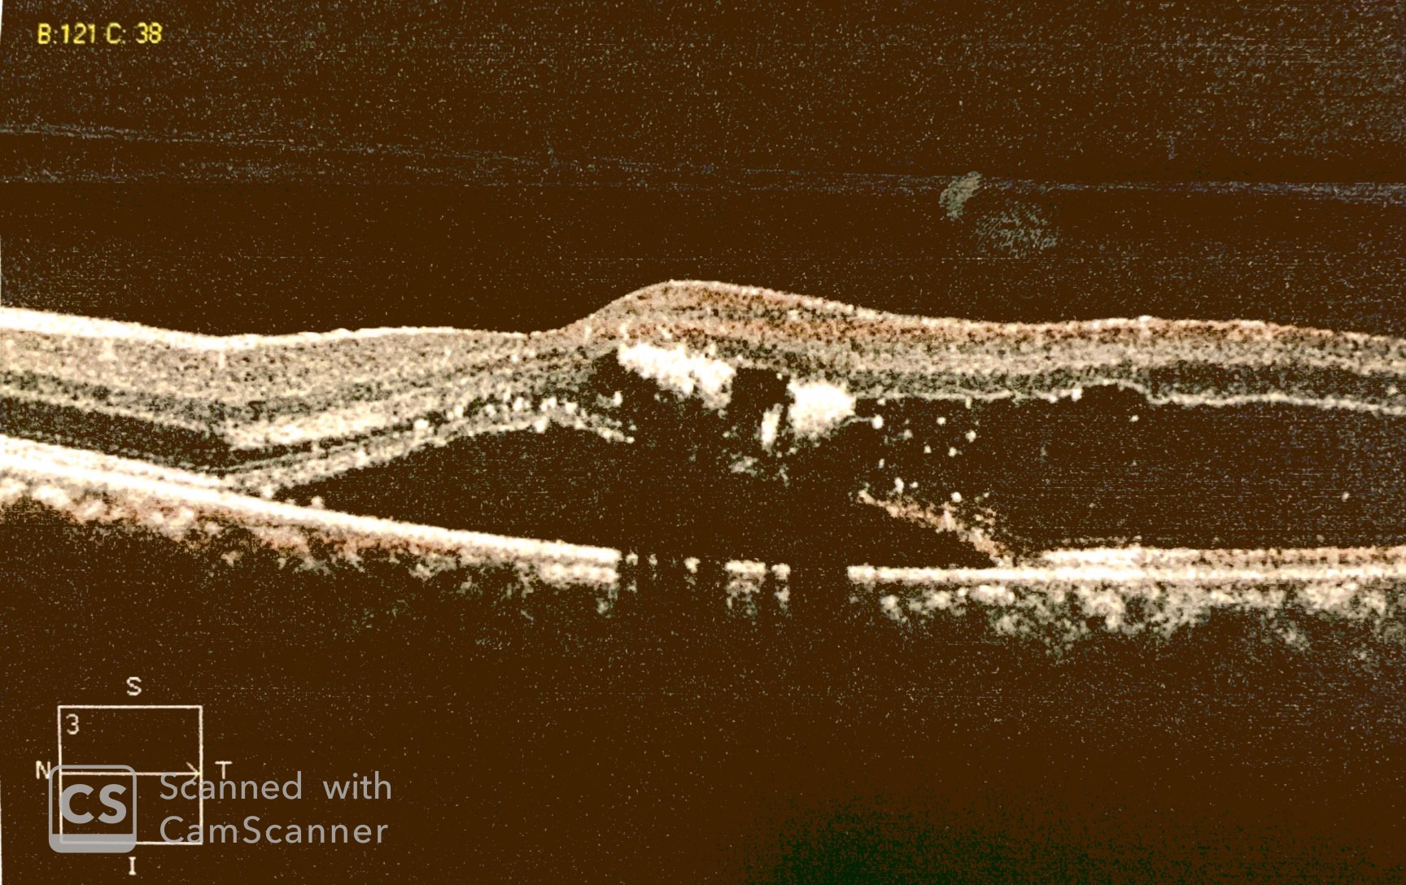
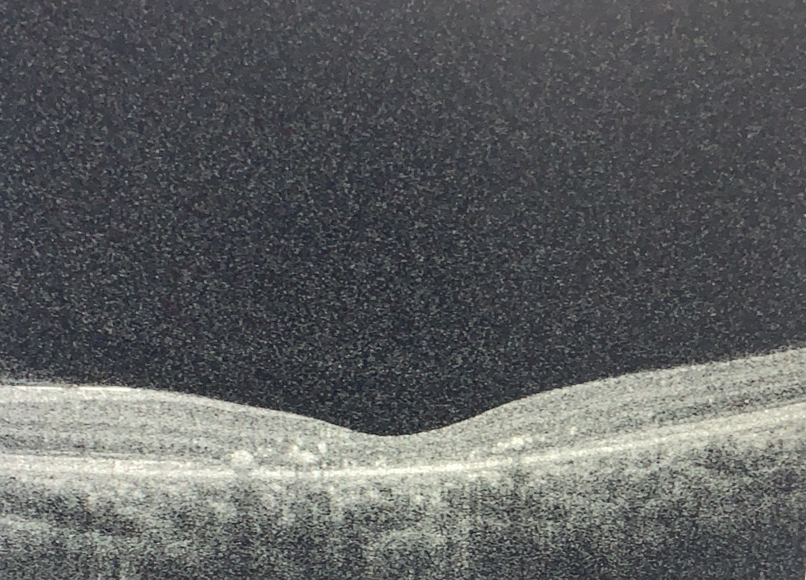
Retinal capillary hemangioma with serous retina detachment: A Case Report.
Beatriz Mello Mencaroni¹, Paulo Henrique Horizonte², Leandro Pocay Alves da Silva⁴, Raimunda Cristina Mendonça Freire de Oliveira², Carolina Maria Barbosa Lemos³, Nathália Nishiyama Tondelli¹, Gabriella Marranghello Mingione¹, André Marcelo Vieira Gomes ⁴
⁽¹⁾ First year resident of Instituto Suel Abujamra; ⁽²⁾ First year Retina and Vitreous fellowship student of Insituto Suel Abujamra; ⁽³⁾ Second year resident of Instituto Suel Abujamra; ⁽⁴⁾ Second year Retina and Vitreous fellowship student of Insituto Suel Abujamra; ⁽⁵⁾ Chief of Retina and Vitreous Fellowship program of Instituto Suel Abujamra.
PURPOSE
1
2
8
Argon laser photocoagulation was performed on the left eye, in order to seal tumor nourishing vessels. After 60 days os argon laser treatment, visual acuity improved to 20/100. In addition, the patient is currently waiting an application of bevacizumab. Other therapeutic modalities are also possible, such as
To describe a case of retinal capillary hemangioma with serous retina detachment.
INTRODUCTION
Retinal hemangioblastoma (capillary hemangioma) is a rare tumor, stimulated by vascular endothelial growth factor (VEGF) secreted by stromal tumor cells and with a more common presentation in young adults. It may appear as an isolated tumor or as part of von Hippel-Lindau's disease (VHL), described in 1904. It presents, initially, as a small, well-defined reddish lesion. The well-established tumor, on the other hand, appears as a round orange-reddish mass, followed by dilatation and tortuosity of vessels, usually superotemporal or inferotemporal. Angiofluoresceinography shows early hyperfluorescence, with late leakage.
Fig. 1 and 2: retinography of the left eye
3
4
5
Fig. 8: retinography after photocoagulation
cryotherapy, brachytherapy and vitreoretinal surgery.
DISCUSSION
Hemangioblastomas should be investigated in patients with risk factors or who present with retinal detachment. The low visual acuity can be justified by the formation of exudates around the tumor or in the macula. Other common complications are bleeding and leakage, mainly due to major macular edema and retinal detachment, which, in most cases, is rhegmatogenic or traction.
METHODS
Fig 3, 4 and 5: Fluorescence angiography of the left eye
6
Medical records review.
RESULTS
A 31-year-old patient presented with the complaint of low visual acuity in the left eye (20/400) for 15 days.The initial fundscopy of the pacient showed hard peripheral exudates, detachment of the macular serous retina and vasoproliferative lesion at the end of the superior temporal arch.
BIBLIOGRAPHY
1-Ophthalmic Pathology and Intraocular Tumors.” Basic and Clinical Science Course. American Academy of Ophthalmology. 2010-2011.
2- Basic and Clinical Science Course 2016-2017 American Academy of Ophthalmology.
3-”Pediatric Ophthalmology and Strabismus.” Basic and Clinical Science Course. American Academy of Ophthalmology. 2010-2011.
4-Drolet, B.A. et al. “Hemangiomas in Children.” N Eng J Med 1999;341:173-181.
Fig 6: OCT of the left eye
Fig 7: OCT of the left eye after photocoagulation
Notes:
purpose, methods, results and discussion

