Slide 1
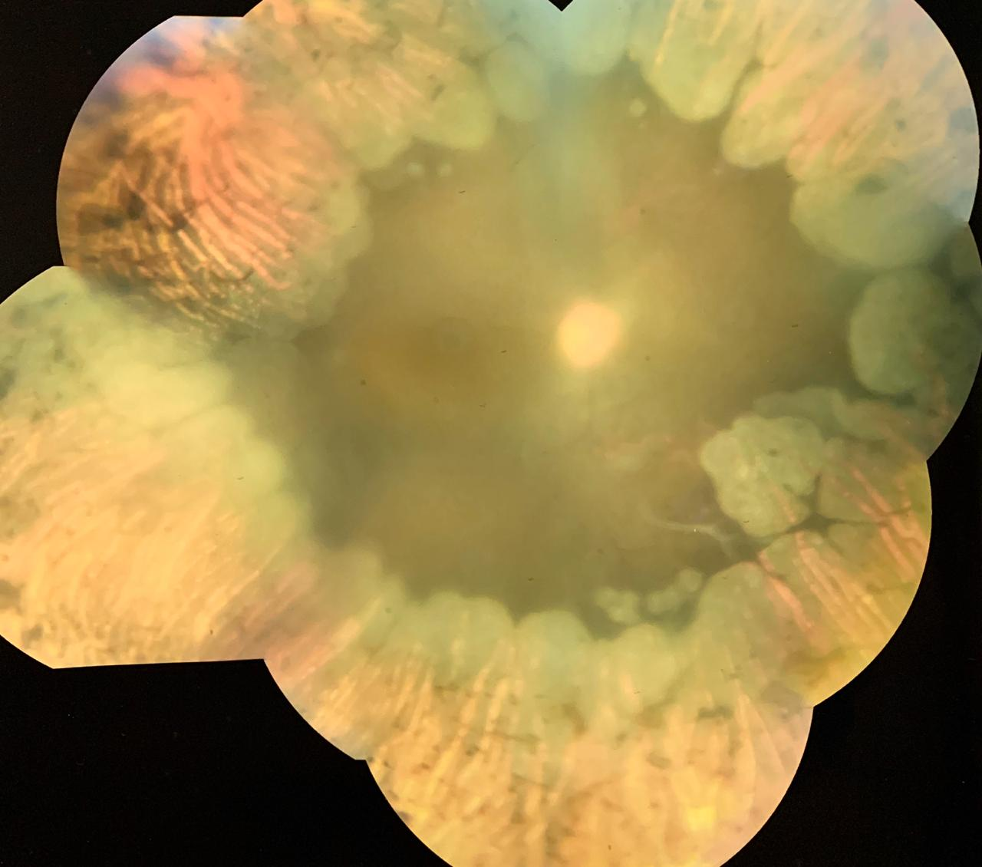
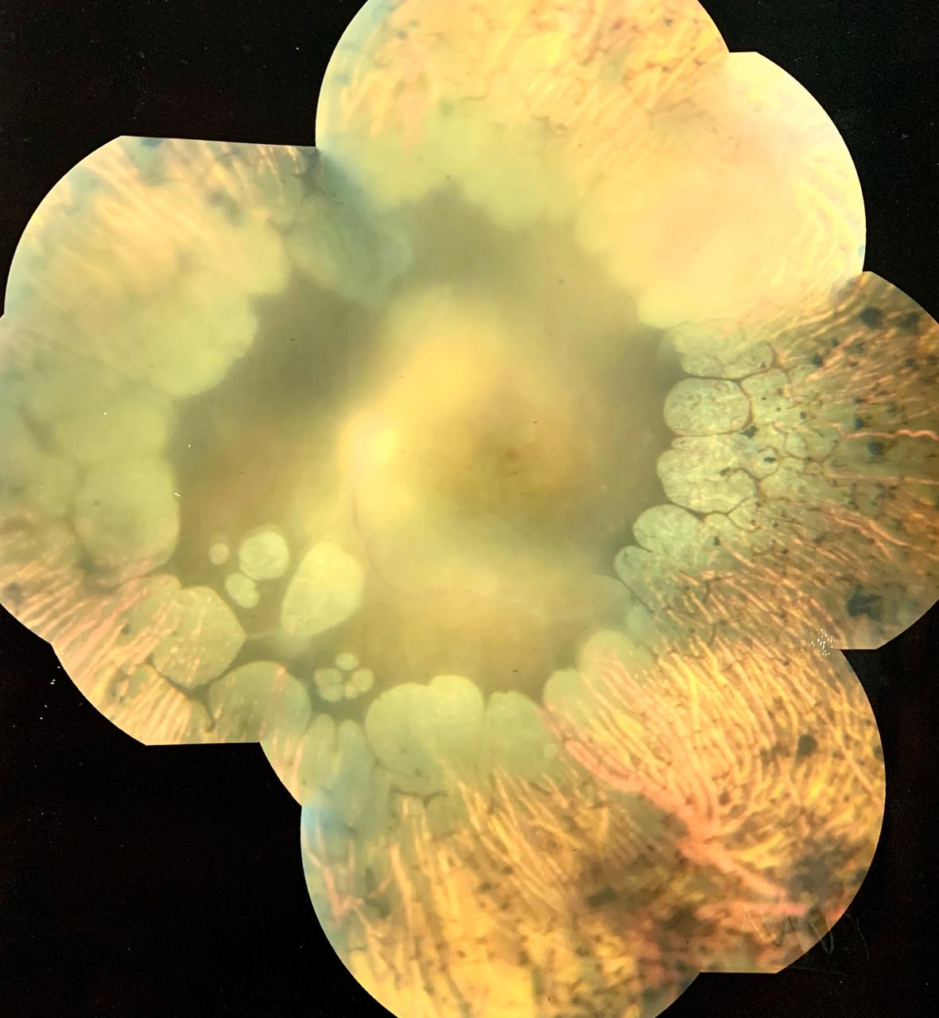
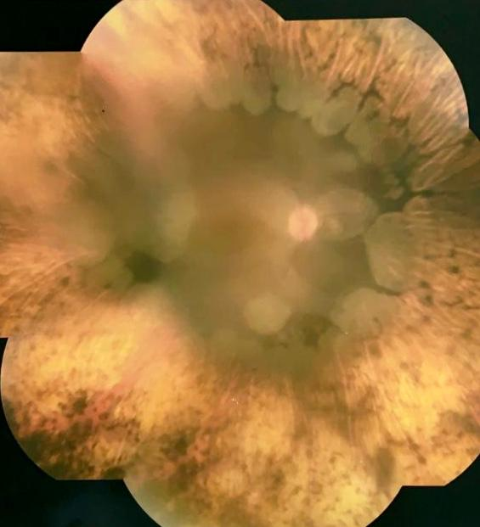
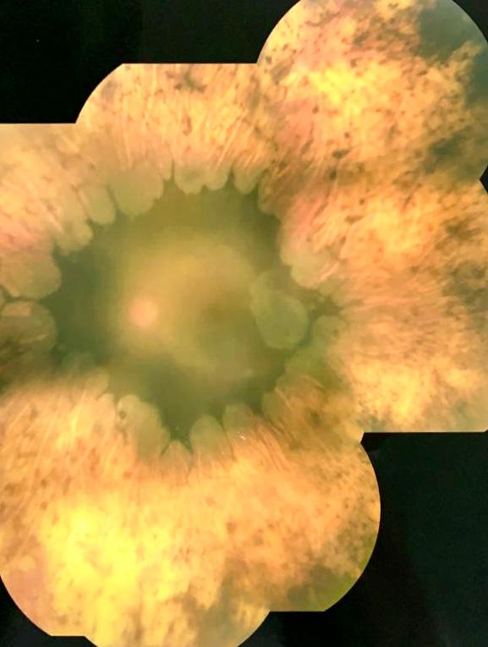
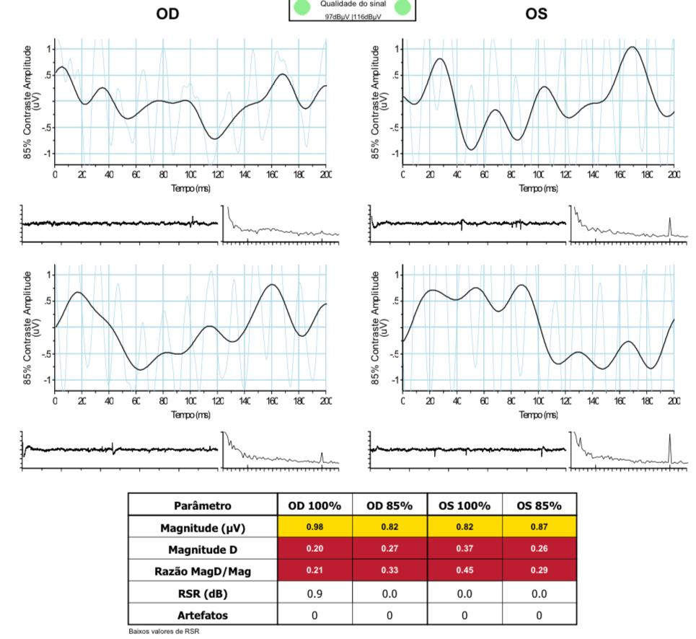
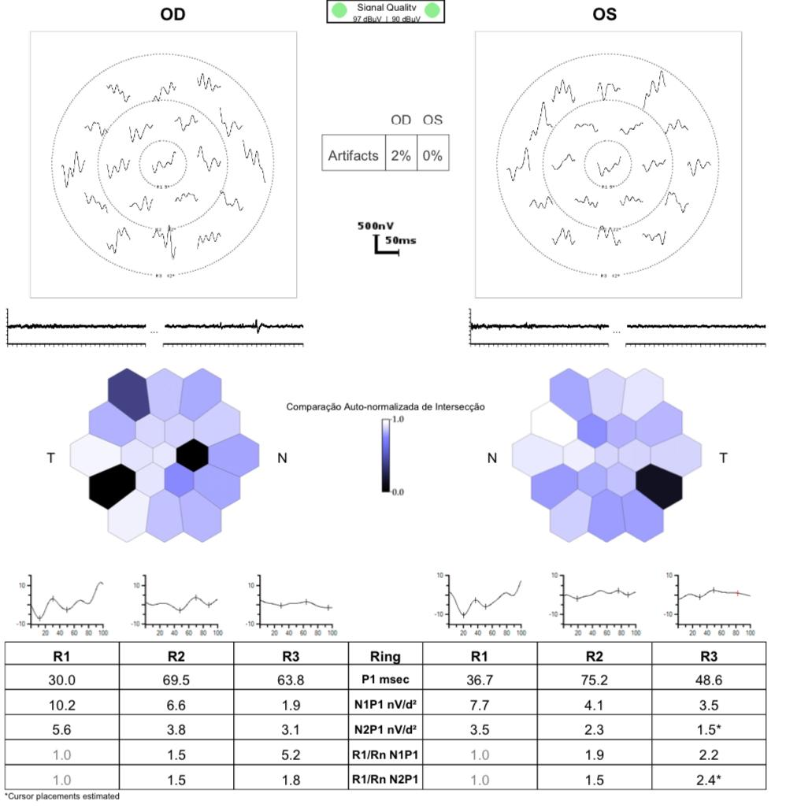
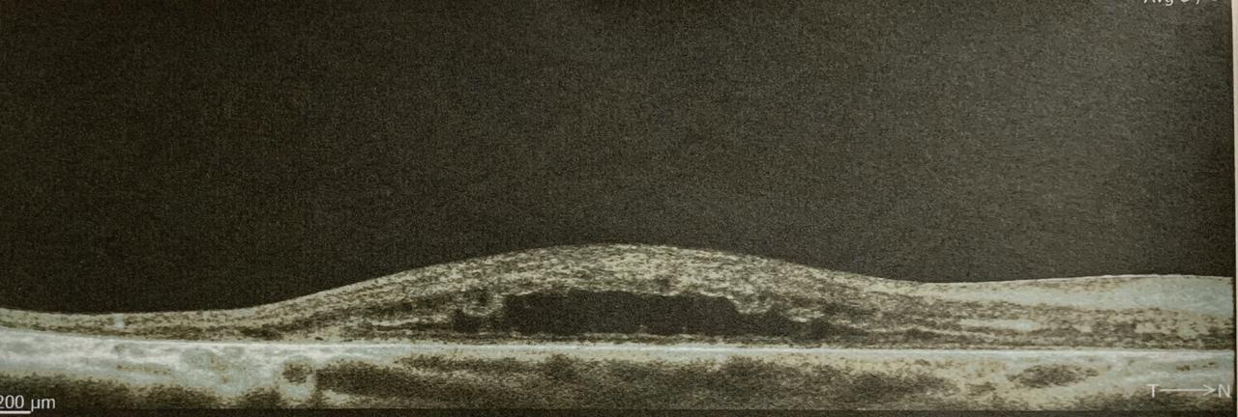
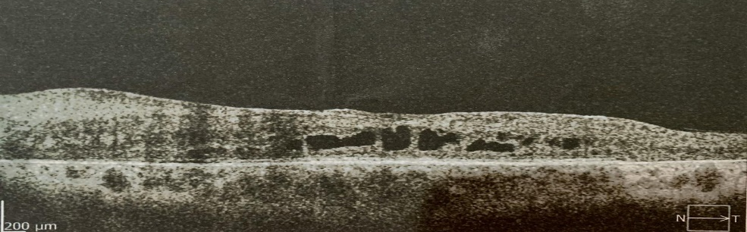
A Case Series of Gyrate Atrophy
Paulo Henrique Horizonte, Nathália Nishiyama Tondelli, Rafael Garcia, Mariângela Zanon Casoni, Fernanda de Castro Rollo Sampaio, Andréia Novelli, Walther de Oliveira Campos Neto, André Marcelo Vieira Gomes.
Instituto Suel Abujamra
PURPOSE
They all had elevated ornithine plasma levels. The electroretinography (ERG) showed completely extinguished response. The 3 patients are currently on a restricted arginine diet and receive daily vitamin B6 supplementation.
Retinography of both eyes showed vascular thinning, well-defined areas of chorioretinal atrophy with confluent circular lesions in the periphery and middle periphery, sparing the macular region.
To describe A Case Series of Gyrate Atrophy
INTRODUCTION
Gyrate Atrophy (GA) is a rare autosomal recessive retinal dystrophy characterized by progressive choroiretinal degeneration. There are approximately 200 cases reported worldwide. It is caused by a deficiency in the enzyme ornithine aminotransferase (OAT), resulting from mutations in the OAT gene. This deficiency leads to a significant increase in the ornithine levels in the plasma. Patients usually present with myopia, nyctalopia, peripheral vision loss and posterior subcapsular cataract (SCP). Fundoscopy reveals bilateral patchy, well-demarcated circular areas of atrophy in the mid to far periphery. The macula is spared until late in the disease course.
Fig. 1 and 2: retinography of the both eyes of one of the patients.
DISCUSSION
GA diagnosis is made by the symptoms associated with typical fundoscopy and ancillary exams. Non-ocular findings include mild cognitive impairment and speech defects. There is no curative regimen for GA, but ornithine reduction is believed to slow the disease progression. Thus, a restriction in the arginine (ornithine precursor) intake is recommended. Vitamin B6 supplementation is also defended. The prognosis is considerably variable and gene therapy is a promising emerging technology.
METHODS
Case series
RESULTS
We report here a series of 3 patients, approximately 20 years old, with gyrate atrophy followed in our retina service. Two of them were sisters and had best corrected visual acuity of 20/400 in both eyes. SCP cataract was seen in two of them. Bilateral fundoscopy of all three patients revealed typical lesions. The OCT showed loss of foveal depression and areas of significant thinning of both inner and outer retina. In addition, the two sisters had bilateral macula edema. Autofluorescence demonstrated focal and confluent areas of absent autofluorescence.
Fig. 3 and 4: retinography of the both eyes of another patient.
BIBLIOGRAPHY
1- Basic and Clinical Science Course 2016-2017 American Academy of Ophthalmology - Gyrate Atrophy
2. OyamaguchiI EK, et al. Girate atrophy of the retina and choroid - Case report. Arq. Bras. Oftalmol. vol.66 no.4 São Paulo July/Aug. 2003
3. Santos DVV, et al. Macular edema associated with gyrate atrophy managed with intravitreal triamcinolone: a case report. Arq. Bras. Oftalmol. vol.70 no.5 São Paulo Sept./Oct. 2007
Fig 5 and 6: ERG
Fig. 7 and 8: OCT of the right and left eye.
Notes:
purpose, methods, results and discussion

