Slide 1
Retina START Clinical Case
Tomás Teixeira-Pinto
Leandro Jerez Chaves
Amanda Schnorr
Rodrigo Jorge

Slide 2
Caso
33-year-old, businessman, male.
Presents with a history of paracentral scotoma in his left eye following strenuous physical activity 10 days ago. Sudden and painless onset. No other complaints.
Medical and ocular history: none.
Medication: Topical Minoxidil for hair loss in the last 3 months.

Slide 3
Physical
Uncorrected VA: 20/20 OU
Biomicroscopy: no notable findings OU.

Slide 4
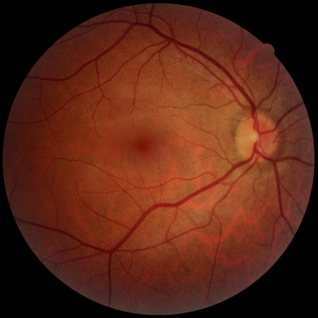
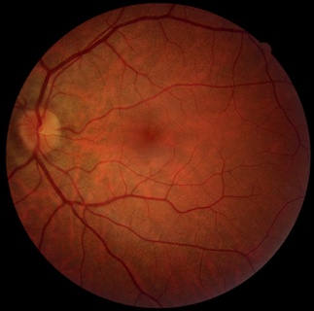

Slide 5
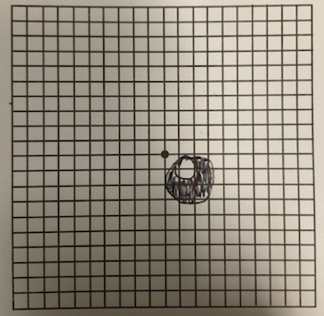
Amsler Grid OS

Slide 6
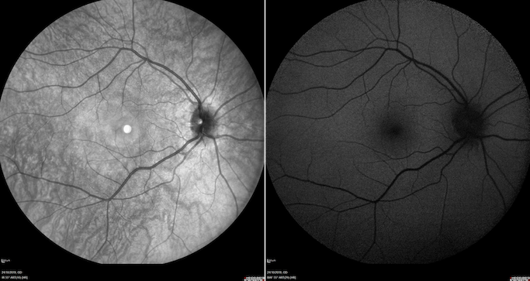

Slide 7
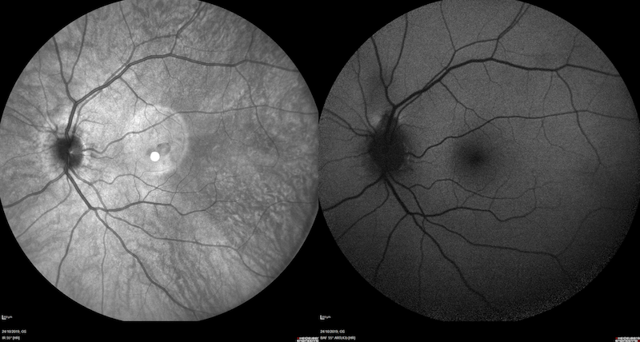

Slide 8
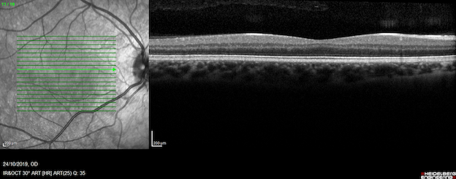

Slide 9
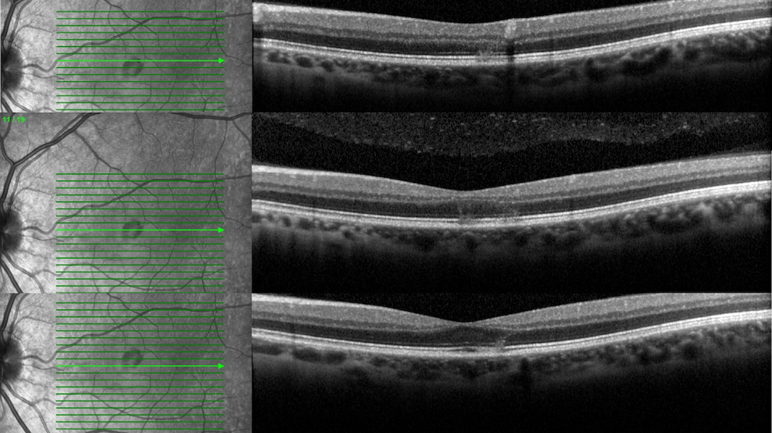

Slide 10
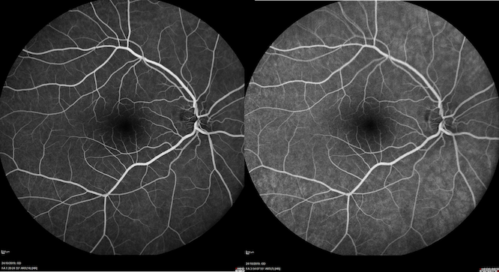

Slide 11
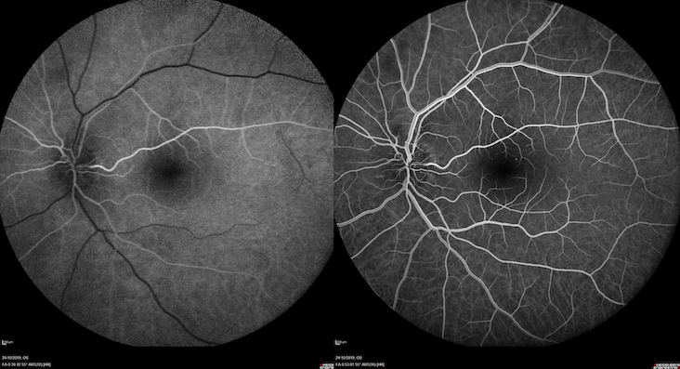

Slide 12
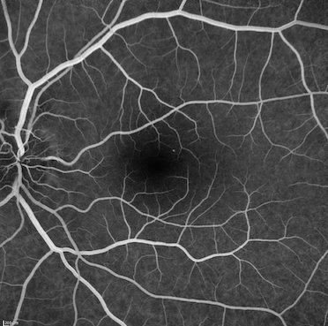

Slide 13
Diagnostic Hypothesis
Acute Macular Neuroretinopathy (AMN) OS Etiology – Exercise?
The patient was advised about the disease, and remained in clinical follow-up.

